Slide 1
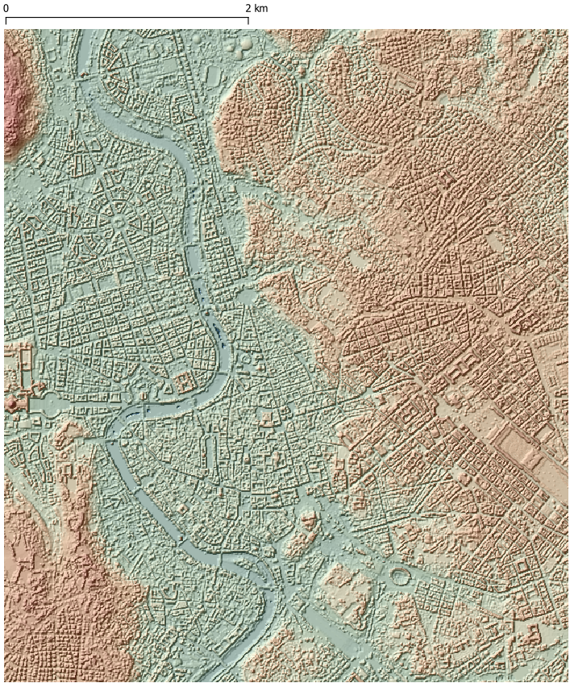
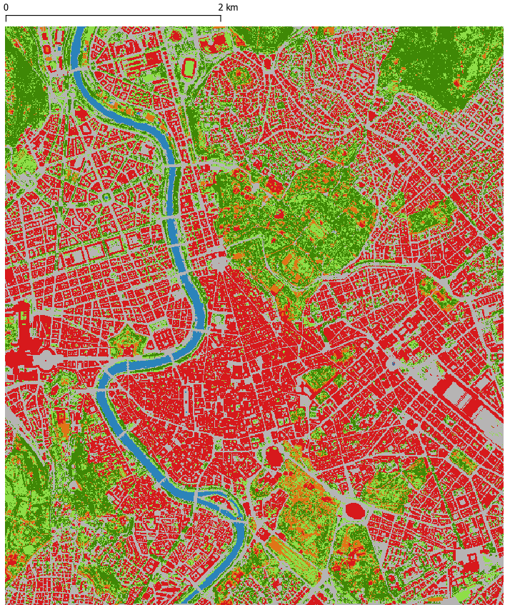
MAFIS
Calculation of Land Surface Temperature in cities using the example of Košice and Rome through custom, physically-based models and 3D surface models
Testing new methodologies in geospatial analysis and remote sensing for mapping trees in cities and their impact on microclimate and quality of life.
MULTIPLE ACTORS FOREST INFORMATION SERVICE
Altitude of digital surface model
The City of Rome
Altitude (m a.s.l.)
0
75
100
Land cover
Source: WorldView
Date & Time: 4 September 2021, 11:25 CET (9:25 GMT)
Resolution: 0.3 m
110
140
237
Trees
Shrubs and low vegetation
Bare soil
Digital surface model
Height and hillshade
Source: Lidar
Resolution: 0.5 m
Date & Time: 2020?
Asphalt
Buildings
Water

Slide 2
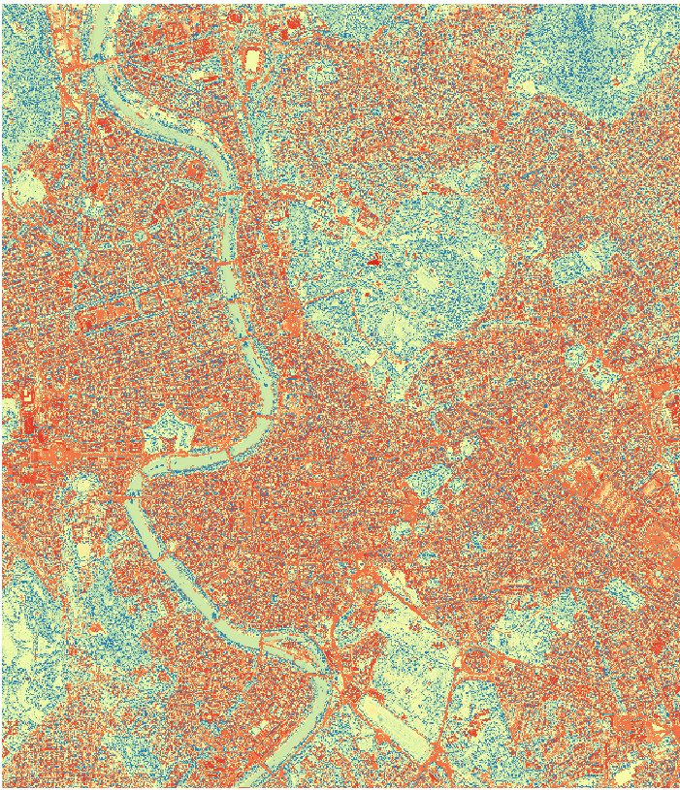
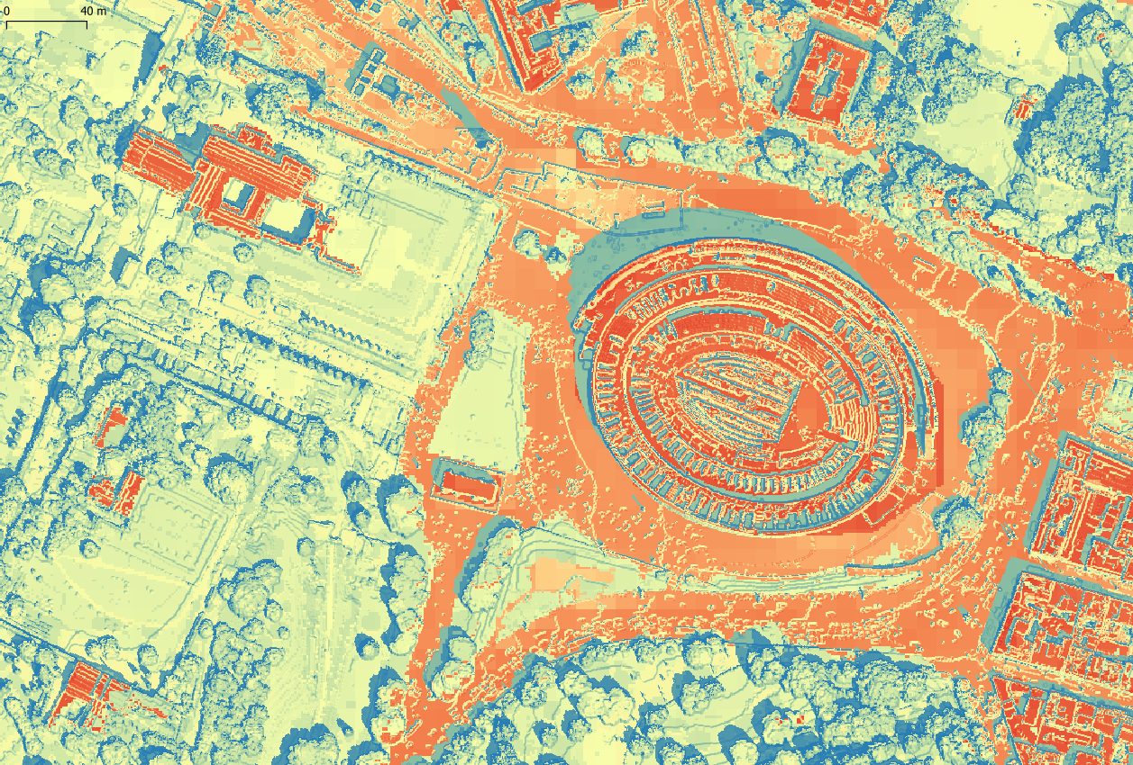
MAFIS
MULTIPLE ACTORS FOREST INFORMATION SERVICE
Modelled land surface temperature (°C)
The City of Rome
Air temperature: 27.4°C
Date & Time: 4 June 2021,
11:00 CET (9:00 GMT)
Modelled land surface
temperature (°C)
Resolution: 0.5 m
26
27
30
35
40
Area: Forum Romanum Coloseum
50
55
66
The City of Rome

Slide 3
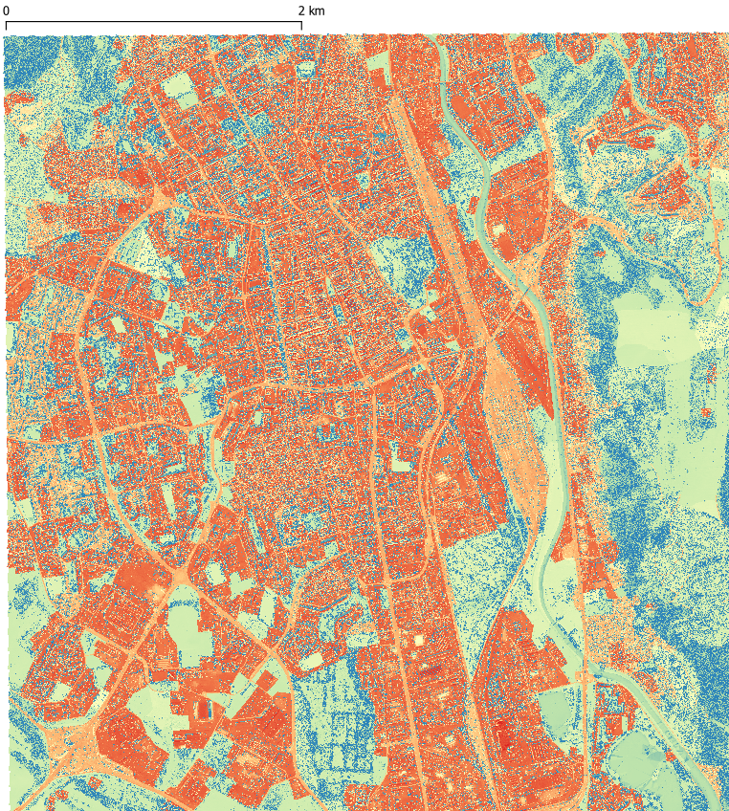
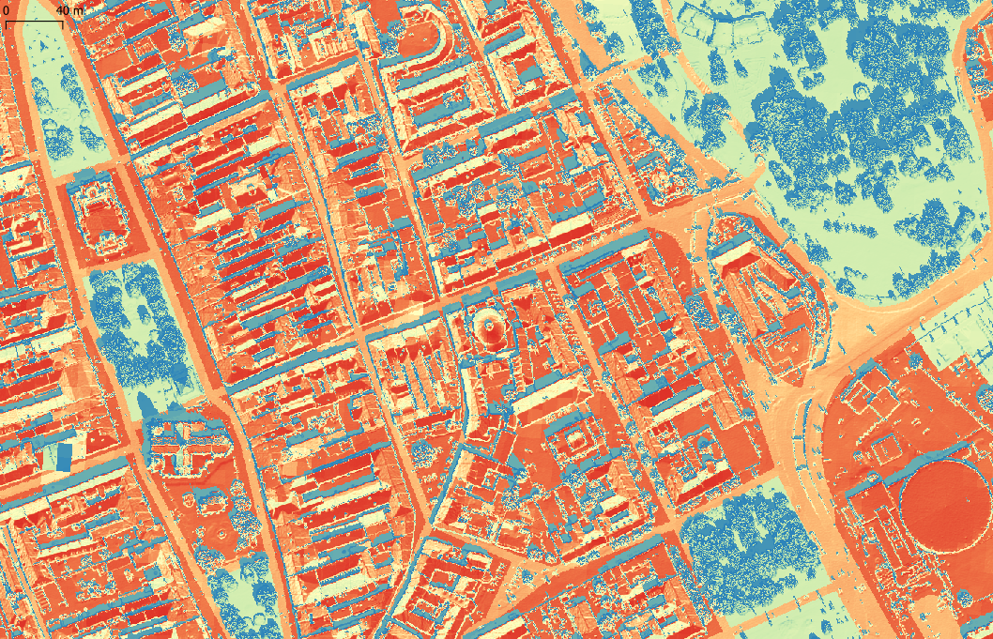
MAFIS
MULTIPLE ACTORS FOREST INFORMATION SERVICE
Modelled land surface temperature (°C)
The City of Košice
Air temperature: 30°C
Date & Time: 18 June 2021,
11:00 CET (9:00 GMT)
Modelled land surface
temperature (°C)
Resolution: 0.5 m
26
27
30
35
40
50
The City of Košice
Area: Historical centre and park
55
66

Slide 4
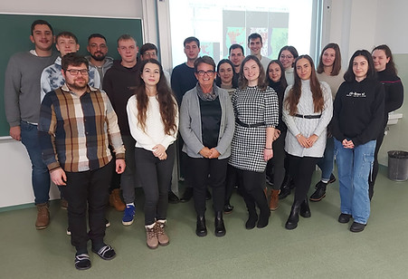
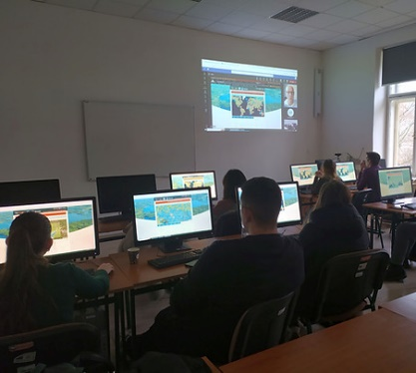
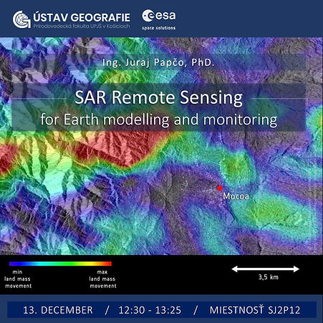
ENEUM
Enhancing Earth Observation Curriculum with a Focus on ESA Sensors
Two new university courses were created, with complete syllabi and study materials: Earth Observation Applications and Applied Radar Remote Sensing
A dedicated website was created for the purposes of project publicity and as an organized storage of the course material including syllabi, lecture presentations, practical handouts and sample data
4 invited guest lecturers delivered a lecture and/or practical hands-on exercise with ESA/Copernicus satellite data in presence or online during winter semester from October to December 2023

Slide 5
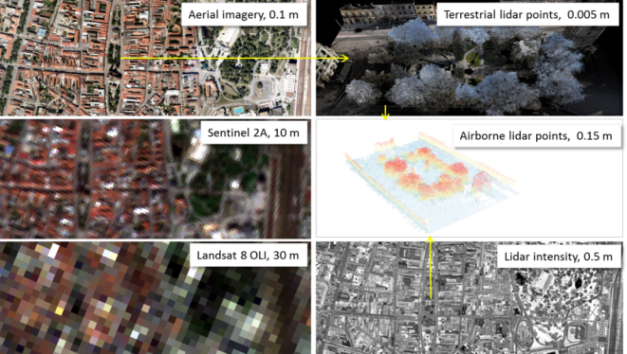
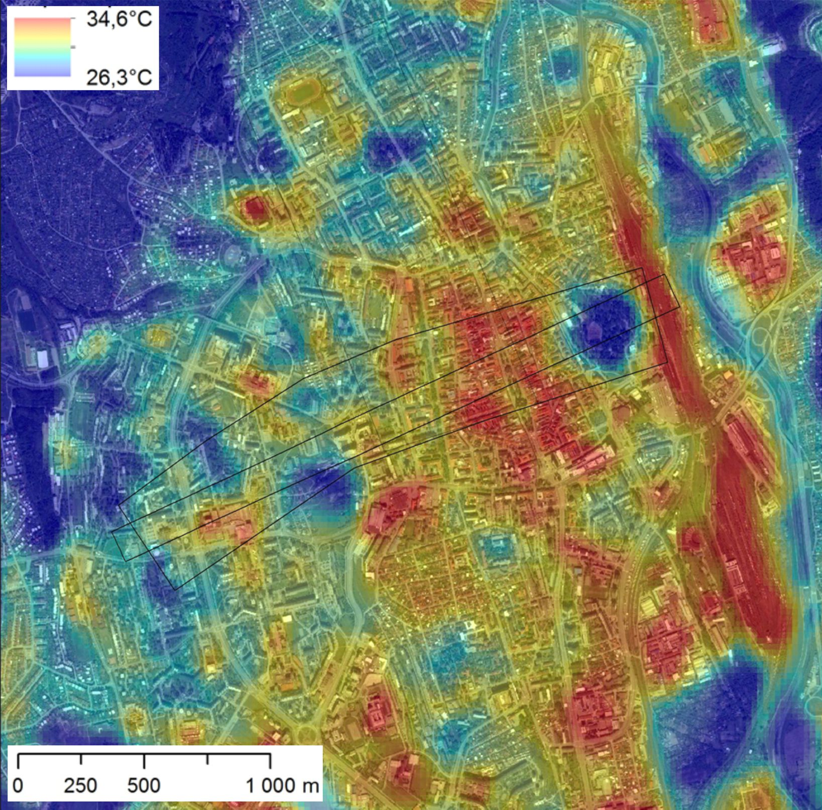
SURGE
Simulating the cooling effect of urban greenery based on solar radiation modelling and a new generation of ESA sensors
The first ESA PECS Call for Slovakia (06/2015).
The project aimed to assess the feasibility of using Sentinel 2 satellite imagery for monitoring urban greenery and its impact on the urban microclimate.
The objective was to determine how Sentinel imagery can be used to parameterize sunlight transmission of urban greenery for typical annual seasons.

Slide 6
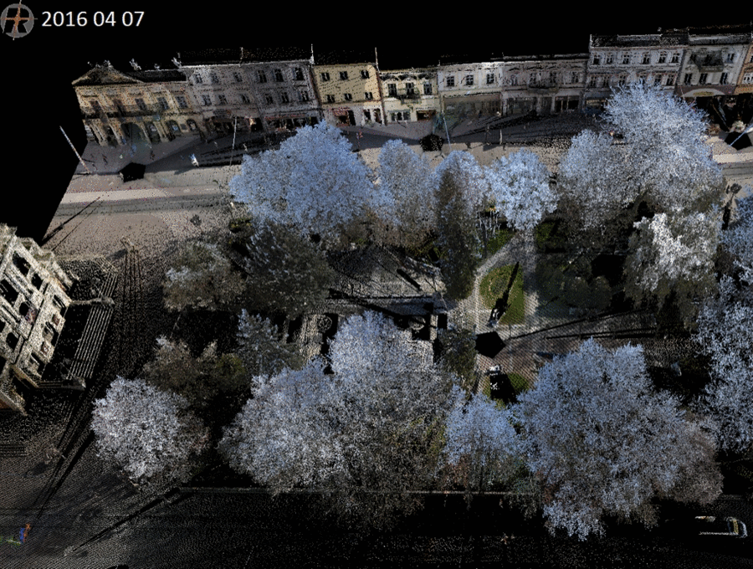
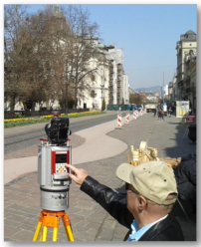
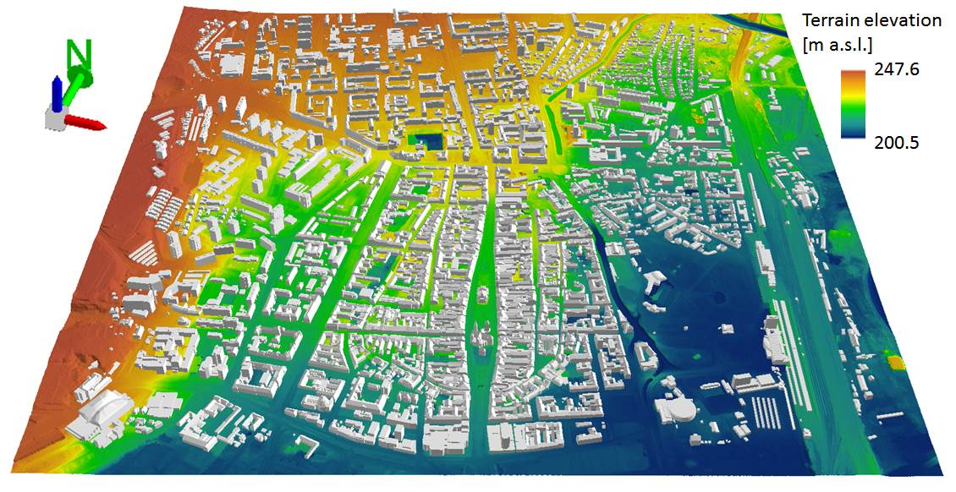
SURGE
Simulating the cooling effect of urban greenery based on solar radiation modelling and a new generation of ESA sensors
Virtual 3D city model of the study area
Terrestrial laser scanning of urban vegetation on four smaller sites within the study area in high resolution and high accuracy synchronised with Sentinel 2A

Slide 7
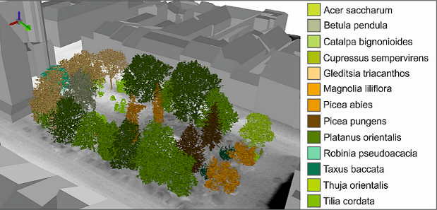
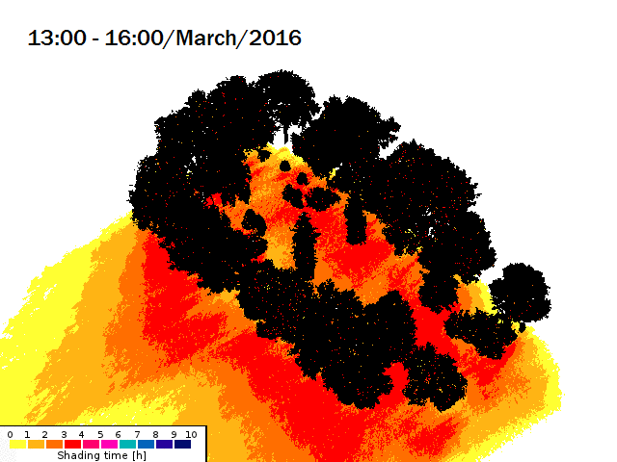
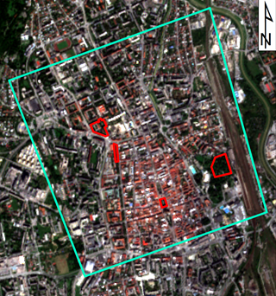
SURGE
Simulating the cooling effect of urban greenery based on solar radiation modelling and a new generation of ESA sensors
Simulation of shadowing effects by 3D tree models
Hlavná ulica, Košice

Slide 8
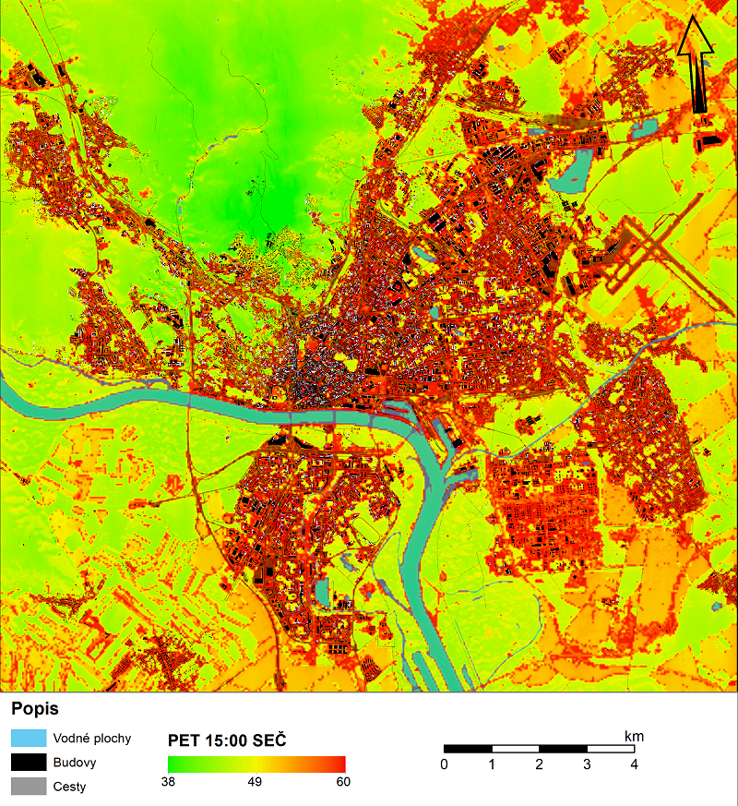
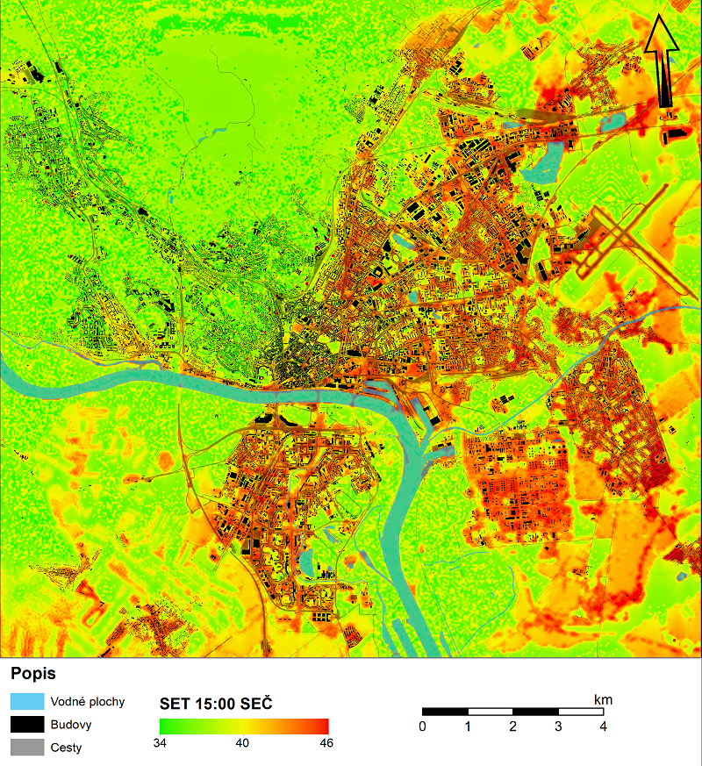
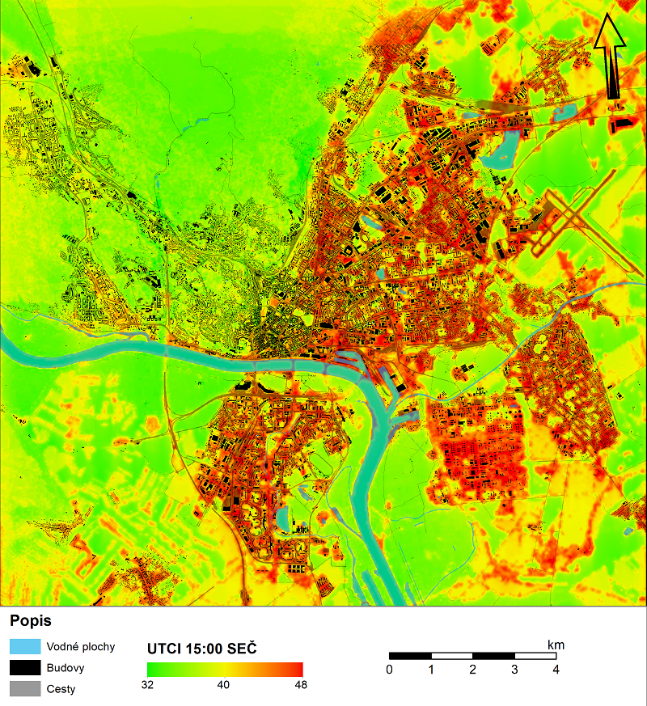
URBANA
A
Modelling heat stress on urban population in the cities Košice and Bratislava

Slide 9
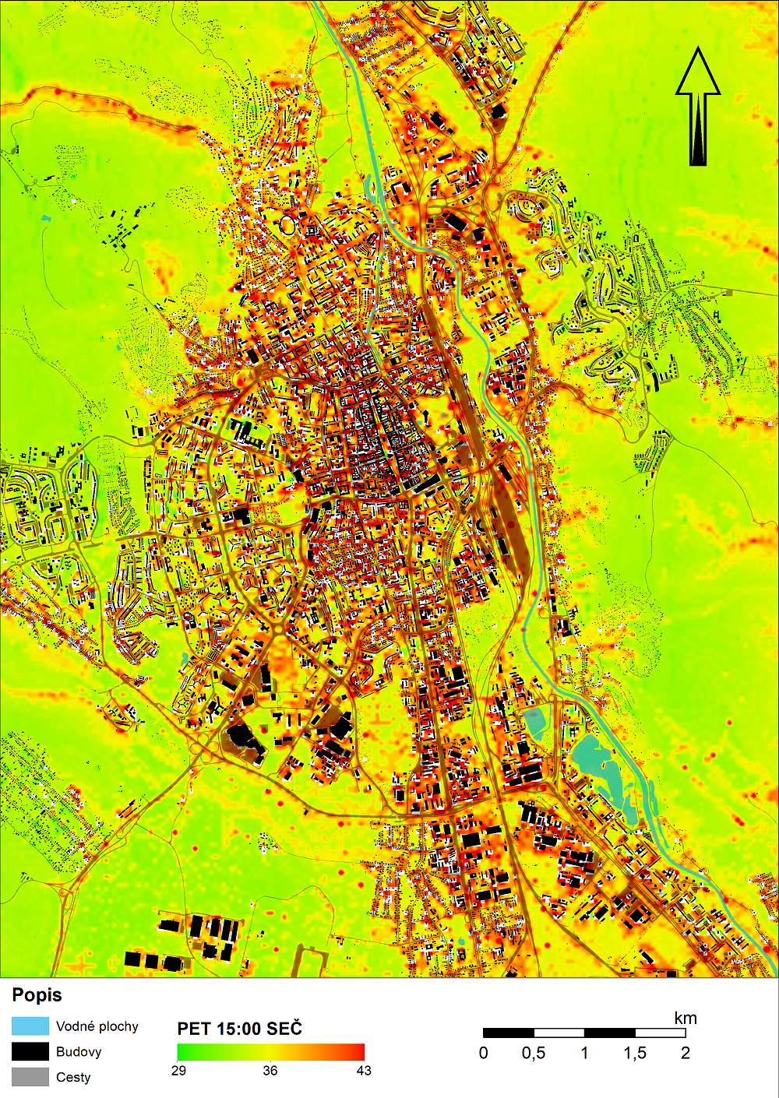
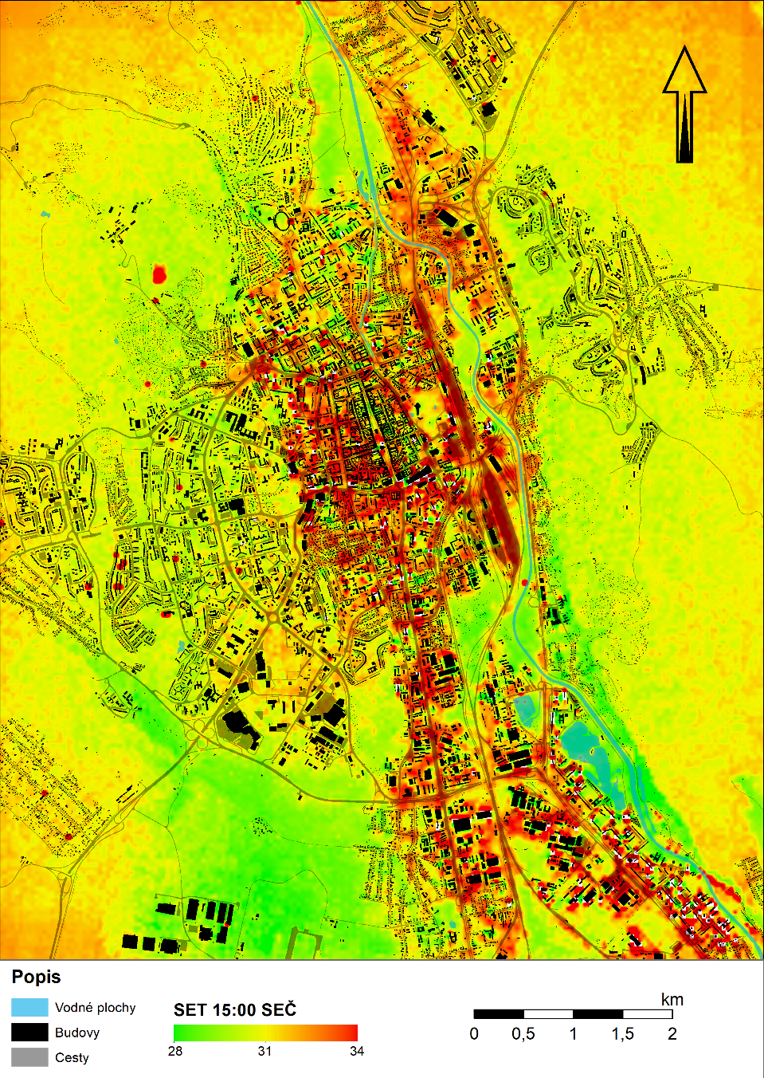
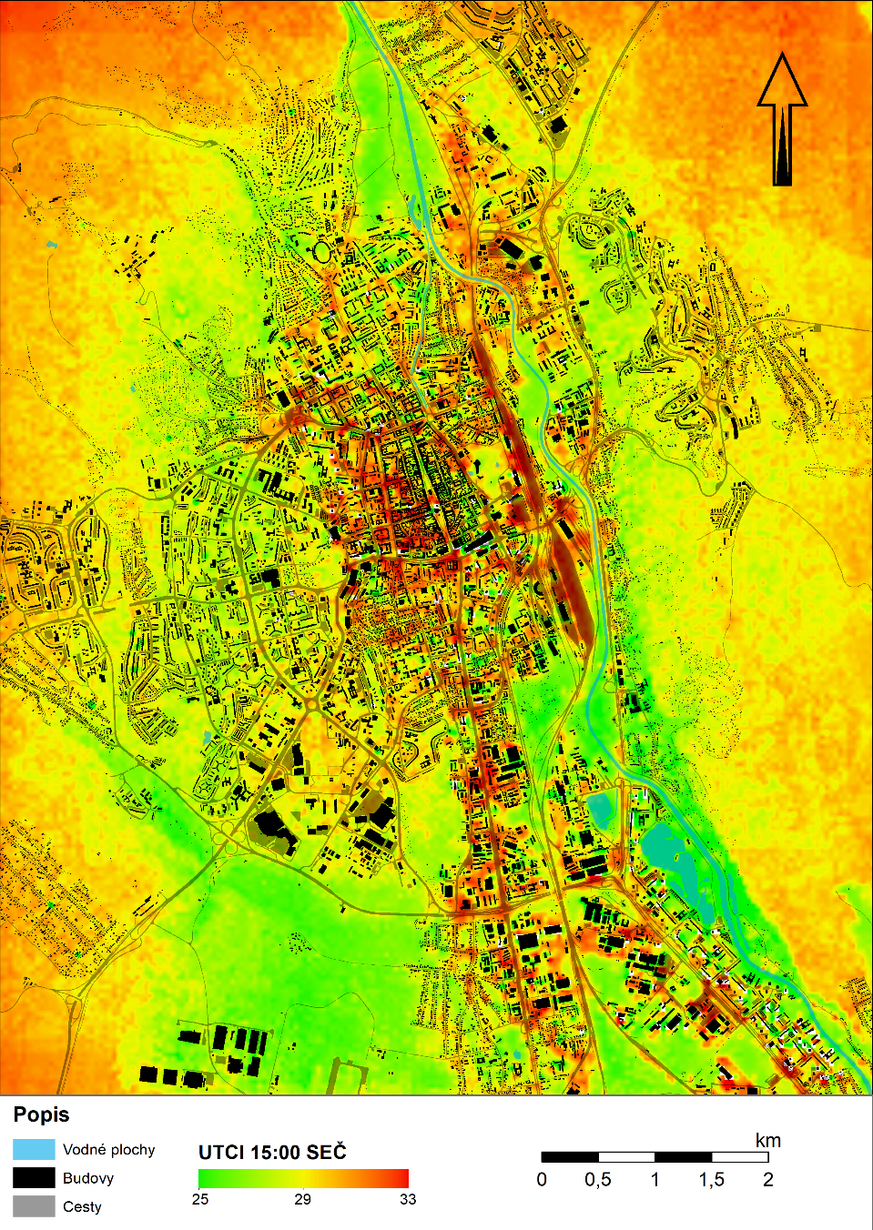
URBANA
A
Modelling heat stress on urban population in the cities Košice and Bratislava

Slide 10
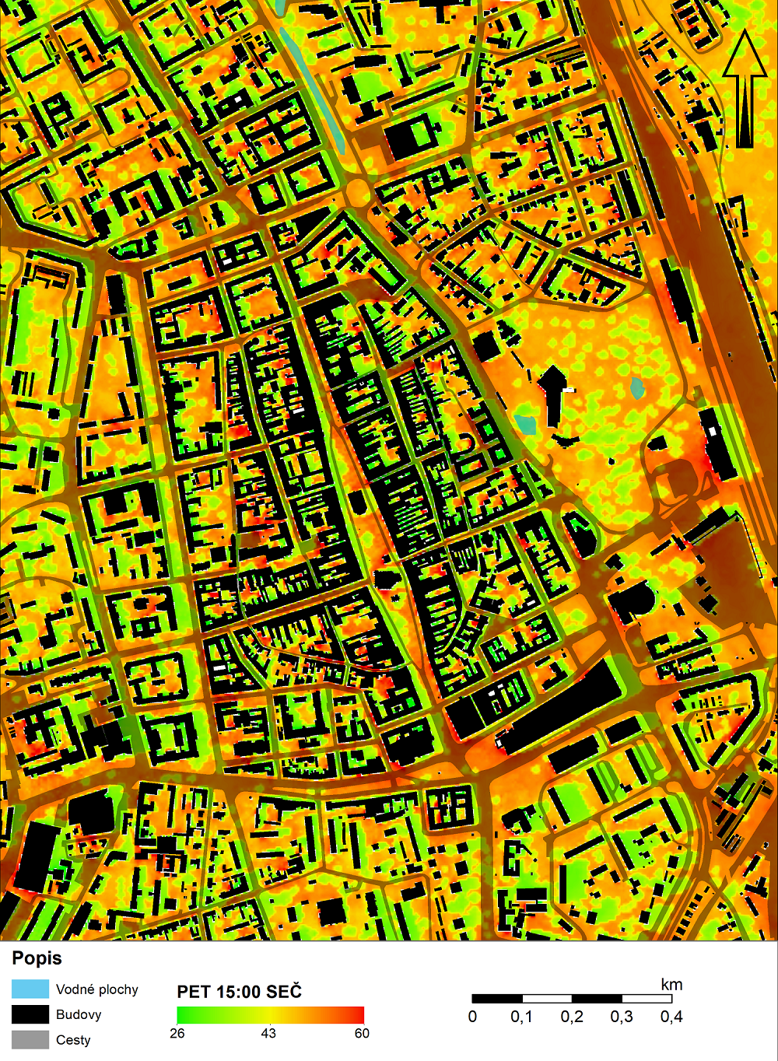
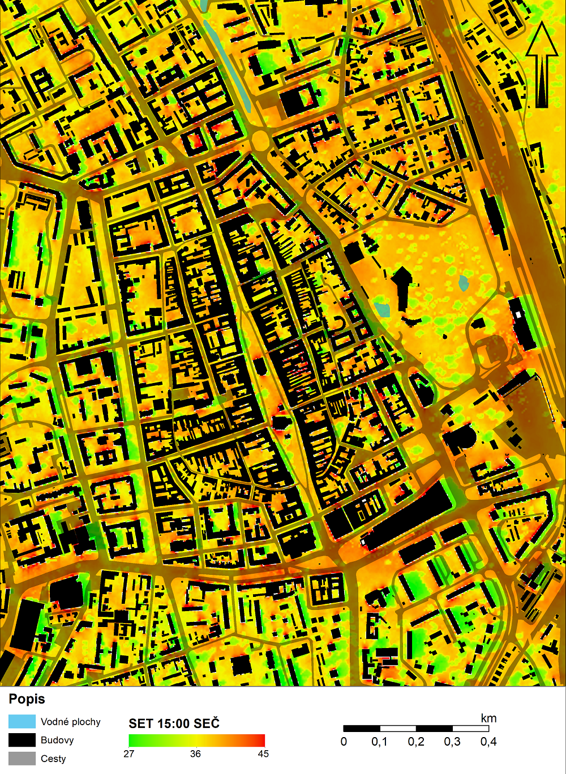
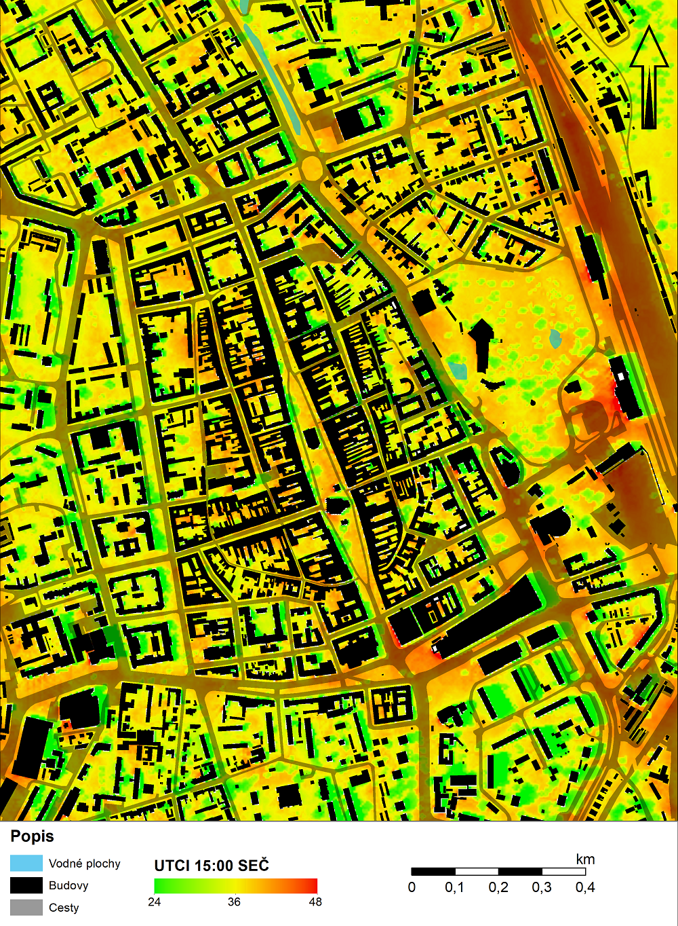
URBANA
A
Modelling heat stress on urban population in the cities Košice and Bratislava

Slide 11
Study Programmes
Single degree study
BSc. Geography and Geoinformatics
MSc. Geography and Geoinformatics
PhD. Geoinformatics and Remote Sensing
The first and only accredited PhD. study program of this specialization in Slovakia (to date)
Joint degree study
BSc., Geography with other Science (e.g. Mathematics, Computer Science, Physics, Biology, Chemistry, Slovak, German, English language, History)
Msc. Geography teaching
https://studijne-programy.upjs.sk/en/faculty/PF

Slide 12
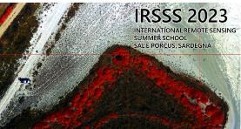
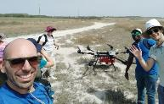
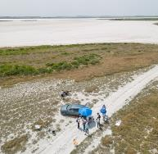
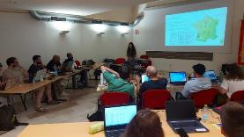
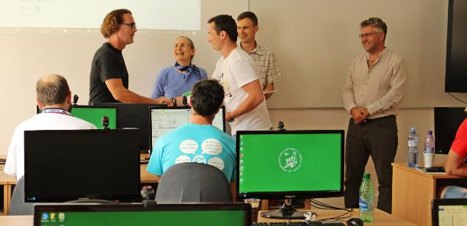
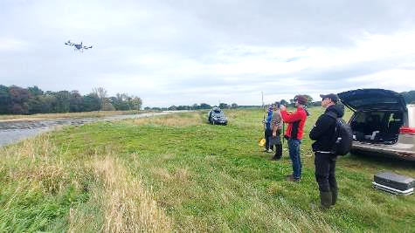
PUBLIC OUTREACH
Summer schools
Int. Rem. Sens. Summer School, Univ. Cagliari (07/2023)
Workshop on Lidar mapping/Sentinel 3 Odra river, Univ. Wroclaw (10/2023)
Exploring the landscape with dynamic visualization, tangible interaction, and UAV-lidar (07/2019)

