Slide 1



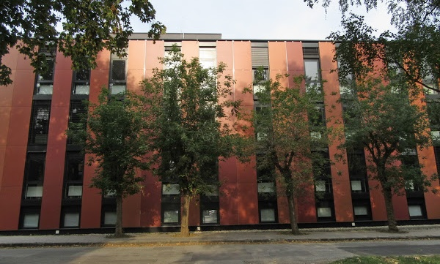



Štúdium, výskum
a laboratóriá
Ústavu geografie
Adresa: Jesenná 5, Košice, 040 01
http://uge.science.upjs.sk

Slide 2



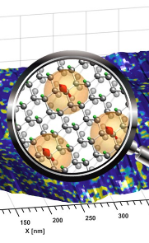


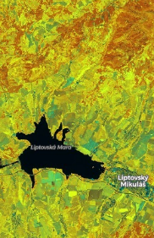







Prírodovedecká fakulta
Ústav biologických a ekologických vied
Ústav fyzikálnych vied
Ústav chemických vied
Ústav
informatiky
Ústav
geografie
Ústav
matematiky

Slide 3

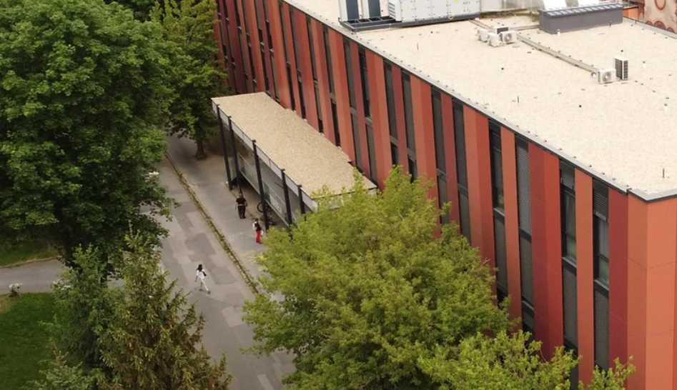
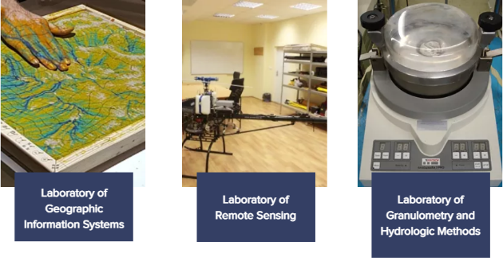
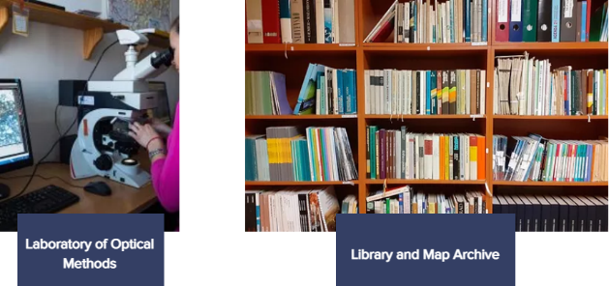
Vzdelávanie, veda a výskum
Tri oddelenia
Oddelenie fyzickej geografie a geológie
Oddelenie humánnej a regionálnej geografie
Oddelenie geoinformatiky a diaľkového prieskumu Zeme
Jesenná 5
Štyri laboratóriá a knižnica
Laboratórium geografických informačných systémov
Laboratórium diaľkového prieskumu Zeme
Laboratórium granulometrie a hydrologických metód
Laboratórium optických metód
Notes:
While the photo cameras or multispectral cameras have been the most popular sensors for mini and small UAV systems, the integrated use of UAV hyperspectral imaging and/or laser scanning is a recent issue, because of reducing the size and weight of hyperspectral scanner allows for their integration on UAV platforms. Hyperspectral remote sensing, also known as imaging spectroscopy, is a relatively new technology for UAV platforms that has been used in detection of vegetation species and biomass (Aasen, H. et al., 2015) or precision agriculture (Zarco-Tejada et al., 2013; Bareth et al., 2015; Sima et al., 2016).
Hyperspectral imaging sensors (spectrometers) capture reflected electromagnetic energy in hundreds of contiguous narrow spectral bands with high spectral resolution, typically in visible and near-infrared spectrum. Such sensors combined with unpiloted aerial systems (UAS) enable fast, flexible and non-destructive detection of subtle spectral features and dynamics of landscape changes.
The power and value of hyperspectral imaging four our team is in its capability to - Identify, Quantify (Measure) and Map landscape properties in each pixel of the target image.

Slide 4
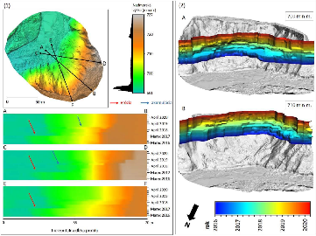
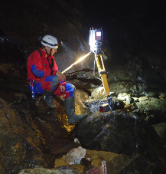
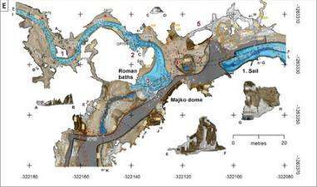
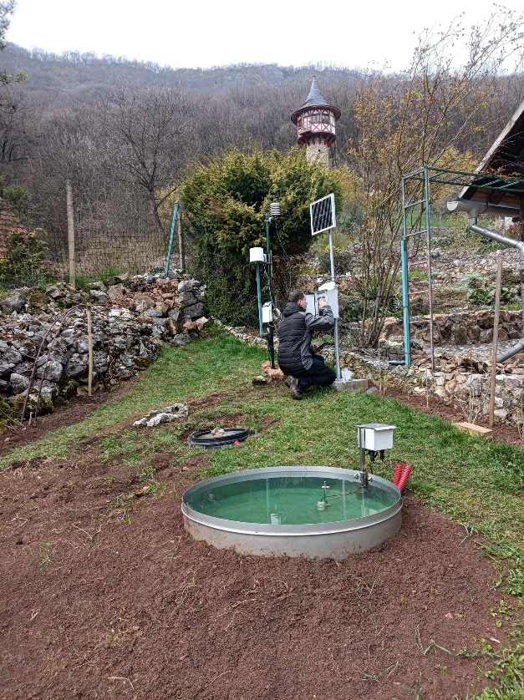
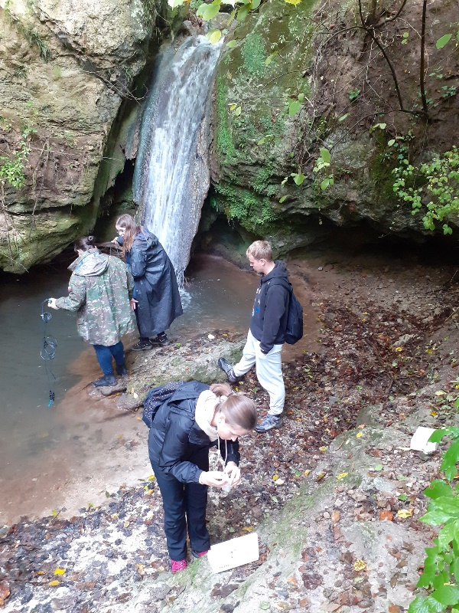
Vzdelávanie, veda a výskum
Tri oddelenia
Oddelenie fyzickej geografie
a geológie
Výskum a vzdelávanie
Karsológia a speleológia
Prírodné hrozby a riziká
Pôvod a vlastnosti hornín
Vlastnosti a úrodnosť pôdy
Hydrológia a hydrogeológia
Notes:
While the photo cameras or multispectral cameras have been the most popular sensors for mini and small UAV systems, the integrated use of UAV hyperspectral imaging and/or laser scanning is a recent issue, because of reducing the size and weight of hyperspectral scanner allows for their integration on UAV platforms. Hyperspectral remote sensing, also known as imaging spectroscopy, is a relatively new technology for UAV platforms that has been used in detection of vegetation species and biomass (Aasen, H. et al., 2015) or precision agriculture (Zarco-Tejada et al., 2013; Bareth et al., 2015; Sima et al., 2016).
Hyperspectral imaging sensors (spectrometers) capture reflected electromagnetic energy in hundreds of contiguous narrow spectral bands with high spectral resolution, typically in visible and near-infrared spectrum. Such sensors combined with unpiloted aerial systems (UAS) enable fast, flexible and non-destructive detection of subtle spectral features and dynamics of landscape changes.
The power and value of hyperspectral imaging four our team is in its capability to - Identify, Quantify (Measure) and Map landscape properties in each pixel of the target image.

Slide 5
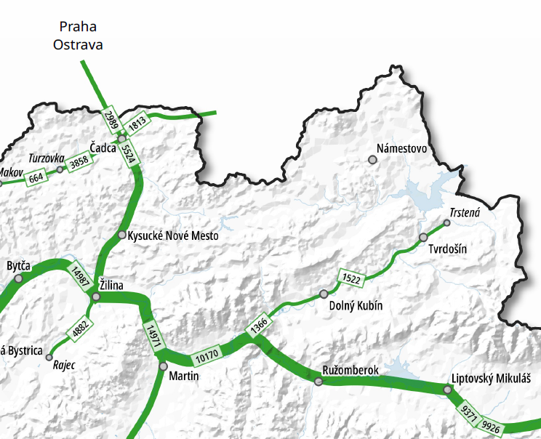
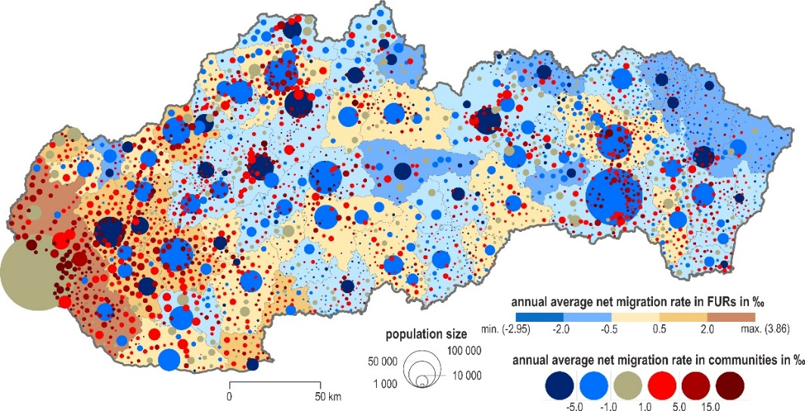
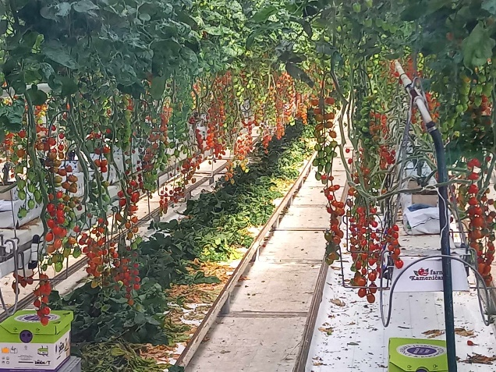
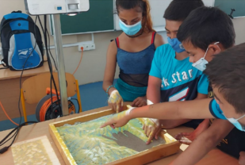
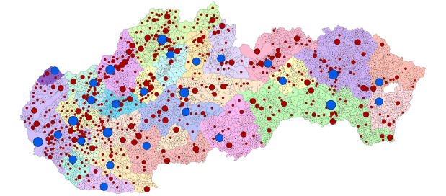
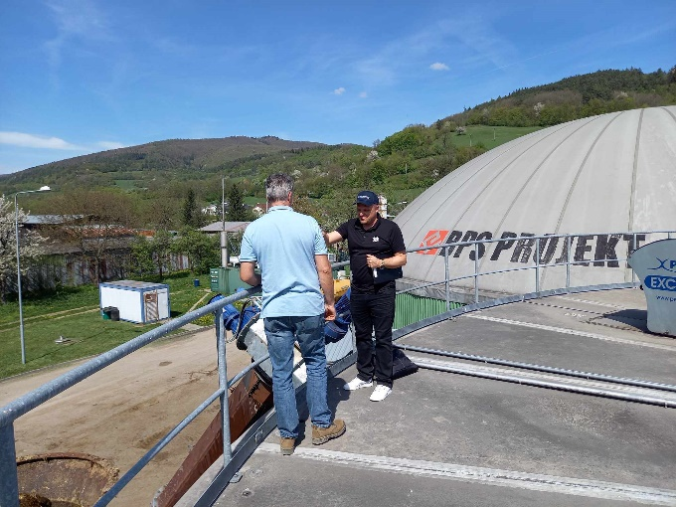
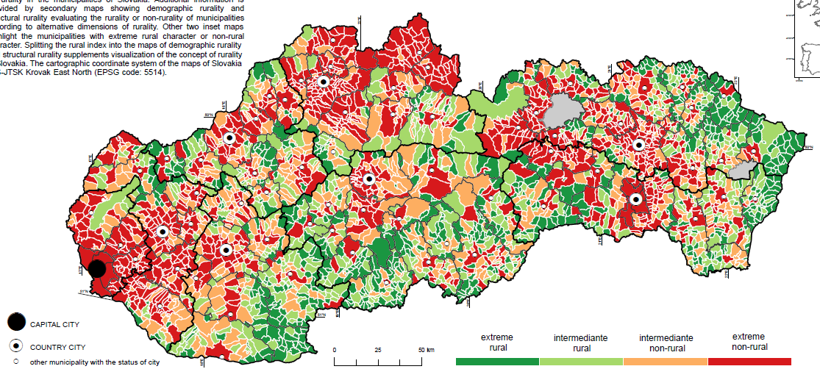
Vzdelávanie, veda a výskum
Tri oddelenia
Oddelenie humánnej a regionálnej geografie
Výskum a vzdelávanie
Populačné analýzy a modelovanie
Migrácia a ľudský kapitál
Urbánny vývoj a regionálny rozvoj
Percepcia obyvateľstva
Geografia hospodárstva a dopravy
Obnoviteľné zdroje energie
Didaktika geografie
Notes:
While the photo cameras or multispectral cameras have been the most popular sensors for mini and small UAV systems, the integrated use of UAV hyperspectral imaging and/or laser scanning is a recent issue, because of reducing the size and weight of hyperspectral scanner allows for their integration on UAV platforms. Hyperspectral remote sensing, also known as imaging spectroscopy, is a relatively new technology for UAV platforms that has been used in detection of vegetation species and biomass (Aasen, H. et al., 2015) or precision agriculture (Zarco-Tejada et al., 2013; Bareth et al., 2015; Sima et al., 2016).
Hyperspectral imaging sensors (spectrometers) capture reflected electromagnetic energy in hundreds of contiguous narrow spectral bands with high spectral resolution, typically in visible and near-infrared spectrum. Such sensors combined with unpiloted aerial systems (UAS) enable fast, flexible and non-destructive detection of subtle spectral features and dynamics of landscape changes.
The power and value of hyperspectral imaging four our team is in its capability to - Identify, Quantify (Measure) and Map landscape properties in each pixel of the target image.

Slide 6
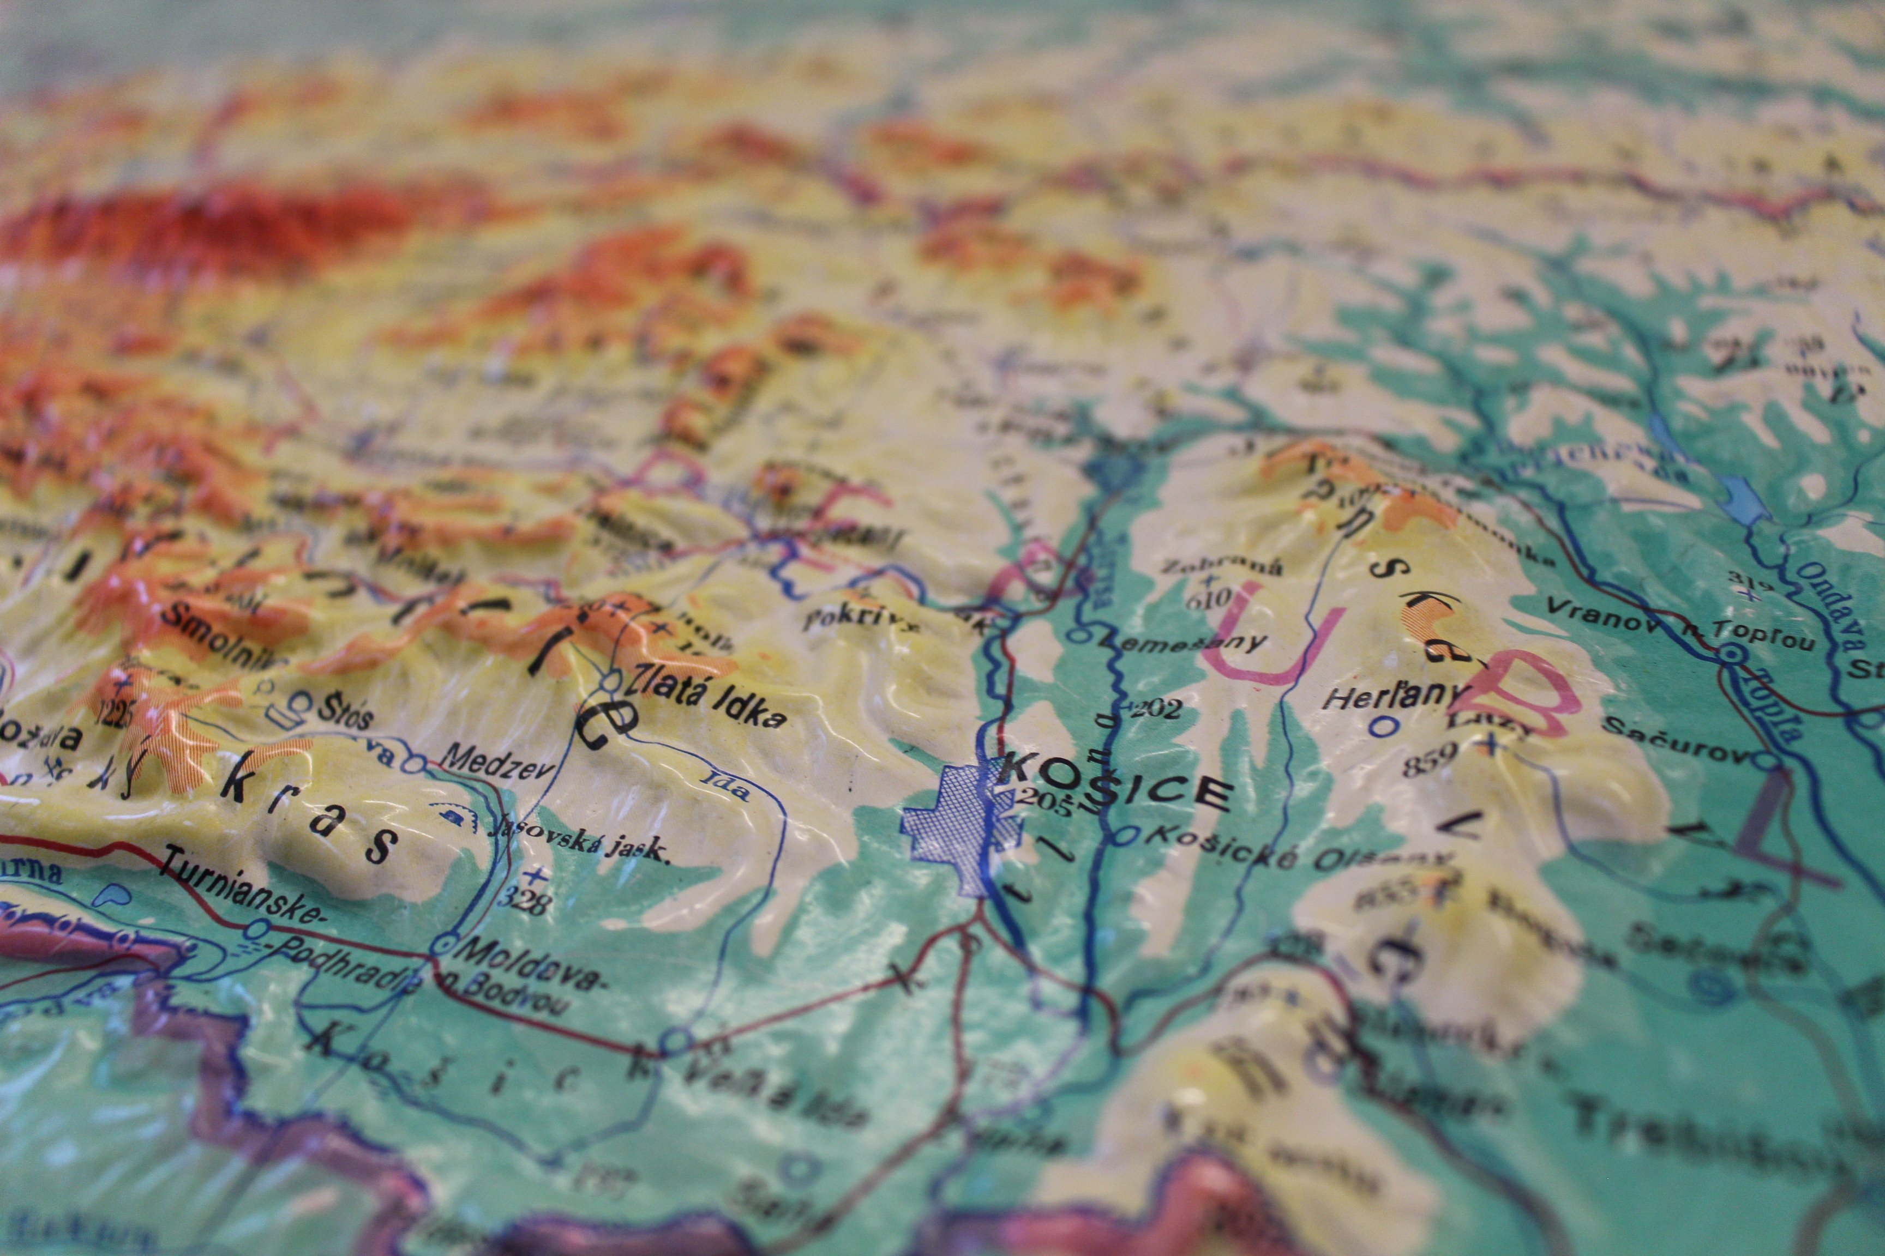
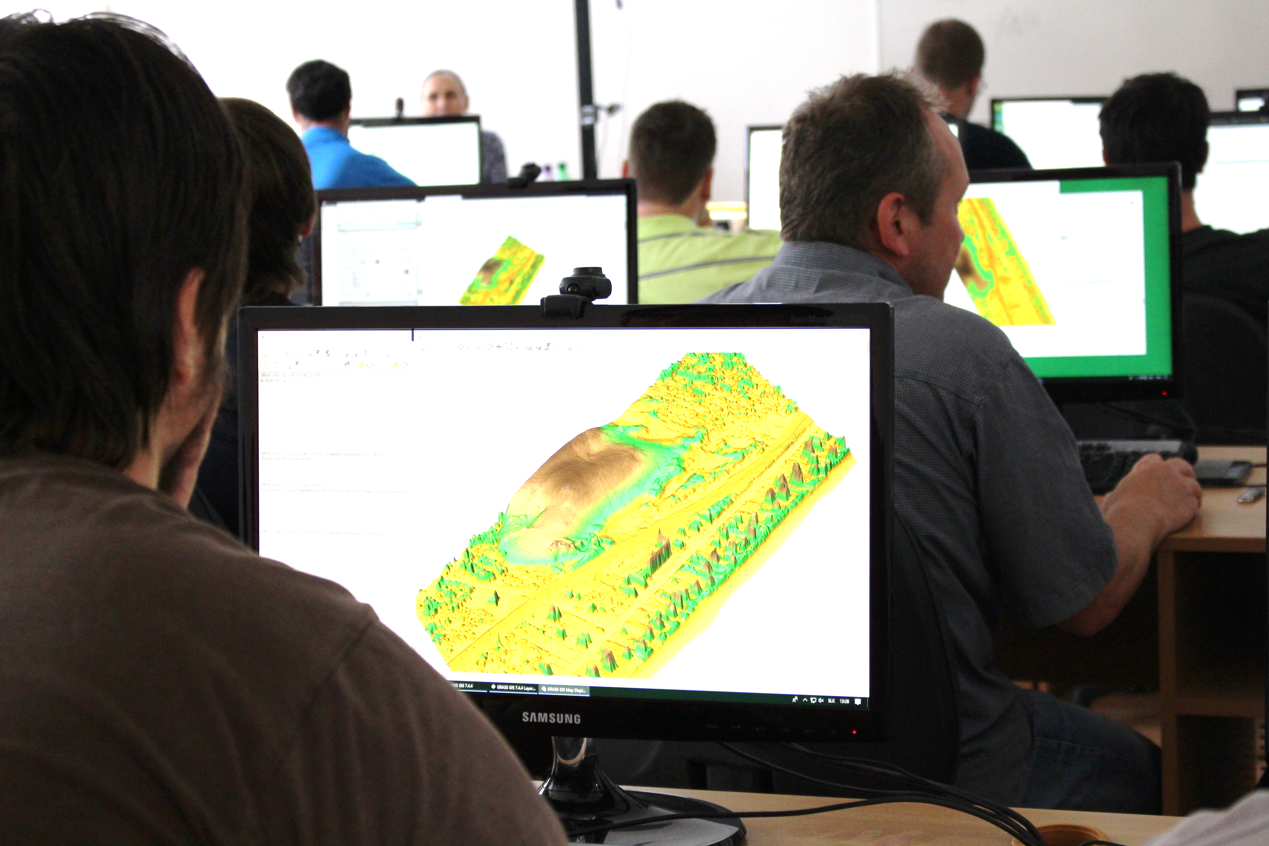
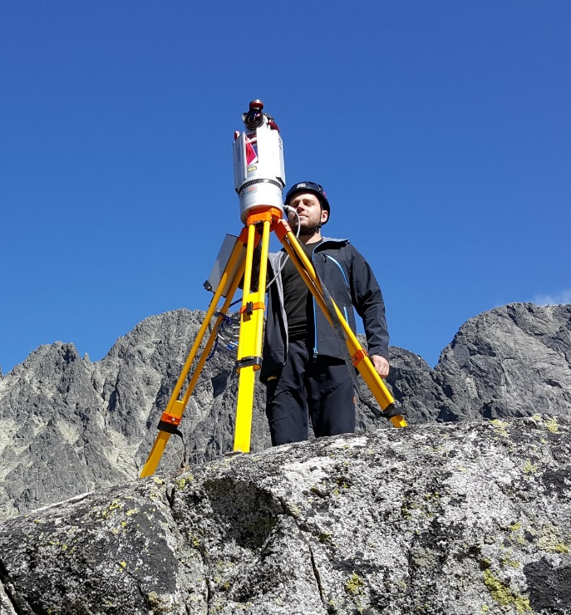
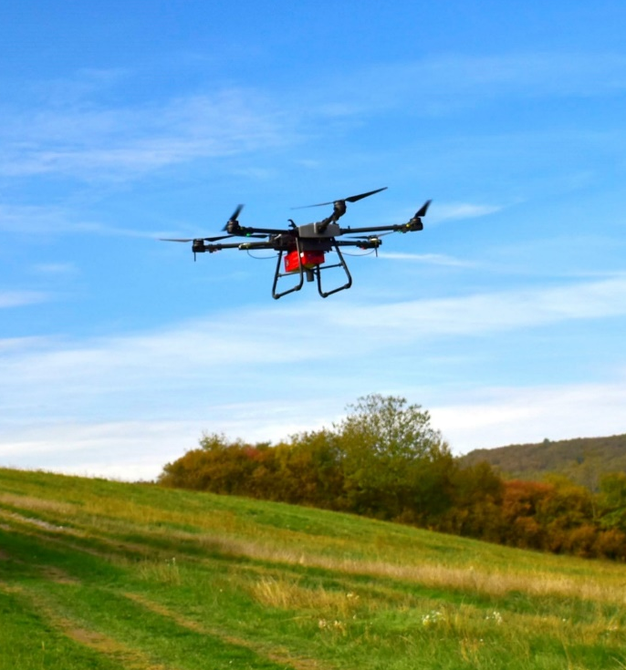
Vzdelávanie, veda a výskum
Tri oddelenia
Oddelenie geoinformatiky
a diaľkového prieskumu Zeme
Výskum a vzdelávanie
Kartografia a geoinformatika
Geografické informačné systémy
Diaľkový prieskum Zeme
Priestorové analýzy a modelovanie
Bezpilotné letecké systémy
Pozemné laserové skenovanie
Letecké laserové a hyperspektrálne skenovanie
Notes:
While the photo cameras or multispectral cameras have been the most popular sensors for mini and small UAV systems, the integrated use of UAV hyperspectral imaging and/or laser scanning is a recent issue, because of reducing the size and weight of hyperspectral scanner allows for their integration on UAV platforms. Hyperspectral remote sensing, also known as imaging spectroscopy, is a relatively new technology for UAV platforms that has been used in detection of vegetation species and biomass (Aasen, H. et al., 2015) or precision agriculture (Zarco-Tejada et al., 2013; Bareth et al., 2015; Sima et al., 2016).
Hyperspectral imaging sensors (spectrometers) capture reflected electromagnetic energy in hundreds of contiguous narrow spectral bands with high spectral resolution, typically in visible and near-infrared spectrum. Such sensors combined with unpiloted aerial systems (UAS) enable fast, flexible and non-destructive detection of subtle spectral features and dynamics of landscape changes.
The power and value of hyperspectral imaging four our team is in its capability to - Identify, Quantify (Measure) and Map landscape properties in each pixel of the target image.

Slide 7

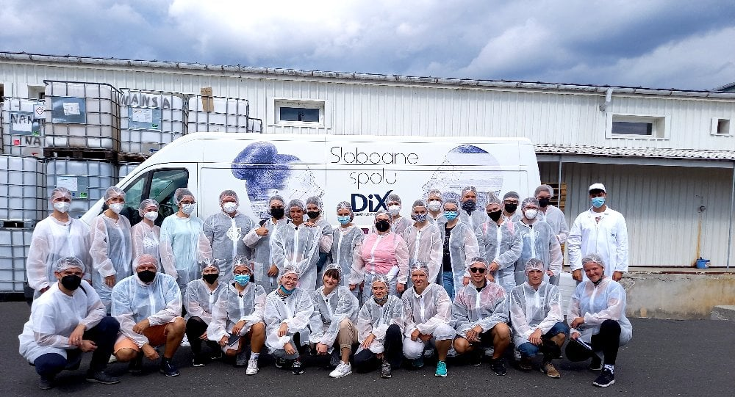
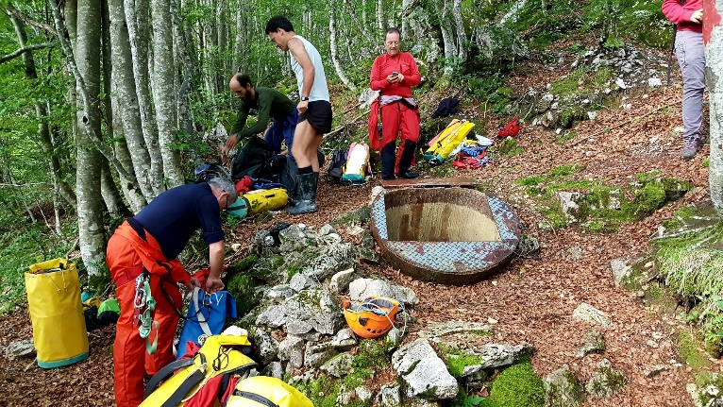
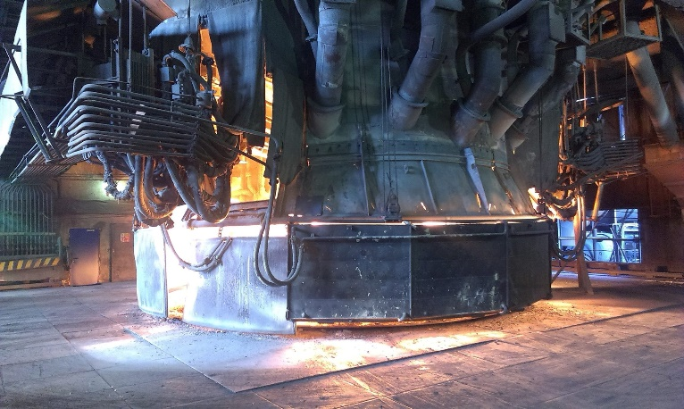
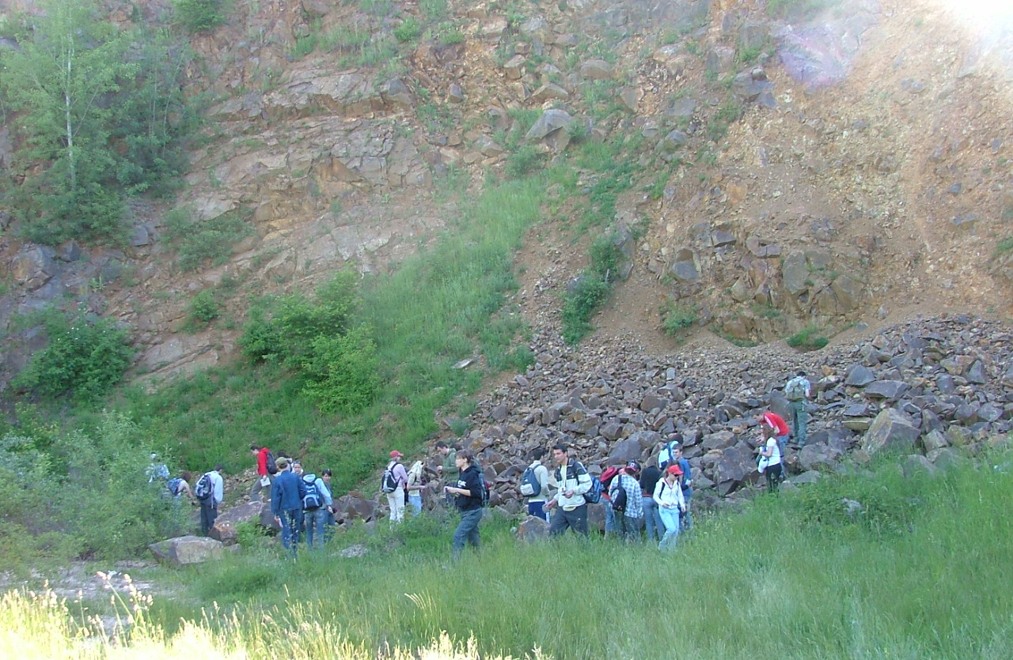
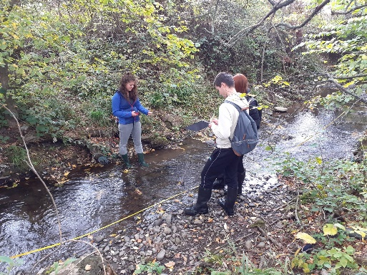
Vzdelávanie, veda a výskum
Vzdelávanie
Vyučovanie v teréne
Príprava pre prax
Mäkké zručnosti
  Kritické myslenie, prezentačné, argumentačné, organizačné zručnosti
Moderné technológie
Rovnocenný vzťah a spätná väzba
Individuálne potreby
Podpora štúdia v zahraničí
Notes:
While the photo cameras or multispectral cameras have been the most popular sensors for mini and small UAV systems, the integrated use of UAV hyperspectral imaging and/or laser scanning is a recent issue, because of reducing the size and weight of hyperspectral scanner allows for their integration on UAV platforms. Hyperspectral remote sensing, also known as imaging spectroscopy, is a relatively new technology for UAV platforms that has been used in detection of vegetation species and biomass (Aasen, H. et al., 2015) or precision agriculture (Zarco-Tejada et al., 2013; Bareth et al., 2015; Sima et al., 2016).
Hyperspectral imaging sensors (spectrometers) capture reflected electromagnetic energy in hundreds of contiguous narrow spectral bands with high spectral resolution, typically in visible and near-infrared spectrum. Such sensors combined with unpiloted aerial systems (UAS) enable fast, flexible and non-destructive detection of subtle spectral features and dynamics of landscape changes.
The power and value of hyperspectral imaging four our team is in its capability to - Identify, Quantify (Measure) and Map landscape properties in each pixel of the target image.

Slide 8
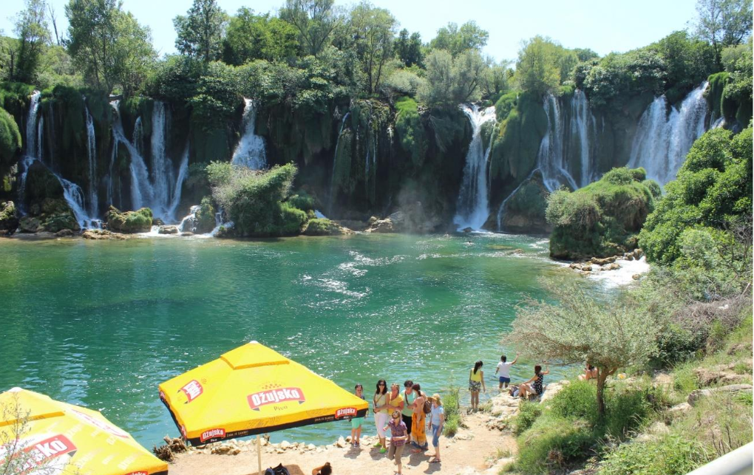

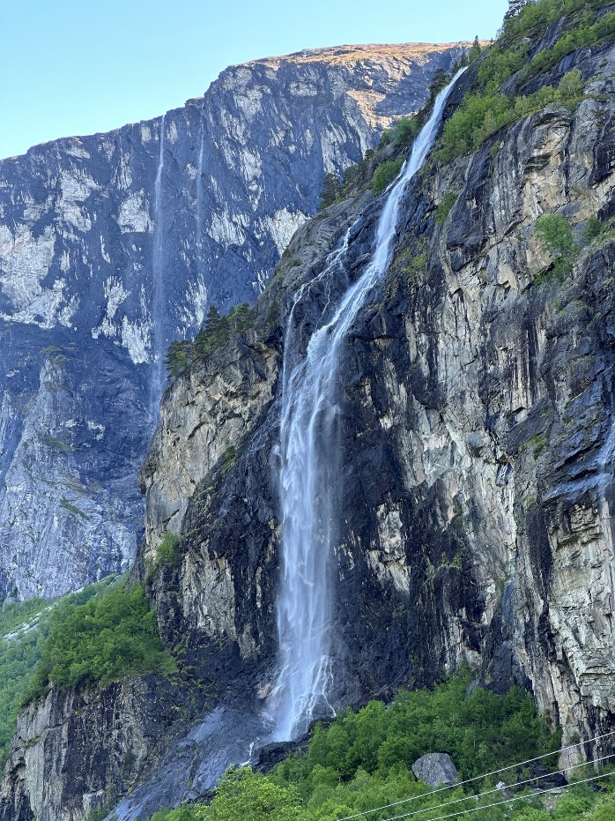
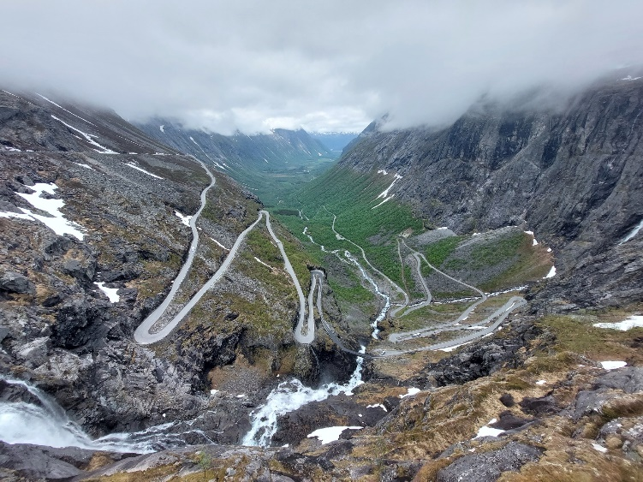
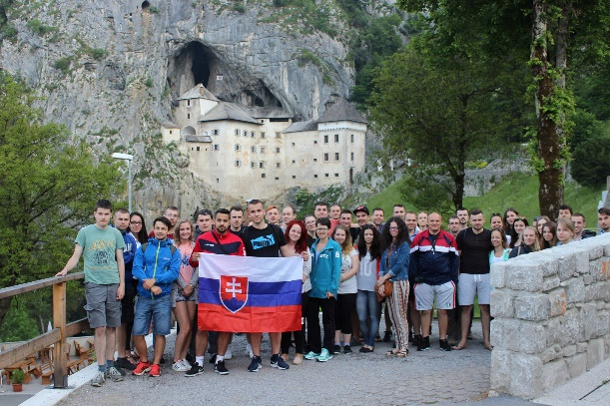


Vzdelávanie, veda a výskum
Vzdelávanie
Vyučovanie v teréne
Príprava pre prax
Mäkké zručnosti
  Kritické myslenie, prezentačné, argumentačné, organizačné zručnosti
Moderné technológie
Rovnocenný vzťah a spätná väzba
Individuálne potreby
Podpora štúdia v zahraničí
Notes:
While the photo cameras or multispectral cameras have been the most popular sensors for mini and small UAV systems, the integrated use of UAV hyperspectral imaging and/or laser scanning is a recent issue, because of reducing the size and weight of hyperspectral scanner allows for their integration on UAV platforms. Hyperspectral remote sensing, also known as imaging spectroscopy, is a relatively new technology for UAV platforms that has been used in detection of vegetation species and biomass (Aasen, H. et al., 2015) or precision agriculture (Zarco-Tejada et al., 2013; Bareth et al., 2015; Sima et al., 2016).
Hyperspectral imaging sensors (spectrometers) capture reflected electromagnetic energy in hundreds of contiguous narrow spectral bands with high spectral resolution, typically in visible and near-infrared spectrum. Such sensors combined with unpiloted aerial systems (UAS) enable fast, flexible and non-destructive detection of subtle spectral features and dynamics of landscape changes.
The power and value of hyperspectral imaging four our team is in its capability to - Identify, Quantify (Measure) and Map landscape properties in each pixel of the target image.

Slide 9
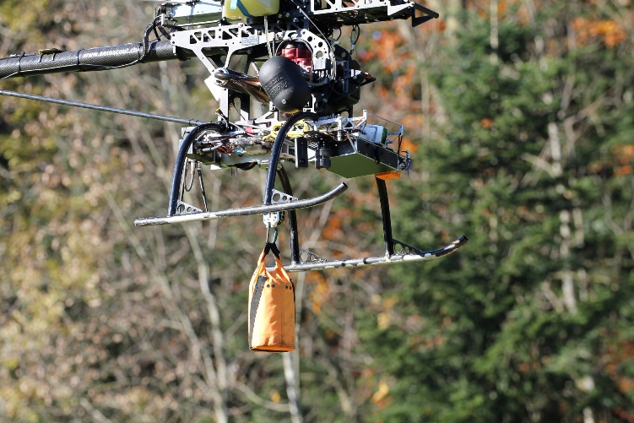
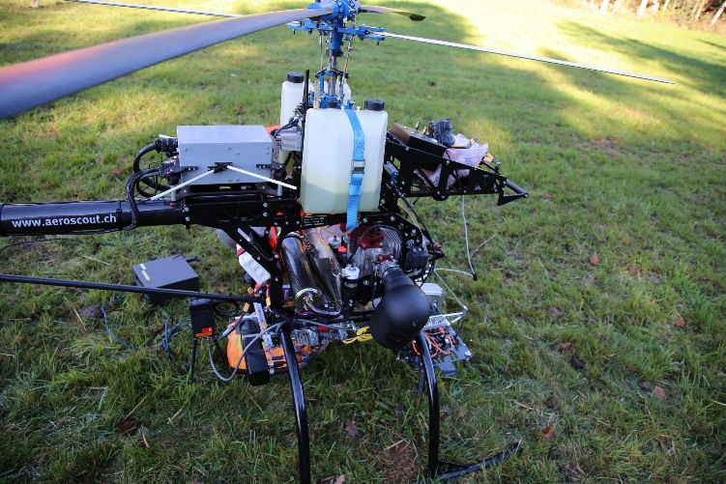
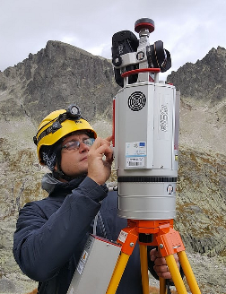
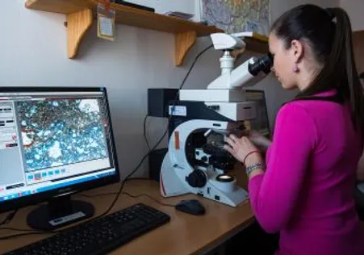

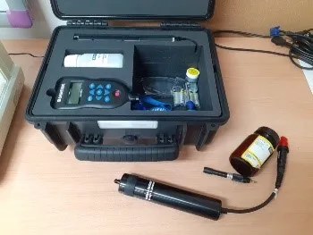

Vzdelávanie, veda a výskum
Vzdelávanie
Vyučovanie v teréne
Príprava pre prax
Mäkké zručnosti
  Kritické myslenie, prezentačné, argumentačné, organizačné zručnosti
Moderné technológie
Spätná väzba
Individuálne potreby
Podpora štúdia v zahraničí
http://umbrasolutions.eu/
Notes:
While the photo cameras or multispectral cameras have been the most popular sensors for mini and small UAV systems, the integrated use of UAV hyperspectral imaging and/or laser scanning is a recent issue, because of reducing the size and weight of hyperspectral scanner allows for their integration on UAV platforms. Hyperspectral remote sensing, also known as imaging spectroscopy, is a relatively new technology for UAV platforms that has been used in detection of vegetation species and biomass (Aasen, H. et al., 2015) or precision agriculture (Zarco-Tejada et al., 2013; Bareth et al., 2015; Sima et al., 2016).
Hyperspectral imaging sensors (spectrometers) capture reflected electromagnetic energy in hundreds of contiguous narrow spectral bands with high spectral resolution, typically in visible and near-infrared spectrum. Such sensors combined with unpiloted aerial systems (UAS) enable fast, flexible and non-destructive detection of subtle spectral features and dynamics of landscape changes.
The power and value of hyperspectral imaging four our team is in its capability to - Identify, Quantify (Measure) and Map landscape properties in each pixel of the target image.

Slide 10
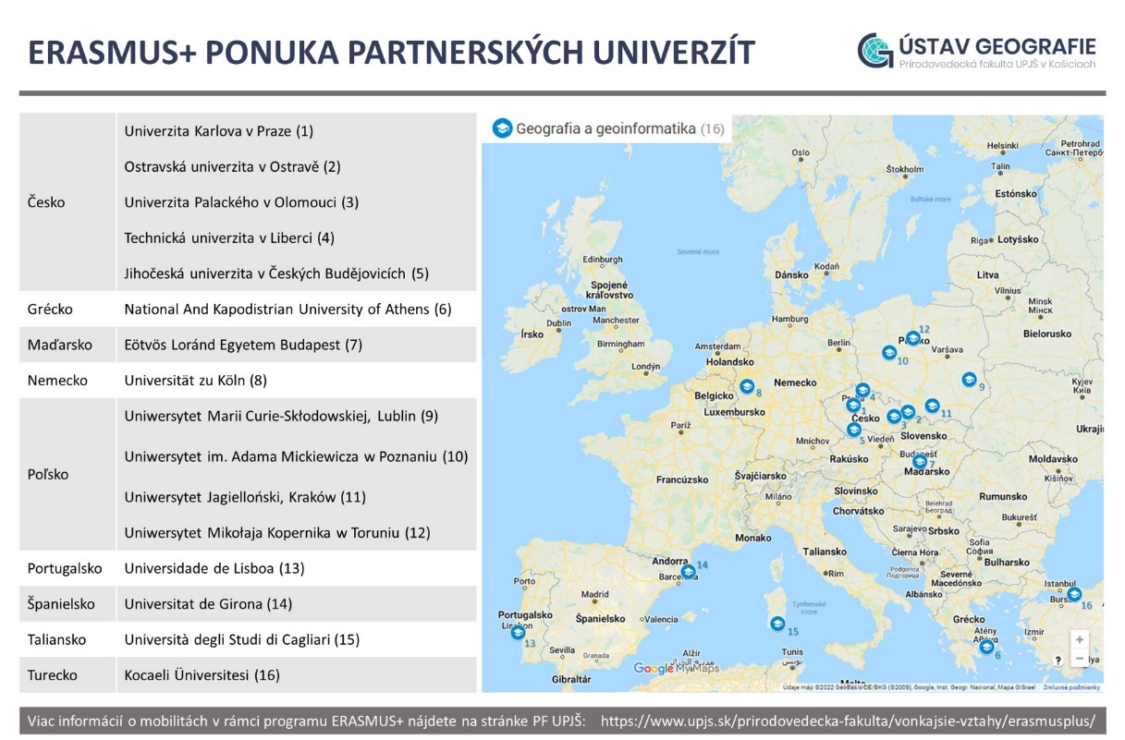


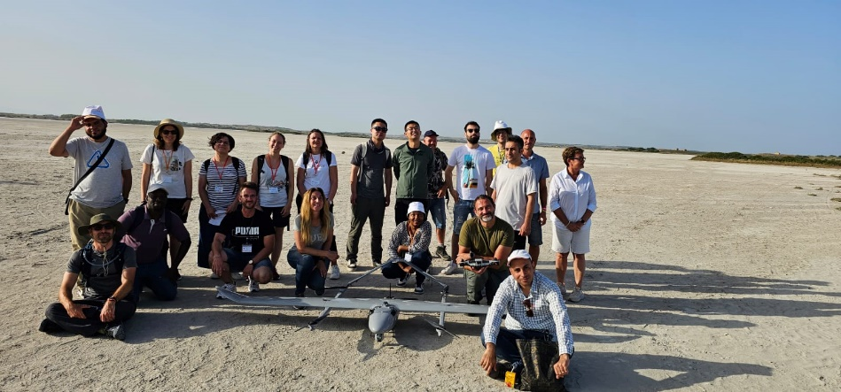
Vzdelávanie, veda a výskum
Vzdelávanie
Vyučovanie v teréne
Príprava pre prax
Mäkké zručnosti
  Kritické myslenie, prezentačné, argumentačné, organizačné zručnosti
Moderné technológie
Spätná väzba
Individuálne potreby
Podpora štúdia v zahraničí
Notes:
While the photo cameras or multispectral cameras have been the most popular sensors for mini and small UAV systems, the integrated use of UAV hyperspectral imaging and/or laser scanning is a recent issue, because of reducing the size and weight of hyperspectral scanner allows for their integration on UAV platforms. Hyperspectral remote sensing, also known as imaging spectroscopy, is a relatively new technology for UAV platforms that has been used in detection of vegetation species and biomass (Aasen, H. et al., 2015) or precision agriculture (Zarco-Tejada et al., 2013; Bareth et al., 2015; Sima et al., 2016).
Hyperspectral imaging sensors (spectrometers) capture reflected electromagnetic energy in hundreds of contiguous narrow spectral bands with high spectral resolution, typically in visible and near-infrared spectrum. Such sensors combined with unpiloted aerial systems (UAS) enable fast, flexible and non-destructive detection of subtle spectral features and dynamics of landscape changes.
The power and value of hyperspectral imaging four our team is in its capability to - Identify, Quantify (Measure) and Map landscape properties in each pixel of the target image.

Slide 11
UPLATNENIE ABSOLVENTOV
Jednoodboroví študenti
štátna správa a samospráva, súkromný sektor
odborné inštitúcie ochrany prírody, cestovného ruchu
odborné inštitúcie pre územné plánovanie a rozvoj
inštitúcie využívajúce GIS pri riešení úloh zberu dát o krajine a ich spracovania
inštitúcie využívajúce IKT a zamerané na vývoj softvéru
Medziodboroví študenti
učitelia na základných a stredných školách všetkých typov, pôsobenie aj na vysokých školách
vedecko-výskumné ústavy a výpočtové strediská
Notes:
While the photo cameras or multispectral cameras have been the most popular sensors for mini and small UAV systems, the integrated use of UAV hyperspectral imaging and/or laser scanning is a recent issue, because of reducing the size and weight of hyperspectral scanner allows for their integration on UAV platforms. Hyperspectral remote sensing, also known as imaging spectroscopy, is a relatively new technology for UAV platforms that has been used in detection of vegetation species and biomass (Aasen, H. et al., 2015) or precision agriculture (Zarco-Tejada et al., 2013; Bareth et al., 2015; Sima et al., 2016).
Hyperspectral imaging sensors (spectrometers) capture reflected electromagnetic energy in hundreds of contiguous narrow spectral bands with high spectral resolution, typically in visible and near-infrared spectrum. Such sensors combined with unpiloted aerial systems (UAS) enable fast, flexible and non-destructive detection of subtle spectral features and dynamics of landscape changes.
The power and value of hyperspectral imaging four our team is in its capability to - Identify, Quantify (Measure) and Map landscape properties in each pixel of the target image.

Slide 12

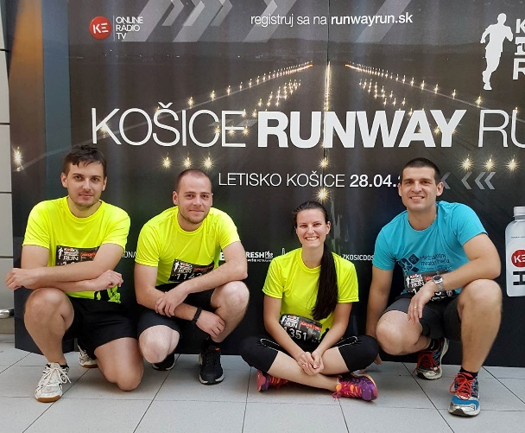



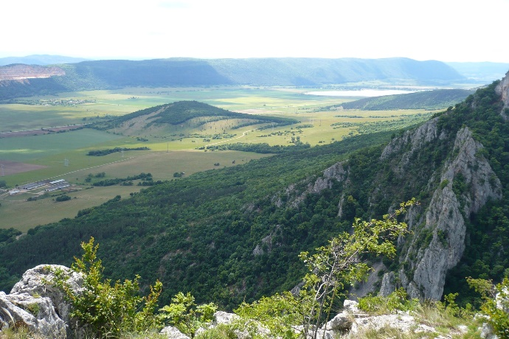
Ďalšie aktivity
Klub učiteľov geografie
Športové a spoločenské podujatia
Košická pobočka Slovenskej geografickej spoločnosti
Notes:
While the photo cameras or multispectral cameras have been the most popular sensors for mini and small UAV systems, the integrated use of UAV hyperspectral imaging and/or laser scanning is a recent issue, because of reducing the size and weight of hyperspectral scanner allows for their integration on UAV platforms. Hyperspectral remote sensing, also known as imaging spectroscopy, is a relatively new technology for UAV platforms that has been used in detection of vegetation species and biomass (Aasen, H. et al., 2015) or precision agriculture (Zarco-Tejada et al., 2013; Bareth et al., 2015; Sima et al., 2016).
Hyperspectral imaging sensors (spectrometers) capture reflected electromagnetic energy in hundreds of contiguous narrow spectral bands with high spectral resolution, typically in visible and near-infrared spectrum. Such sensors combined with unpiloted aerial systems (UAS) enable fast, flexible and non-destructive detection of subtle spectral features and dynamics of landscape changes.
The power and value of hyperspectral imaging four our team is in its capability to - Identify, Quantify (Measure) and Map landscape properties in each pixel of the target image.

Slide 13
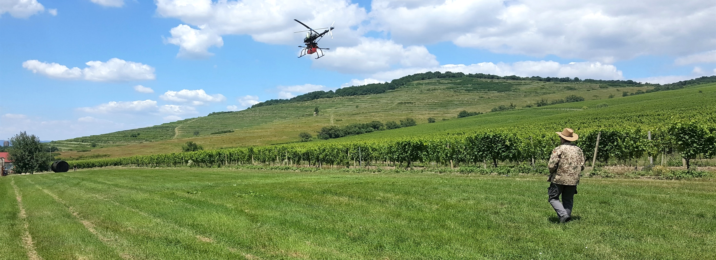


Ďakujeme za pozornosť
UNIVERZITA PAVLA JOZEFA ŠAFÁRIKA V KOŠICIACH
PRÍRODOVEDECKÁ FAKULTA | ÚSTAV GEOGRAFIE
Notes:
Dear ladies and gentleman, in my talk I would like to present a boresight callibration of hyperspectral push-broom sensor onboard an unpiloted helicopter system/vehicle. Our teams is based Slovakia, in the city of Košice, Institute of Geography, Pavol Jozef Šafárik University.

