Slide 1
Okolie Harmaneckej jaskyne izobázové povrchy z lidarových dát

Slide 2
Izobázové povrchy podľa Filosofov 1965, Jedlička et al. 2015 (https://doi.org/10.1016/j.cageo.2015.02.012) 2011
Z údolníc súčasného DEM:
2. rád + vyšší
3. rád + vyšší
4. rád + vyšší
5. rád + vyšší

Slide 3
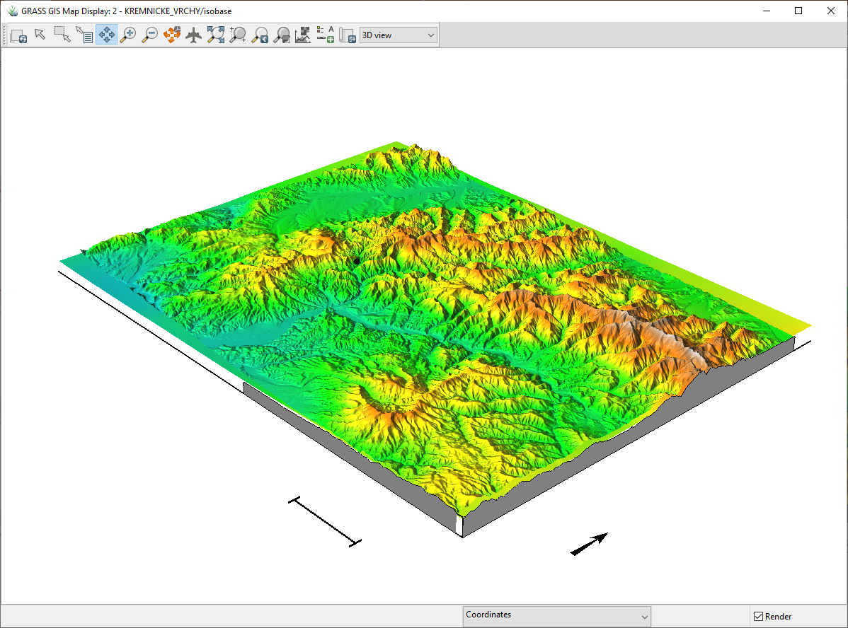
Recent DEM
Red dot – Harmanecká cave
5000 m

Slide 4
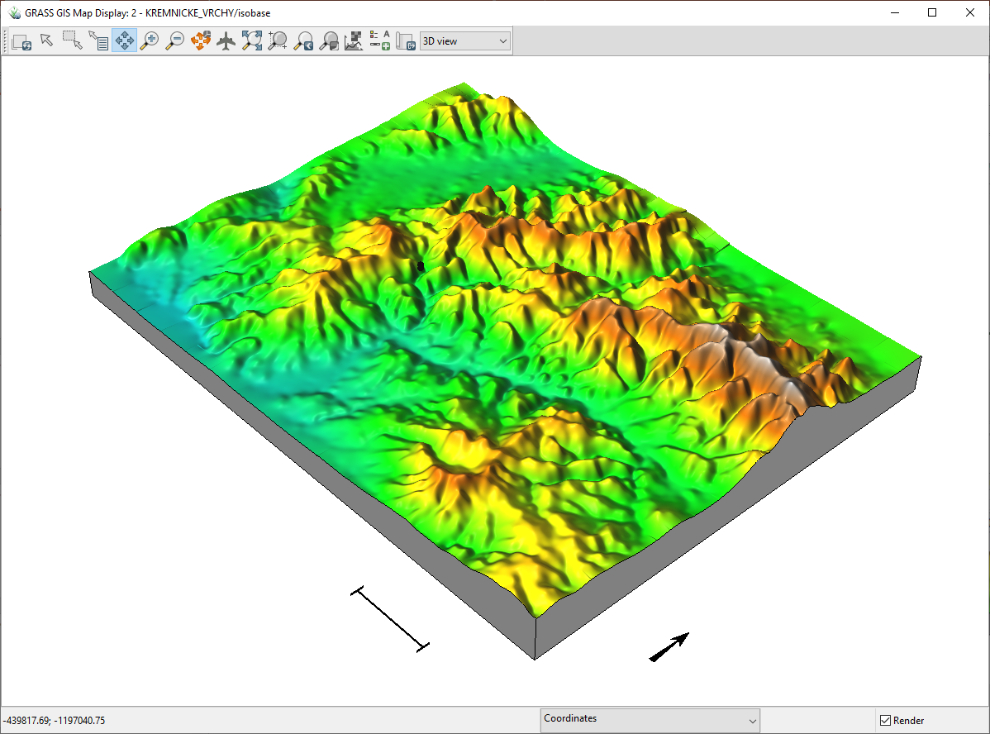
2nd order + higher
5000 m

Slide 5
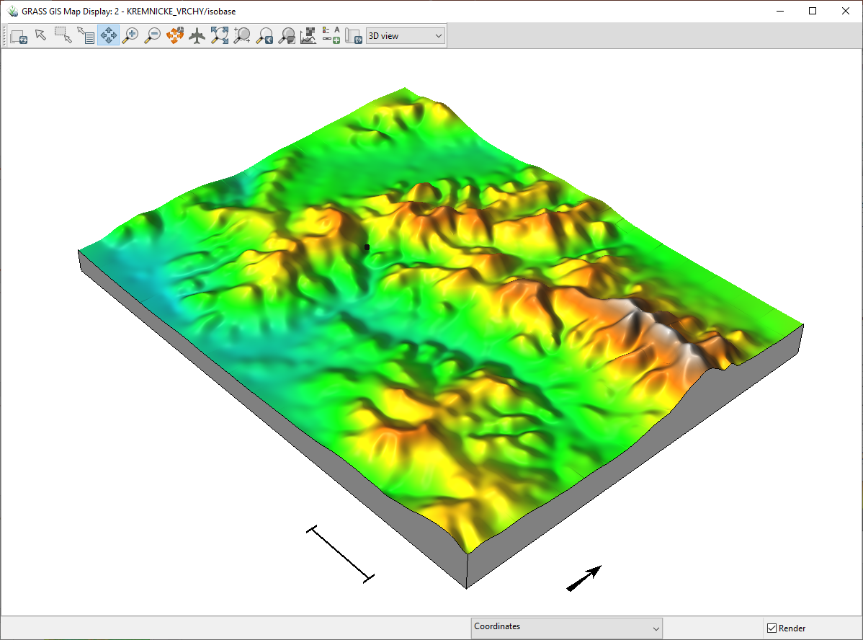
3 order + higher
5000 m

Slide 6
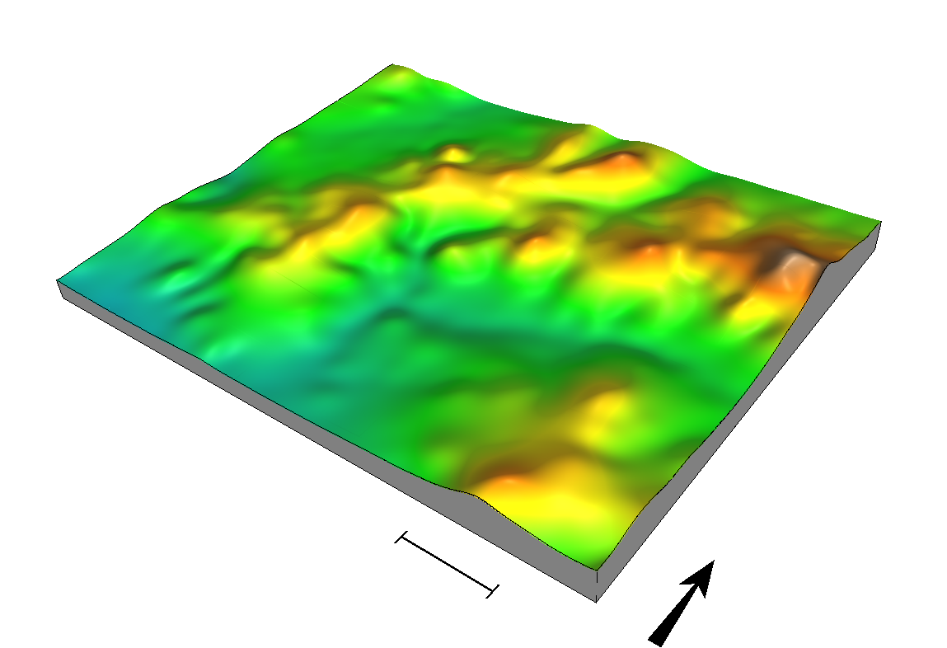
4th order + higher
5000 m

Slide 7
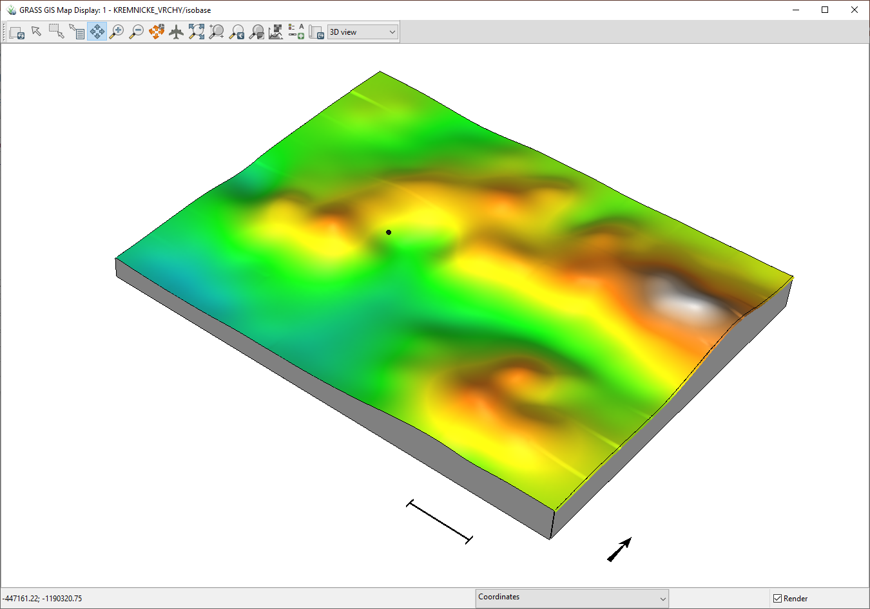
5th order + higher
5000 m

Slide 8
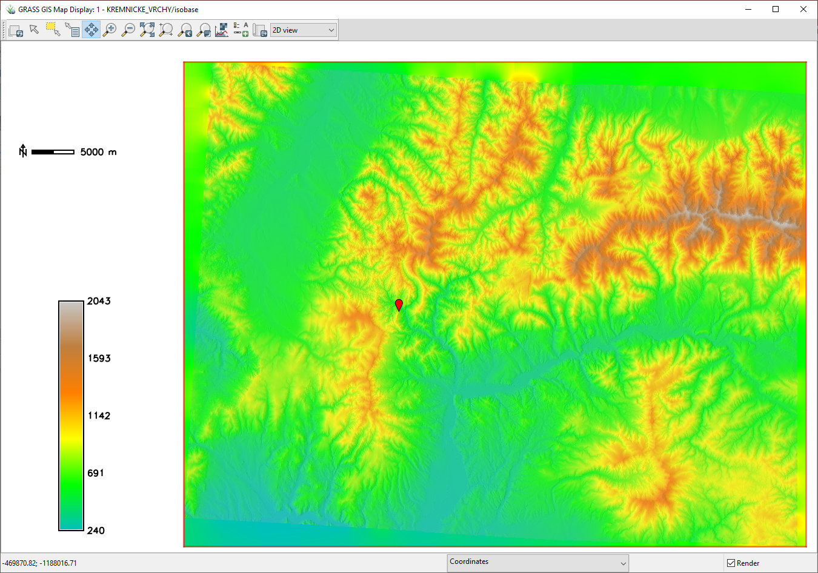
Recent DEM

Slide 9
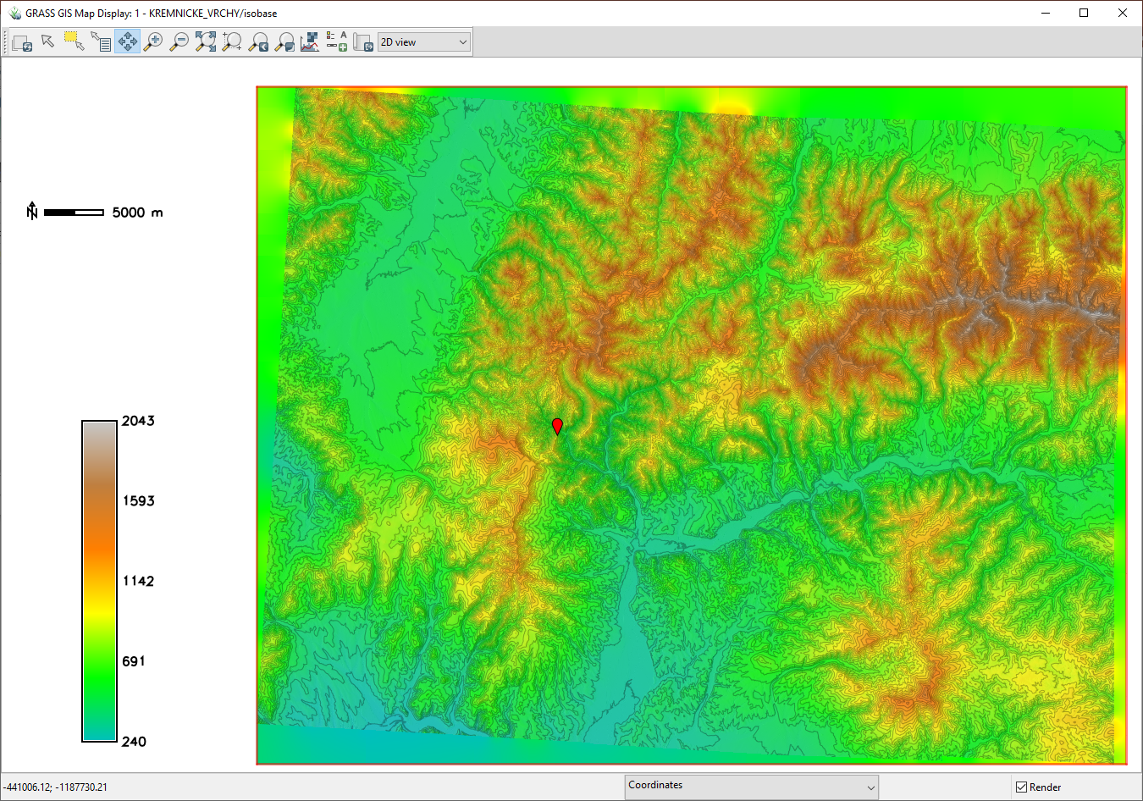
Recent DEM
Contour interval 50 m

Slide 10
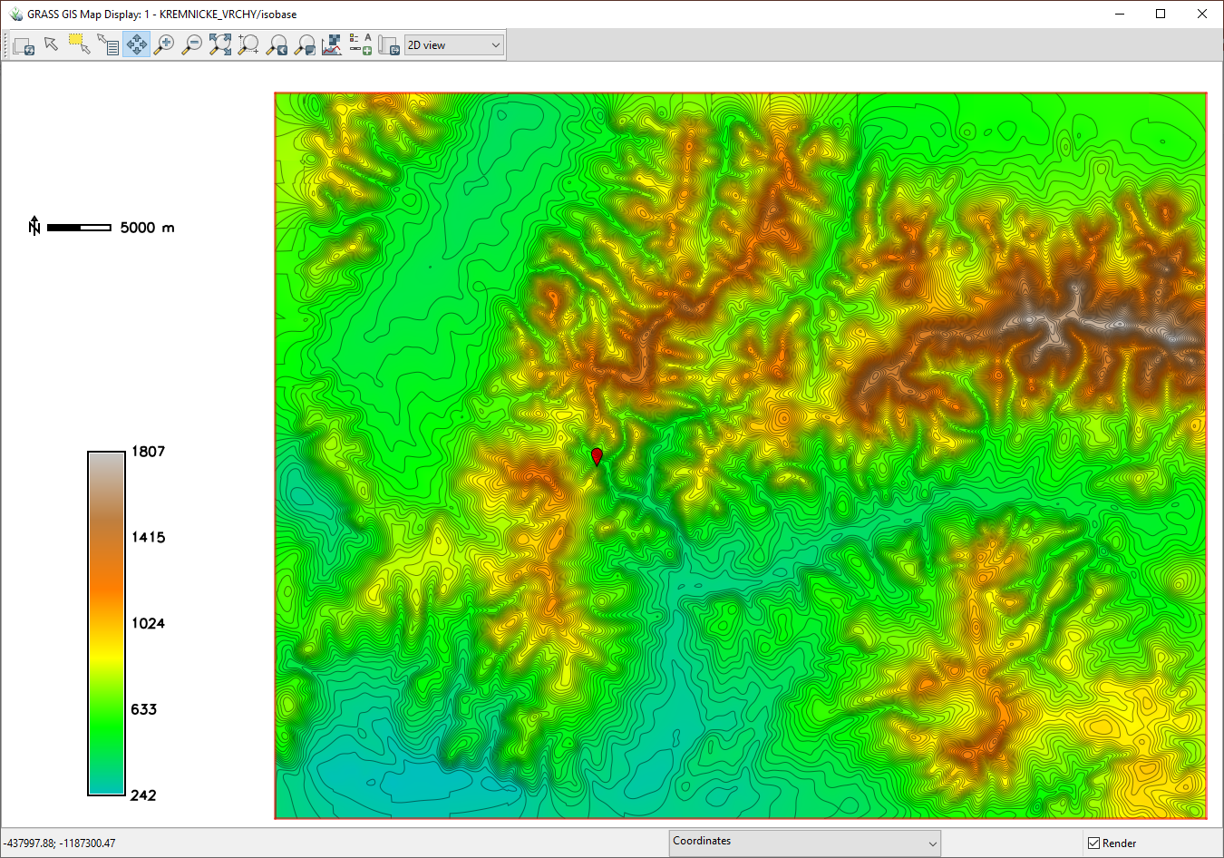
Isobase
2nd order + higher
Contours 20 m

Slide 11
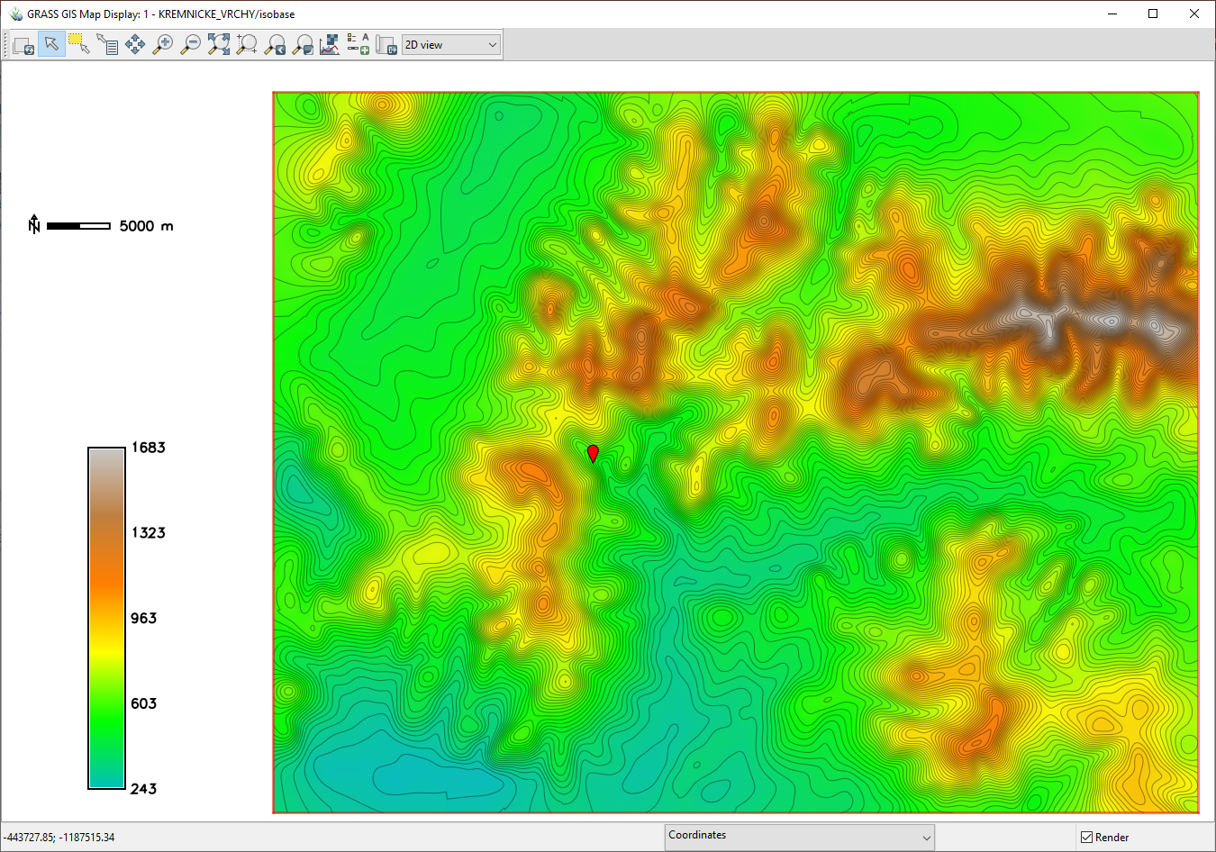
Isobase
3rd order + higher
Contours 20 m

Slide 12
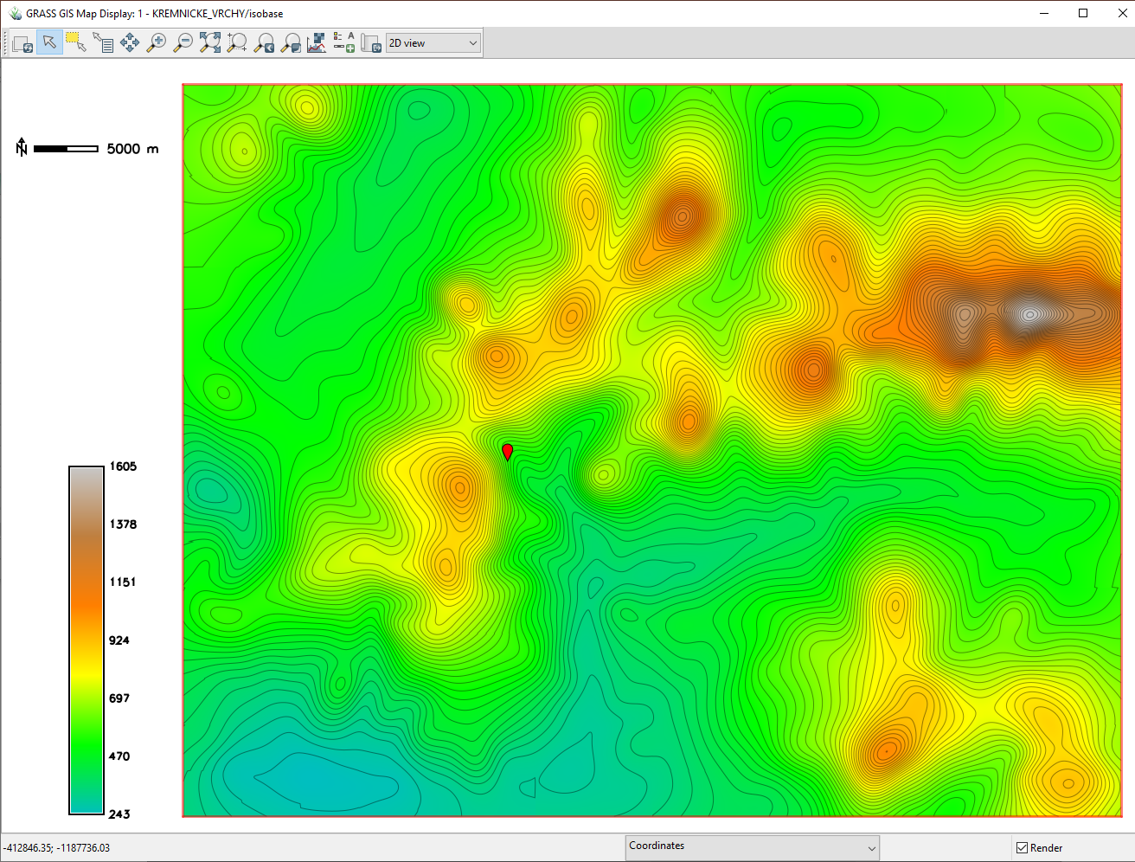
Isobase
4th order + higher
Contours 20 m

Slide 13
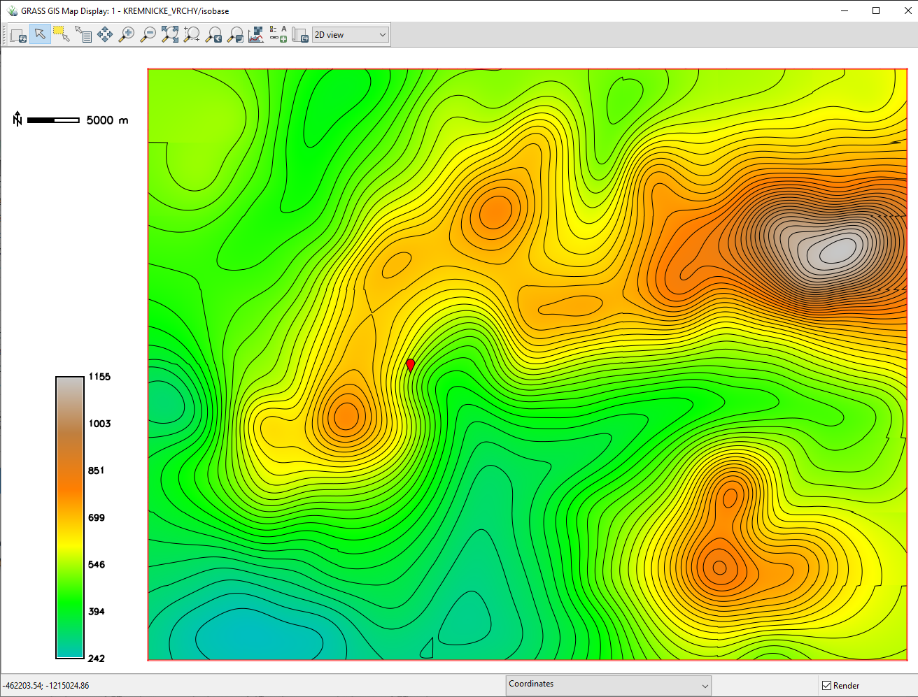
Isobase
5th order + higher
Contours 20 m

Slide 14
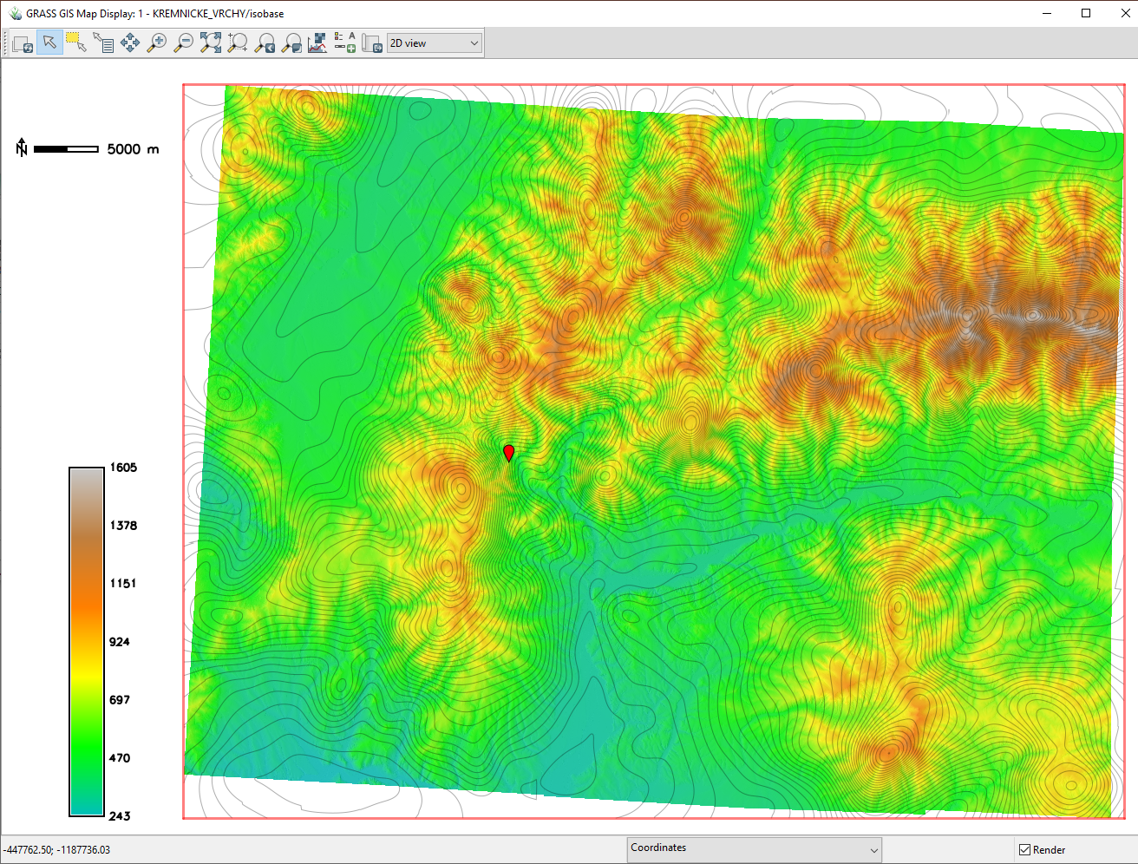
Recent DEM
Contours of isobase 4th order DEM

Slide 15
Recent DEM
Contours of isobase 4th order DEM
up
up
down
down
down
up

Slide 16
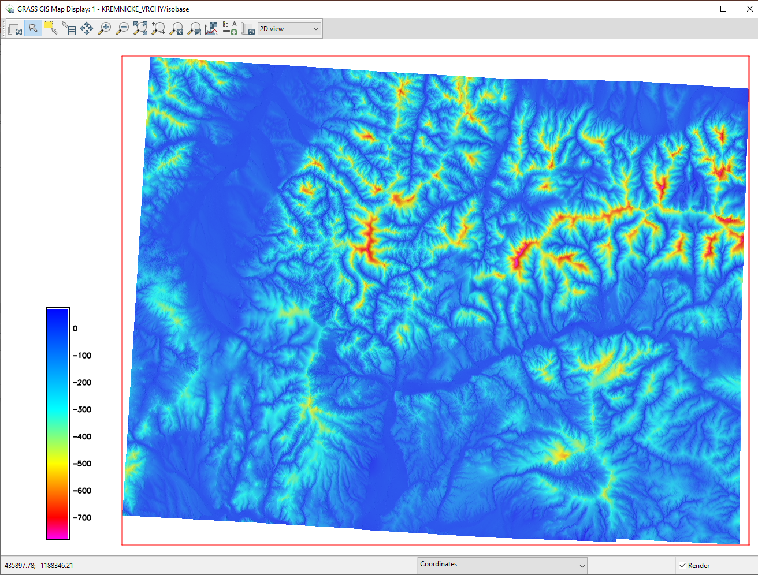
4th order
Differences
Isobase 4th order DEM – recent DEM
Yellow,red parts indicate high difference between DEM and isobase surface, i.e. erosion, uplift,

Slide 17
4th order
Differences
Isobase 4th order DEM – recent DEM

Slide 18
4th order
Differences
Isobase 4th order DEM – recent DEM

Slide 19
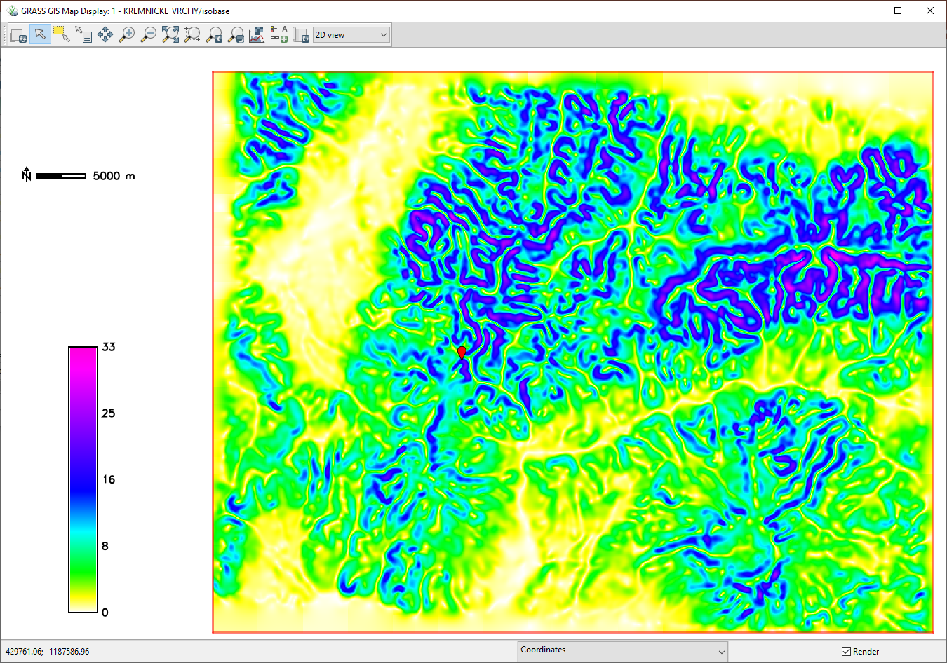
Isobase
2nd order + higher
Slope angle
Elevation Contours 20 m
High slope (gree,blue) indicates slip/contact of two blocks
See Grohmann 2011

Slide 20
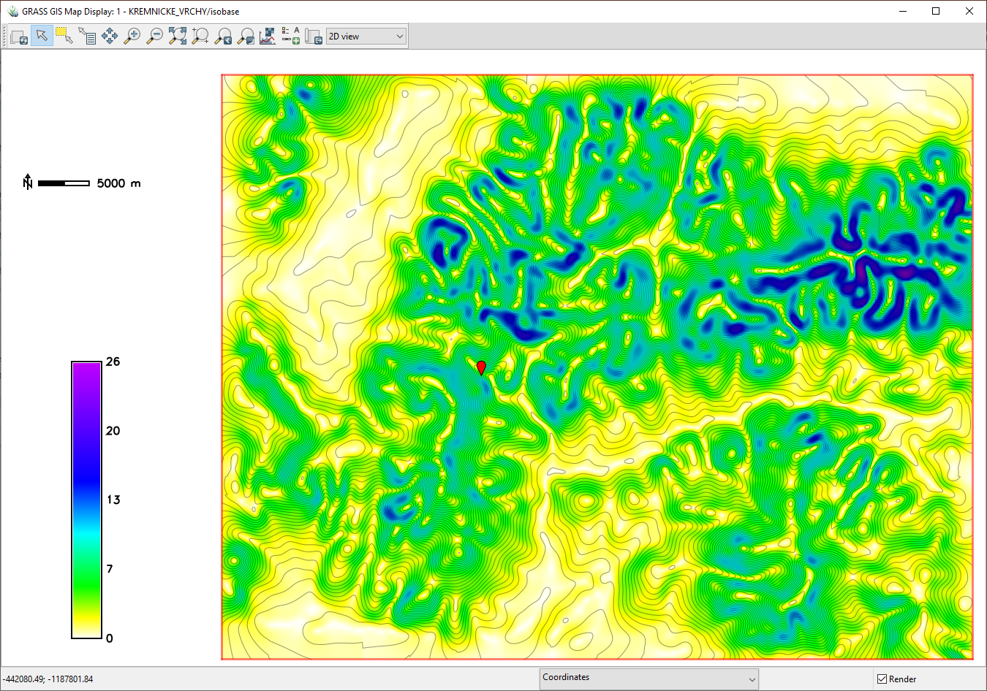
Isobase
3rd order + higher
Slope angle
Elevation Contours 20 m
High slope (gree,blue) indicates slip/contact of two blocks
See Grohmann 2011

Slide 21
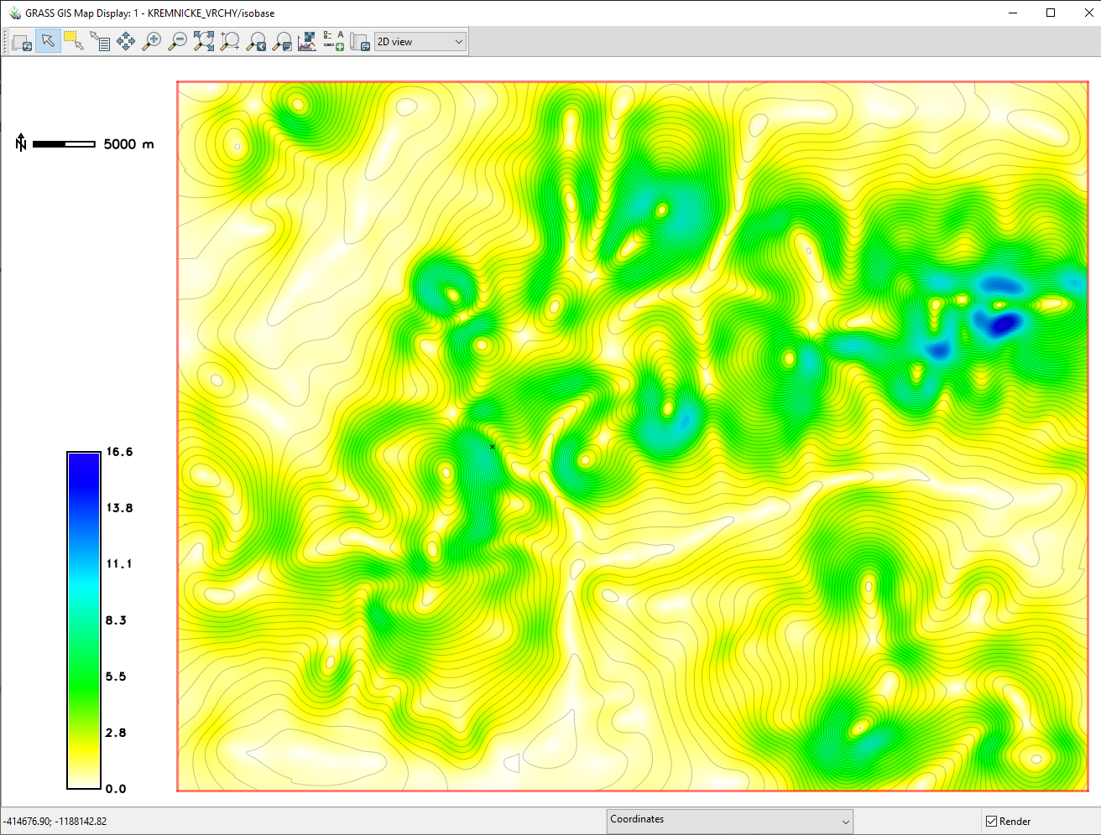
Isobase
4th order + higher
Slope angle
Elevation Contours 20 m
High slope (gree,blue) indicates slip/contact of two blocks
See Grohmann 2011

Slide 22
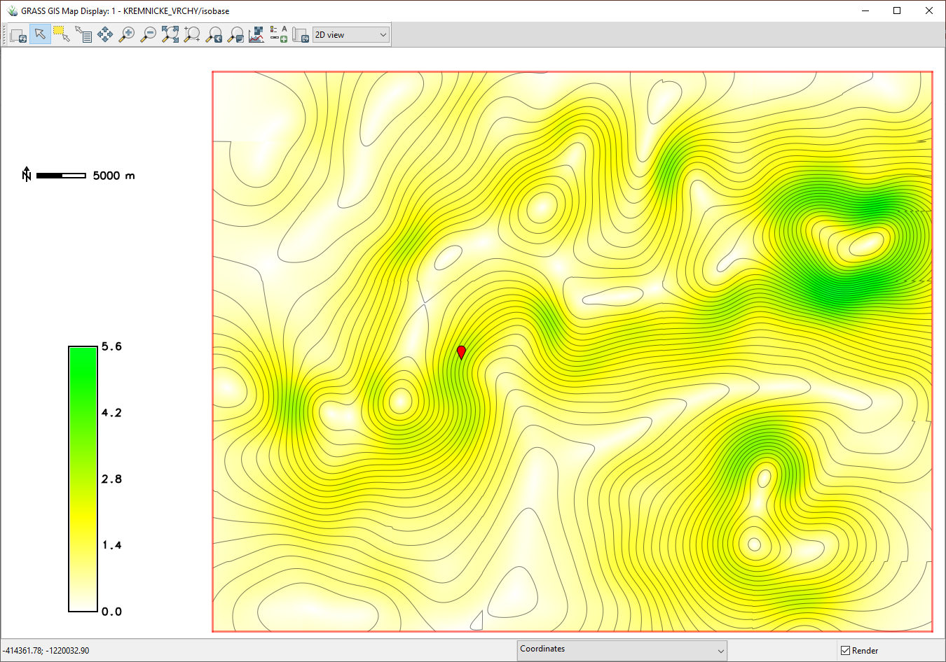
Isobase
5th order + higher
Slope angle
Elevation Contours 20 m
High slope (gree,blue) indicates slip/contact of two blocks
See Grohmann 2011

Slide 23
Izobázové povrchy podľa Grohmanna 2011
2.+3. rád
3.+4. rád
5.+6. rád

Slide 24
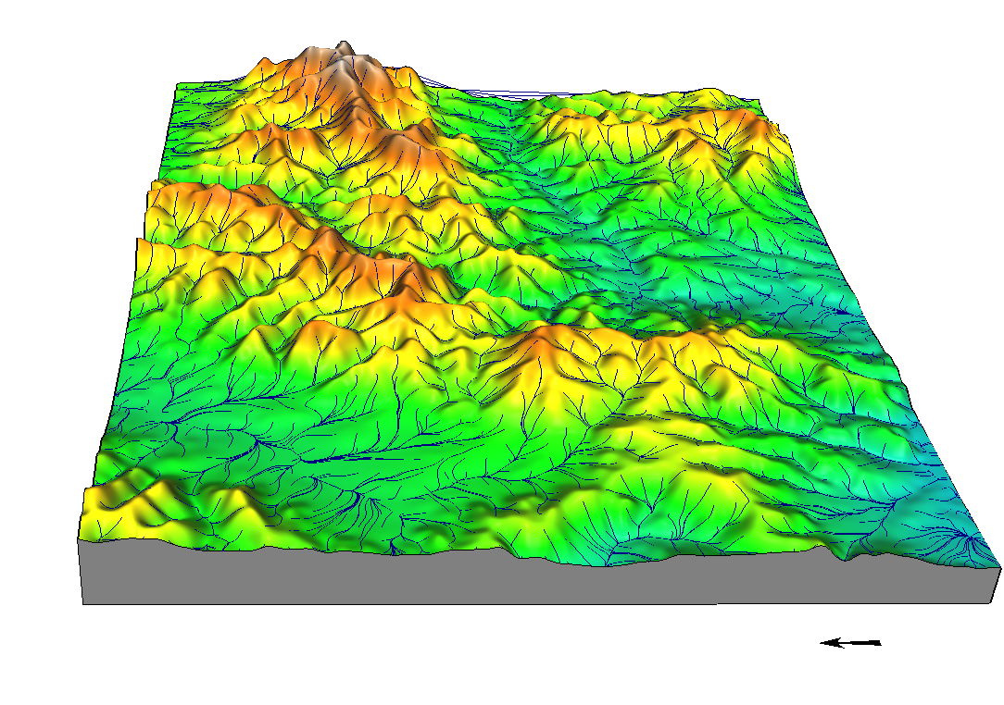
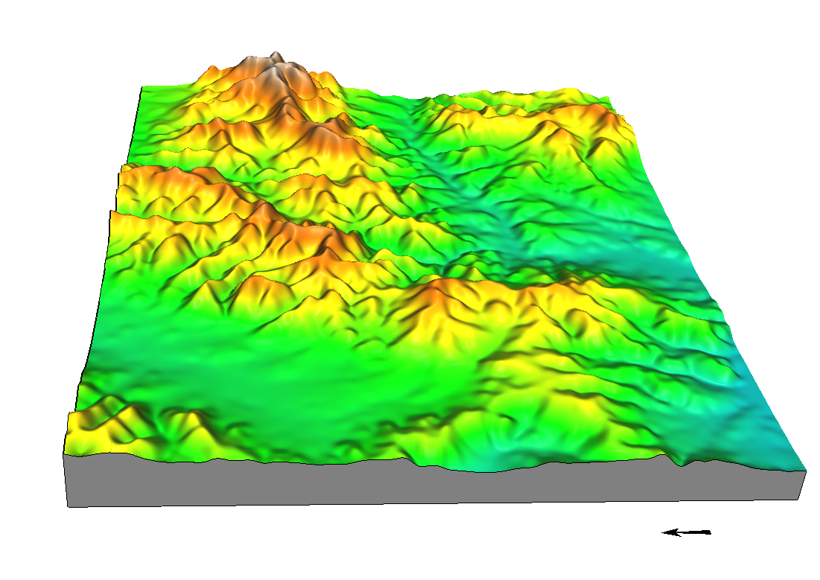
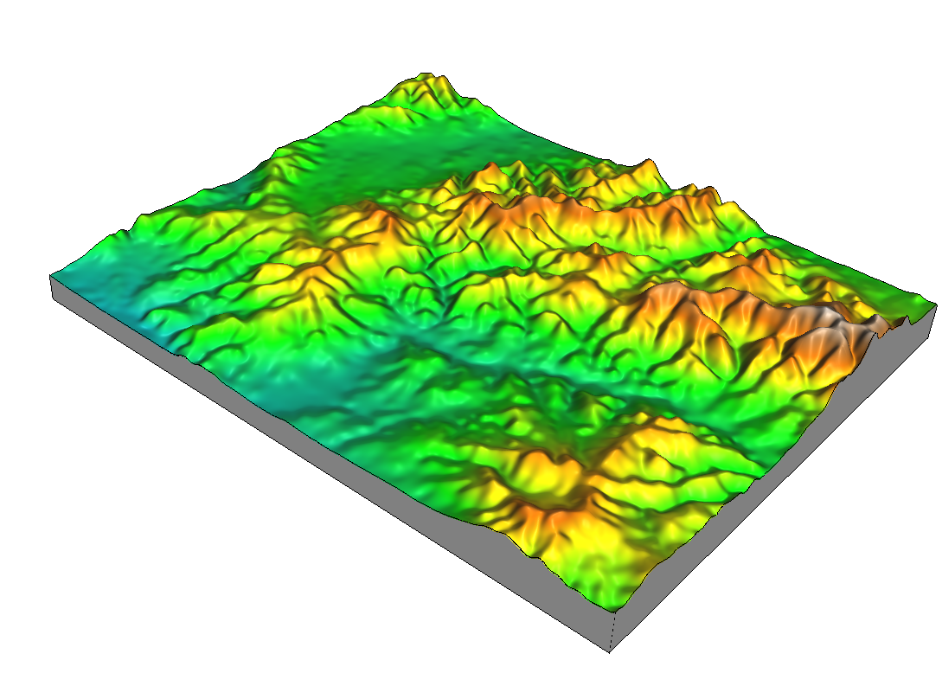
2+3 order

Slide 25
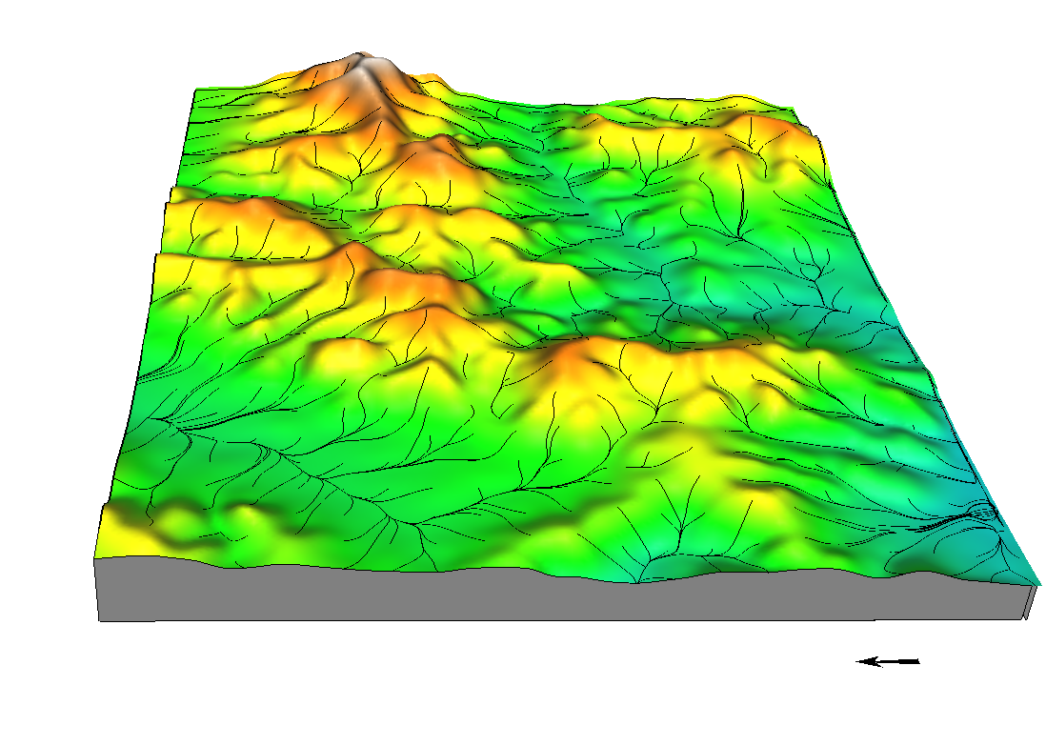
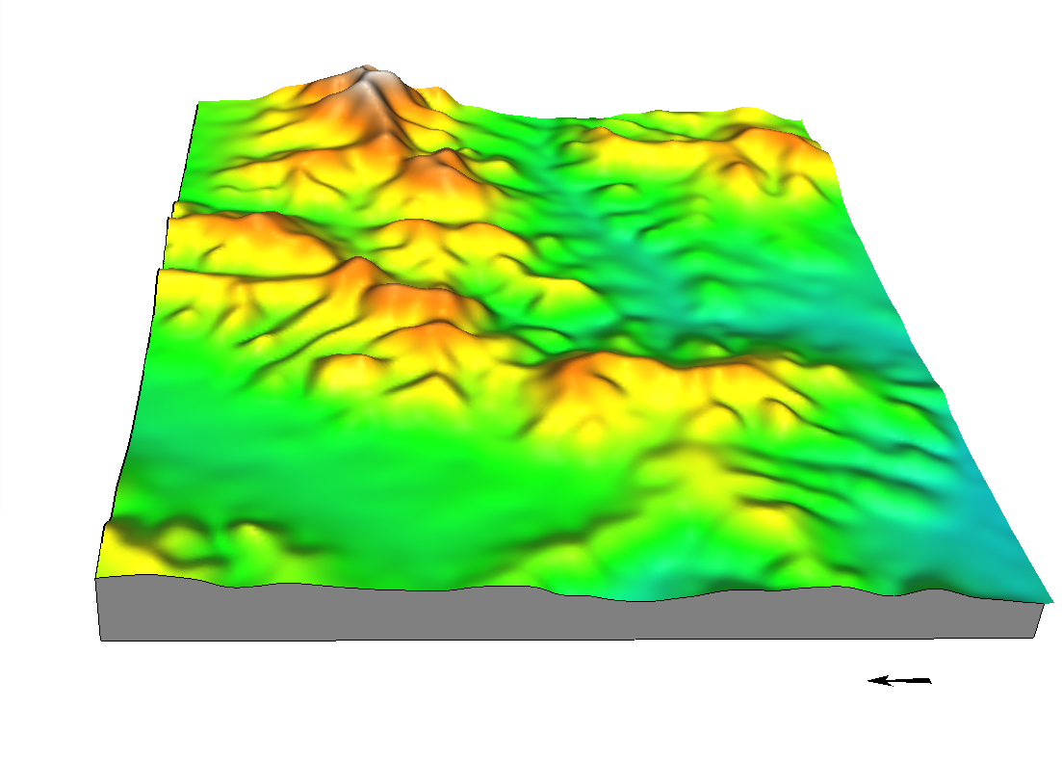
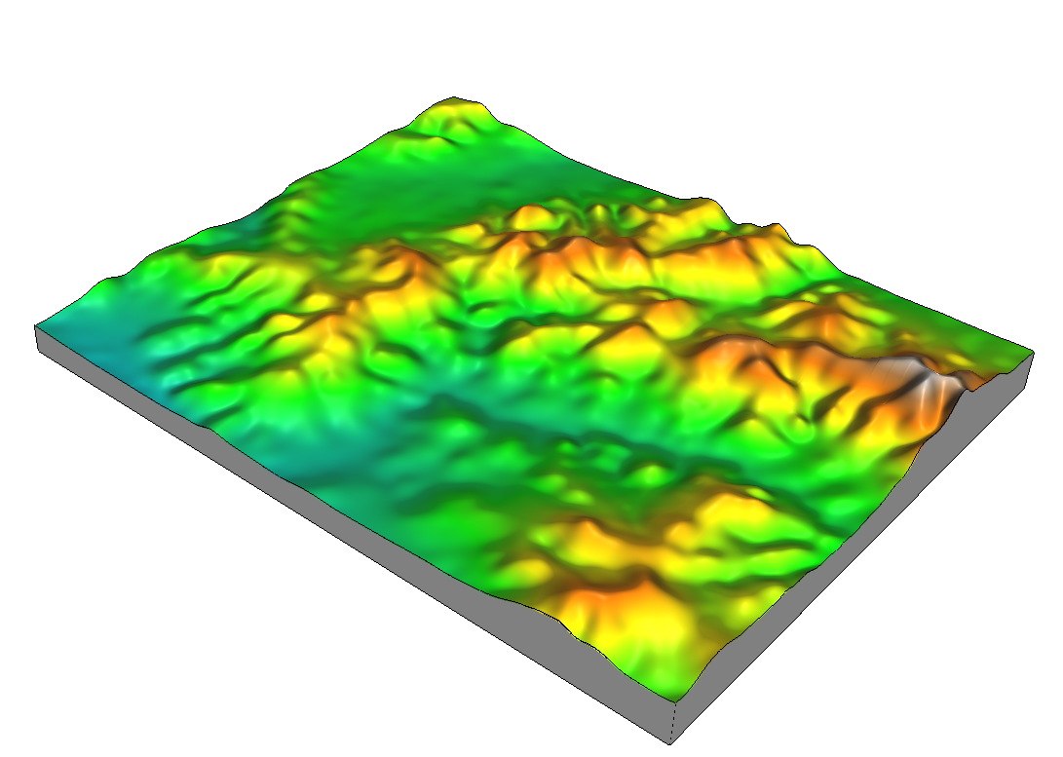
3+4 order

Slide 26
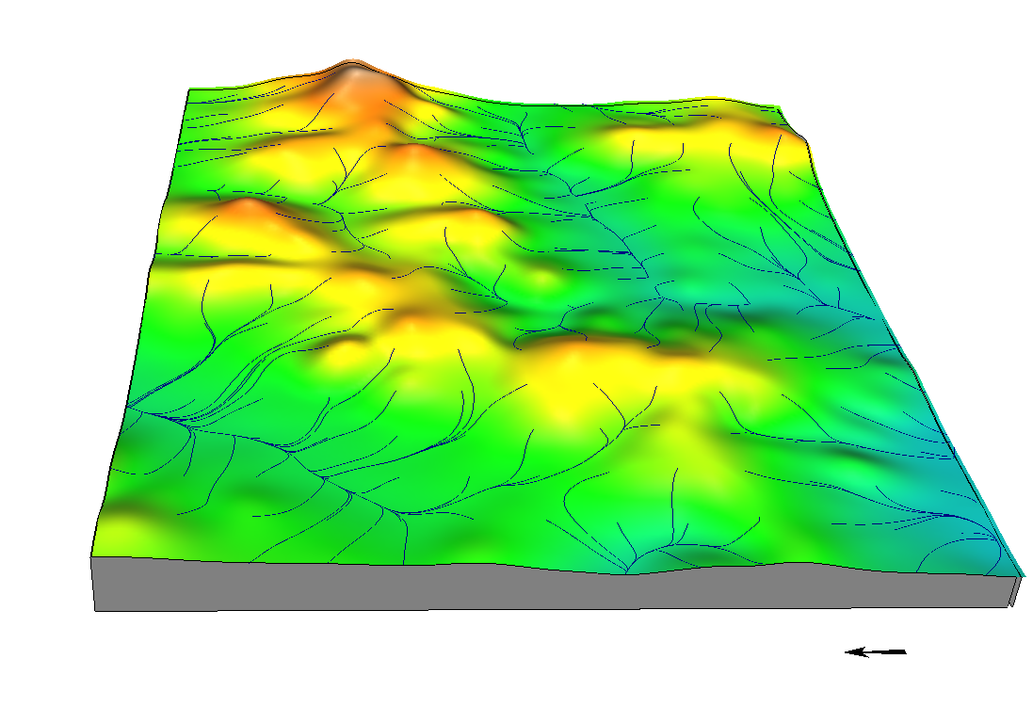
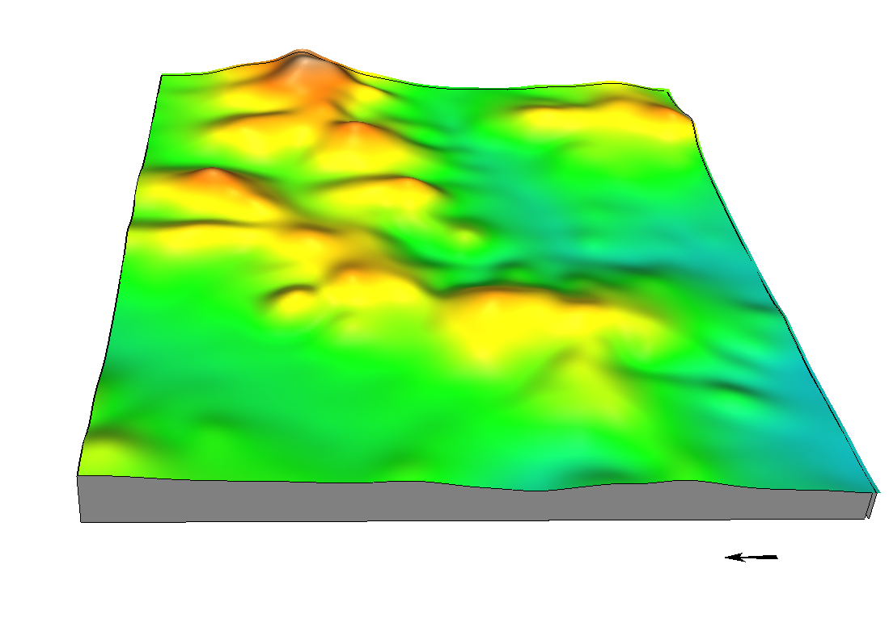
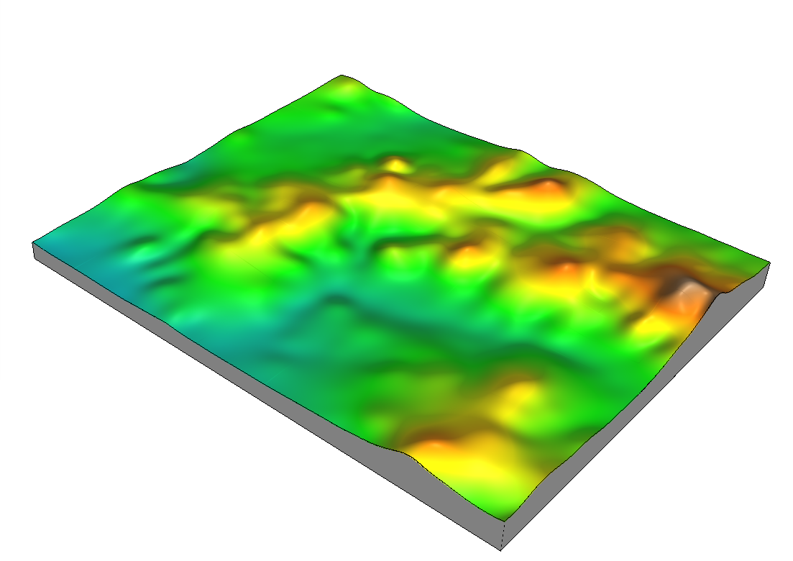
4+5 order

