Slide 1
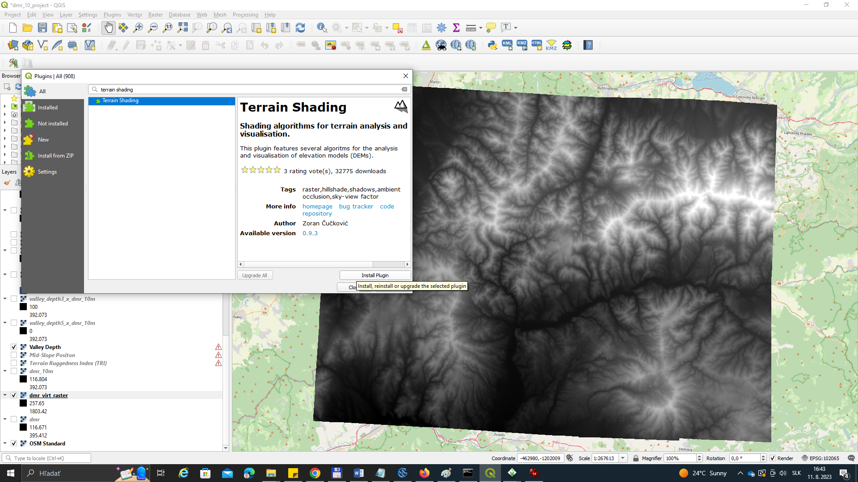

Slide 2
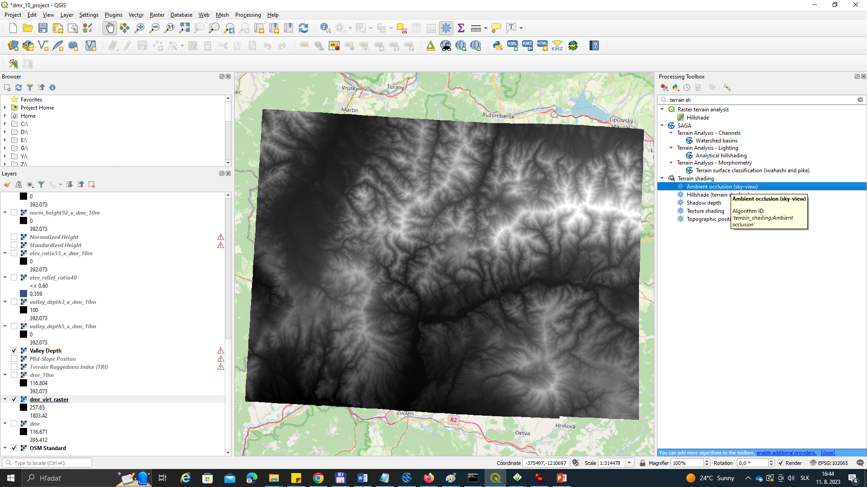

Slide 3
Skyview Dudince DMR 10x10 m

Slide 4
Skyview Dudince DMR 1x1 m

