Slide 1


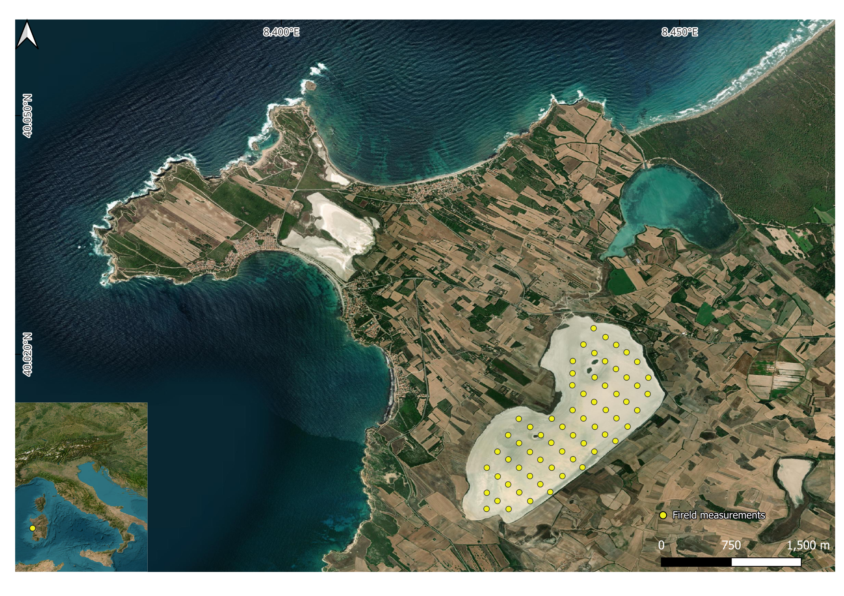
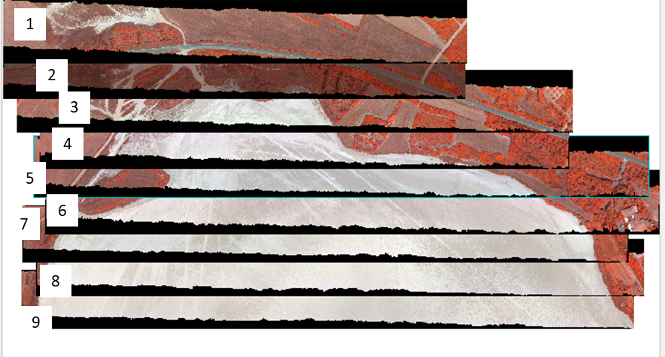
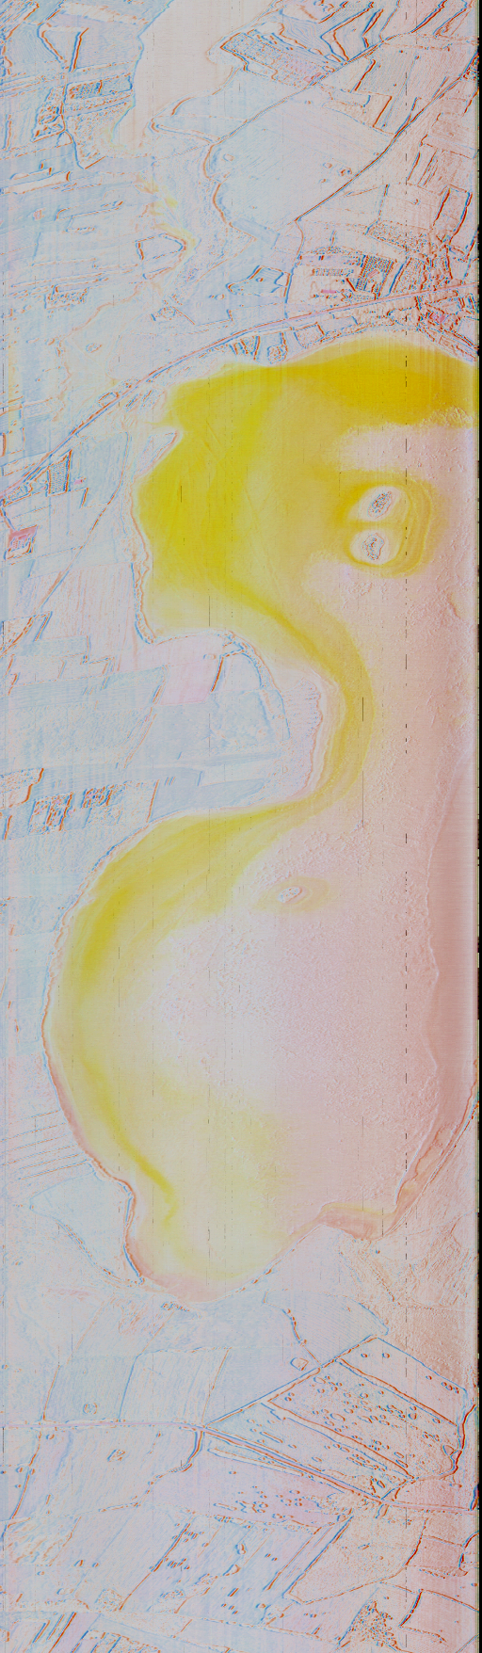
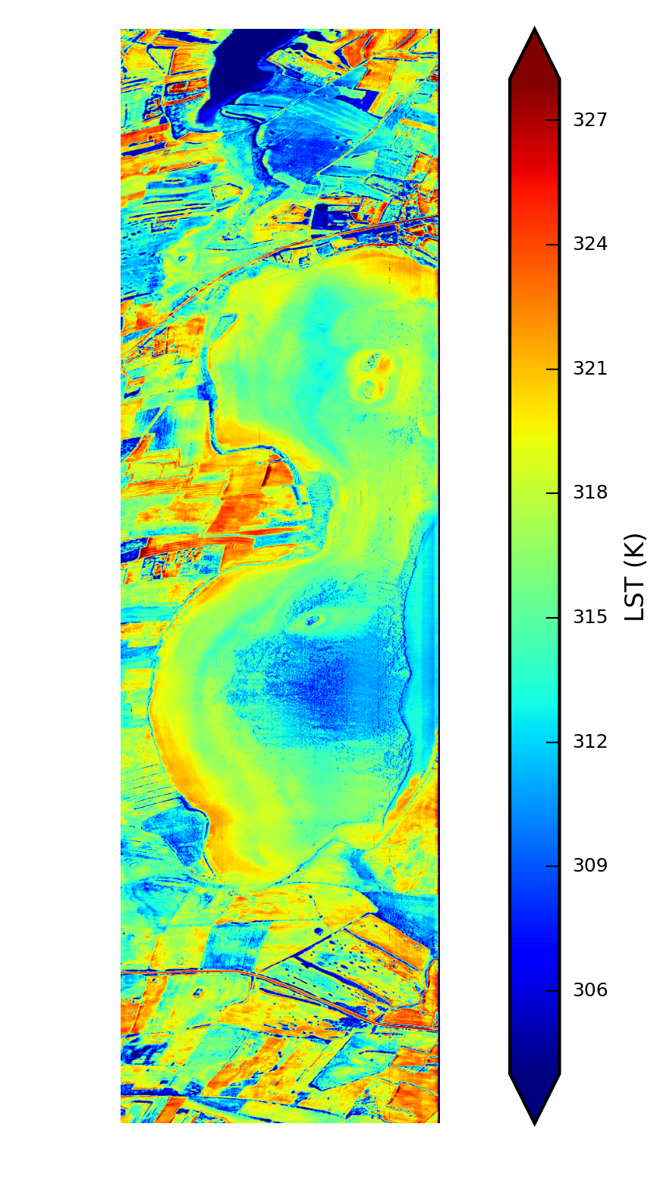
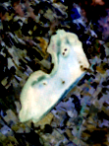
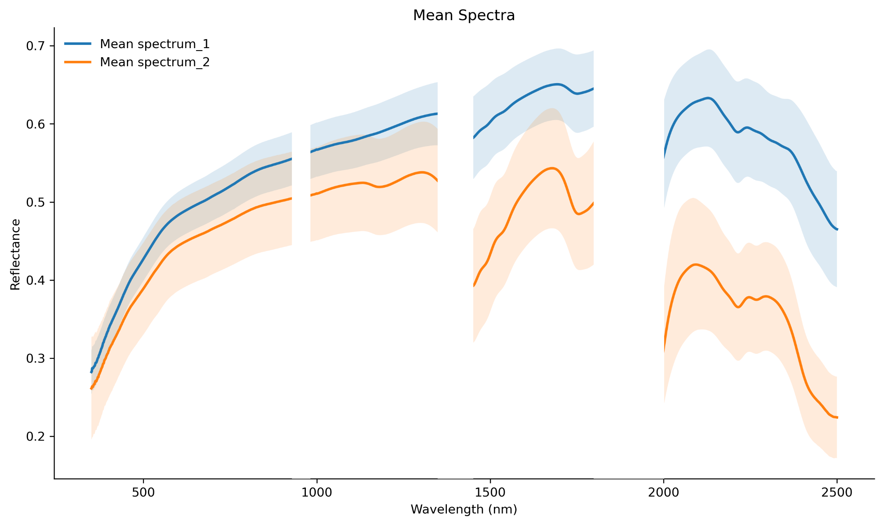
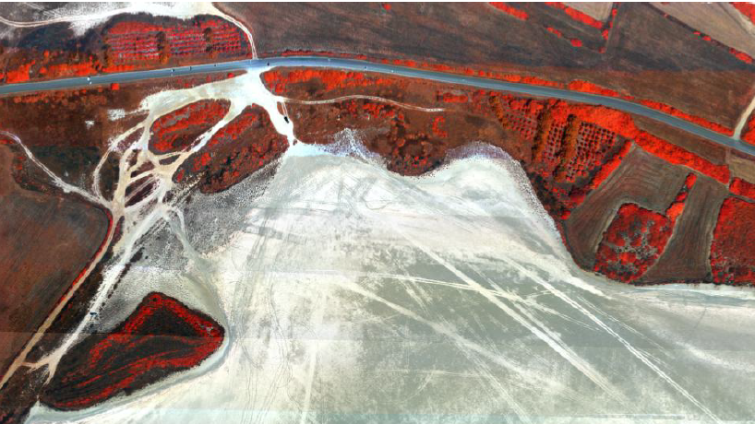
Facing Cal/Val and Surface Classification by Using Multi Instrument Approach
Massimo Musacchio ¹, Malvina Silvestri¹, Federico Rabuffi¹, Marco Casu³ Ilaria Nobile³ Maria Titi Melis³ Marco Solinas¹, Michal Gallay³, Ján Šašak³ , Katarína Onačillová³ , Petra Dávidová³
¹ Istituto Nazionale di Geofisica e Vulcanologia, Italy
² University of Cagliari, Italy
³ Institute of Geography, Pavol Jozef Šafárik University, Košice, Slovakia
Challenge
In the context of the global transition to a green economy and the growing demand for energy security, hyperspectral remote sensing assumes as a key technology for mineral and hydrocarbon exploration. To accomplish this, orbital hyperspectral imaging (HSI) systems require high radiometric and spectral accuracy, which depends on well-characterized ground calibration and validation (Cal/Val) sites. Such sites must exhibit spectral homogeneity and temporal stability to enable robust assessment of sensor performance across multiple spatial and spectral scales.
Approach
Multi-scale and multi-instrument approach integrating ground data and laboratory analysis of the Sal 'e Porcus pond (SPp) in Sardinia, Italy, evaluating its suitability as a CAL/VAL reference site for current and upcoming mission.
Main Characteristics
Largest dry pond in Sardinia - flat-bottomed interdunal depression collecting rainwater. Avg. depth: ~40 cm Max. depth: ~1 m. Hydrologically isolated basin - no tributaries or emissaries.
Seasonal Dynamics: intense evaporation in summer – dry pond - salt-covered surface
Geological and Hydrological Features: Basin bottom composed of greyish-white clay sediments (impermeable). Limited water infiltration enhances surface salt accumulation after evaporation
Relevance: Natural environment for studying evaporitic processes, seasonal salt deposition, surface composition variability, spectral response in saline environments.
Remote sensing data
Drone
Hyperspectral + LiDAR
Airborne
HyTES
Spaceborne
PRISMA
HyTES emissivity
R: 10.7 µm,
G: 9.2 µm,
B: 8.5 µm
HyTES LST
PRISMA - Reflectance
R: 2010.66 nm,
G: 1765.51 nm,
B: 1273.49 µm
Field and Laboratory spectroscopy
X-Ray Diffraction
Conclusion
By providing a well-documented natural target with known spectral and mineralogical properties, this work supports the calibration and validation of hyperspectral data products. The characterization of Sal 'e Porcus directly contributes to Cal/Val efforts for the PRISMA and follow-on mission (PRISMA-SG) and CHIME in the VSWIR domain, while also providing a reference framework for future thermal infrared missions. This ensure these systems achieve the calibration accuracy needed to resolve spectral features critical for surface mineral mapping

