Slide 1



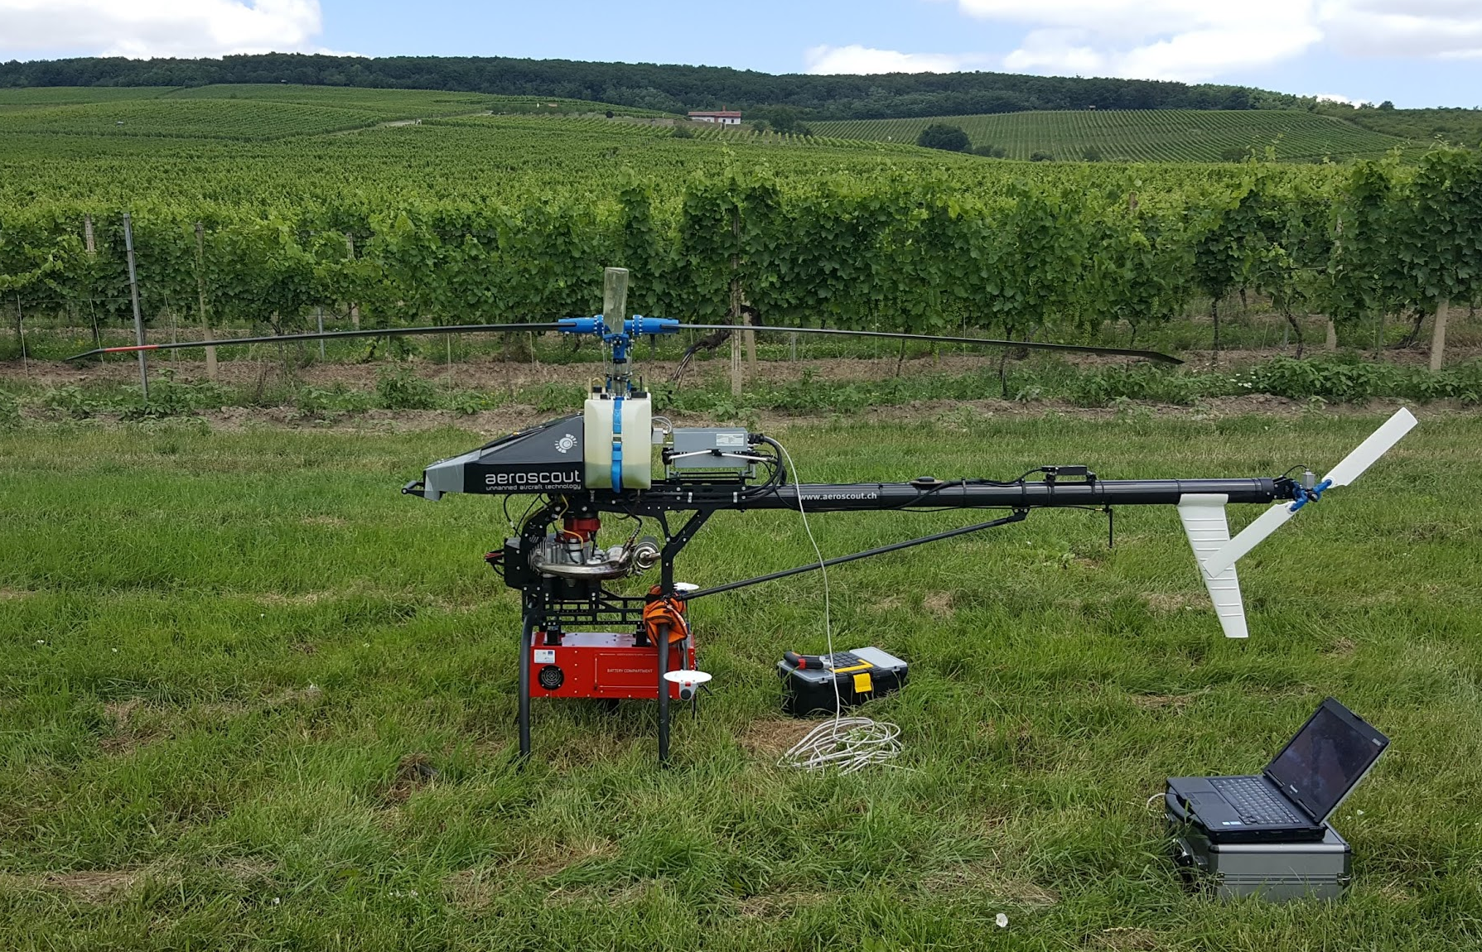
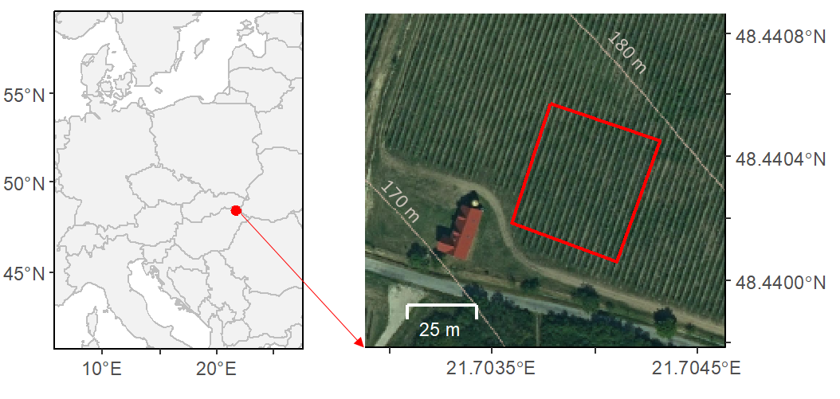




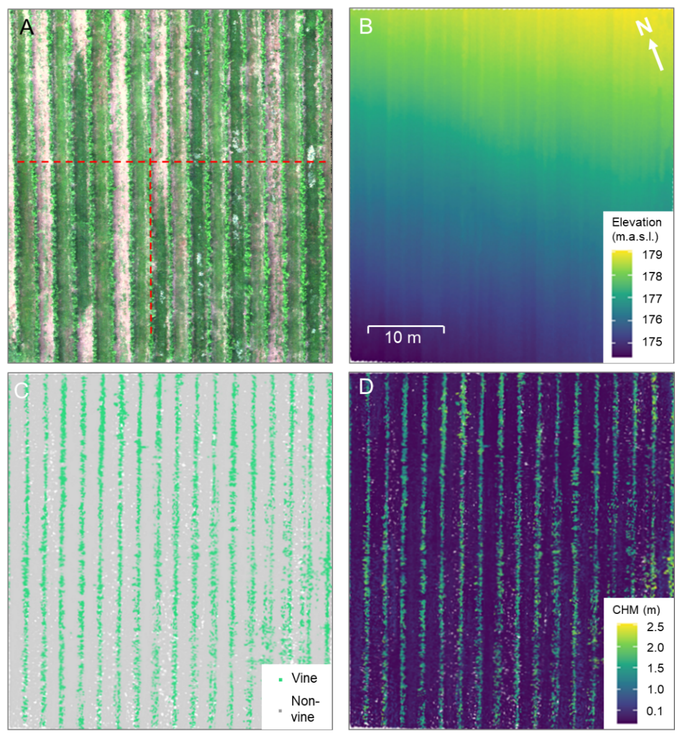
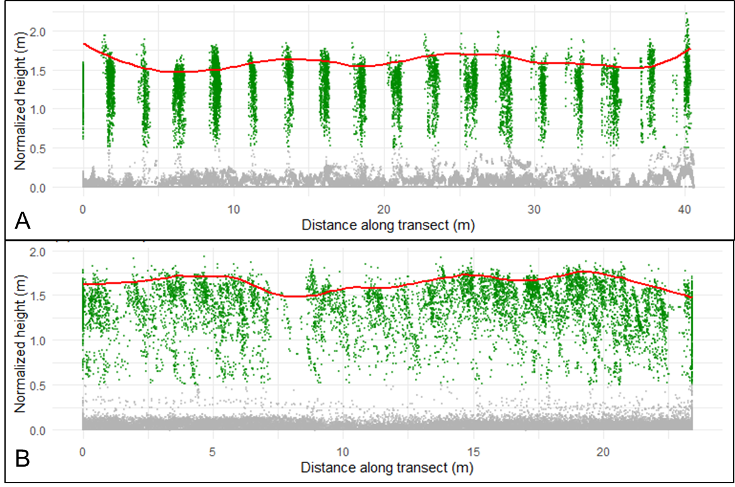
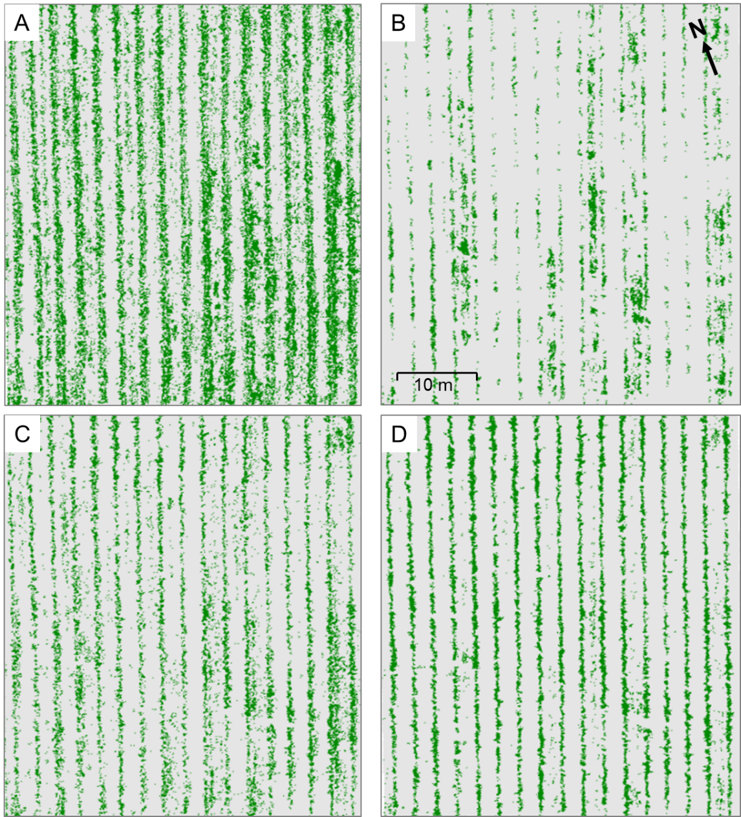
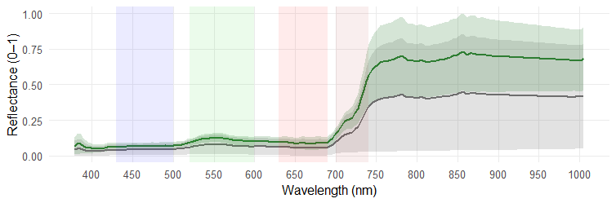
INTEGRATING UAV HYPERSPECTRAL IMAGERY AND LIDAR
FOR VINEYARD ROW DETECTION
Michal Gallay^{1*}, Vasyl Cherlinka¹, Ján Kaňuk², Ján Šašak¹, Katarína Onačillová¹, Liubov Cherlinka³
1 Institute of Geography, Pavol Jozef Šafárik University, Košice, Slovakia (michal.gallay@upjs.sk, vasyl.cherlinka@upjs.sk, jan.sasak@upjs.sk, katarina.onacillova@upjs.sk)
2 PHOTOMAP, s.r.o., Košice, Slovakia (jan.kanuk@photomap.sk)
3 NGO SSELMB Terra, Chernivtsi, Ukraine, cherlinka.liubov@chnu.edu.ua
Motivation
Precision viticulture relies on high-resolution, timely data to support vineyard management and improve grape quality. UAV-based remote sensing enables flexible monitoring, with hyperspectral imagery capturing biochemical traits and LiDAR providing detailed 3D canopy structure. While each technique has limitations, their integration combines spectral and structural strengths, improving vine detection and reducing background interference.
This approach is especially relevant in the Tokaj wine region, where complex terrain and microclimatic variation affect vine vigour. Despite Tokaj’s significance, vineyard remote-sensing research in its Slovak part remains scarce and lacks hyperspectral–LiDAR applications. This study addresses that gap by demonstrating how multimodal UAV data can enhance precision viticulture and contribute to the sustainable management of this culturally valuable landscape.
Research area
Methods and data
The experimental site is situated in the Slovak part of the Tokaj wine-growing region, located in the southeastern part of Slovakia on the border with Hungary. The area of interest lies between the villages of Malá Tŕňa and Bara (48.4403° N, 21.7038° E) on a south-facing slope. The geo-logical bedrock consists mainly of Permian to Carboniferous conglomerates, sandstones, and shales, which form the substrate of the local soils. The soils are predominantly Cambisols, characterized by shallow profiles with high skeletal content. The texture corresponds to medium-heavy soils with a tendency toward lighter fractions.
UAV-based hyperspectral and LiDAR data were acquired over a vineyard using the Scout B1-100 helicopter platform. Two tightly co-registered payloads were deployed: a RIEGL VUX-1 laser scanner for 3D structure and an AISA KESTREL 10 hyperspectral camera (400–1000 nm) for canopy reflectance. LiDAR was flown at 30 m AGL (5 m/s), providing point densities >600 pts/m²; hyperspectral data were collected at 100 m AGL (5 m/s) with ~0.1 m GSD. An atmospheric correction was applied in ENVI 5.3 using the FLAASH module to transform radiance into surface reflectance.
LiDAR point clouds were georeferenced, filtered, and classified into ground and vegetation to derive a digital terrain model and a normalized canopy height model (CHM, 10 cm resolution). Hyperspectral data were radiometrically and geometrically corrected, atmospherically corrected to surface reflectance, and resampled to 10 cm.
Four input feature sets were prepared: (i) PCA-reduced hyperspectral cube, (ii) PCA-reduced hyperspectral + CHM, (iii) PCA-reduced simulated RGB composite, and (iv) PCA-reduced RGB + CHM. In each case, the first three principal components (>99% variance) and, where applicable, CHM were used as predictors in a supervised maximum likelihood classification with two classes: vine rows and non-vine areas.
Accuracy was assessed using 1,000 independent reference points interpreted from hyperspectral RGB orthophotos and validated by field observations.
Location of the study area in the Slovak Tokaj region (left) and orthophoto of the vineyard site as marked by red rectangle.
Transect profiles across (A) and along (B) vineyard rows show LiDAR point heights above ground, with grey points for non-vine returns and green points for vine returns. The red line marks the smoothed 99th-percentile vine height, approximating the upper canopy envelope.
Results
Conclusion
Tab. 1. Variance explained by the first three principal components for each dataset.
This study demonstrates the potential of integrating UAV-based LiDAR and hyperspectral data for vineyard mapping in the Slovak part of the Tokaj Region. While hyperspectral imagery alone was prone to confusion between vine canopies, soil, and inter-row vegetation, incorporating LiDAR-derived canopy height models (CHM) significantly improved classification accuracy, reaching 96% with a Kappa of 0.85. Even natural colour composites combined with CHM achieved satisfactory results, emphasizing the practical value of structural information when hyperspectral data are unavailable. Accurate delineation of vine rows forms a key basis for precision viticulture, supporting tasks such as vigour monitoring, yield estimation, and site-specific canopy management. The integration of hyperspectral and LiDAR data thus provides vineyard managers with reliable, high-resolution maps for decision-making, while offering a scalable framework for broader viticultural applications. Future research should expand toward multi-temporal monitoring, incorporate additional variables such as vigour or disease status, and employ advanced machine-learning methods to enhance robustness and operational use in the sustainable management of the Tokaj wine landscape.
Dataset | PC1 (%) | PC2 (%) | PC3 (%) | Cumulative variance (%)
(D) HS + CHM (185 bands) | 96.35 | 3.2 | 0.10 | 99.47
(C) HS only (184 bands) | 95.82 | 3.45 | 0.11 | 99.38
(B) RGB (3 bands) | 93.11 | 5.72 | 1.18 | 100.00
(A) RGB + CHM (4 bands) | 96.48 | 3.31 | 0.21 | 100.00
Tab. 2. Summary of accuracy assessment for vineyard classification using PCA and the maximum likelihood classifier with different input datasets.
Input dataset | OA (%) | Kappa | PA Vine (%) | PA Non-vine (%) | UA Vine (%) | UA Non-vine (%) | F1-score | BA (%)
(D) HS + CHM | 96.0 | 0.85 | 81.6 | 99.0 | 94.7 | 96.2 | 0.88 | 90.3
(C) RGB + CHM | 93.0 | 0.75 | 71.3 | 97.9 | 87.9 | 94.2 | 0.79 | 84.6
(B) HS | 89.0 | 0.55 | 48.9 | 97.6 | 81.0 | 90.1 | 0.61 | 73.2
(A) RGB | 89.0 | 0.60 | 58.6 | 95.9 | 75.0 | 91.7 | 0.66 | 77.3
Acknowledgement
This research was financially supported by the European Union’s NextGenerationEU initiative through the Recovery and Resilience Plan for Slovakia (Project No. 09I03-03-V01-00049) and from the CLIMANEMU project (No. 09I04-03-V02-00002) supported by the Recovery and Resilience Plan for Slovakia co-funded by the European Union and the Slovak Republic. Additional support was received from the VEGA project No. 1/0780/24 and KEGA project No. 023UPJŠ-4/2025, funded by the Ministry of Education, Science, Research, and Youth of the Slovak Republic. We sincerely thank Mr. Jaroslav Ostrožovič, Head of the Ostrožovič s.r.o. company, for granting access to their vineyard and allowing the field mapping.
Results of binary maximum likelihood classification of vineyard structure: (A) simulated natural-colour composite (3-band RGB) image, (B) complete hyperspectral (HS) image, (C) simulated natural-colour composite combined with the canopy height model (CHM), and (D) complete HS image combined with CHM.
Blue
Green
Red
Red Edge
Near Infra Red
References
Vine row -area
[1] BIEHL, L., LANDGREBE, D. 2025: MultiSpec [Computer software]. Purdue University, West Lafayette.
[2] KALISPERAKIS, I., STENTOUMIS, C., GRAMMATIKOPOULOS, L., KARANTZALOS, K. 2015: Leaf area index estimation in vineyards from UAV hyperspectral data, 2D im-age mosaics and 3D canopy surface models. The International Archives of the Photo-grammetry, Remote Sensing and Spatial Information Sciences, 40, 299-303.
[3] MATESE, A., TOSCANO, P., DI GENNARO, S.F., GENESIO, L., VACCARI, F.P., PRIMICERIO, J., BELLI, C., ZALDEI, A., BIANCONI, R., GIOLI, B. 2015: Intercom-parison of UAV, aircraft and satellite remote sensing platforms for precision viticulture. Remote Sensing, 7(3), 2971–2990.
[4] PÁDUA, L., MATESE, A., DI GENNARO, S. F., MORAIS, R., PERES, E., & SOUSA, J. J. 2022: Vineyard classification using OBIA on UAV-based RGB and multispectral data: A case study in different wine regions. Computers and Electronics in Agriculture, 196, 106905.
[5] SOFIA, S., AGOSTA, M., ASCIUTO, A., CRESCIMANNO, M., GALATI, A. 2025: Unleashing profitability of vineyards through the adoption of unmanned aerial vehicles technology systems: The case of two Italian wineries. Precision Agriculture, 26(41), 2–28.
[6] TOSIN, R. 2020: Estimation of grapevine predawn leaf water potential based on hyperspec-tral reflectance data in Douro wine region. Vitis, 59, 9–18.
Inter-row area
Mean spectral reflectance curves (solid lines) of vine canopies (green) and inter-row areas (dark grey), derived from the classification results shown in Figure 5D, with ribbons indicating ±1 standard deviation. Coloured regions denote key spectral intervals: Blue (430–500 nm), Green (520–600 nm), Red (630–690 nm), Red edge (700–740 nm), and Near-infrared (760–1000 nm). Spectral separation between vine and inter-row areas is most pronounced in the red-edge and NIR domains, which are widely used for vegetation monitoring.
ENMAP 14.07.2023
0
500 m
PRISMA 15.07.2023
0
500 m

