Slide 1






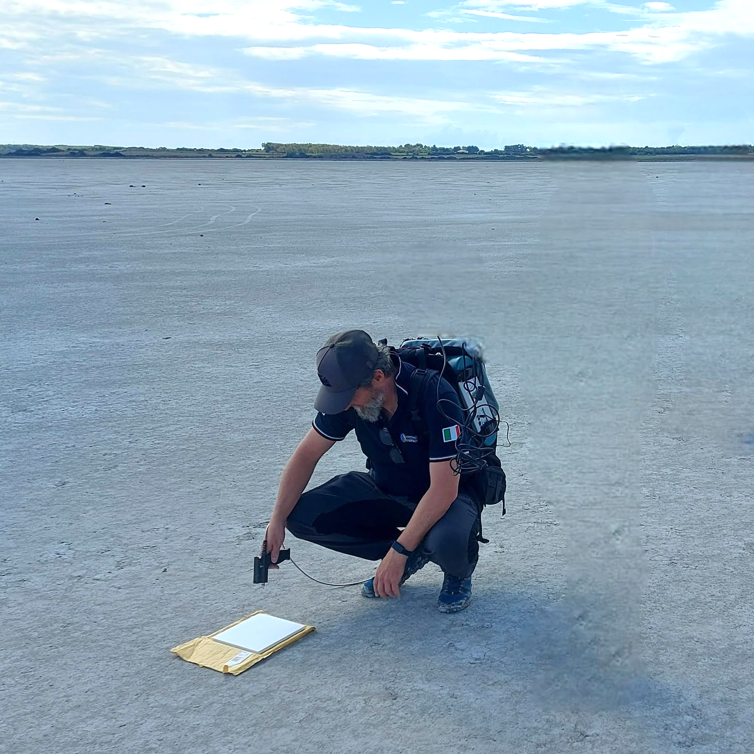
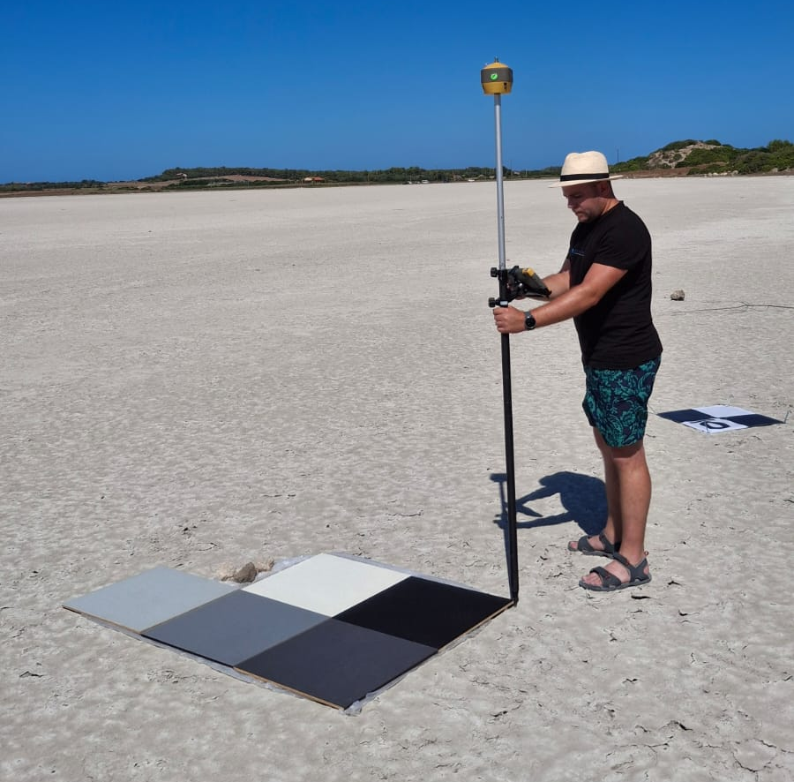
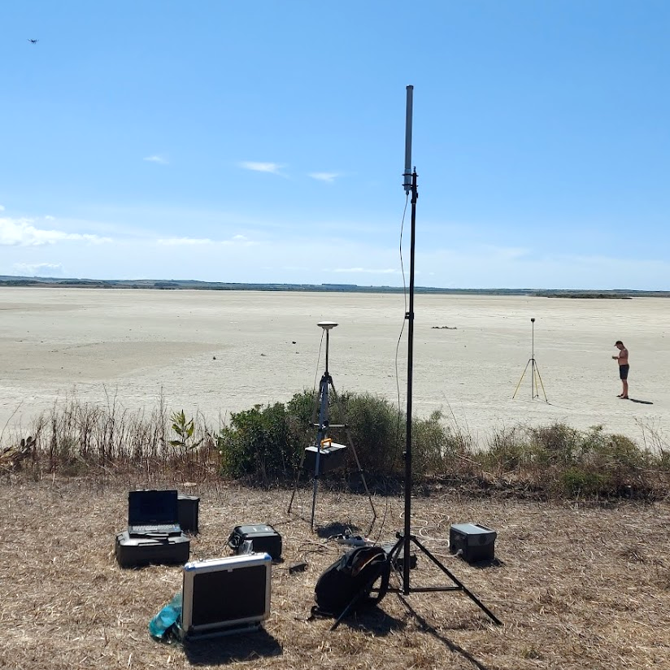
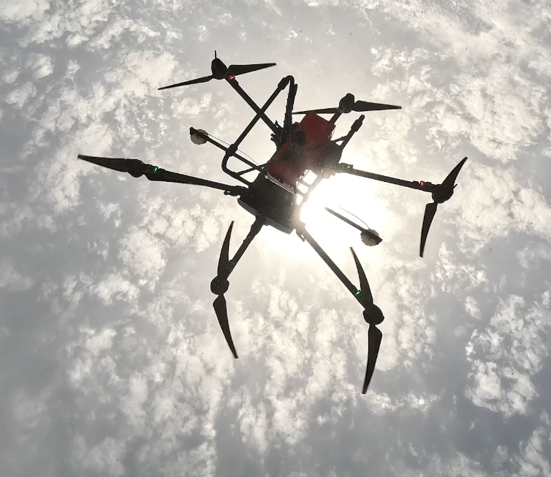

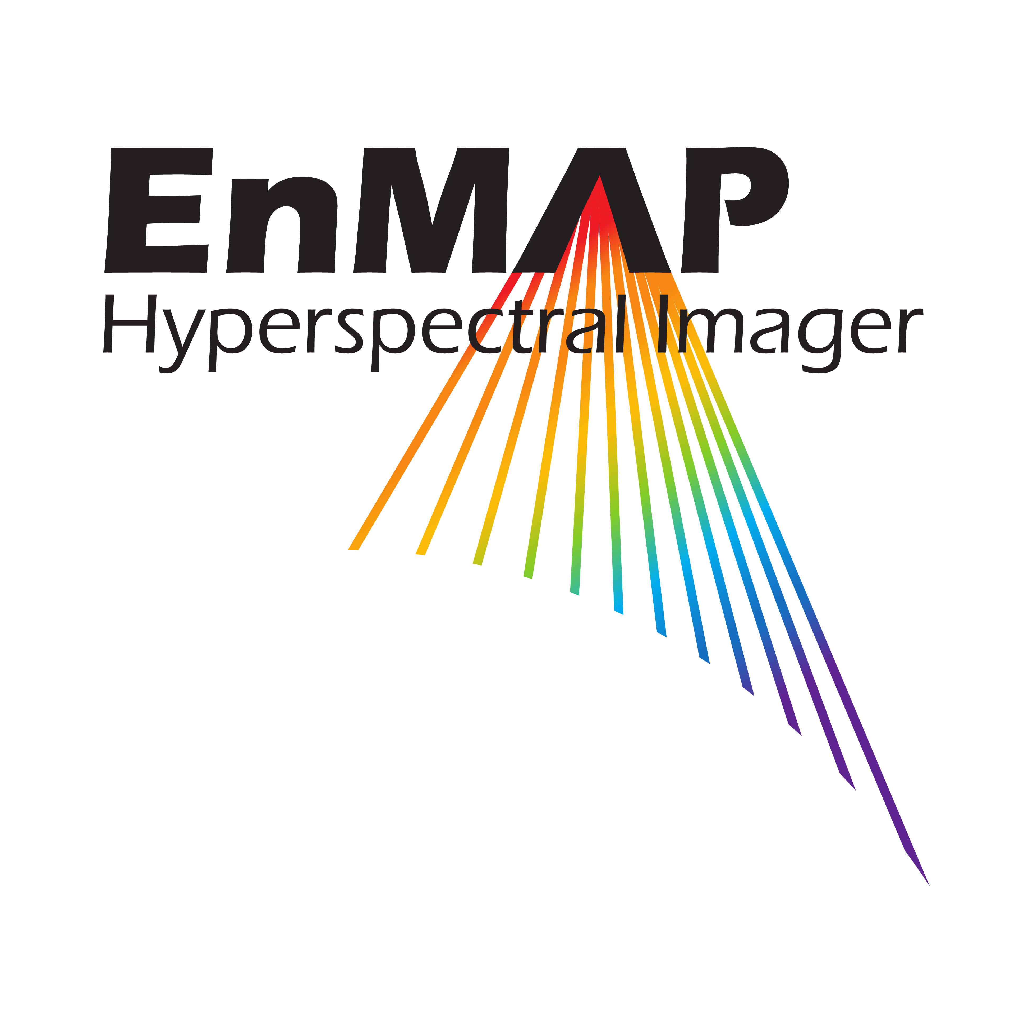

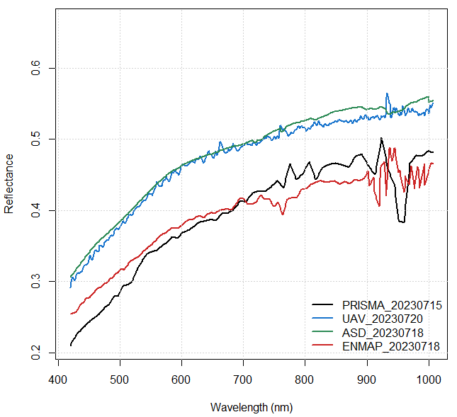
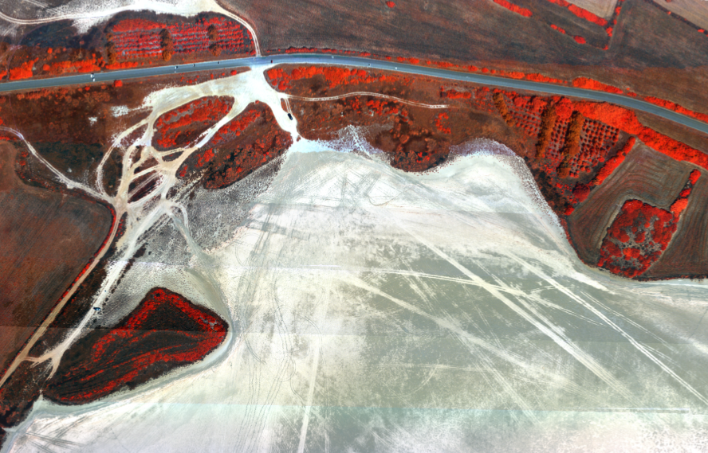
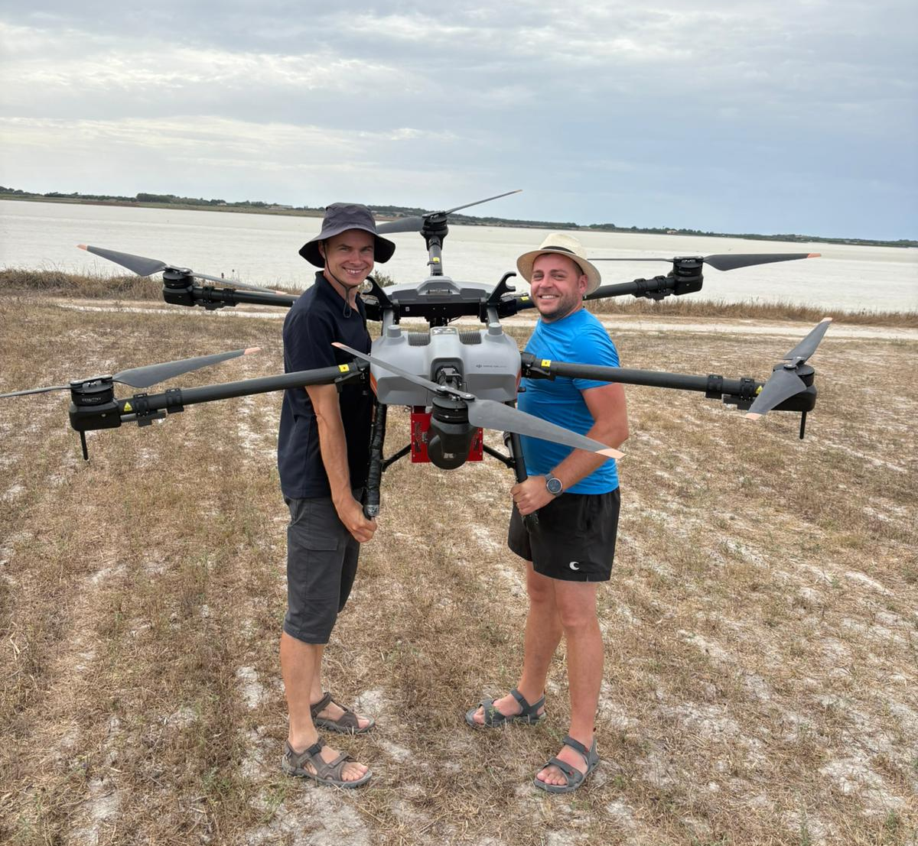
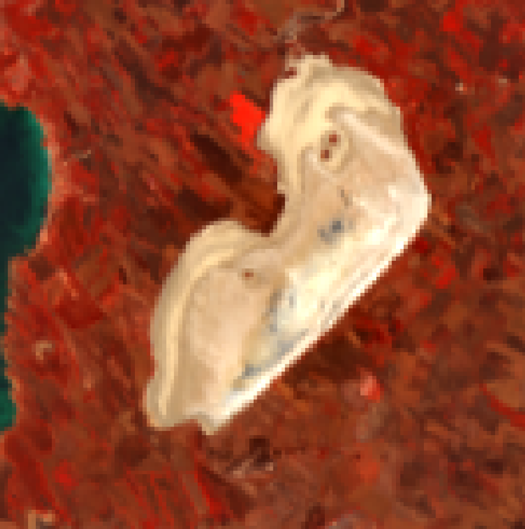
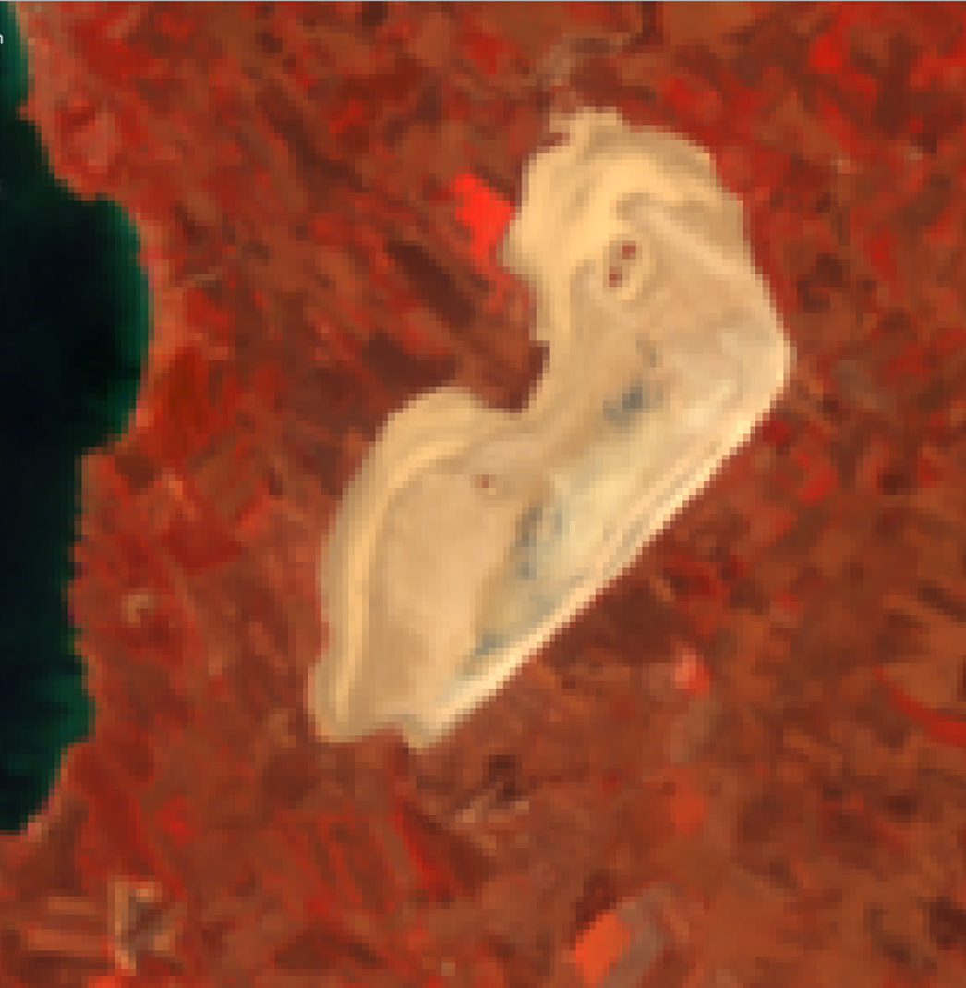
LINKING UAV AND SPACEBORNE IMAGING SPECTROSCOPY FOR MULTI-SCALE CALIBRATION AND VALIDATION OF A MEDITERRANEAN SALINE SURFACE
Michal Gallay^{1*}, Ján Kaňuk², Ján Šašak¹, Katarína Onačillová¹, Petra Dávidová¹, Maria Teresa Melis³, Massimo Musacchio⁴, Marco Casu⁵, Ilaria Nobile³, Claudia Collu^{3,5}, Constantino Nieddu³
¹ Pavol Jozef Šafárik University in Košice, Faculty of Science, Institute of Geography, Slovakia ( michal.gallay@upjs.sk, jan.sasak@upjs.sk, katarina.onacillova@upjs.sk, petra.davidova@student.upjs.sk )
² PHOTOMAP, s.r.o., Košice, Slovakia ( jan.kanuk@photomap.sk )
³ University of Cagliari, Department of Chemical and Geological Sciences, Italy ( mariateresa.melis@unica.it, costantino.nieddu@unica.it, ilaria.nobile@unica.it )
⁴ Istituto Nazionale di Geofisica e Vulcanologia (INGV), Rome, Italy ( massimo.musacchio@ingv.it )
⁵ Sapienza University of Rome, Department of Civil, Constructional and Environmental Engineering, Rome, Italy (marco.casu@unica.it )
*corresponding author e-mail: michal.gallay@upjs.sk
Motivation
New hyperspectral satellite missions such as ASI-PRISMA and DLR-EnMAP, together with the forthcoming ESA-CHIME mission and emerging commercial hyperspectral systems including Planet-Tanager, Airbus’ planned hyperspectral constellation, and Maxar’s commercial hyperspectral imaging program under development, are rapidly expanding access to detailed spectral observations. Ensuring cross-sensor consistency and interoperability across these platforms requires robust calibration and validation (CAL/VAL) approaches grounded in traceable multi-scale measurements. UAV-based hyperspectral imaging provides an effective intermediate link between ground spectrometry and orbital observations, offering high spatial detail and flexible acquisition conditions for controlled reflectance comparison. The goal of this study is to assess the suitability of Sal ’e Porcus as a CAL/VAL reference site by evaluating whether UAV-based hyperspectral data, calibrated with in-situ spectrometry, can provide reliable reflectance measurements for cross-sensor comparison with ASI-PRISMA and DLR-EnMAP.
Research area
Methods and data
The Sal’e Porcus pond (~3.2 km²), located on the Sinis Peninsula in western Sardinia near San Vero Milis and Riola Sardo, is the island’s largest temporary pond. It occupies a flat interdunal depression where rainwater accumulates, reaching up to 1 m in depth. Lacking both tributaries and outlets, it forms an independent hydrological basin. During summer, intense evaporation dries the pond completely, leaving a broad salt crust. The impermeable greyish-white clay sediments at the bottom prevent infiltration, promoting seasonal salt deposition on the surface.
We collected ground spectra with an ASD FieldSpec 3 Pro and measured radiometric targets, enabling empirical-line calibration of the UAV hyperspectral data to surface reflectance.
PLATFORM | SENSOR | SPECTRAL RANGE | NUMBER OF SPECTRAL BANDS | SPECTRAL RESOLUTION | SPATIAL RESOLUTION
Ground | ASD FieldSpec | ~350–2500 nm | Continuous (1–3 nm sampling) | N/A | Point measurement
UAV | AISA Kestrel 10 | 400–1000 nm | ~324 bands | ~10 nm | ~10 cm GSD
Satellite | ASI — PRISMA | 400–2500 nm (VNIR+SWIR) | ~240 bands (66 VNIR + 174 SWIR) | ~12–16 nm | ~30 m
Satellite | DLR — EnMAP | 420–2450 nm (VNIR+SWIR) | 224 bands (102 VNIR + 122 SWIR) | ~6.5 nm (VNIR), ~10 nm (SWIR) | ~30 m
Geographical location of the SPp and the distribution of the sampled points within the area corresponding to the analyzed pixels belonging to the ASI-PRISMA and DLR-EnMAP.
A customized DJI AGRAS T30 equipped with a Specim AISA Kestrel 10 acquired VNIR hyperspectral imagery. Reflectance of five radiometric targets was measured before the flight using an ASD handheld spectrometer, and all elements were georeferenced with RTK GNSS.
Results
Conclusion
Linear regression between spectral bands 400-1000 nm (interpolated per 1 nm)
pair |  |  | N of interpolated spec. bands | PEARS. COR | REGRES. SLOPE | R² |  | RMSE | MAE | SD_RES
PRISMA | vs | UAV | 589 | 0.970 | 0.863 | 0.942 |  | 0.016 | 0.011 | 0.016
PRISMA | vs | ASD | 589 | 0.981 | 0.877 | 0.962 |  | 0.013 | 0.008 | 0.013
PRISMA | vs | EnMAP | 589 | 0.961 | 0.714 | 0.924 |  | 0.015 | 0.010 | 0.015
UAV | vs | ASD | 589 | 0.995 | 1.001 | 0.990 |  | 0.007 | 0.005 | 0.007
UAV | vs | EnMAP | 589 | 0.986 | 0.824 | 0.972 |  | 0.009 | 0.006 | 0.009
ASD | vs | EnMAP | 589 | 0.984 | 0.817 | 0.969 |  | 0.010 | 0.006 | 0.010
Spectral comparisons across ASD, UAV, PRISMA, and EnMAP show consistently high agreement over the 400–1000 nm range. UAV and ASD spectra match most closely (Pearson r = 0.995, slope = 1.001, R² = 0.990), indicating that the UAV empirical line calibration preserves in-situ reflectance characteristics. PRISMA exhibits strong correlation with both UAV (r = 0.970, R² = 0.942, slope = 0.863) and ASD (r = 0.981, R² = 0.962, slope = 0.877), while EnMAP also shows high agreement with UAV (r = 0.986, R² = 0.972, slope = 0.824) and ASD (r = 0.984, R² = 0.969, slope = 0.817). Residuals are low and unbiased across all comparisons (RMSE < 0.016 reflectance),confirming internally consistent reflectance scaling among sensors.
a
b
• UAV spectra match ASD closely
→ calibration robust
• PRISMA/EnMAP show high cross-
sensor consistency with UAV/ASD
• Residuals low and unbiased
(RMSE < 0.016)
• Sal’e Porcus is supported as
a candidate CAL/VAL reference site
• UAV imaging is a practical bridge
between ground and satellite data
X
c
d
Acknowledgement
X
This research originated thanks to the COOL project supported by the Italian Space Agency (ASI); additional support came from the VEGA project No. 1/0780/24 and the KEGA project No. 023UPJŠ-4/2025, both funded by the Ministry of Education, Science, Research, and Youth of the Slovak Republic, and from the CLIMANEMU project (No. 09I04-03-V02-00002) supported by the Recovery and Resilience Plan for Slovakia co-funded by the European Union and the Slovak Republic.
References
[1] MUSACCHIO, M., SILVESTRI, M., ROMANIELLO, V., CASU, M., BUONGIORNO, M. F., MELIS, M. T., 2024: Comparison of ASI-PRISMA Data, DLR-EnMAP Data, and Field Spectrometer Measurements on “Sale ‘e Porcus”, a Salty Pond (Sardinia, Italy). Remote Sensing, 16(6), 1092.
[2] NIYOGI, D., JAMSHIDI, S., SMITH, D., KELLNER, O., 2020: Evapotranspiration Climatology of Indiana, USA Using In-Situ and Remotely Sensed Products. Journal of Applied Meteorology and Climatology, 59, 2093–2111.
[3] COGLIATI, S., SARTI, F., CHIARANTINI, L., COSI, M., LORUSSO, R., LOPINTO, E., MIGLIETTA, F., GENESIO, L., GUANTER, L., DAMM, A., et al., 2021: The PRISMA imaging spectroscopy mission: Overview and first performance analysis. Remote Sensing of Environment, 262, 112499.
[4] HELLER PEARLSHTIEN, D., PIGNATTI, S., GREISMAN-RAN, U., BEN-DOR, E., 2021: PRISMA sensor evaluation: A case study of mineral mapping performance over Makhtesh Ramon, Israel. International Journal of Remote Sensing, 42, 5882–5914.
ENMAP 14.07.2023
0
500 m
PRISMA 15.07.2023
0
500 m
Reflectance spectra (a) extracted at point 2 marked X, shown together with the corresponding pixel locations in (b) UAV, (c) EnMAP, and (d) PRISMA hyperspectral datasets.

