Slide 1
UNIVERSITY COURSE EARTH OBSERVATION APPLICATIONS
EXERCISE 8 – TUTORIAL
Sentinel-1 & Sentinel-2 for Snow and Ice using the SNAP software
FUNDED BY SLOVAK REPUBLIC UNDER THE PECS (PLAN FOR EUROPEAN COOPERATING STATES)

Slide 2
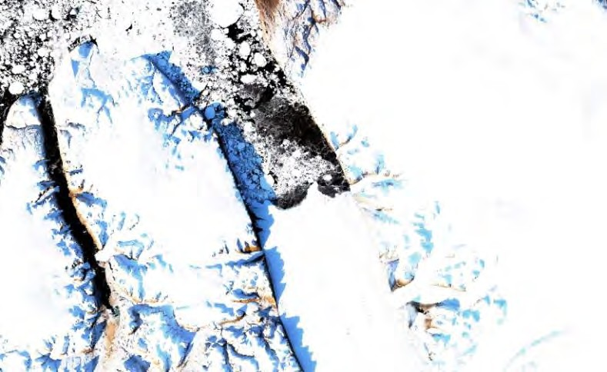
1 Introduction
Greenland ice sheet is the second largest ice mass on Earth. As climate changes, the ice sheet surface melt is increasing and more and more fresh-water flows to the ocean, contributing to the global sea-level rise.
Glacier velocity is a vital part of glacier monitoring and understanding the glacier
system dynamics as well as its contribution to the global sea level. Satellite data is a perfect tool for monitoring glacier velocity over large areas. Two methods are commonly used
Sentinel-2 image of Petermann Glacier tongue on 10 Sept. 2017 (Credits: contains modified Copernicus Sentinel data)
to derive the speed of the ice flow from the satellite data: 1) SAR interferometry; 2) feature/speckle tracking (optical/SAR data) between consecutive acquisitions. In this tutorial we will use the second method applied to Sentinel-1 data.
The Petermann Glacier is a large tidewater glacier draining more than 4% of the Greenland ice sheet through the 90 km long Petermann Fjord and terminating in a floating ice tongue, which currently covers an area of 900 km². Estimated 12 billion tonnes of ice are drained to the ocean annually with estimated ice flow speed of 1 km/year.
Training
Approximate duration of this training session is one hour.
Data used
Two Sentinel-1A IW GRDH images with HH & HV polarization acquired on 26 September 2017 and 8 October 2023 [downloadable @https://dataspace.copernicus.eu/] S1A_IW_GRDH_1SDH_20230926T113616_20230926T113641_050498_061508_2030.zip S1A_IW_GRDH_1SDH_20231008T113616_20231008T113641_050673_061B09_3507.zip
Software
Internet browser, SNAP + Sentinel-1 Toolbox, (Extra steps: QGIS)

Slide 3
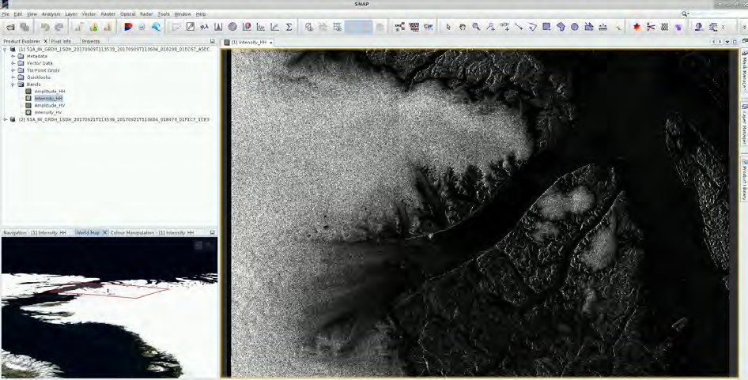
3 SNAP – open and explore data
Open SNAP Desktop (icon located on the desktop); click Open Product and open both downloaded products
The opened products will appear in Product Explorer window. Click + to expand the contents of product [1] from 9 September 2017, then expand Bands folder and double click on Intensity_HH band to visualize it.

Slide 4
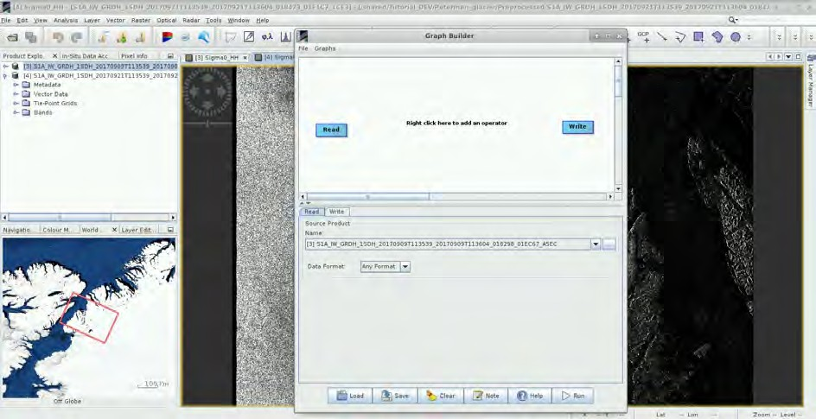
We can see that the view appears as if “mirrored”: this is because the scene was acquired during descending pass (the satellite was moving in direction from north to south, looking to the right (in this case west)) and the view shows the pixels in order of the data acquisition, as the image is not yet projected into cartographic coordinates.
3.1 Pre-processing
We need to apply identical pre-processing steps to both of our scenes. However, processing the data step by step and product by product would be time consuming and inconvenient, luckily, we can use the Batch Processing tool available in SNAP to apply all steps to both images in one go (this also saves disk space as only the final product is physically saved).
To use the tool, we first need to define the process we want to apply and all its steps. We can do this using the GraphBuilder tool.
So let’s build our graph. Go to Tools → GraphBuilder.
At the moment, the graph has only two operators: Read (to read the input) and Write (to write the output).
In the first step, we will update the orbit metadata (See NOTE 1). To add the operator right-click the white space between the existing operators and go to Add → Radar → Apply-Orbit-File.
NOTE 1: The orbit state vectors provided in the metadata of a SAR product are generally not accurate and can be refined with the precise orbit files which are available days-to-weeks after the generation of the product. The orbit file provides accurate satellite position and velocity information. Based on this information, the orbit state vectors in the abstract metadata of the product are updated. (SNAP Help)
A new operator rectangle appeared in our graph and new tab appeared below. Now connect the new Apply-Orbit-File operator with the Read operator by clicking to the right side of the Read operator and dragging the red arrow towards the Apply-Orbit-File operator.

Slide 5
In the next step we will remove the thermal noise (See NOTE 2). We do this by right-clicking the white space somewhere left of the resample operator and going to Add → Radar → Radiometric → ThermalNoiseRemoval. Connect the ThermalNoiseRemoval operator with the Apply-Orbit-File operator.
NOTE 2: Thermal noise in SAR imagery is the background energy that is generated by the receiver itself (SNAP Help). It skews the radar reflectivity to towards higher values and hampers the precision of radar reflectivity estimates. Level-1 products provide a noise LUT for each measurement dataset, provided in linear power, which can be used to remove the noise from the product.
Now we can add the Calibration operator. The objective of SAR calibration is to provide imagery in which the pixel values can be directly related to the radar backscatter. Though uncalibrated SAR imagery is sufficient for qualitative use, calibrated SAR images are essential to quantitative use of SAR data (See NOTE 3). To add the operator go to Add → Radar → Radiometric → Calibration. Connect the Calibration operator, to both the ThermalNoiseRemoval operator and Write operator.
NOTE 3: Typical SAR data processing, which produces level-1 images, does not include radiometric corrections and significant radiometric bias remains. The radiometric correction is necessary for the pixel values to truly represent the radar backscatter of the reflecting surface and therefore for comparison of SAR images acquired with different sensors or acquired from the same sensor but at different times, in different modes, or processed by different processors. (SNAP Help)
For the moment, do not change anything in the parameter tabs and save the graph as
Graph_preprocess.xml to:
/shared/Training/CRYO02_GlacierVelocity_Greenland_TutorialKit/Processing by clicking Save at the bottom of the window. After you have saved it, close the GraphBuilder window.
In the Product Explorer window, select (highlight) the product [1] (9 September 2017). Open the Batch Processing tool (Tools → Batch Processing).
We will add both opened products by clicking Add Opened on the upper right (second icon from the top) and then click Refresh (second icon from the bottom). Then we click Load Graph at the bottom of the window and navigate to our saved graph and open it. We see that new tabs have appeared at the top of window corresponding to our operators with the exception of Write; this is correct as these parameters will be set in the I/O Parameters tab.
In the I/O Parameters tab set “Directory” to
/shared/Training/CRYO02_GlacierVelocity_Greenland_TutorialKit/Processing and make sure the
“Keep source product name” option is selected (See NOTE 4).
NOTE 4: The product file names will be identical to the input file names. If you set your output directory to the folder that contains your input data the input data will be overwritten.

Slide 6
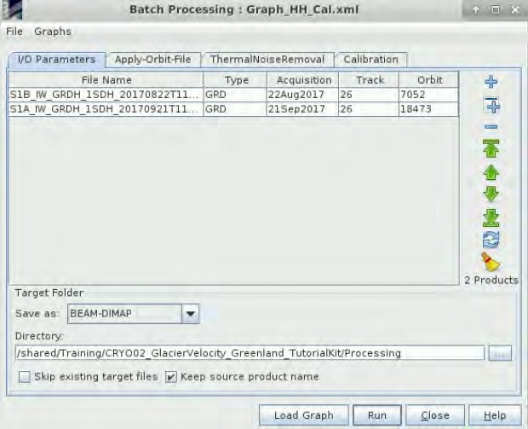
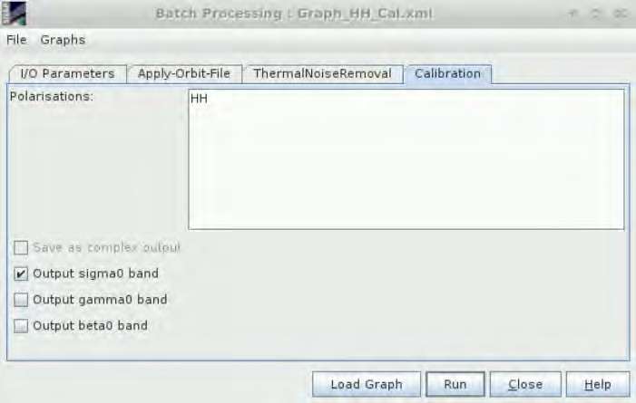
In the Apply-Orbit-File tab we can accept the default settings.
In the ThermalNoiseRemoval tab select HH polarization and make sure that the “Remove Thermal Noise” option is selected.
In the Calibration tab we will also accept all default settings and then click Run.

Slide 7
You should have 2 new products in the Product Explorer window. Close the Batch Processing window.
5.4 Coregistration and Offset tracking
To simplify the process, we will also create a new graph for the next processing steps. Let’s open the
Graph Builder again (Tools → Graph Builder).
First, we need to delete the Write operator. Right click on it and select “Delete”. Then we need to add a second Read operator. Right-click in the white space and go to Add → Input-Output → Read.
We will add the DEM-Assisted Coregistration operator by going to Add → Radar → Coregistration →
DEM-Assisted-Coregistration and connect both Read operators to it.
Next, we will add the Subset operator (Add → Raster → Geometric → Subset) and connect the DEM- Assisted-Coregistration operator to it.
Since we want to continue to Offset Tracking and save this subset separately as well, we will add the Offset-Tracking operator (Add → Radar → SAR Applications → Offset-Tracking) and the Write operator (Add → Input-Output → Write). Connect the Subset operator to both Offset-Tracking and Write operator.
As the last step, we will add another Write operator (Add → Input-Output → Write) and connect the
Offset-Tracking operator to it in order to save the final product (See TIP 2).

Slide 8
Tabs corresponding to each of the operators have appeared below the graph. We will go through them one by one to set all the parameters.
TIP 2: It may seem strange to write the two products separately, especially since we will stack them in the next step; however, the output of offset tracking is not only a raster but also a vector point layer containing the velocity at each Ground Control Point (GCP) and additional information that could be useful, such as heading (direction of the movement) and directional components. SNAP does not currently offer operator to export the vector layer in graph. If you do not need the vector layer, you can use the following graph set up.
5.4.1 Read
First let’s go to the first Read tab and make sure that the pre-processed product [3] from 9-Sept 2017 is selected as the Source product. Then go to the Read(2) tab and set the pre-processed product [4] from 21-Sept 2017 as the Source product.
5.4.2 DEM-assisted coregistration
Image coregistration is the process of geometrically aligning two or more images so that corresponding pixels represent identical area on earth surface. It is possible to coregister two or more products using only orbit state vectors, however for the purpose of offset tracking we need more precise coregistration. Therefore, we use additional information provided by digital elevation model (DEM).
Go to the DEM-Assisted-Coregistration tab and set “Digital Elevation Model”: ACE30 (Auto Download)
5.4.3 Subset
Since our Area of Interest (AOI) is quite small and there is no need to process the whole image, we start with sub-setting the scene to a more manageable size. This will reduce the processing time in

Slide 9
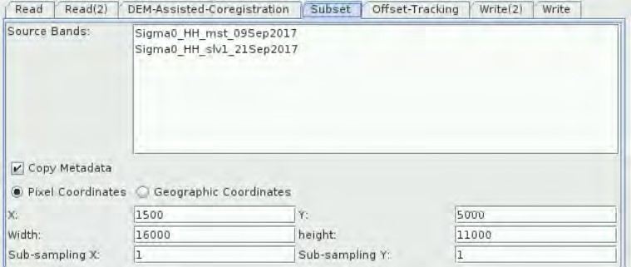
further steps and is recommended when the analysis is focused only over a specific area and not at the complete scene. Go to the Subset tab and at “Pixel Coordinates” set:
X: 1500 Width: 16000 Y: 5000 Height: 11000
5.4.4 Offset Tracking
Offset Tracking is used to estimate the motion of a feature between two acquisitions through cross- correlation on selected Ground Control Point (GCP) in coregistered images (master and slave) in both slant-range and azimuth direction. The movement velocity is then computed based on the offsets estimated by the cross-correlation (See NOTE 5). The velocities computed on the GCP grid are interpolated to create velocity map. It is a method frequently used for glacier motion estimation.
NOTE 5: The Offset Tracking is performed in the following sub-steps (ESA Snap):
For each point in the user-specified GCP grid in master image, compute corresponding pixel position in slave image using normalized cross-correlation.
If the computed offset between master and slave GCP positions exceeds the maximum offset (computed from user specified maximum velocity), then the GCP point is marked as outlier.
Perform local average for the offset on valid GCP points.
Fill holes caused by the outliers. The offset at missing point will be replaced by a new offset computed by local weighted average.
Compute the velocities for all points on GCP grid from their offsets.
Finally, compute velocities for all pixels in the master image from the velocities on GCP grid by interpolation (final product has same pixel size as the input data).
To perform the Offset-Tracking, we need to set several parameters. First, we need to set the GCP grid spacing in pixels in range and azimuth directions (determines the resolution/level-of-detail of our velocity product). We will set the spacing to 60 pixels (600m) in both directions, this balance between the level of detail and smoothness of our output, is sufficient for our purposes (also: the higher the resolution => the longer the processing time).
Next, we need to set the Registration Window dimensions; the size of the registration window depends on the maximum velocity of the glacier (from literature of historical data) and the period between the data acquisitions. Our images were acquired 12 days apart and the maximum speed of the Petermann Glacier is close to 5 m/day, this means that the glacier surface will shift by maximum 60 meters. This means that we can keep the default setting of 128 pixels (1280x1280m). To filter out false high values we also set the known maximum glacier velocity to 5 m/day. So, we need to set:
Grid Azimuth Spacing (in pixels): 60
Grid Range Spacing (in pixels): 60

Slide 10
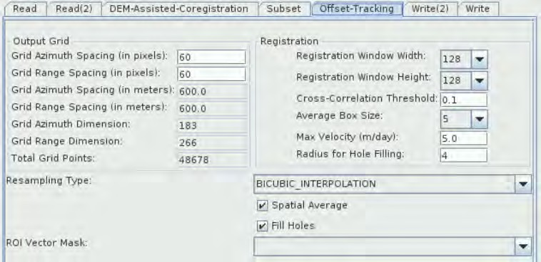
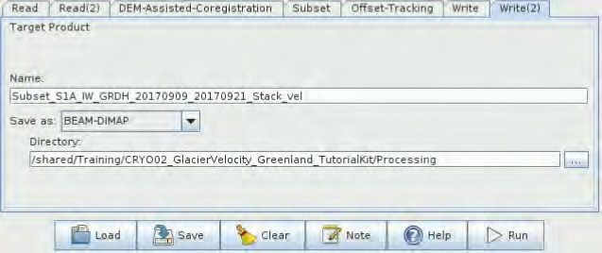
Max Velocity (m/day): 5.0
5.4.5 Write operators
In the Write tab (connected to the Subset operator), set the product name to
Subset_S1A_IW_GRDH_20170909_20170921_Stack and the target directory to
/shared/Training/CRYO02_GlacierVelocity_Greenland_TutorialKit/Processing.
In the Write(2) tab (connected to the Offset-Tracking operator), set the product name to
Subset_S1A_IW_GRDH_20170909_20170921_Stack_vel and the target directory to
/shared/Training/CRYO02_GlacierVelocity_Greenland_TutorialKit/Processing.
Click Save to save the graph with the name “Graph_offset_tracking”, at the following directory:
/shared/Training/CRYO02_GlacierVelocity_Greenland_TutorialKit/Processing.
Click Run. This might take a while. Approximate processing time: 35 minutes.
After the processing is completed, close the Graph Builder window. Two new products [5] and [6] have appeared in the Product Explorer window. Expand the velocity product [5] and double click the Velocity_slv1_21Sep2017 band to open it in the View window. On top of the velocity map we can see

Slide 11
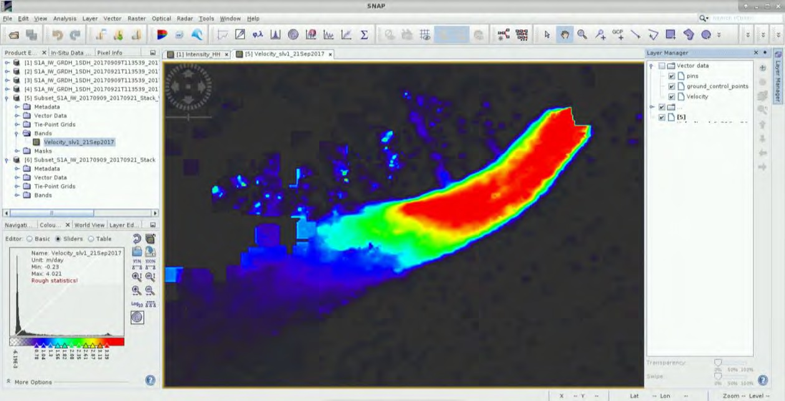
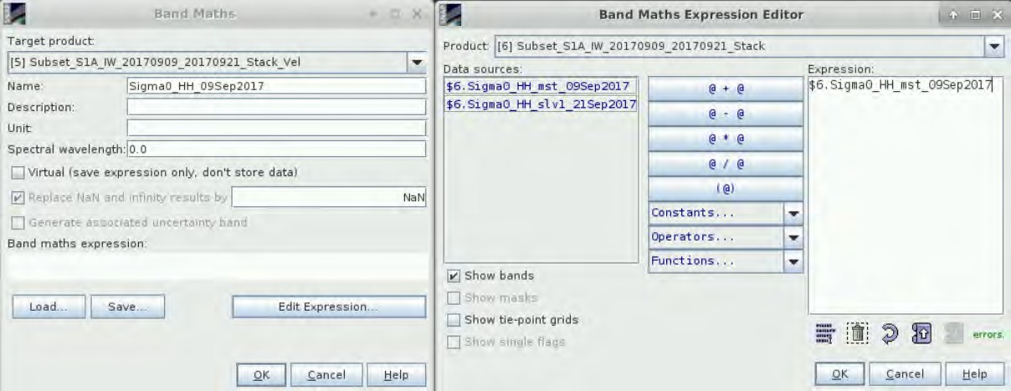
the geolocation point grid that obscures our view. We can hide it by going to Layer Manager on the right side (or go to Layer → Layer Manager to open it) and deselect the vector folder.
5.5 Stack the products
Let’s join the two outputs to a single product, for this we will use the Band Math function. Right-click product [5] and open BandMath dialog. Set “Name” to Sigma0_HH_09Sep2017 and deselect the Virtual (save expression only, don’t store data) option because we want to store the data.
Then click on the Edit Expression… and a new dialog will open. Set Product to:
[6] Subset_S1A_IW_20170909_20170921_Stack.
Then in Data Sources, click on $6.Sigma0_HH_mst_09Sep2017 band.
Click OK in both windows. Repeat the process to add also the second band. This time set “Name” to Sigma0_HH_21Sep2017 and in Data Sources, click on $6.Sigma0_HH_slv1_21Sep2017 band. The new bands will automatically open in the view. Go to the Layer Manager in the upper right corner and deselect the Vector folder in both images.

Slide 12
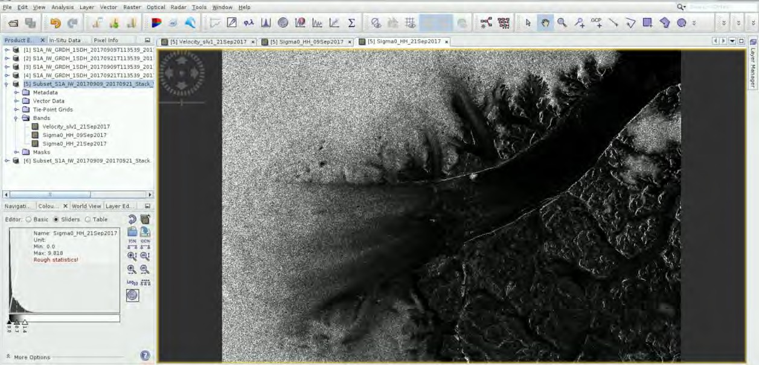
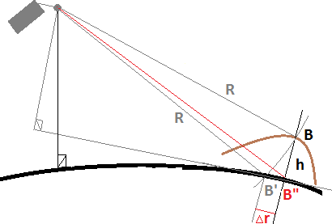
In the Product Explorer Window, select products [1] to [4]; right-click and select Close 4 Products.
5.6 Terrain correction
Our data are still in radar geometry, moreover due to topographical variations of a scene and the tilt of the satellite sensor, the distances can be distorted in the SAR images. We need to apply Terrain Correction to compensate for the distortions and reproject the scene to geographic projection. (See
NOTE 6)
NOTE 6: The geometry of topographical distortions in SAR imagery is shown on the right. Here we can see that point B with elevation h above the ellipsoid is imaged at position B’ in SAR image, though its real position is B". The offset Δr between B' and B" exhibits the effect of topographic distortions. (SNAP Help)
Click Radar → Geometric → Terrain Correction → Range-Doppler Terrain Correction
In the I/O Parameters tab set as “Source Product” the product [5] (velocity product). In “Target Product”, keep the default name and set the “Directory” to:
/shared/Training/CRYO02_GlacierVelocity_Greenland_TutorialKit/Processing.
In the Processing Parameters tab set:
Digital Elevation Model: ACE30 (Auto Download)
Map Projection: Click on it, choose Predefined CRS and click on “Select”. In “Filter” search for 32621
(EPSG: 32621 – WGS84 / UTM Zone 21N) and when you find it click OK to both windows.

Slide 13
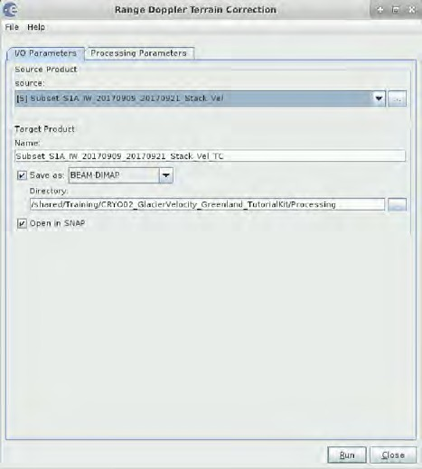
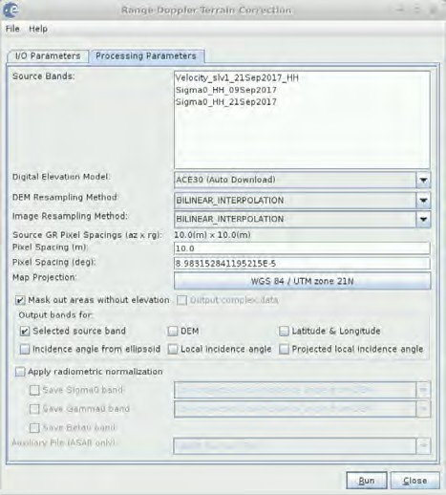
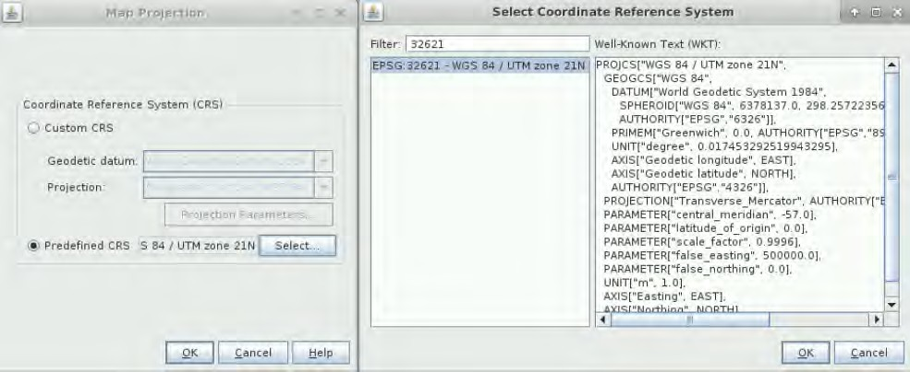
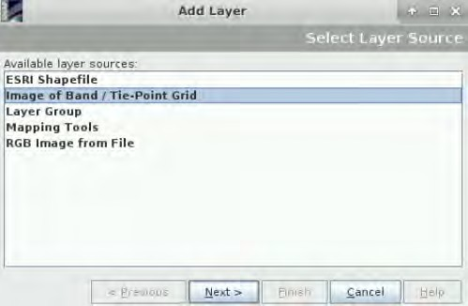
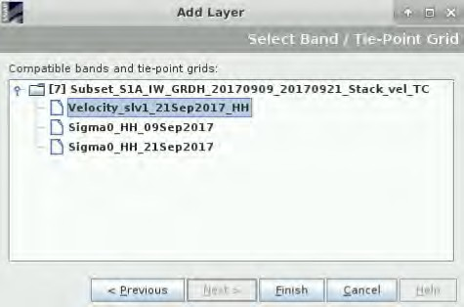
Keep defaults values for the other parameters. Click Run. Approximate processing time: 2.5 minutes.
5.7 Visualize
Close Range Doppler Terrain Correction window. Let’s overlay the velocity data on top of the original data. Expand the new georeferenced product [7] and open the Sigma0_HH_21Sep2017 band in View window. We can stretch the histogram a little in the Colour Manipulation tab (move the white slider on the right, to approx. 0.45).
Then go to the Layer Manager in the top right corner and in the Vector data folder deselect Velocity. Then click on to add an overlay layer, select Image of Band / Tie-Point Grid and select the Velocity_slv1_21Sep2017_HH. Then click Finish.

Slide 14
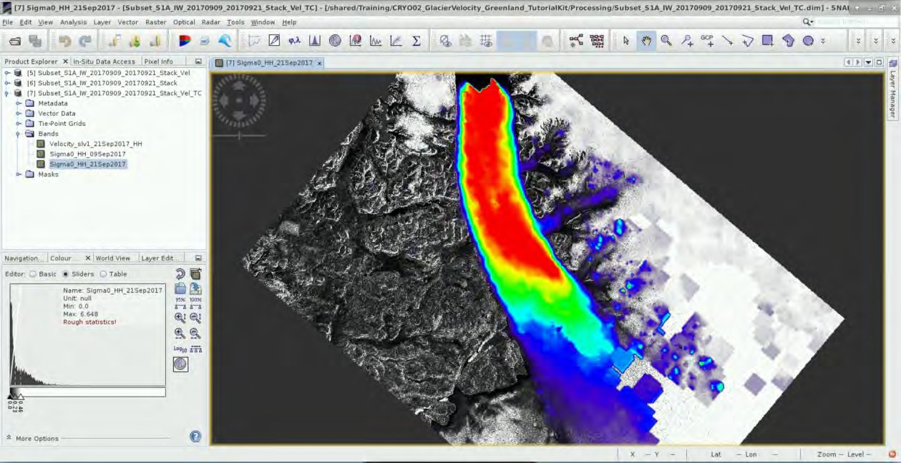
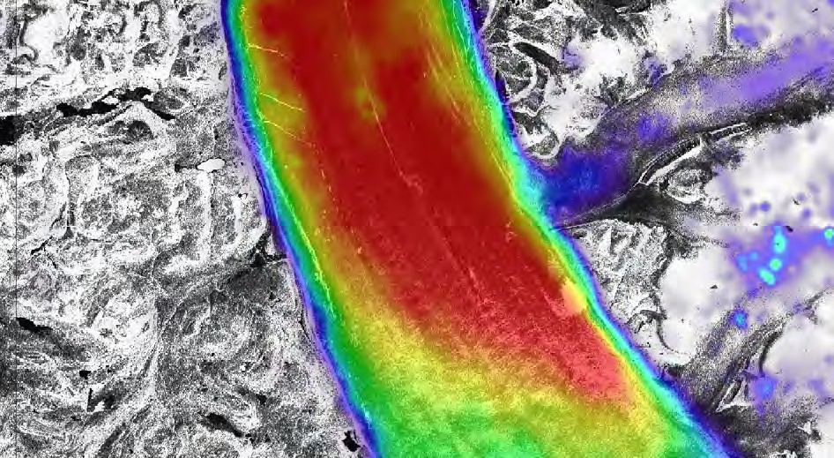
Now, we can see the velocity band overlaid over the original image, we can adjust the transparency by going to the Layer Manager, selecting the Velocity_slv1_21Sep2017 and moving the transparency slider on the bottom of the tab.
We can also make the layer semi-transparent. In Layer Manager, select the overlaid Velocity layer and move the transparency slider at the bottom of the tab.

Slide 15
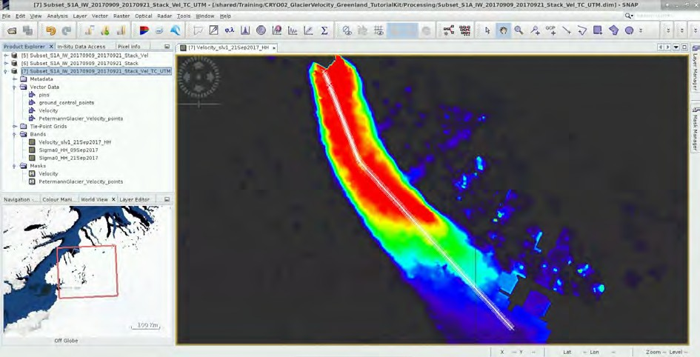
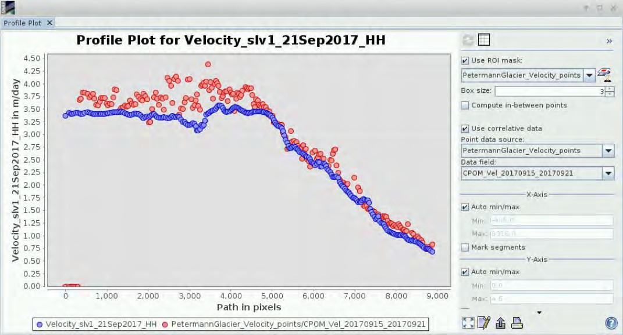
Now let’s compare the profiles. In the Product Explorer window, in the product [7], highlight the
Velocity_slv1_21Sep2017_HH band. Then go to Analysis and click on Profile Plot.
Select the Use ROI mask and choose PetermannGlacier_Velocity_points
Deselect Compute in-between points.
Select
Use correlative data and set:
Point data source: PetermannGlacier_Velocity_points
Data field: CPOM_Vel_20170915_20170921
We can see that the CPOM data show more variability but otherwise agree quite nicely with our estimation. The increased variability is likely a result of shorter time period between used acquisitions (6 days, compared to 12 days period for our input images) and much finer GCP grid spacing (100 m, compared to our 600 m).
Now change the correlative Data field to ENVEO_Vel_20161223_20170222.

Slide 16
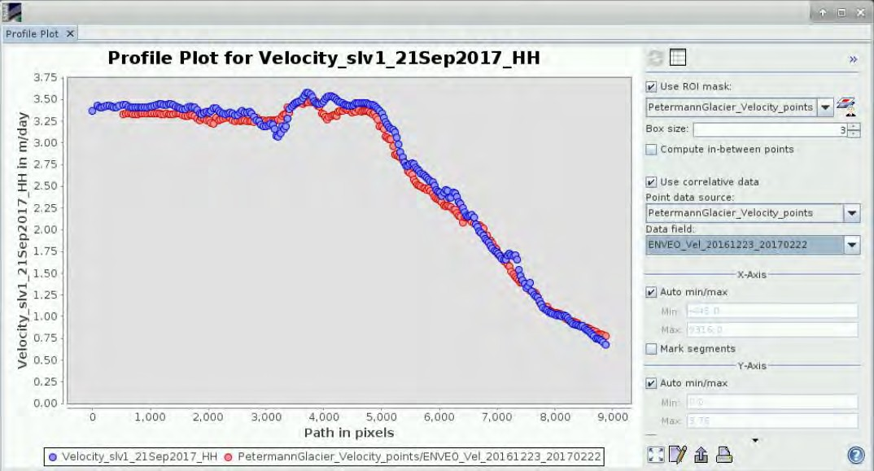
We can see that our estimation agrees with the ENVEO velocity almost perfectly. The ENVEO velocity uses the same time period between images (12 days), but the estimated velocities are averaged over 3-month period which is likely responsible for the minor differences. Glacier velocity changes over time as it is partly driven by the melt, therefore we can expect that the velocity would be slightly lower during the winter months compared to early fall.
Other suggested steps
Export velocity
Now we can export our results to an ESRI Shapefile (.shp) format that is more manageable and can be processed and visualized further in software such as QGIS. The shapefile will contain following information:
Coordinates of GCP point in master image (9 Sept)
Coordinates of corresponding point in slave image (21Sept)
The distance travelled
Velocity in m/day
Heading in degrees (East from North)
Range shift
Azimuth shift
In order to view this, expand the “Vector Data” folder of the product [7] and double click on Velocity.

Slide 17
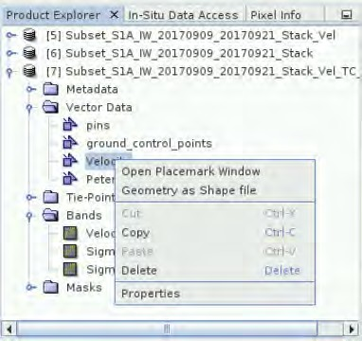
Depending on the version of SNAP you have there might be a reoccurring bug that prevents simple export of the detections to ESRI shapefile format. Outlined below is a method to export for versions without the bug (OPTION 1) and a work-around method for versions with the bug (OPTION 2).
6.1.1 OPTION 1 – No error
In Product Explorer window, expand the product [7] and open the Vector Data folder. Right-click on the Velocity layer and select Geometry as a Shapefile. Save the layer to the Processing folder with the name “Velocity.shp”.
6.1.2 OPTION 2 – SNAP versions with error
If the approach described in OPTION 1 does not work for you then the version of SNAP installed on your machine likely contains the mentioned error.
Click OK and make the following steps.
The detections are stored in the output product folder as a CSV file. The CSV file can be loaded directly to QGIS and converted into shapefile.
In your VM, go to Applications → Processing and open QGIS Desktop. Now, click on the “Add Delimited Text Layer” in the vertical menu on the left of the window. In the window that opens, click Browse and navigate to:
/shared/Training/CRYO02_GlacierVelocity_Greenland_TutorialKit/Processing/, open subset_S1A_IW_GRDH_1SDV_20170909_20170921_Stack_Vel_TC.data folder, vector_data folder, select Velocity.csv and click “Open”.
then
open
A table will appear in the bottom of the window. Select Custom delimiters, and select Tab, unselect all other delimiters and in Other Delimiters type delete all.
In Record options, set Number of header lines to discard to 3 and select the “First record has field names” option. Finally, in the Geometry definition, select “Well known text (WKT)” and set Geometry Field to “geometry:Point”.

Slide 18
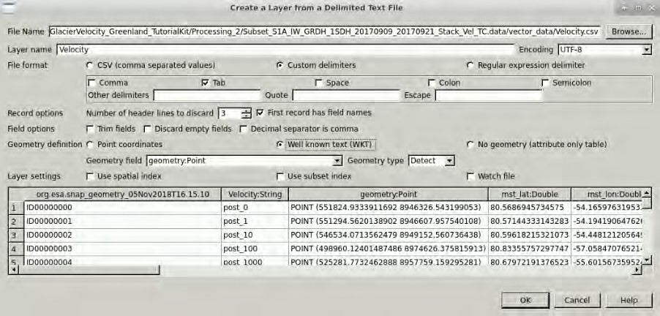
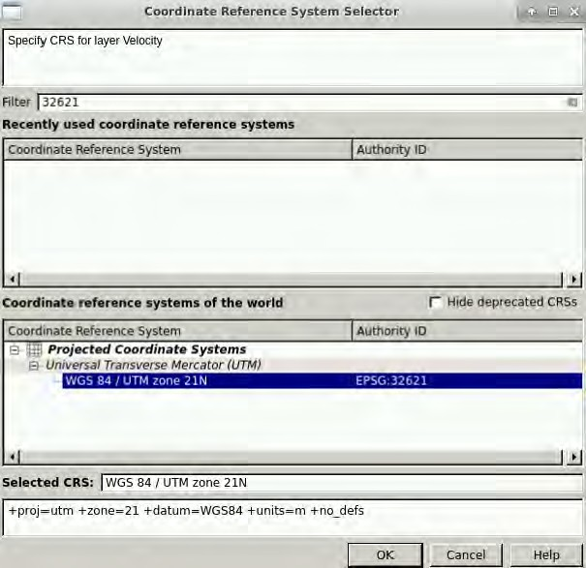
Then, click OK. The following window will appear. In “Filter”, type 32621 and you will see that in the “Coordinate reference systems of the world” tab, the “WGS 84 / UTM zone 21N” Coordinate Reference System will appear. Select it and click OK.
The new layer Velocity will appear in the Layers Panel.

Slide 19
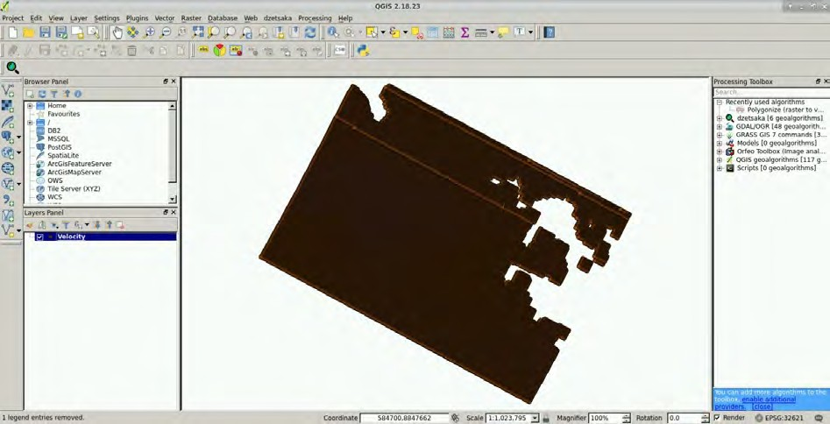
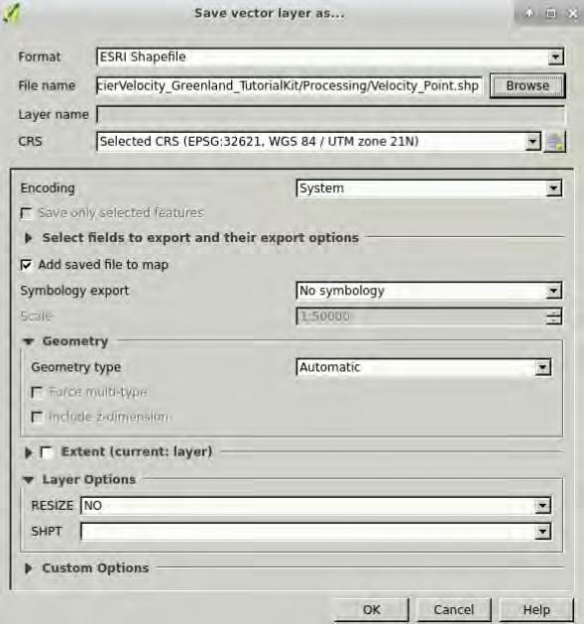
Click OK. Then right-click on the layer again and go to Save as. In the window that opens, set:
Format: ESRI Shapfile
Filename: /shared/Training/CRYO02_GlacierVelocity_Greenland_TutorialKit/Processing/Velocity_
Point.shp (Click “Browse”, navigate to the following path: /shared/Training/CRYO02_GlacierVelocity_ Greenland_TutorialKit/Processing/, select the Velocity_Point.shp file and click Save.)
CSR: Selected CRS (EPSG:32621, WGS 84 / UTM zone 21N)
Then click OK.

Slide 20
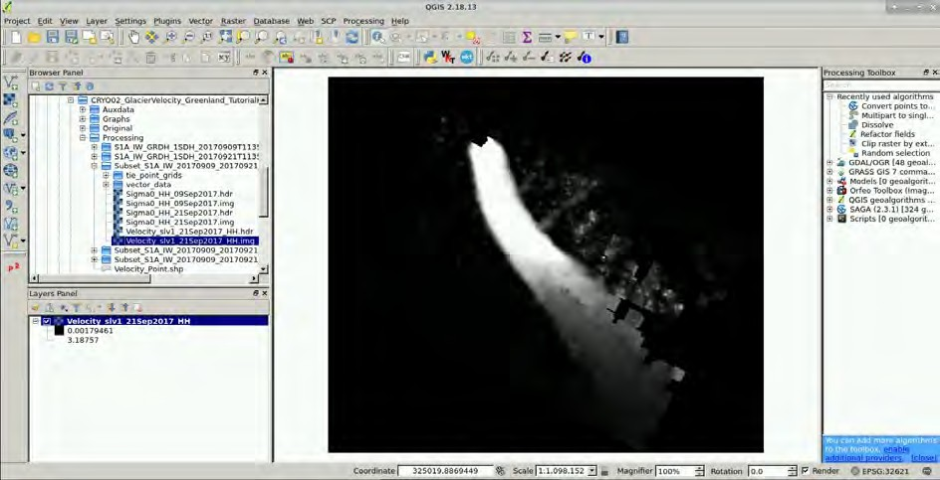
To the following window that appears, click “Overwrite file”.
Now you have the layer saved as an ESRI Shapefile. Close QGIS.
6.2 Visualize in QGIS
Minimize the SNAP window and open or re-open QGIS (Applications → Processing → QGIS Desktop). Once the QGIS is loaded let’s open the Velocity raster band.
Navigate to the Processing folder in the Browser Panel on the left side of the window, expand the Subset_S1A_IW_20170909_20170921_Stack_Vel_TC.data folder and double-click the Velocity_slv1_21Sept2017_HH.img.
The raster layer will be opened and added to the Layers Panel below the Browser Panel.
To change the appearance right-click the layer in Layer Panel, go to “Properties” and in Style tab set:
Render type: “Singleband pseudocolor”
You can select any colour pallet and adjust the classes to your liking, however for our purposes we will use predefined colour pallet and classes saved as a text file in the Auxdata folder. To load it, click “Load color map from file” (indicated on the image below), then navigate to
/shared/Training/CRYO02_GlacierVelocity_Greenland_TutorialKit/Auxdata and select
Glacier_velocity_ColourPallet.txt
Click OK.

Slide 21
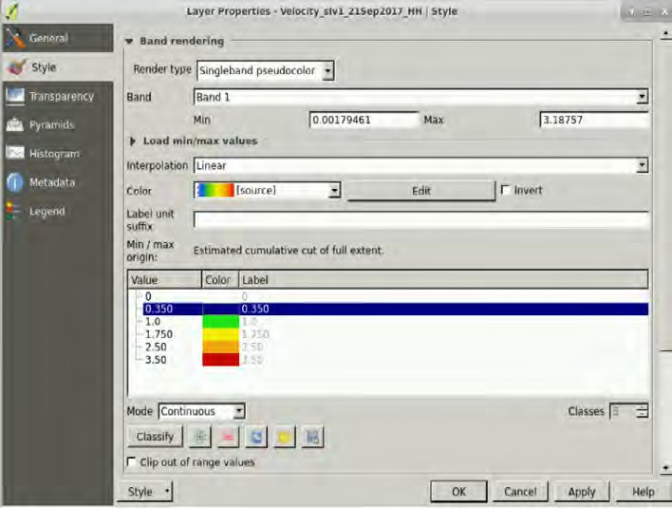
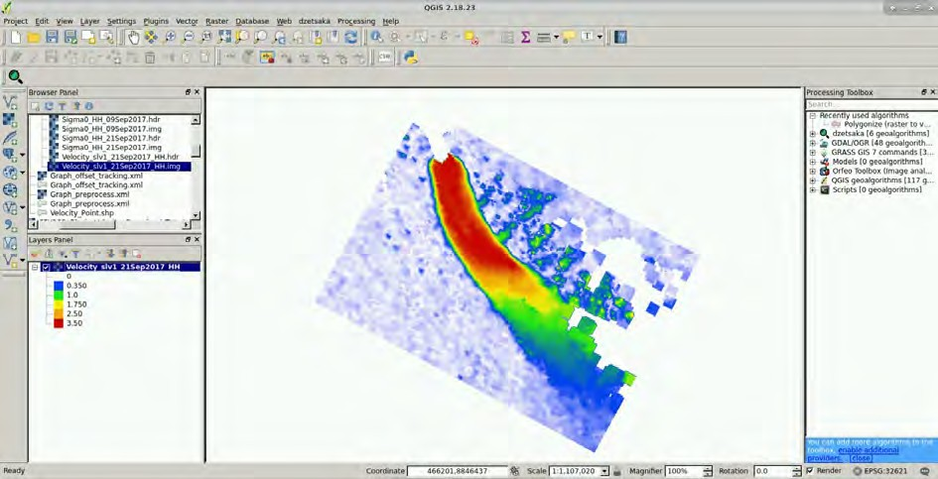
6.3 Add vector Velocity fields
In the Browser Panel double click the Velocity_point.shp layer to load it. We need to filter the layer a little since the point grid is too dense for our purposes.

Slide 22
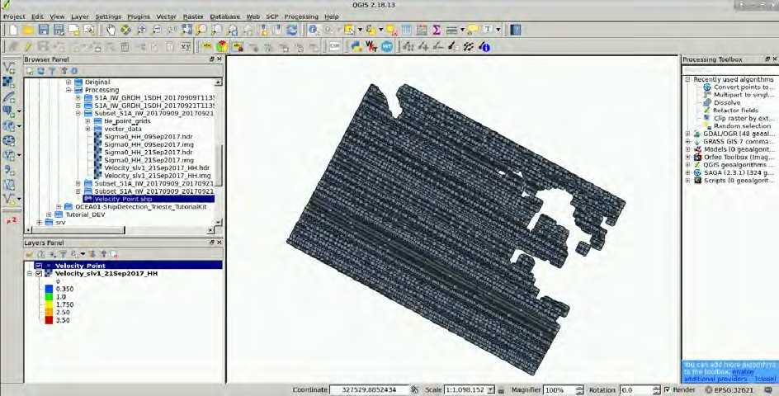
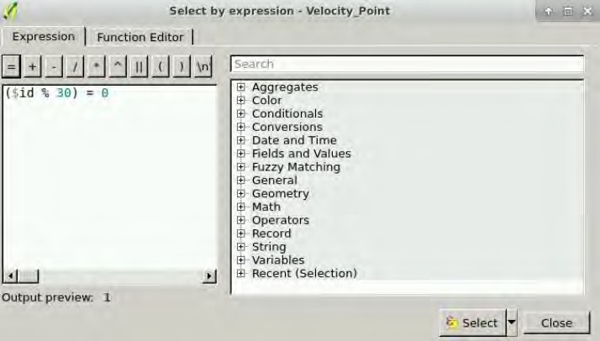
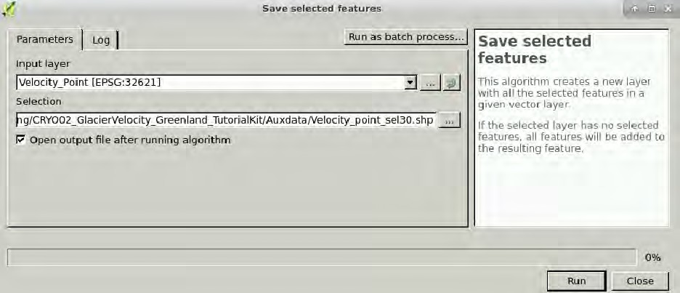
The simplest way to do this is to create subset with every n^{th} point (or for example random selection). Select the Velocity_point.shp in the Layer Panel and in the upper tool panel click (above) and set Expression: ($id % 30) = 0
Click Select and then close the window. Go to the Processing Toolbox at the right side of the window, in the search box type “Save” and press Enter. Then double-click on the Save selected features tool and set “Selection” to /shared/Training/CRYO02_GlacierVelocity_Greenland_TutorialKit/Processing (choose “Save to file…”) and write as “File name”: Velocity_point_sel30.shp. Click Save and press Run.
Set output directory

Slide 23
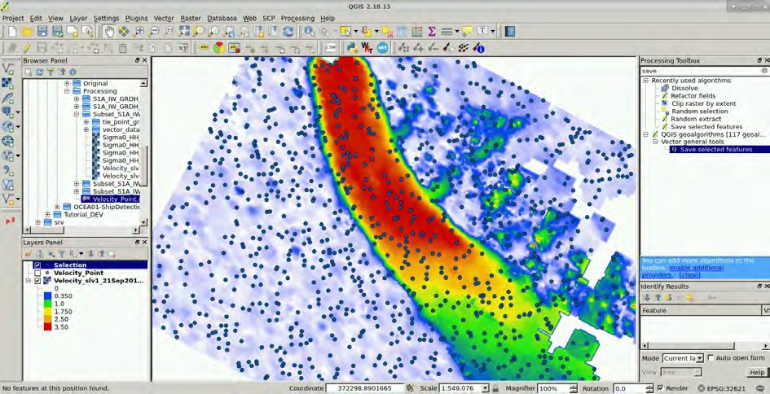
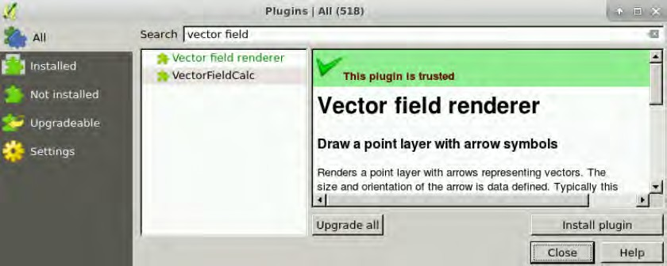
New point layer Selection appeared in Layers Panel. Deselect the original Velocity_point layer in the
Layers Panel to hide it.
Plugins
To visualize the velocity vector fields, we need to use the Vector field renderer plug-in or install it (if it is not already installed). We can do this by going to the Plugins menu on the top of the QGIS window (indicated above) and go to Manage and Install Plugins…
In the Plugins dialog search for Vector field, select Vector field renderer and press Install plugin.
Close the dialog. Now make sure the Selection layer is highlighted in the Layers Panel and then click on Apply vector renderer to current layer in the toolbar at the top of the window.
At the Vector field tab, set as:
Vector field type: Polar (length, angle) field
Length attribute: velocity
Angle attribute: heading
Arrow format: Size:
Base size: 0.20
Scale: 1.5
Head (relative): 0.20
and Shaft width: 0.20

Slide 24
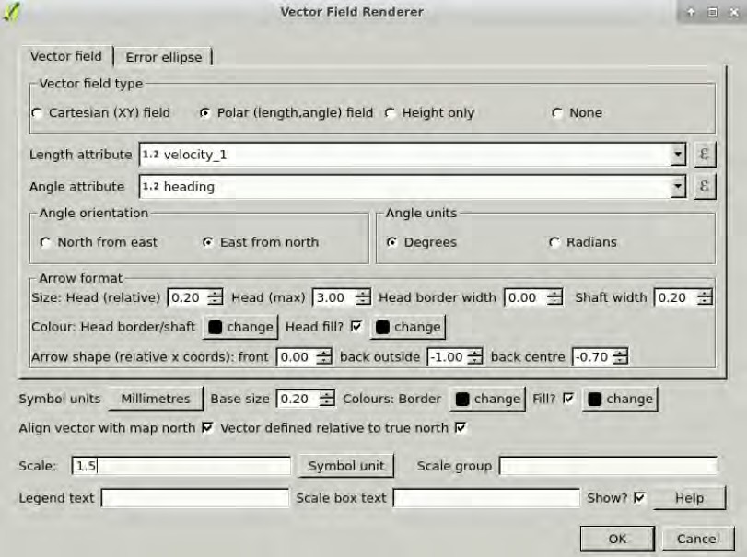
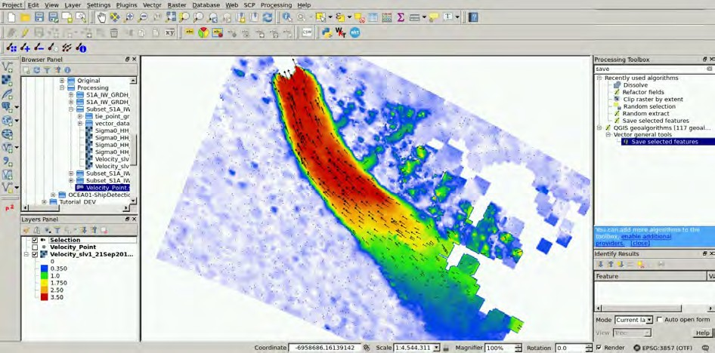
Click OK.
Now we can inspect the direction of the ice flow. As a last step we can add a base map. Go to Web →
OpenLayers plugin → Bing Maps → Bing Aerial.
Drag the Bing Aerial layer to the bottom of all layers in the Layers Panel to visualize the result.
Click on the Display the vector scale box icon, in Location choose “Top right", in Box deselect "Fill Box" and click OK.

Slide 25
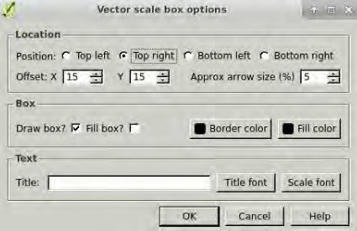
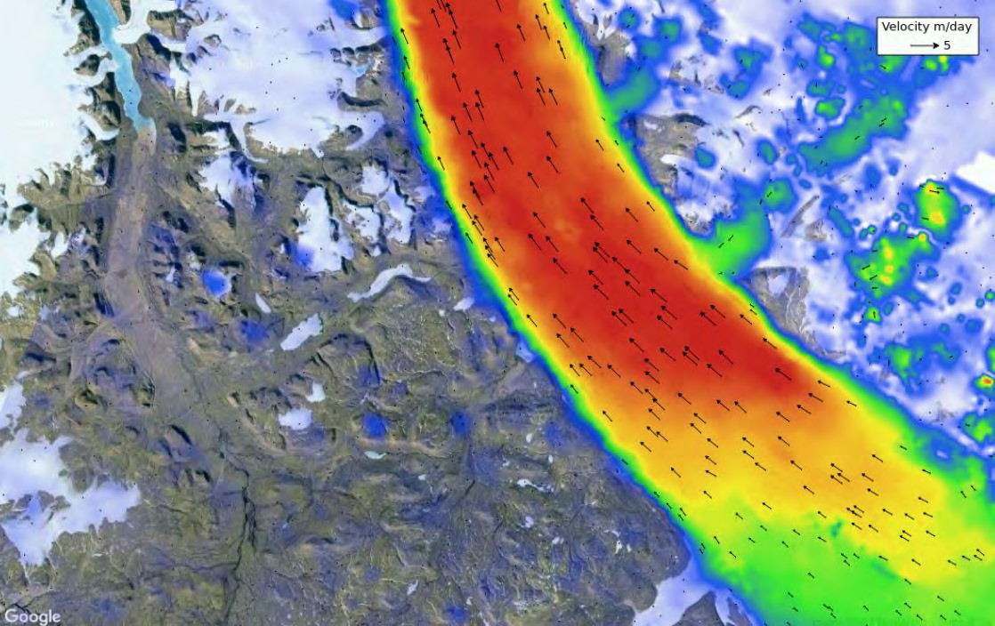
THANK YOU FOR FOLLOWING THE EXERCISE!

