Slide 1
Introduction
Input data: Sentinel-1 GRDH images over Germany
Output data: temporal backscatter signatures for various land cover types

Slide 2
Data processing
Creating a subset of S1 GRDH images
Spatial subset depending on the AOI
Radiometric calibration
Conversion of image intensity to sigma0 providing the radar backscatter
Terrain correction
Compensate for geometric distortions caused by topographical variations of a scene and the tilt of satellite sensor
Creating a multitemporal stack
Collocation spatially overlapping products (based on geolocation)
Speckle filtering
Filtering the inherent salt and pepper like texturing called speckles
Linear to dB conversion
Compensate for very high dynamic range in visualisation
Stack statistics
Analysis of temporal backscatter signatures

Slide 3
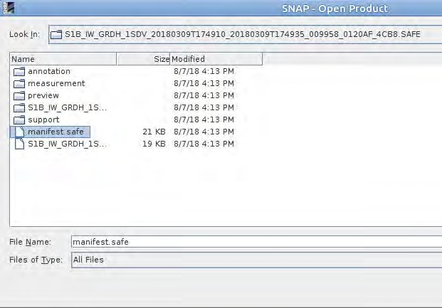
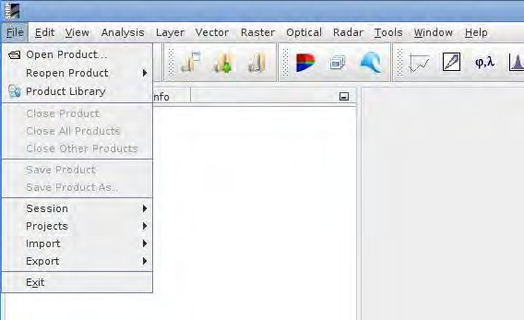
Data preparation
1. Opening the S1 data

Slide 4
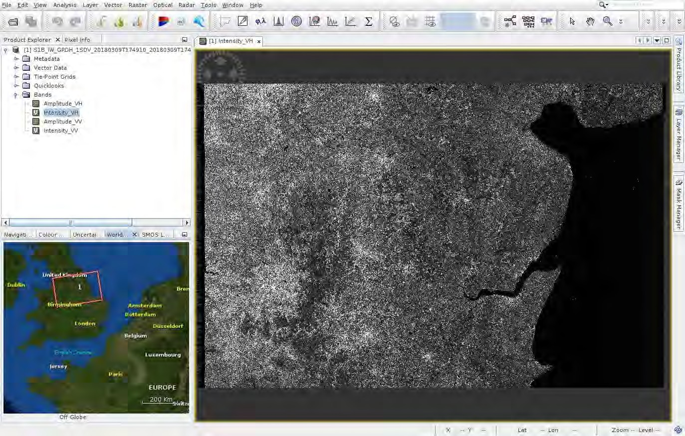
Data preparation

Slide 5
Spatial subset

Slide 6
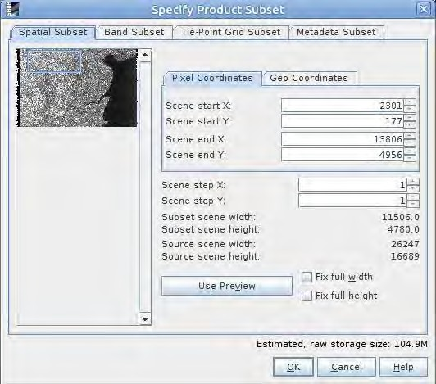
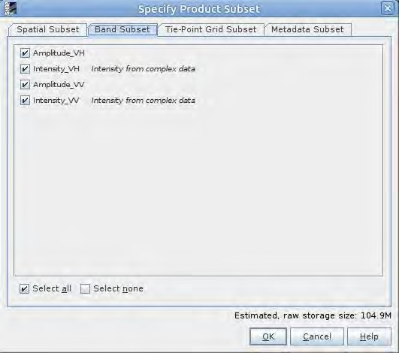
Spatial subset - parameters

Slide 7
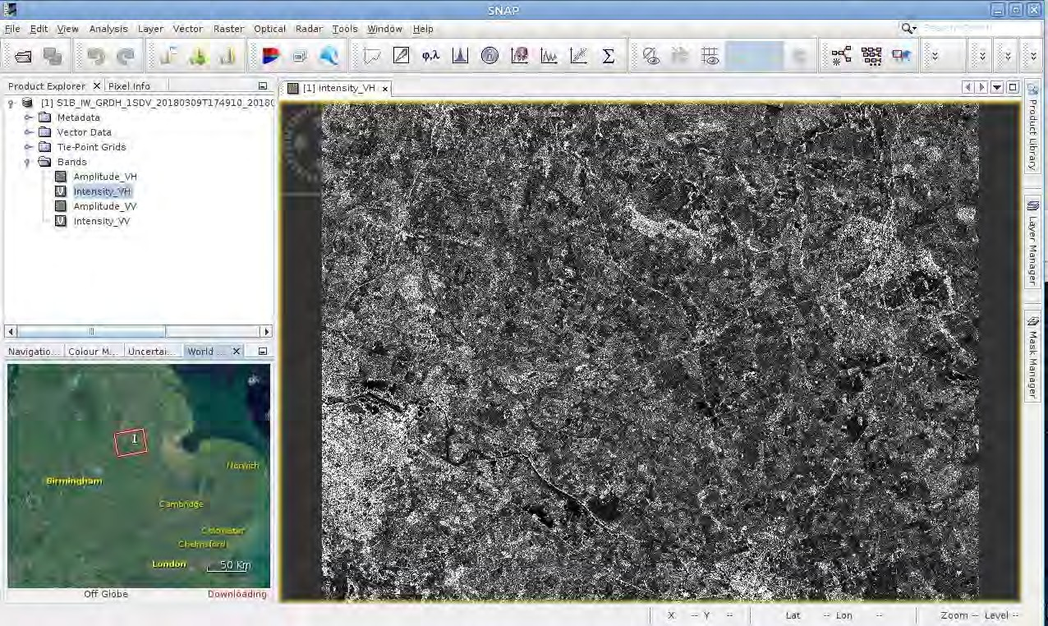
Data check

Slide 8
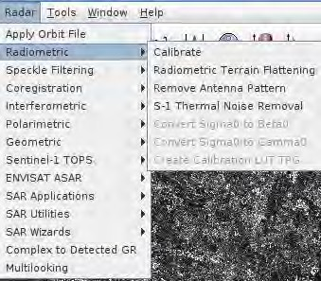
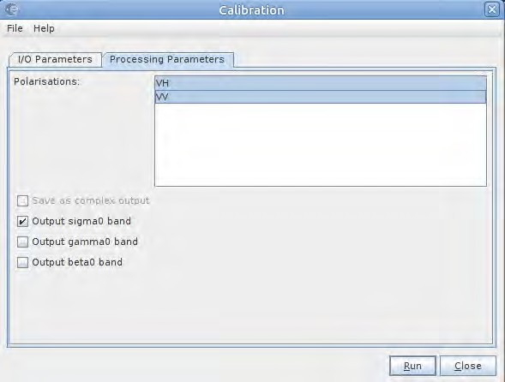
Radiometric Calibration

Slide 10
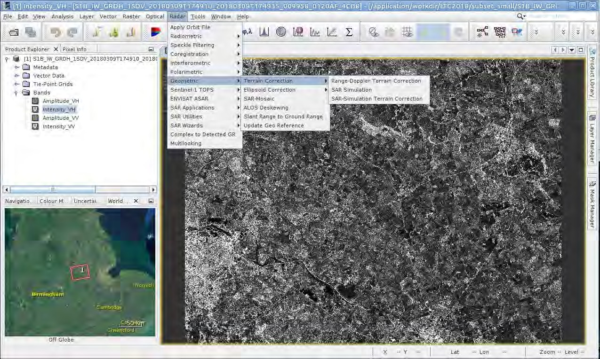
Geocoding

Slide 11
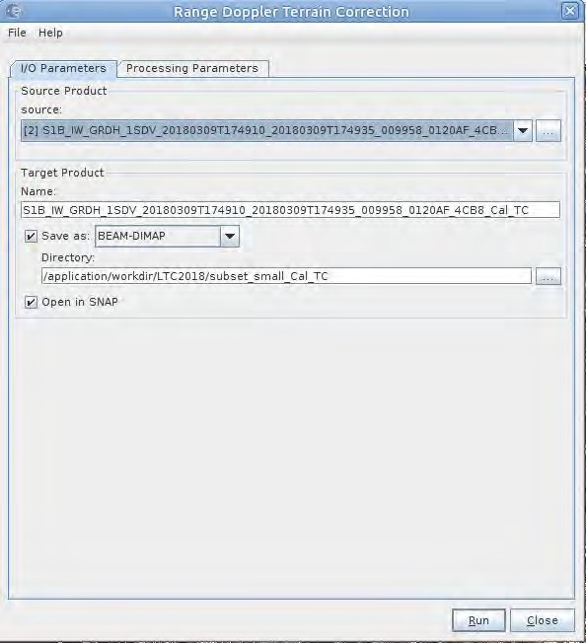
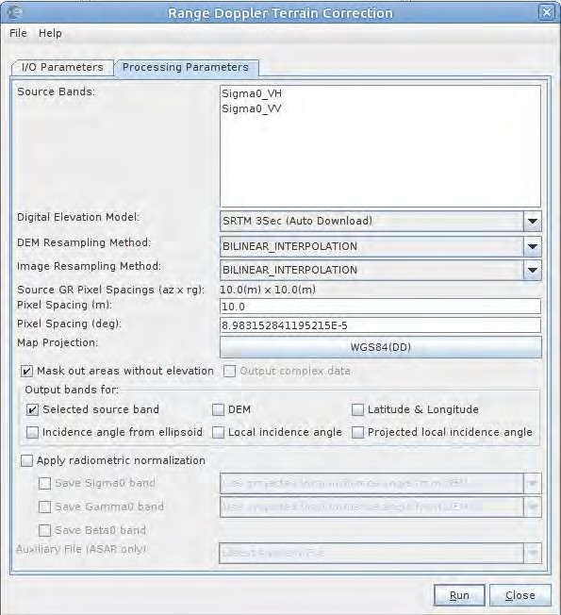
Geocoding

Slide 12
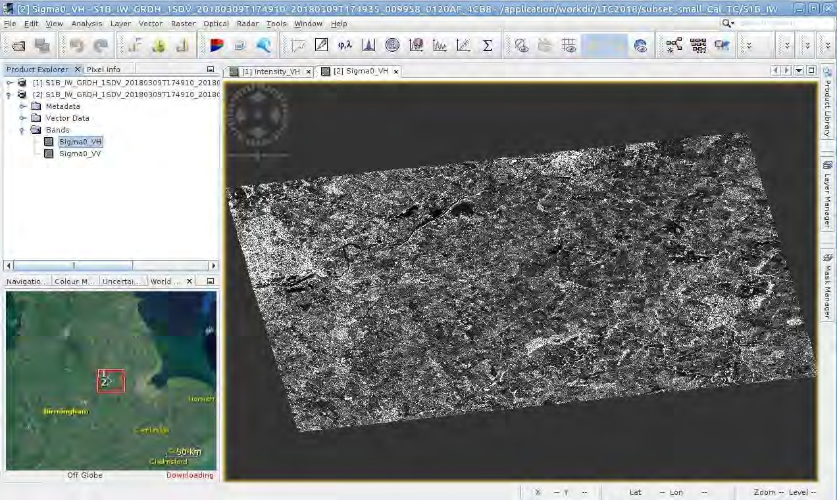
Data check

Slide 13
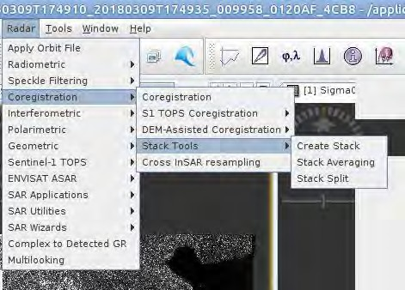
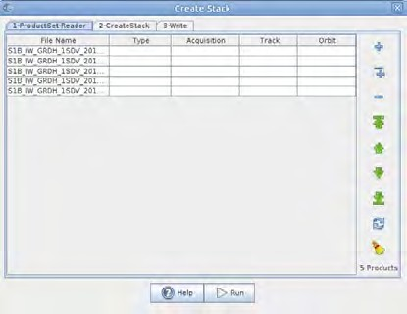
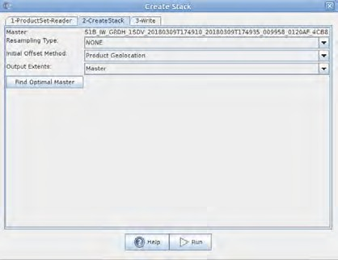
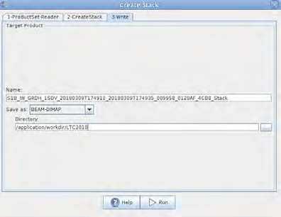
Creating multitemporal stack
Product geolocation (if terrain corrected)
Orbits (not terrain corrected)

Slide 14
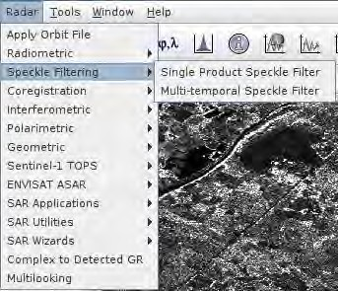
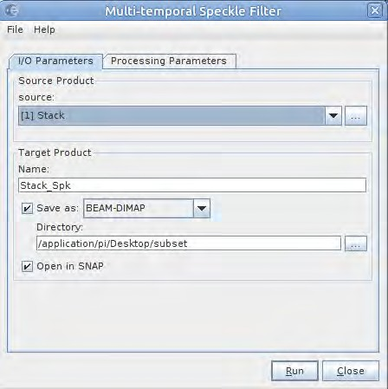
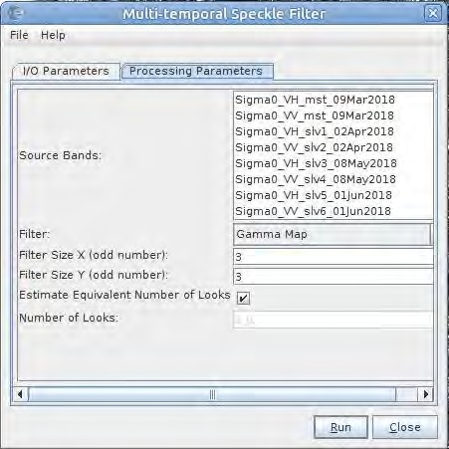
Multitemporal speckle filtering

Slide 15
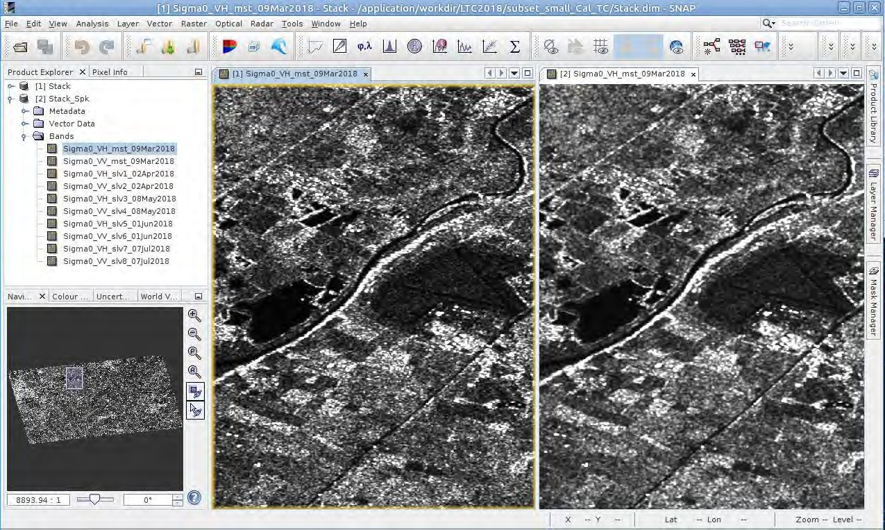
Multitemporal speckle filtering
Not filtered
Filtered

Slide 16
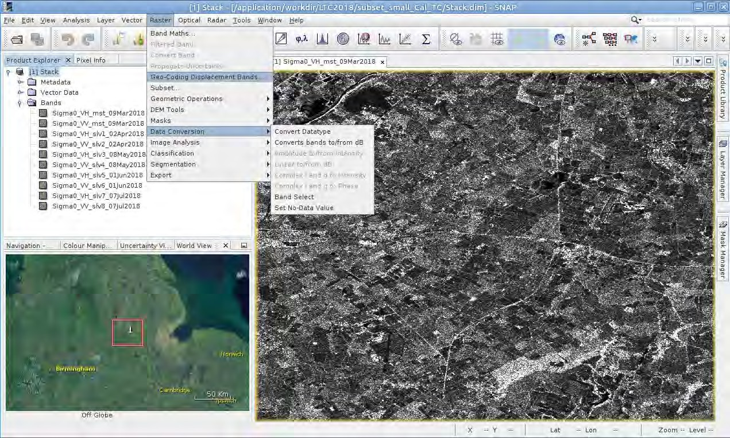
Conversion from linear to dB

Slide 17
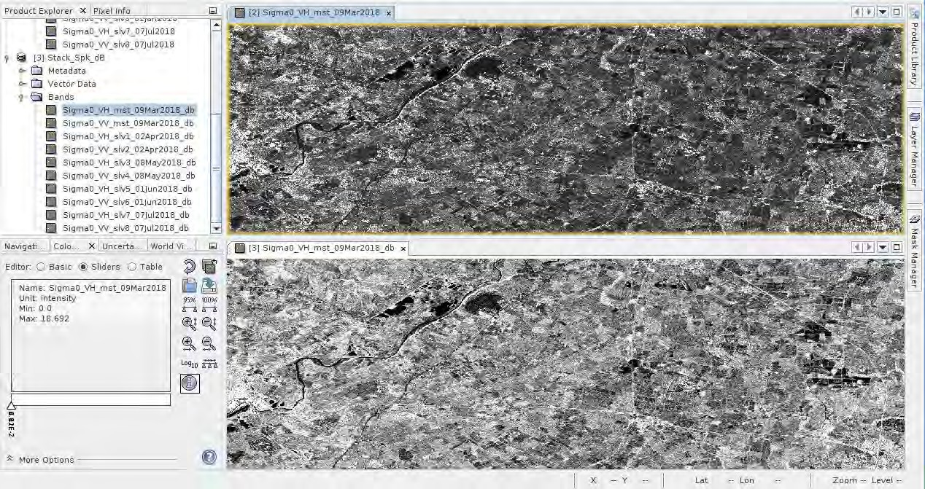
Linear vs dB comparison

Slide 18
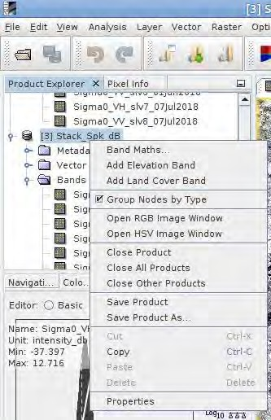
RGB Composite
Right click on the product

Slide 19
RGB Composite

