Slide 1

Programming Basics (Python)
Syntax, variables, data types, inputs and outputs, debugging
Mgr. Tomáš Fedor

Slide 2

Lesson outline
Syntax in Python
Variables
print and input commands
Data types
Debugging and the most common errors
Independent work

Slide 3

Syntax
Line indentation (“indentation”)
Separates a block of code and defines its structure
In other languages this is done using “{}”; line indentation has no effect

Slide 4
Syntax
Line indentation (“indentation”)
Separates a block of code and defines its structure
In other languages this is done using “{}”; line indentation has no effect
if 7 > 3:
print("7 is greater than 3")
vs:
if 7 > 3:
print("7 is greater than 3")

Slide 5
Syntax
In other languages this is done using “{}”; line indentation has no effect
“{}” when using “Formatted string literals” (f):
name=("Tomáš")
city=("Košice")
print(f"My name is {name} and I live in {city}.")
*{ – alt + 123
*} – alt +125

Slide 6
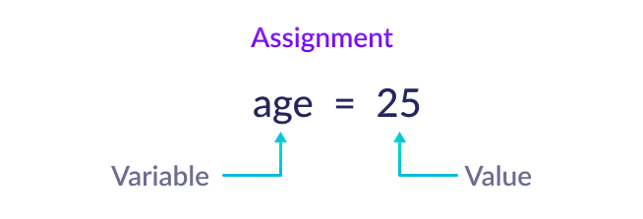
Variables
Assigning a value using “=”
x = 4
y = "Hello, world!"
print(x)
print(y)

Slide 7
Variables
Case sensitive
No spaces, numbers at the beginning, or operators
Correctly defined:
Incorrectly defined:
myvar = "Text1"
my_var = "Text2"
_my_var = "Text3"
myVar = "Text4"
MYVAR = "Text5"
myvar2 = "Text6"
2myvar = "Text"
my-var = "Text"
my var = "Text"

Slide 8
Variables
What if we want to define several variables at once?
x = y = z = "Košice"
print(x)
print(y)
print(z)
“=” means that the given variables have the same value

Slide 9
Variables
What if we want to define several variables at once?
Or by creating a list:
x, y, z = "Košice", "Prešov", "Poprad"
print(x)
print(y)
print(z)
print(x, y, z)
cities = ["Košice", "Prešov", "Poprad"]
x, y, z = cities
print(x)
print(y)
print(z)
*[– alt + F
*] – alt + G
*[] – altgr + F

Slide 10
print and input
print – displays an output / value
input – asks for an input / value
x=input("enter text: ")
print(x)
y=input("enter number: ")
print(y)

Slide 11
print and input
print – displays an output / value
input – asks for an input / value
x=input("enter text: ")
print(x)
y=input("enter number: ")
print(y)
What is the difference?

Slide 12
print and input
print – displays an output / value
input – asks for an input / value
x=input("enter text: ")
print(x)
y=input("enter number: ")
print(x)
Difference?
By default, it is defined
as a text string
x=input("first number: ")
y=input("second number: ")
print(x+y)

Slide 13
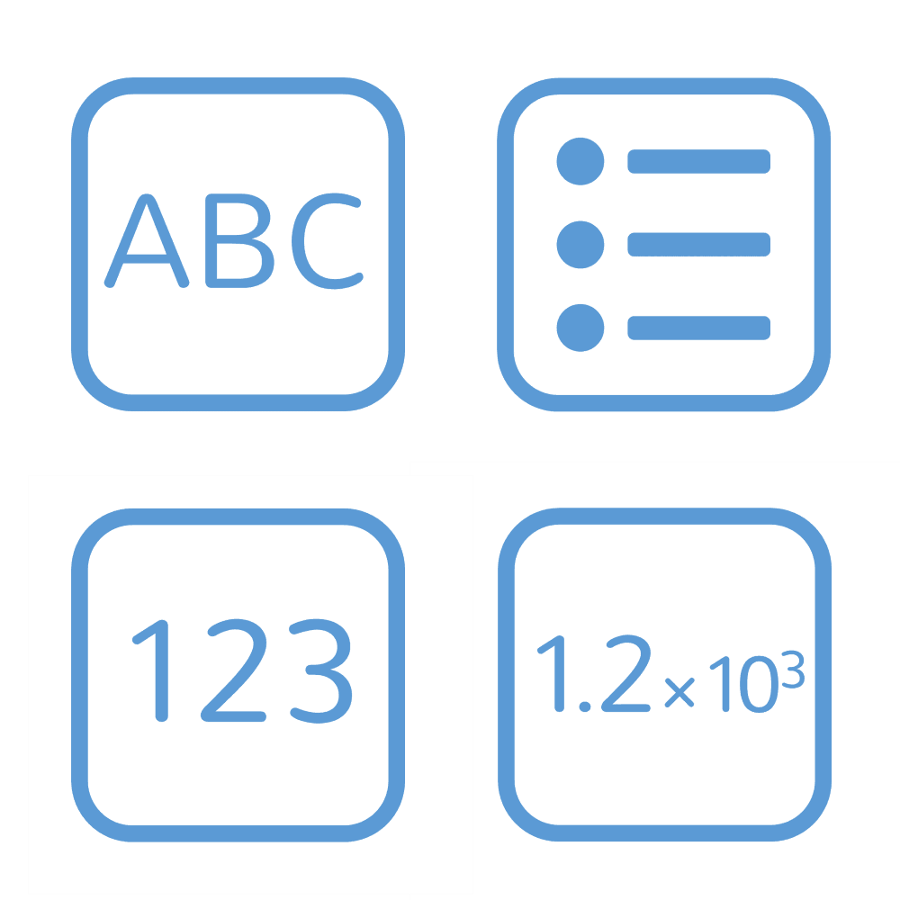
Basic data types
String – text string (str or string)
Integer – whole number (int or integer)
Float – real numbers with a decimal point (float)
Boolean – binary value true/false (bool)

Slide 14
Defining a data type
By writing the data type before the parentheses:
x=float(4)
By converting an existing variable:
x=4
x=float(x)
By asking for input:
x=float(input("Enter a number: "))

Slide 15
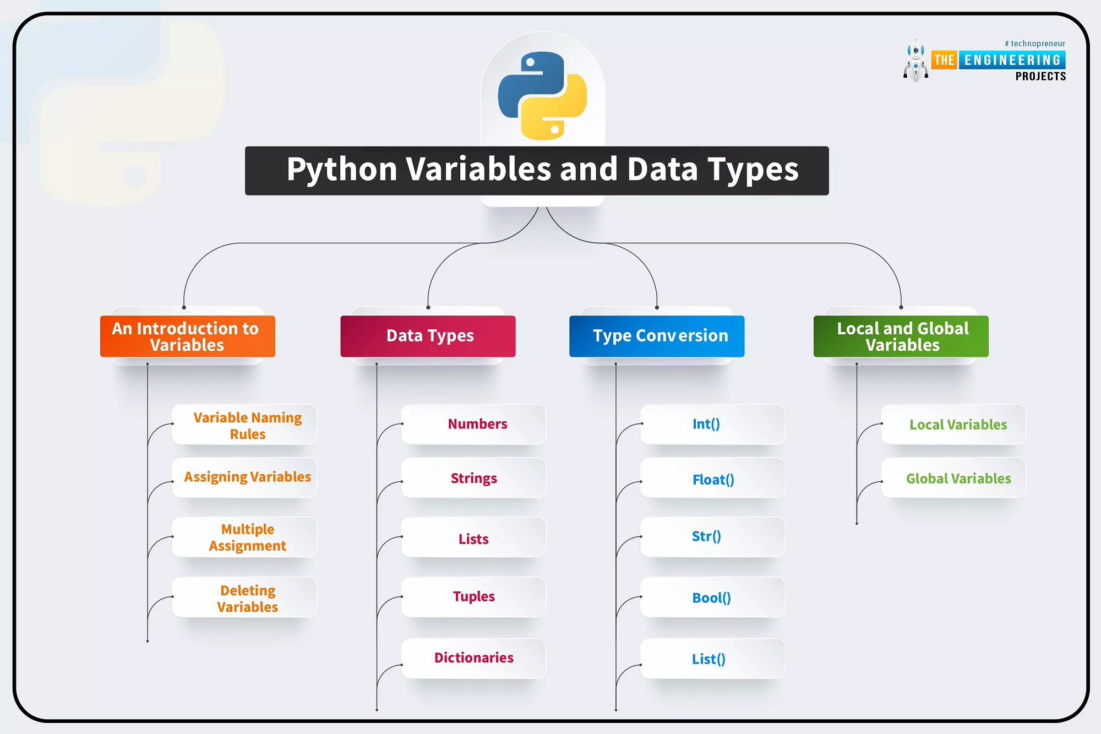

Slide 16

What data type is it?
Determining it using “type”
y=4.5
print(type(y))
<class 'float'>

Slide 17

Task
Create a simple script that asks for your first name and surname and prints them. Define the data type.
Create a simple script that prints two entered numbers as a concatenated text string.
Add three whole numbers (sum of three numbers).
Multiply two whole numbers (multiplication).

Slide 18
Task
Calculate the volume of a cube.
Create a simple calculator that calculates your age in whole years.
Use a binary answer to define a variable indicating whether the sun is shining outside.
Create a simple calculator for basic arithmetic operations – sum, difference, product, quotient.

Slide 19

Debugging
Fixing and finding errors
Implemented directly in the environment (PyCharm)
Finding errors line by line
Syntax errors
Runtime error
Logical errors

Slide 20

Syntax errors
The interpreter cannot read the code
Missing punctuation (, ], ;, etc.)
Line indentation
Incorrectly defined variables (e.g. keywords)

Slide 21
Syntax errors
1) print("Hello
2) print("Good day")
3) class = 5
4) items = [1 2, 3]
5)
name = "Jane"
message = f"Hello {name"
print(message)

Slide 22
Syntax errors
1) print("Hello
2) print("Good day")
3) class = 5
4) items = [1 2, 3]
5)
name = "Jane"
message = f"Hello {name"
print(message)
Unclosed text string
1) print("Hello")
2)print("Good day")
3) class = 5
4) items = [1, 2, 3]
5)
name = "Jane"
message = f"Hello {name}"
print(message)
Line indentation
Keyword used as a variable
Missing comma in a list
Missing parenthesis

Slide 23

Runtime error
The syntax is correct
Error while running the code
Undefined variable
Incorrect data type
Division by zero
Importing a non-existent module or file...

Slide 24
Runtime error
print(x)
2) total = "2" + 2
3) number = int("text")
4) from math import function
5) assert 2 + 2 == 5

Slide 25
Runtime error
print(x)
2) total = "2" + 2
3) number = int("text")
4) from math import function
5) assert 2 + 2 == 5
Undefined variable
Adding a text string and a number
Incorrectly defined data type
Non-existent function
False statement (assertion error)

Slide 26

Logical errors
They produce incorrect (illogical) results
No error message may be displayed
More difficult to detect
“What the program does vs. what it should do”

Slide 27
Logical errors
a = 10
b = 20
total = a + a
print(total)
x = 10
if x < 5: print("x is greater")
a, b = 3, 2
print(a // b)

Slide 28
Logical errors
a = 10
b = 20
total = a + a
print(total)
x = 10
if x < 5: print("x is greater")
a, b = 3, 2
print(a // b)
Do we want to include variable b as well?
Do we want it to be greater or smaller?
Do we want integer division?

Slide 29

Debugging – independent work
Download the .py file containing a simple calculator from Webshared. It contains errors – fix them.
https://uge-share.science.upjs.sk/webshared/Vyucba/Python/python_cvicenia/

Slide 30

Debugging – bonus task
How would AI deal with debugging the same code? Compare it with your results.

Slide 31

Discussion
What data types do you know?
Where can you use them appropriately?
How should you proceed when debugging?
Using AI for debugging and code checking?

