Slide 1

Programming Basics (Python)
Introductory Exercise
Mgr. Tomáš Fedor

Slide 2

Exercise Content
Introduction to the Course
Installing Python and Overview of the Environment
Programming Environments and the Interpreter
Running a Simple Script
Examples of Applying Artificial Intelligence

Slide 3
Course Overview
1. Introduction to the programming environment, applications of the Python programming language, and the use of Python in GIS.
2. Introduction to AI tools used in programming and code generation using these tools.
3. Basic code syntax, working with outputs (print, input...). Identifying errors in code.
4. Defining variables, overview of data types, basic operators (arithmetic, relational, logical...).
5. Conditions (if, elif, else), “for” and “while” loops and their use.
6. Defining functions and return values. Importing modules.
7. String operations (len, split, replace, find...), reading from and writing to files.
8. Types of errors (syntax, logical...) and their identification in code (breakpoints, stepping).
9. 1st practical assessment
10. Implementation in GIS, introduction to the command line, running scripts via the console. Loading a shapefile and displaying attributes.
11. API in GRASS GIS, running simple demonstration scripts. Working with libraries, introduction to PyGRASS (access and basic operations with vector data).
12. Scripts in ArcGIS, visual programming.
13. 2nd practical assessment

Slide 4


Course Assessment
2× practical test
30% 1st practical test (7th week of the winter semester)
70% 2nd practical test (13th week of the winter semester)
grading scale: A = 100-91%
B = 90-81%
C = 80-71%
D = 70-61%
E = 60-51%
Fx = 50-0%

Slide 5

Programming and Coding
“Instructions” for a computer to perform tasks
Solving more complex tasks
-logical
Task automation
- repetitive tasks
Wide range of applications

Slide 6

Programming in Geography?
Specific tasks
Processing large datasets
Task automation
Examples?

Slide 7
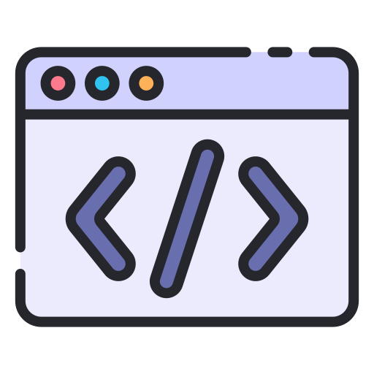
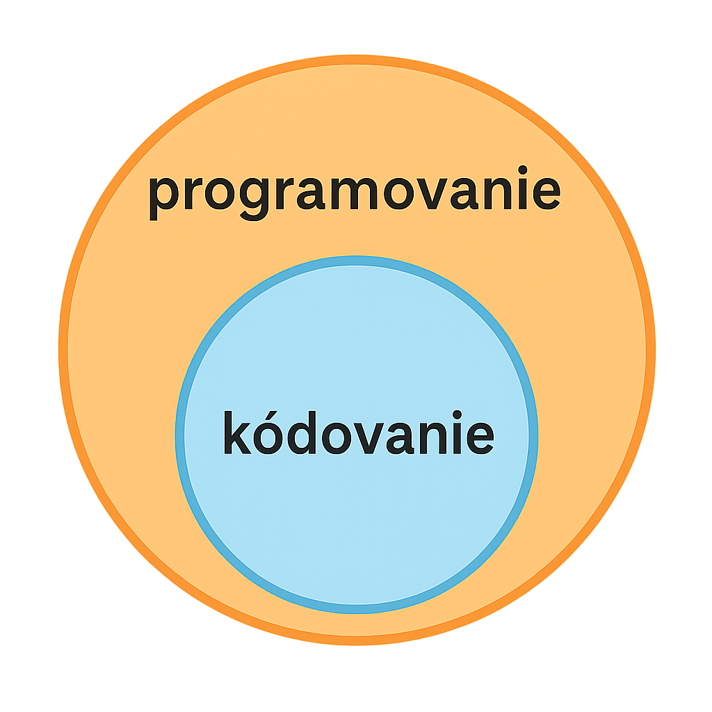
Programming vs. Coding
Preparing software or a program
Implementing requirements into code
Debugging and testing
Creating program documentation, etc.
programming
Our input that the computer can read
A subset of programming
Preparing the code itself
Language and syntax
coding

Slide 8

Python
Programming language
Simple syntax
General-purpose focus (various applications)
Open source
Large number of libraries

Slide 9
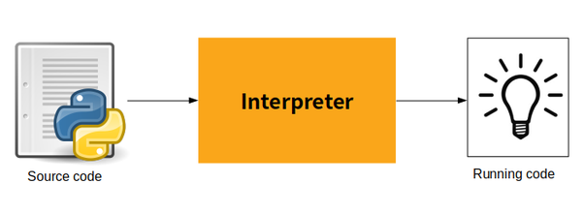
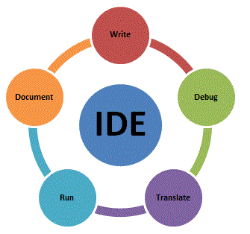

Interpreter and Environment
Interpreter – “interprets” and runs code written in a given programming language
Python 3
Environment – an editor combining several functions (preparation, editing, running code, syntax...)
IDE – Integrated Development Environment
PyCharm

Slide 10
PyCharm and Python 3
Interpreter:
https://www.python.org/downloads/
IDE:
https://www.jetbrains.com/pycharm/download/?section=windows

Slide 11
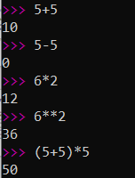
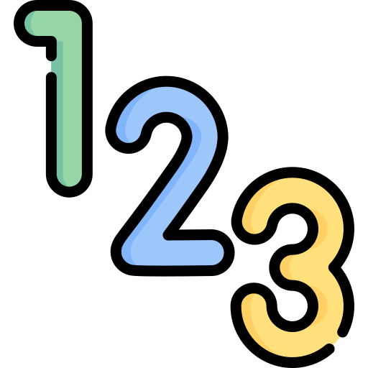
Exercise
Python likes numbers and mathematics. Try entering basic mathematical operations in the Python console.
Use either PyCharm or simply the console (search for “Python” in the bottom left).

Slide 12

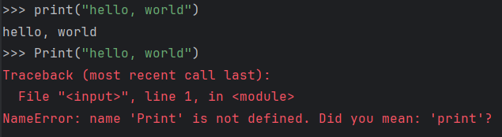
Exercise
Try printing text in the console. To print text, we need the “print” command, which has the following structure:
print("text")
print("Hello, World!")
Python is case-sensitive:

Slide 13
Exercise
In PyCharm (IDE), print your name and the university where you study on two separate lines. Try using the line separator (\n) (\ - AltGr + q).

Slide 14
Exercise
Print your name and the university where you study on two separate lines. There are several options; try using the line separator (\n) (\ = AltGr + q).
print("My name is Tomáš")
print("I study at UPJŠ")
print("My name is Tomáš \nI study at UPJŠ")
Alternatively, use a multiline string with """:
print("""My name is Tomáš
I study at UPJŠ""")

Slide 15
Exercise
Try adding at least 2 options and comment out one of them using #. This excludes the given part from the script by turning it into a comment. You can also comment out part of the text by selecting it and then using the shortcut: Ctrl + 0 + / or AltGr + x
print("My name is Tomáš")
print("I study at UPJŠ")
print("My name is Tomáš \nI study at UPJŠ")
Alternatively, use a multiline string with """:
print("""My name is Tomáš
I study at UPJŠ""")

Slide 16
Exercise
Try adding at least 2 options and comment out one of them using #. This excludes the given part from the script by turning it into a comment. You can also comment out part of the script by selecting it and then using the shortcut: Ctrl + 0 + /
# print("My name is Tomáš")
# print("I study at UPJŠ")
#
# print("My name is Tomáš \nI study at UPJŠ")
print("""My name is Tomáš
I study at UPJŠ""")

Slide 17

Artificial Intelligence in Programming
Code generation
Proposing modifications
Debugging
Explaining code
Correctly defining the request – key for precise understanding by artificial intelligence
Inputs that are too long for AI – better to divide them into smaller parts

Slide 18
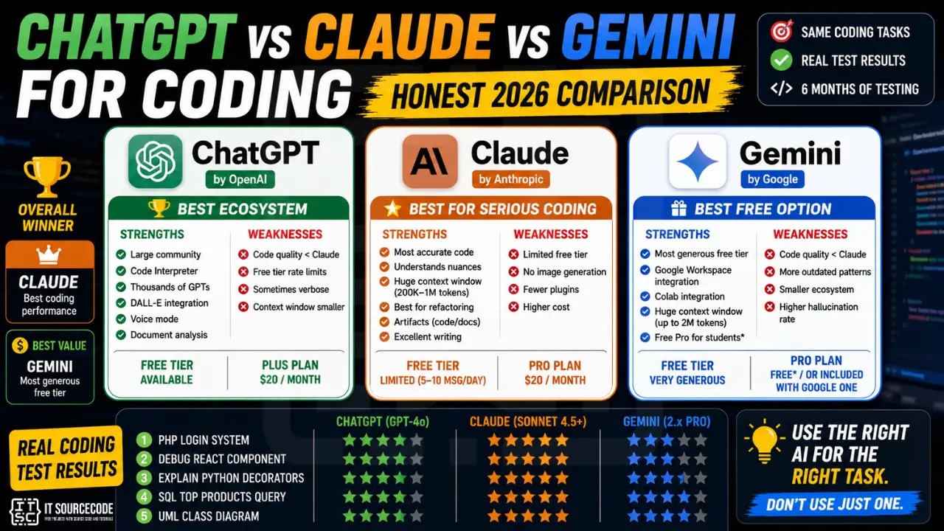
What Tools Are Available?
Various tools
Claude – top!

Slide 19
Exercise
Using one of the AI tools, generate simple Python code that prints the sum of two numbers in PyCharm.

Slide 20
Exercise
Using one of the AI tools, generate simple Python code that prints the sum of two numbers in PyCharm.
Input: “write me a simple python code that will make sum of two numbers.”
# Simple program to add two numbers
# Input two numbers
num1 = float(input("Enter first number: "))
num2 = float(input("Enter second number: "))
# Calculate the sum
sum_result = num1 + num2
# Display the result
print("The sum is:", sum_result)

Slide 21
Exercise
Using one of the AI tools, generate simple Python code that prints the sum of two numbers in PyCharm.
Input: “write me a simple python code that will make sum of two numbers.”
# Simple program to add two numbers
# Input two numbers
num1 = float(input("Enter first number: "))
num2 = float(input("Enter second number: "))
# Calculate the sum
sum_result = num1 + num2
# Display the result
print("The sum is:", sum_result)
What if we define the input differently?
What result will we get using a different AI tool?

Slide 22
Exercise
Create code that converts distance from kilometers to miles.

Slide 23
Exercise
Create code that converts distance from kilometers to miles.
Input: Write me a python code that will convert kilometers to miles.
# Input distance in kilometers
kilometers = float(input("Enter distance in kilometers: "))
# Conversion factor
conversion_factor = 0.621371
# Calculate miles
miles = kilometers * conversion_factor
# Display result
print(f"{kilometers} kilometers is equal to {miles} miles.")

Slide 24
Exercise
Create code to calculate the area of a rectangle.

Slide 25
Exercise
Create code to calculate the area of a rectangle.
“Write a python function that calculates the area of a rectangle given width and height.”
def rectangle_area(width, height):
"""Return the area of a rectangle given width and height."""
return width * height
print(rectangle_area(5, 10))

Slide 26
Exercise
Using AI, generate simple code for:
  Converting temperature from Fahrenheit to Celsius.
  Calculating distance traveled based on speed and time.
  Calculating the volume of a cuboid.

Slide 27

Conclusion
What are the advantages of using AI for code creation?
What are the limitations and what should you watch out for?
How can AI be applied in code creation in geography?

Slide 28
Conclusion
What are the advantages of using AI for code creation?
What are the limitations and what should you watch out for?
How can AI be applied in code creation in geography?
AI – a powerful assistant, but you are in control!

