Slide 1





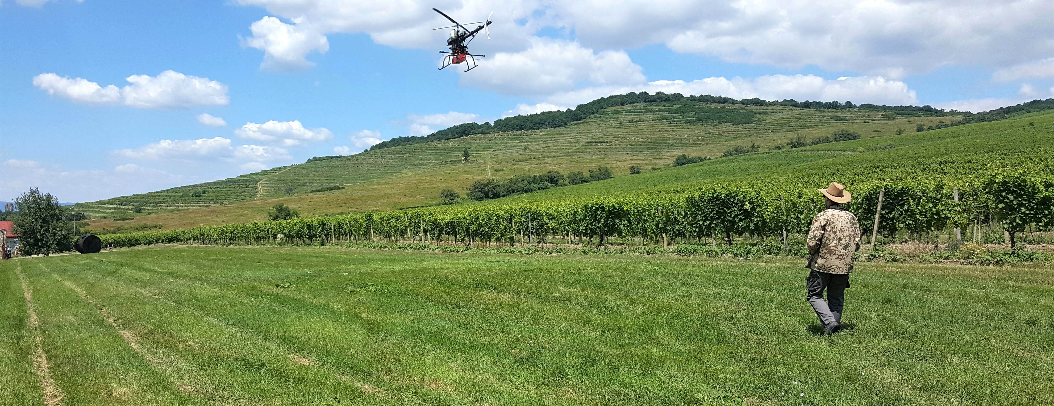

INTERNATIONAL REMOTE SENSING SUMMER SCHOOL
Experiencing Remote Sensing on Sardinia inland site: Advanced summer school
on instruments and methodology for a CAL/VAL site for Optical data
San Vero MiLIS | italy | 17. - 21. july 2023
Airborne Laser Scanning
data quality assessment, lidar data classification, geomorphometric analysis
Ján kaňuk, Ján ŠAŠAK, Michal gallay, Katarína onačillová
INSTITUTE OF GEOGRAPHY, FACULTY OF SCIENCE, PAVOL JOZEF ŠAFÁRIK UNIVERSITY IN KOŠICE, SLOVAKIA
geografia.science.upjs.sk
jan.kanuk@upjs.sk

Slide 2


LiDAR data Classification
Tool: lasindex (ak je potrebné)
  the tool creates LAX file that contains spatial indexing information
Tool: lastile
  the tool tiles point cloud into regular square tiles
  Parameters: tile size 50 m
  buffer 5 m
  ll_x (shift along the X axis) 57 m
  ll_y (shift along the Y axis) 30 m
  Parametre si prispôsobte podľa veľkosti územia a počtu bodov. Ak máte viac ako 1,5 mil. bodov, musíte ich rozdeliť do viacerých dlaždíc (tiles).
Notes:
With a push-broom spectrometer, full spectral image data are recorded simultaneously per line
However, each line of airborne pushbroom images is collected at different time instants. Perspective geometry varies with each pushbroom line, leading to different line displacement, and thus turning the rectification process more difficult

Slide 3
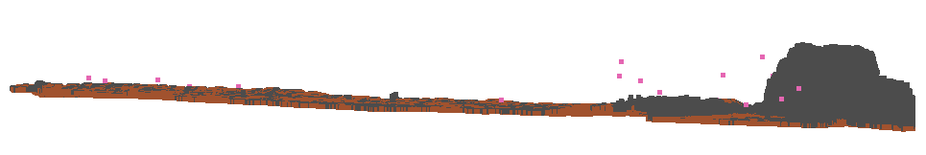
LiDAR data Classification
Tool: lasnoise
  removes or flags isolated (noise) points from point cloud
NOISE
Vyskúšajte najprv defaultne parametre stepxy, step z a isolated.
Ak nebudú fungovať dobre, skúste ich zmeniť.
Notes:
With a push-broom spectrometer, full spectral image data are recorded simultaneously per line
However, each line of airborne pushbroom images is collected at different time instants. Perspective geometry varies with each pushbroom line, leading to different line displacement, and thus turning the rectification process more difficult

Slide 4
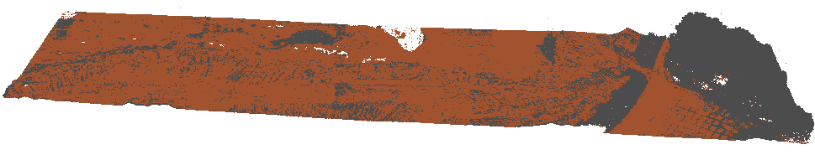
LiDAR data Classification
Tool: lasground
  extracts ground points from point cloud and splits the points into two categories – ground and unclassified points
  Landscape type zvoľte na základe toho, či sa na vašom území nachádzajú budovy alebo nie. Ak tam máte plošne malé domy, zvoľte town or flats, ak ide o mestskú zástavbu, zvoľte city or warehouse.
  Parameters: landscape type - wilderness
  ignore points – low noise (7) and high noise (18)
  tick the option „compute height“
ground points
unclassified points
Notes:
With a push-broom spectrometer, full spectral image data are recorded simultaneously per line
However, each line of airborne pushbroom images is collected at different time instants. Perspective geometry varies with each pushbroom line, leading to different line displacement, and thus turning the rectification process more difficult

Slide 5
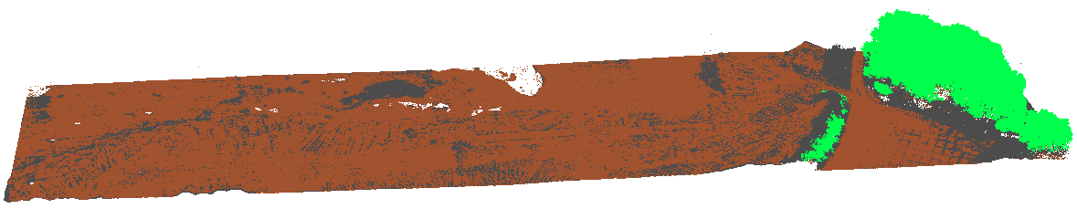
LiDAR data Classification
Tool: lasclassify
  classifies unclassified points to buildings and vegetation categories
ground points
unclassified points
vegetation
Notes:
With a push-broom spectrometer, full spectral image data are recorded simultaneously per line
However, each line of airborne pushbroom images is collected at different time instants. Perspective geometry varies with each pushbroom line, leading to different line displacement, and thus turning the rectification process more difficult

Slide 6
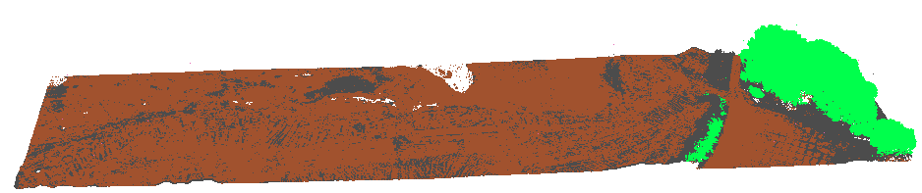

LiDAR data Classification
Tool: las2las
  exports ground points from classified point cloud
  Parameters: filter by classification or return – keep_classification – number or value „2“
Notes:
With a push-broom spectrometer, full spectral image data are recorded simultaneously per line
However, each line of airborne pushbroom images is collected at different time instants. Perspective geometry varies with each pushbroom line, leading to different line displacement, and thus turning the rectification process more difficult

Slide 7
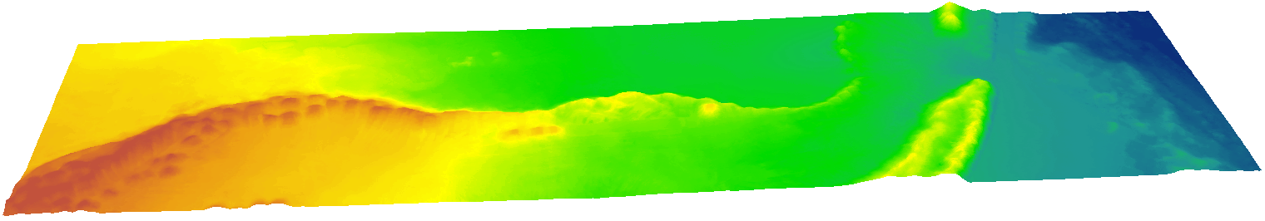
GEOmorphometric analysis
Tool: blas2dem
  creates raster models of elevation
  Parameters: step 0.1 m; item - elevation
Notes:
With a push-broom spectrometer, full spectral image data are recorded simultaneously per line
However, each line of airborne pushbroom images is collected at different time instants. Perspective geometry varies with each pushbroom line, leading to different line displacement, and thus turning the rectification process more difficult

Slide 8

INTERNATIONAL REMOTE SENSING SUMMER SCHOOL
Experiencing Remote Sensing on Sardinia inland site: Advanced summer school
on instruments and methodology for a CAL/VAL site for Optical data
San Vero MiLIS | italy | 17. - 21. july 2023
THANK YOU
FOR
YOUR ATTENTION
Ján kaňuk, Ján ŠAŠAK, Michal gallay, Katarína onačillová
INSTITUTE OF GEOGRAPHY, FACULTY OF SCIENCE, PAVOL JOZEF ŠAFÁRIK UNIVERSITY IN KOŠICE, SLOVAKIA
geografia.science.upjs.sk
jan.kanuk@upjs.sk

