Slide 1





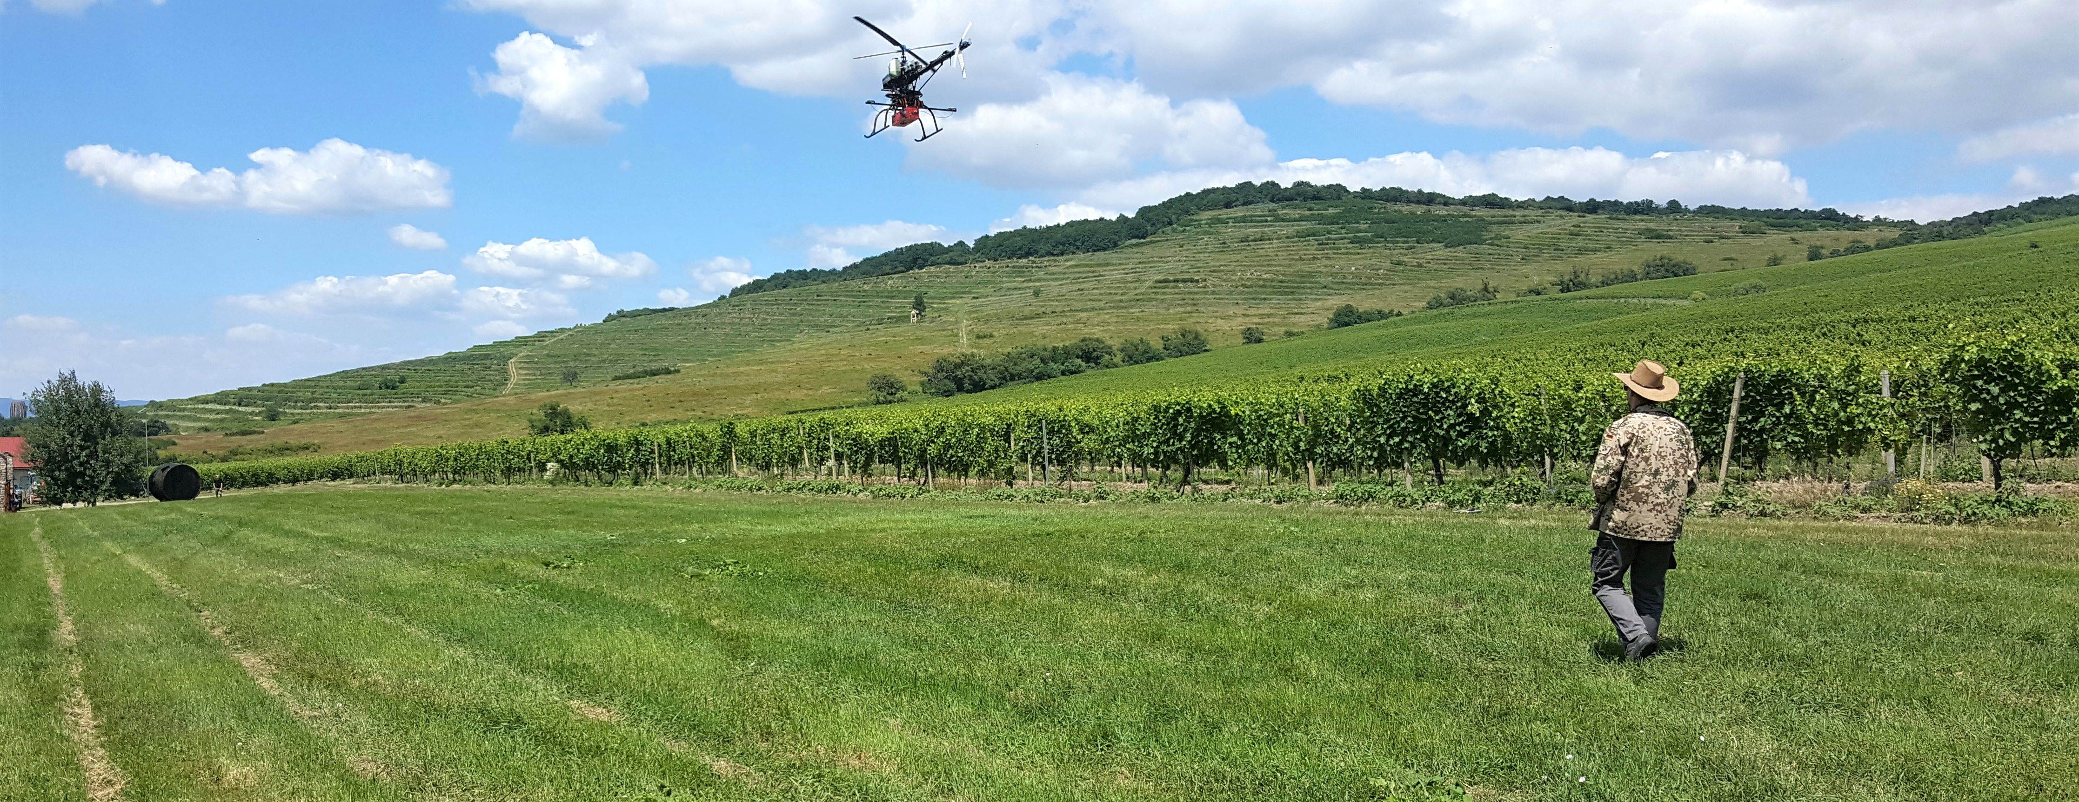

INTERNATIONAL REMOTE SENSING SUMMER SCHOOL
Experiencing Remote Sensing on Sardinia inland site: Advanced summer school
on instruments and methodology for a CAL/VAL site for Optical data
San Vero MiLIS | italy | 17. - 21. july 2023
A
A
Michal gallay, Ján kaňuk, Ján ŠAŠAK, Katarína onačillová
INSTITUTE OF GEOGRAPHY, FACULTY OF SCIENCE, PAVOL JOZEF ŠAFÁRIK UNIVERSITY IN KOŠICE, SLOVAKIA
geografia.science.upjs.sk
katarina.onacillova@upjs.sk

Slide 2
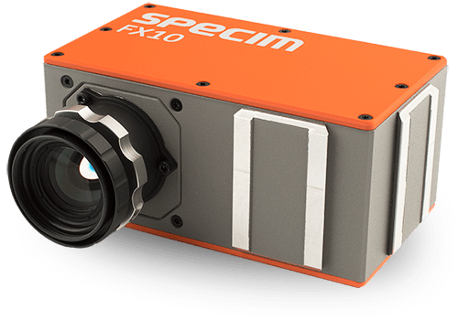
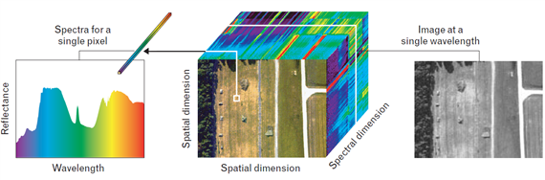
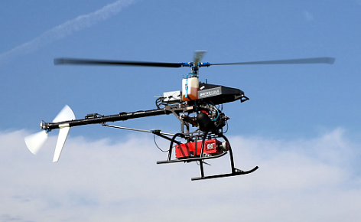


STATE-OF-THE-ART
Hyperspectral imaging sensors:
Capture reflected electromagnetic energy in hundreds of contiguous narrow spectral bands
Combined with UAS:
fast, flexible and non-destructive detection
of subtle spectral features
Chance to develop R&D infrastructure via
the EU structural funds
INSTITUTE OF GEOGRAPHY, FACULTY OF SCIENCE, PAVOL JOZEF ŠAFÁRIK UNIVERSITY IN KOŠICE, SLOVAKIA
geografia.science.upjs.sk
katarina.onacillova@upjs.sk
Notes:
While the photo cameras or multispectral cameras have been the most popular sensors for mini and small UAV systems, the integrated use of UAV hyperspectral imaging and/or laser scanning is a recent issue, because of reducing the size and weight of hyperspectral scanner allows for their integration on UAV platforms. Hyperspectral remote sensing, also known as imaging spectroscopy, is a relatively new technology for UAV platforms that has been used in detection of vegetation species and biomass (Aasen, H. et al., 2015) or precision agriculture (Zarco-Tejada et al., 2013; Bareth et al., 2015; Sima et al., 2016).
Hyperspectral imaging sensors (spectrometers) capture reflected electromagnetic energy in hundreds of contiguous narrow spectral bands with high spectral resolution, typically in visible and near-infrared spectrum. Such sensors combined with unpiloted aerial systems (UAS) enable fast, flexible and non-destructive detection of subtle spectral features and dynamics of landscape changes.
The power and value of hyperspectral imaging four our team is in its capability to - Identify, Quantify (Measure) and Map landscape properties in each pixel of the target image.

Slide 3
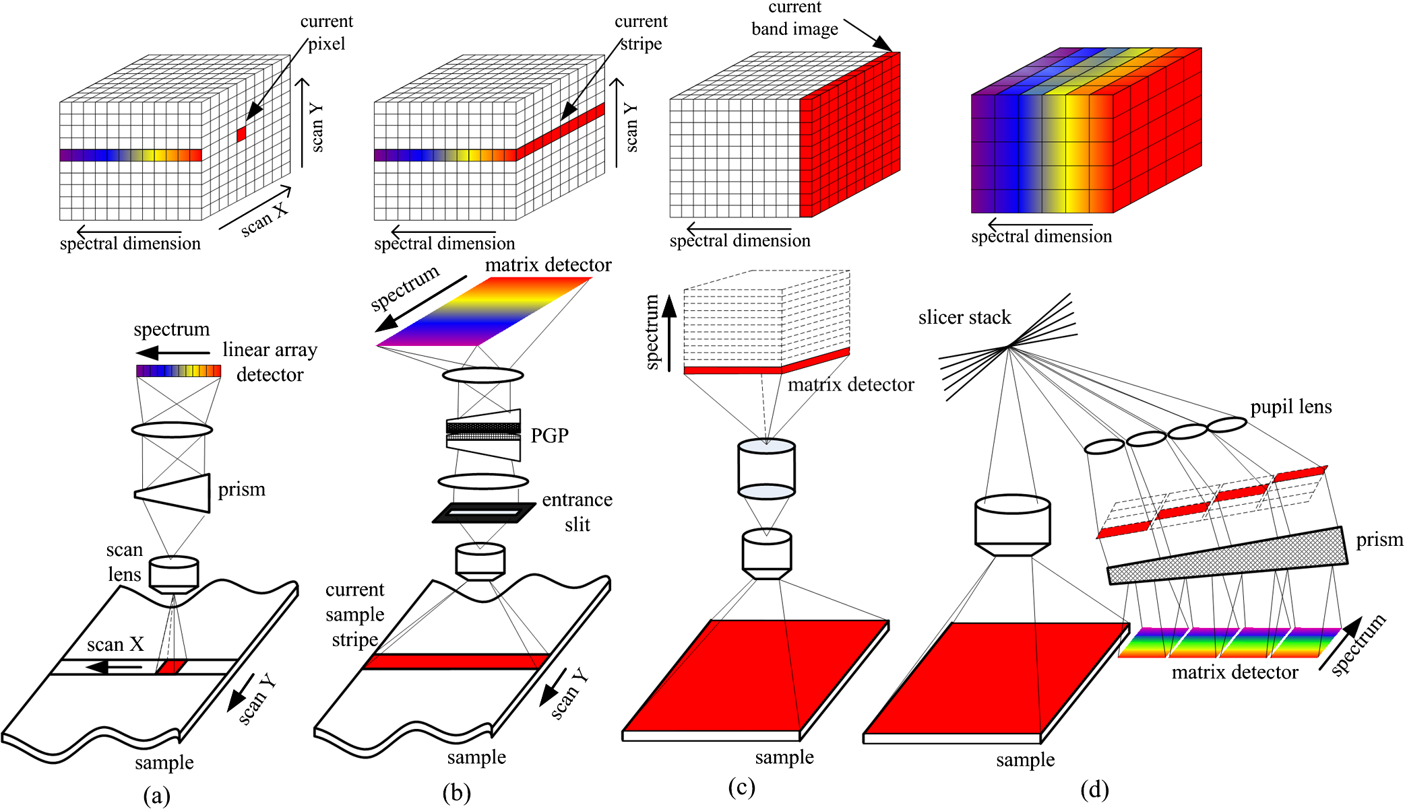
STATE-OF-THE-ART
Push-broom vs other typical spectral imaging approaches
PUSH-BROOM
Full spectral data simultaneously
Image is recorded per line, for all wavelenghts at the same time
Whiskbroom
Pushbroom
Staring
Snapshot
Quingly, L. et al (2013)
Notes:
“Pushbroom” spectrometers use a 2D detector array, and thus collect a vertical slice of the datacube at once so that only one spatial dimension needs to be scanned to fill out the cube.2 A filtered camera, constructed by placing a filter wheel or tunable spectral filter in front of a camera, collects a horizontal slice and thus needs to scan along the spectral dimension to complete the data set.
Pushbroom: Full spectral data simultaneously, with spatial line scanning over time. Imaging spectrograph + 2D array detector
The pushbroom approach, also known as line scanning, has been used by some earth observation satellite systems operating from space, such as the SPOT system. Different from the whiskbroom method that scans one point at a time, the pushbroom method can simultaneously. acquire a slit of spatial information, as well as spectral information corresponding to each spatial point in the slit for one scan, that is, a special y − λ image with one spatial dimension (y) and one spectral dimension (λ) can be taken at the same time with a matrix detector. As shown in Fig. 2(b), the pushbroom method collects a slit image from the object dispersed onto a 2-D detector, in which the spatial information is displayed along one axis and wavelength information along the other. Then the spectral image data cube can be obtained by scanning the slit in the direction of another spatial axis. A pushbroom scanner can get more light than the whiskbroom one, since it can stay at a particular area for a longer time providing a long exposure on the matrix detector and a relatively high spectral resolution as well. However, in most of the pushbroom imagers, either the camera or the object should move accordingly as one line of the image is acquired at each scan and the move should be synchronized with the frame acquisition rate of the array detector in order to ensure the measurement of a smooth image. Another approach to perform the pushbroom procedure is to put a movable slit aperture or a rolling shutter into the conjugate image plane to eliminate out-of-focus light. This method allows for higher illumination transmission while exhibiting only a slight increase in the confocal depth response, which has been widely used in multispectral line confocal imaging systems.

Slide 4
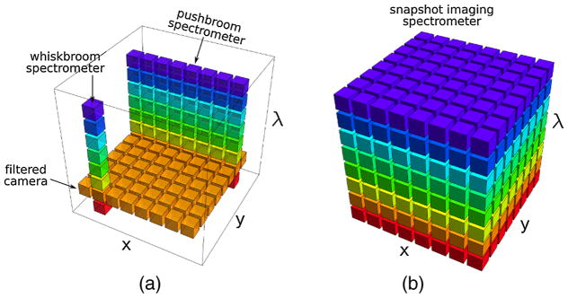
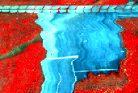
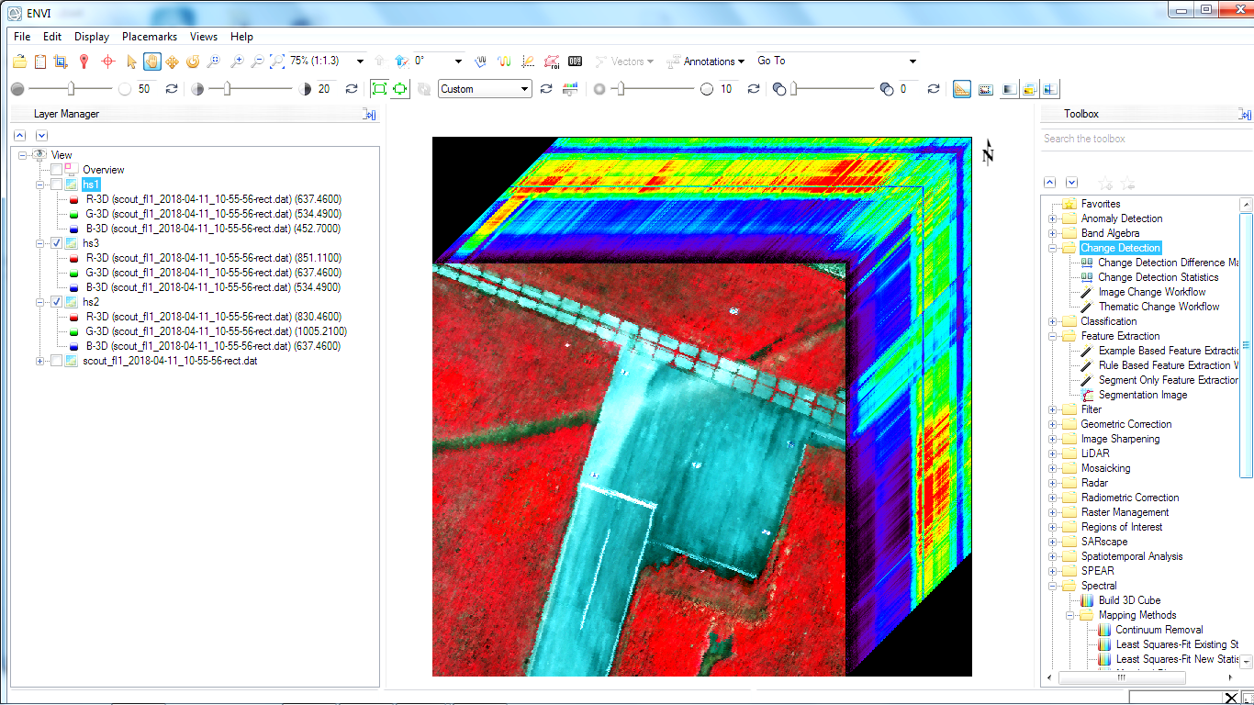
STATE-OF-THE-ART
Rectification process
  With a push-broom spectrometer, full spectral image is recorded per line
  However, each line of airborne pushbroom images is collected at different time instants
  perspective geometry varies with each line
  different line displacement
  Rectification process is needed
Notes:
With a push-broom spectrometer, full spectral image data are recorded simultaneously per line
However, each line of airborne pushbroom images is collected at different time instants. Perspective geometry varies with each pushbroom line, leading to different line displacement, and thus turning the rectification process more difficult

Slide 5
STATE-OF-THE-ART
Boresight calibration of push-broom sensor
  Rectification of the raw image data:
  requires measuring position and attitude of the sensor enabled by IMU/GNSS unit on-board the UAV
  Accurate alignment of overlapping data strips requires compensating for geometric distortions caused by boresight misalignment → BORESIGHT CALIBRATION
Notes:
Rectification of the raw image data requires measuring the position and attitude the sensor which is enabled by IMU/GNSS unit on-board the UAV
Accurate alignment of overlapping data strips requires compensating for geometric distortions caused by boresight misalignment - boresight calibration

Slide 6
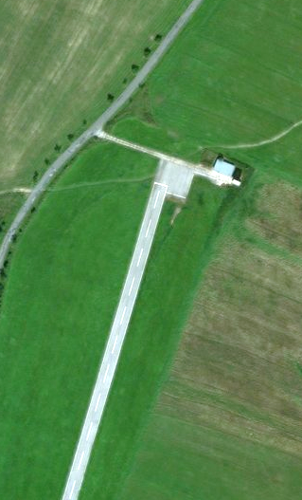
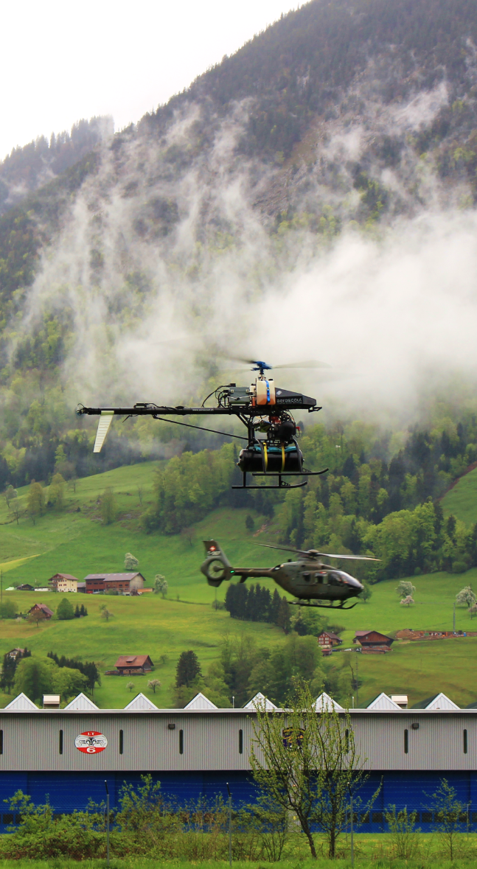
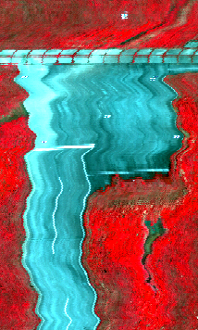
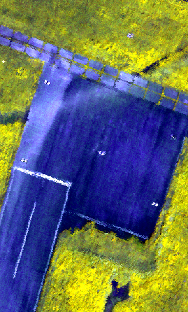
HYPERSPEctral mission
LOCATION
DATA ACQUISITION
DATA PROCESSING
RESULTS

Slide 7
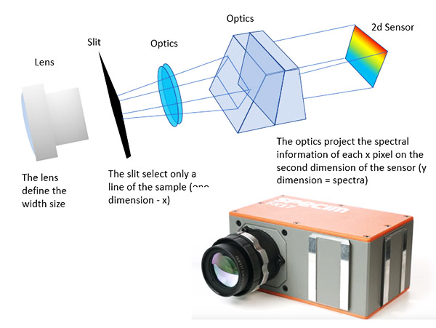

Data acquisition
Hyperspectral payload
AISA Kestrel 10
  Push-broom camera, 4.75 kg
  F/2.4, FOV: 40°
  Spatial resolution: 1024 or 2048 pix.
  Spectral range: 400 – 1000 nm
  Spectral sampling: 1.75/3.5/7 nm
  Max. number of spectral bands: 342
  Frame rate: <130 Hz
  S/N peak: 400-800
  Total system power: <41 W

Slide 8

INTERNATIONAL REMOTE SENSING SUMMER SCHOOL
Experiencing Remote Sensing on Sardinia inland site: Advanced summer school
on instruments and methodology for a CAL/VAL site for Optical data
San Vero MiLIS | italy | 17. - 21. july 2023
THANK YOU
FOR
YOUR ATTENTION
Michal gallay, Ján kaňuk, Ján ŠAŠAK, Katarína onačillová
INSTITUTE OF GEOGRAPHY, FACULTY OF SCIENCE, PAVOL JOZEF ŠAFÁRIK UNIVERSITY IN KOŠICE, SLOVAKIA
geografia.science.upjs.sk
katarina.onacillova@upjs.sk

Slide 9
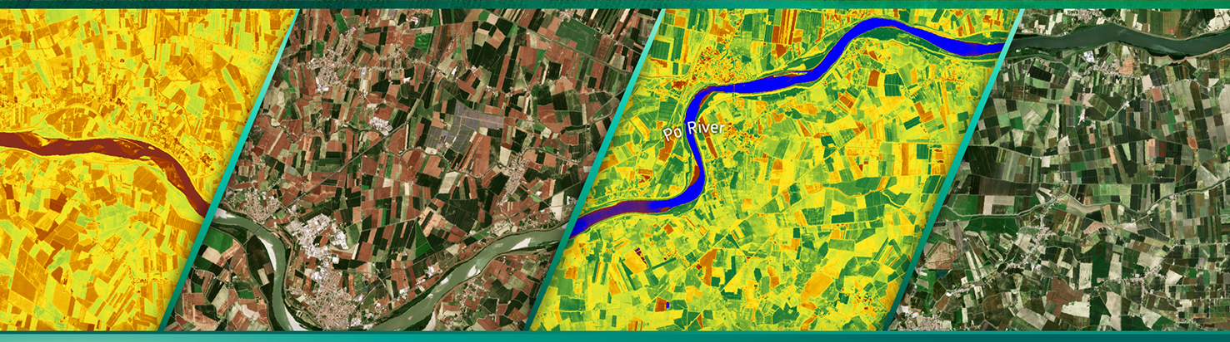
INTERNATIONAL REMOTE SENSING SUMMER SCHOOL
Experiencing Remote Sensing on Sardinia inland site: Advanced summer school
on instruments and methodology for a CAL/VAL site for Optical data
San Vero MiLIS | italy | 17. - 21. july 2023
A
a
Michal gallay, Ján kaňuk, Ján ŠAŠAK, Katarína onačillová
INSTITUTE OF GEOGRAPHY, FACULTY OF SCIENCE, PAVOL JOZEF ŠAFÁRIK UNIVERSITY IN KOŠICE, SLOVAKIA
geografia.science.upjs.sk
katarina.onacillova@upjs.sk

Slide 10
A
- a
A

Slide 11
INTERNATIONAL REMOTE SENSING SUMMER SCHOOL
Experiencing Remote Sensing on Sardinia inland site: Advanced summer school
on instruments and methodology for a CAL/VAL site for Optical data
San Vero MiLIS | italy | 17. - 21. july 2023
THANK YOU FOR YOUR ATTENTION
Michal gallay, Ján kaňuk, Ján ŠAŠAK, Katarína onačillová
INSTITUTE OF GEOGRAPHY, FACULTY OF SCIENCE, PAVOL JOZEF ŠAFÁRIK UNIVERSITY IN KOŠICE, SLOVAKIA
geografia.science.upjs.sk
katarina.onacillova@upjs.sk

