Slide 1
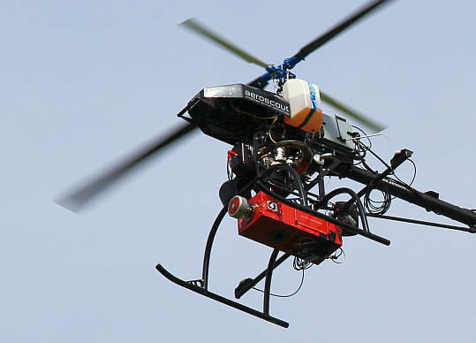

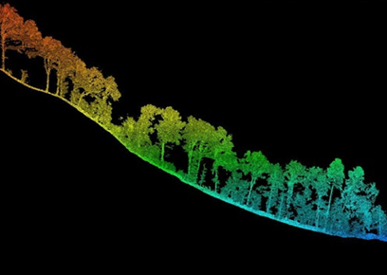
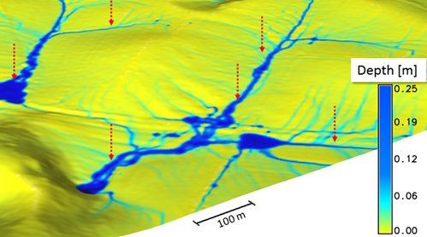




Tematické prieniky geografie a geoinformatiky a informatiky na ÚGE
Diplomový seminár
Michal GALLAY
Institute of Gegraphy
Faculty of Science
Pavol Jozef Šafárik University in Košice
geografia.science.upjs.sk

Slide 2
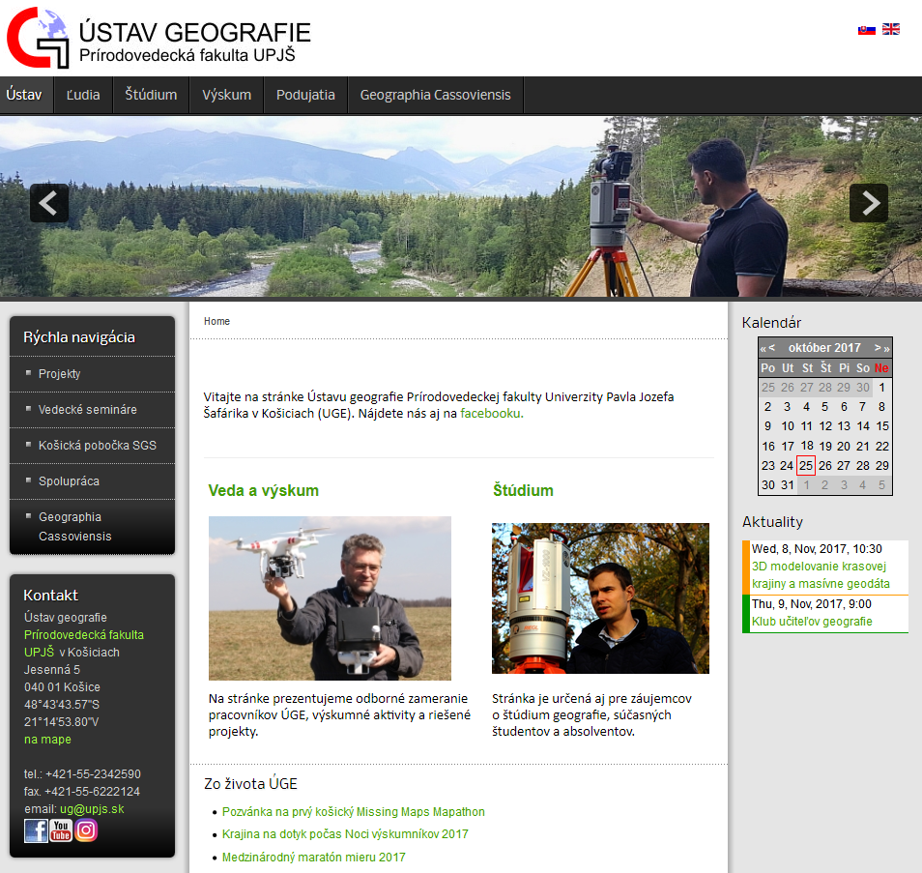
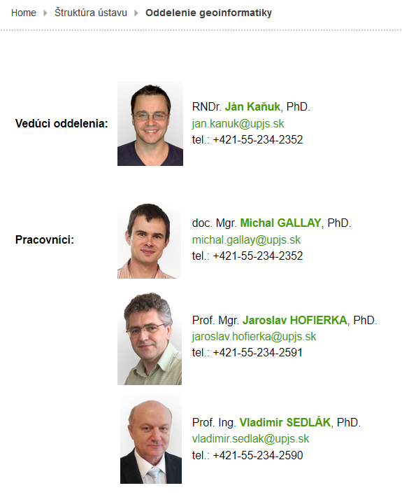
http://geo.ics.upjs.sk/

Slide 3
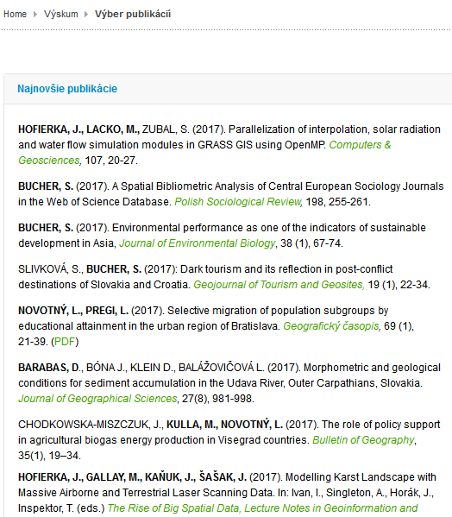
http://geo.ics.upjs.sk/

Slide 4
State-of-the-art in geospatial science
Wide use of sensors (data loggers, remote sensing, IoT)
Generating large amount of data where location matters
  Often 3D points + atributes
Integration of various kinds of big data
  Airborne +terrestrial scanning + multispectral + hyperspectral.
Processing and analysis of the big data is challenging with standard geospatial tools (desktop GIS).
  Surprisingly, most of the current GIS software exploits these advances in a very limited way.
  Still many operations are executed by a single process.
  Some geospatial tasks are more complex and computationally very intensive.
Notes:
Over the last decades, the advances in multi-core processor architecture enabled parallel processing that can better utilize the power of modern computers. The need for a better computer performance is also stimulated by the increasing availability of massive geospatial data, such as from laser scanning. However, this requires specific software with the ability to employ parallel computational capabilities

Slide 5
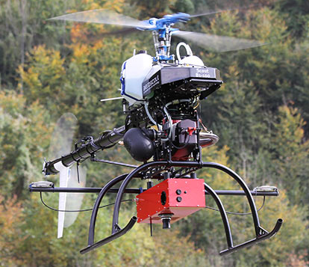
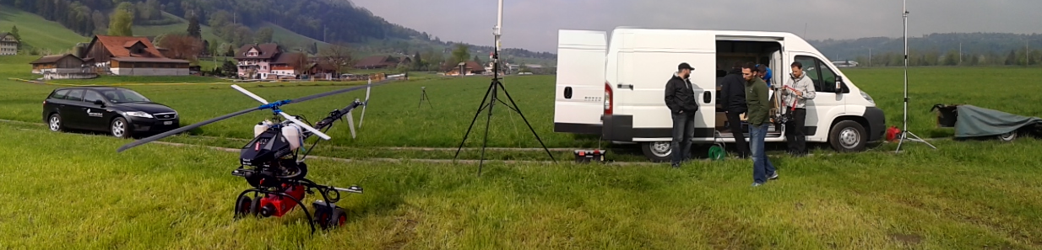
Collection of high resolution spatial data
Riegl VUX-1 laser scanner + digital camera
AISA Kestrel 10 hyperspectral camera
Notes:
Over the last decades, the advances in multi-core processor architecture enabled parallel processing that can better utilize the power of modern computers. The need for a better computer performance is also stimulated by the increasing availability of massive geospatial data, such as from laser scanning. However, this requires specific software with the ability to employ parallel computational capabilities

Slide 6
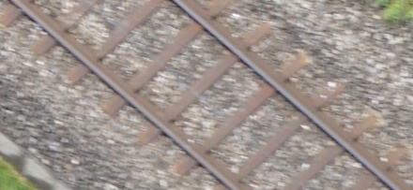
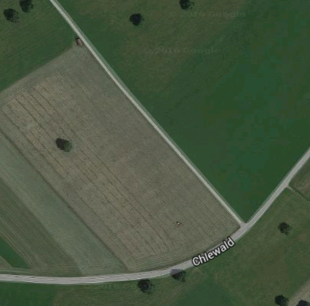
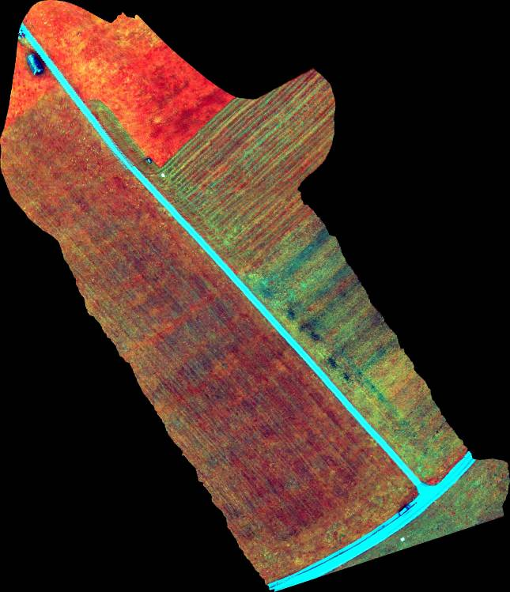
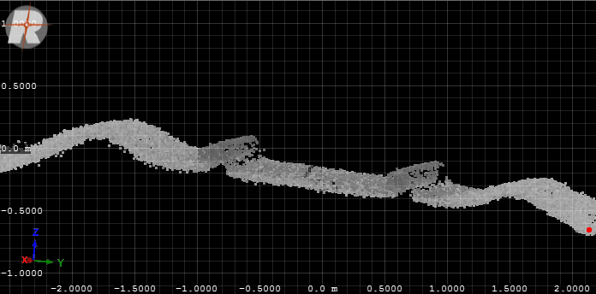
Collection of high resolution spatial data
High accuracy in geometric domain
High accuracy in spectral domain
100 m
Example of a point cloud, 1500 points/m2
Riegl VUX-1 laser scanner + digital camera
AISA Kestrel 10 hyperspectral camera
Notes:
Over the last decades, the advances in multi-core processor architecture enabled parallel processing that can better utilize the power of modern computers. The need for a better computer performance is also stimulated by the increasing availability of massive geospatial data, such as from laser scanning. However, this requires specific software with the ability to employ parallel computational capabilities

Slide 7
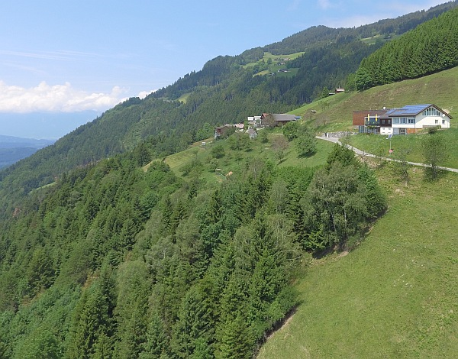
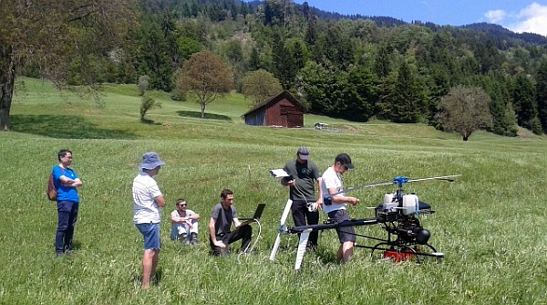
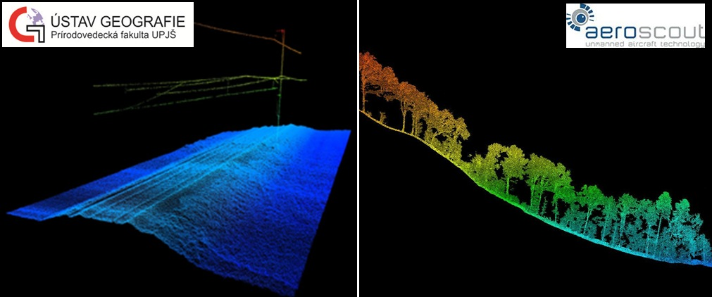
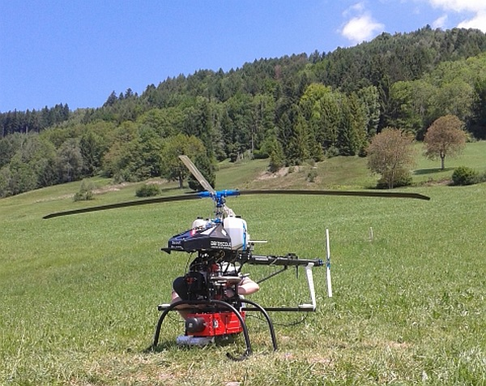
Laser scanning in the Alps, Austria
for Technical University in Vienna
Highly detailed geometric strcuture of the forest

Slide 8

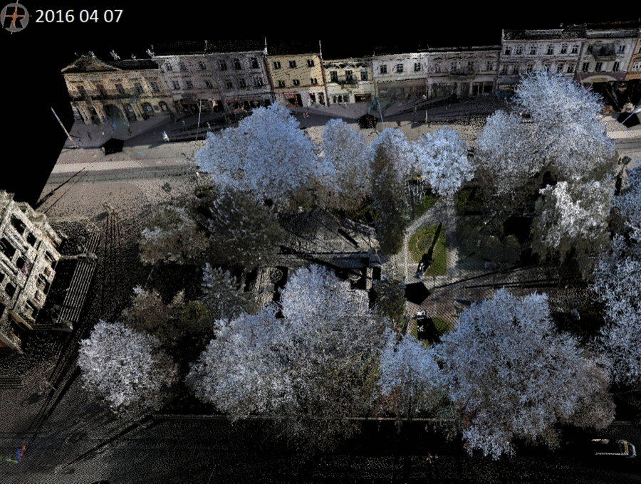
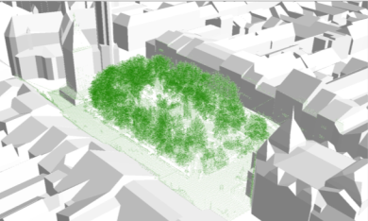
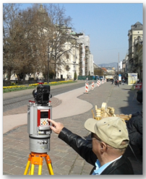
Collection of high resolution spatial data
  Time series of terrestrial laser scanning data
  Synchronous with the Sentinelom 2A sattellite
RIEGL VZ-1000
TLS time series - park Hlavná ulica, Košíce

Slide 9
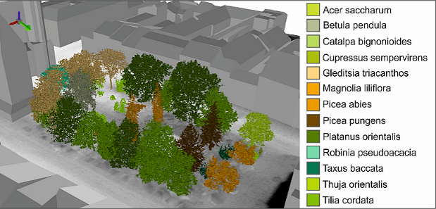
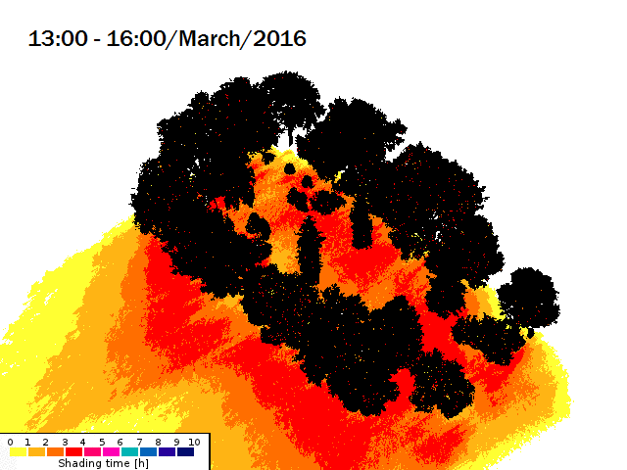
Methodology of processing
and analysis of big 3D data
  Time series of terrestrial laser scanning data for validating solar transmitrance from Sentinel 2A satellite.
Košice, Sentinel 2A
pixel = 10 m

Slide 10
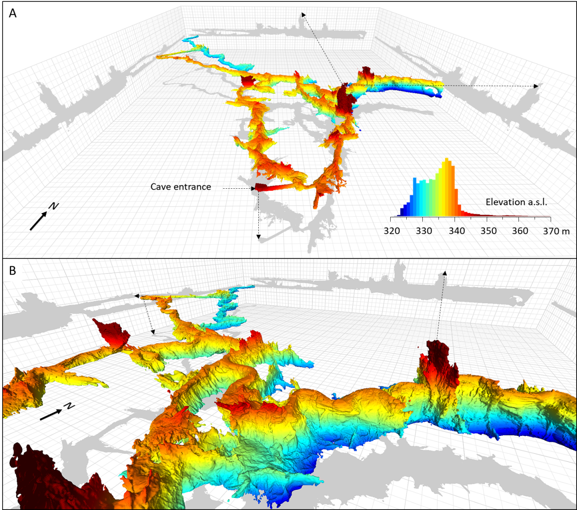
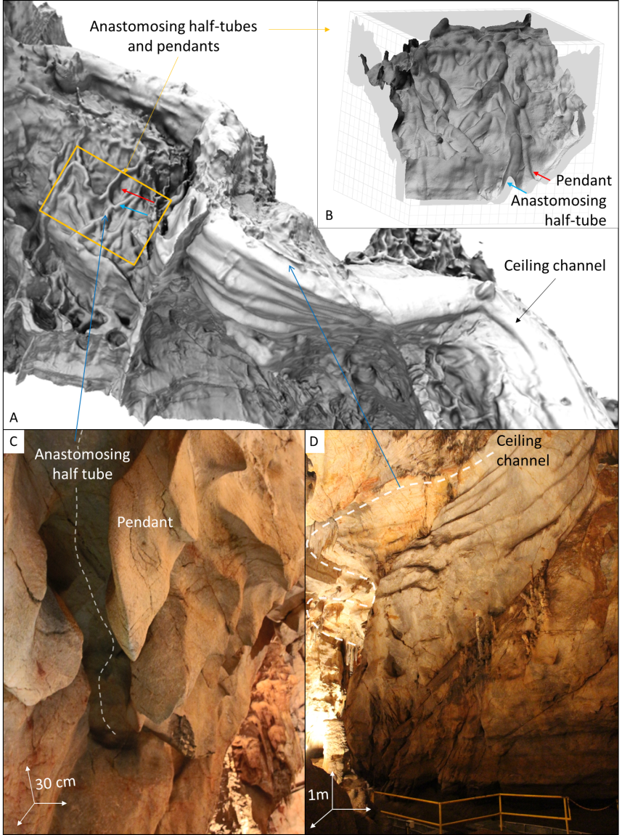
Methodology of processing
and analysis of big 3D data
  Efficient cave laser scanning, 3D meshing and 3D geomorphometry (cave surface analysis)
Domica cave, Slovakia

Slide 11
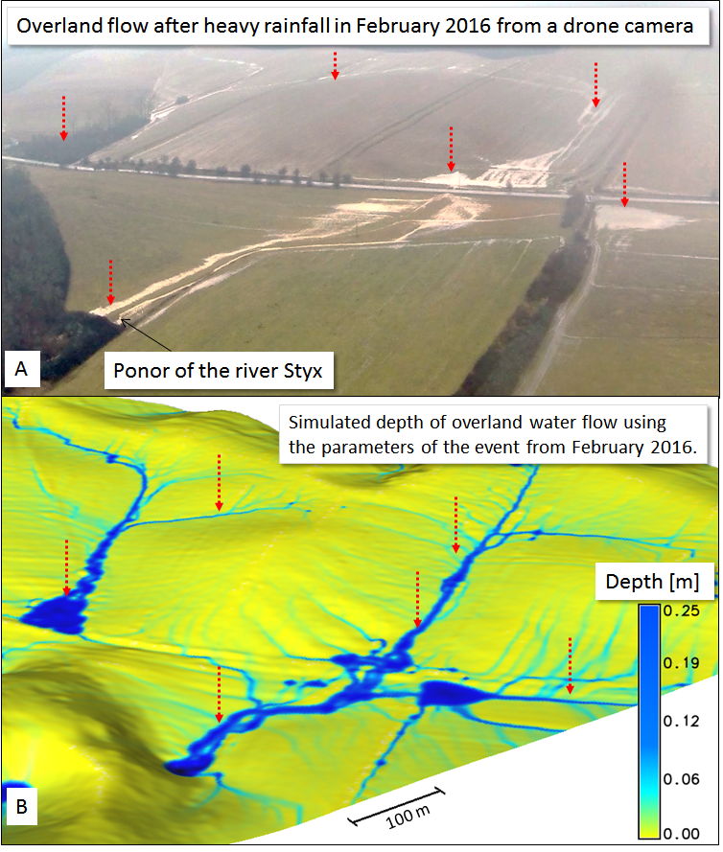

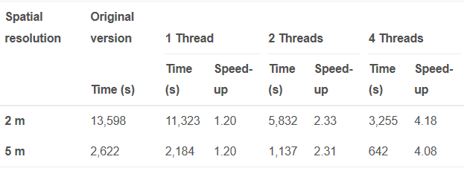
Parallelization of existing GIS routines
Parallelization of existing routines GIS
  spatial interpolation,
  solar radiation
  water flow simulation modules in GRASS GIS using OpenMP
Simulated flood based on high resolution laser scaning digitel terrain model

Slide 12
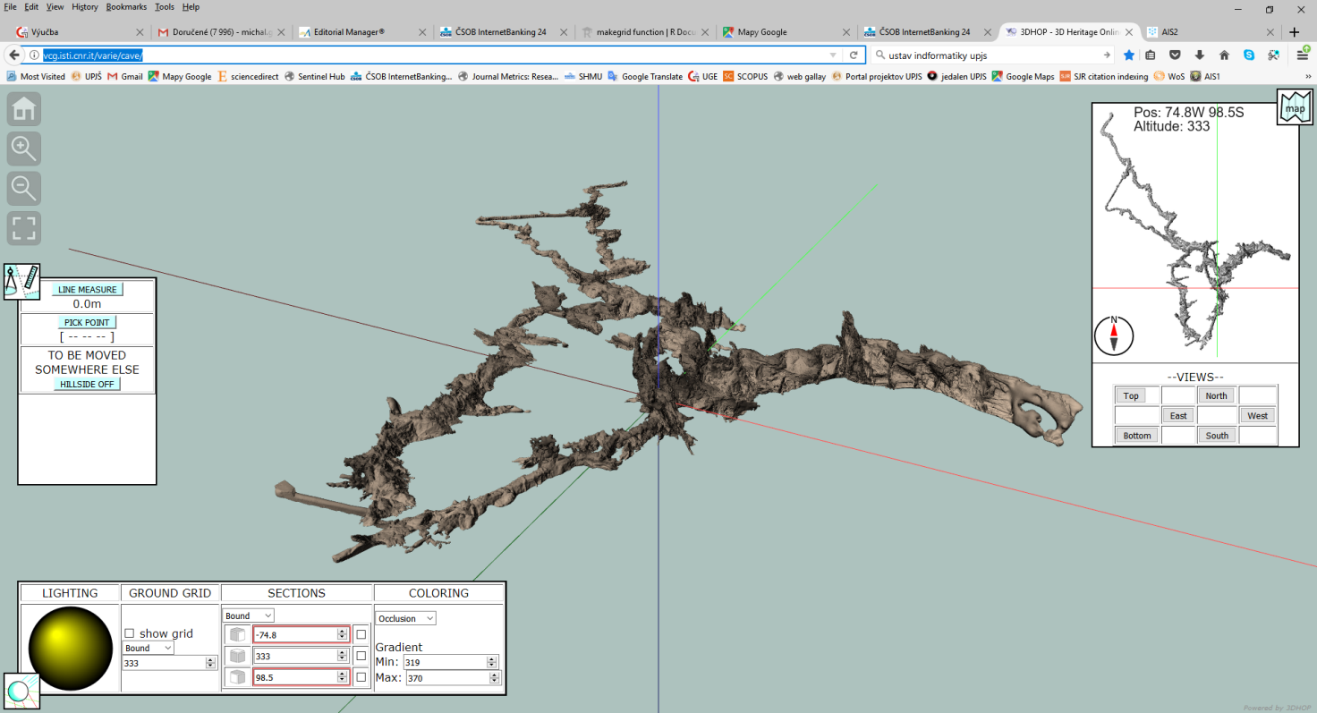
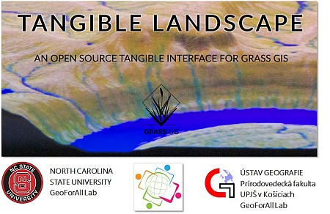
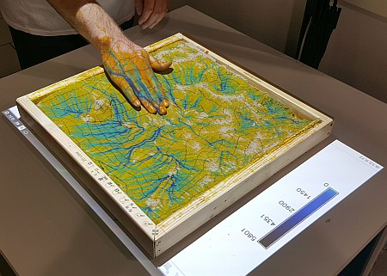
Interactive 3D visualisation
http://vcg.isti.cnr.it/varie/cave/
http://geo.ics.upjs.sk/index.php/19-zo-zivota-ustavu/441-krajina-na-dotyk-pocas-noci-vyskumnikov

Slide 13
Riešené geoinformatické témy diplomových prác s informatickým zameraním
Michal Lacko (2017, Mgr., ÚGE) - Spracovanie dát z bezpilotných leteckých zariadení pre potreby poľnohospodárstva
Phong Nguyen Tien (2018, ÚGE) – Modelovanie distribúcie slnečného žiarenia pomocou 3D modelov miest a open-source GRASS GIS-u
Antónia Matisová (2018, Bc., ÚINF) – Identifikácia kvapľov v 3D modeli jaskyne Domica

Slide 14
Hlavné okruhy
Big-spatial-data processing
Extraction of objects (buildings, landforms)
Algorithms for distributed computing
3D visualisation ()

Slide 15
Ďakujem za pozornosť !
Diplomový seminár
Michal GALLAY
Institute of Gegraphy
Faculty of Science
Pavol Jozef Šafárik University in Košice
geografia.science.upjs.sk

