Slide 1
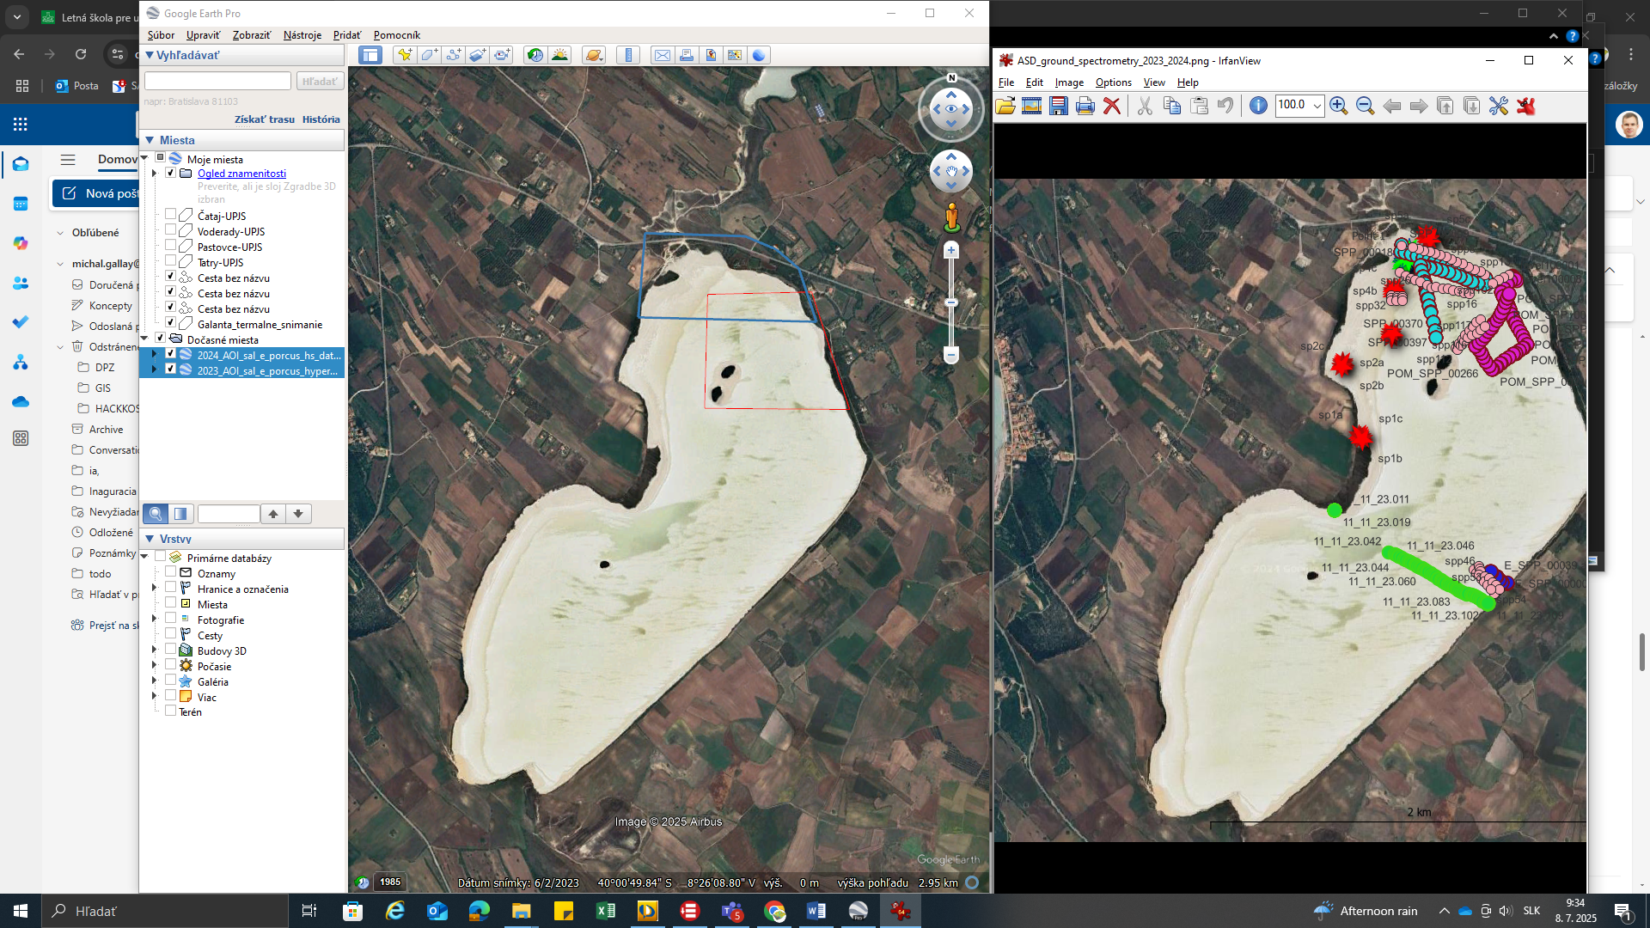
A
B
07/2023
We are staying in Albergo Menhiris
09/2024
C

Slide 2
A
B
07/2023
09/2024
C

