Slide 1
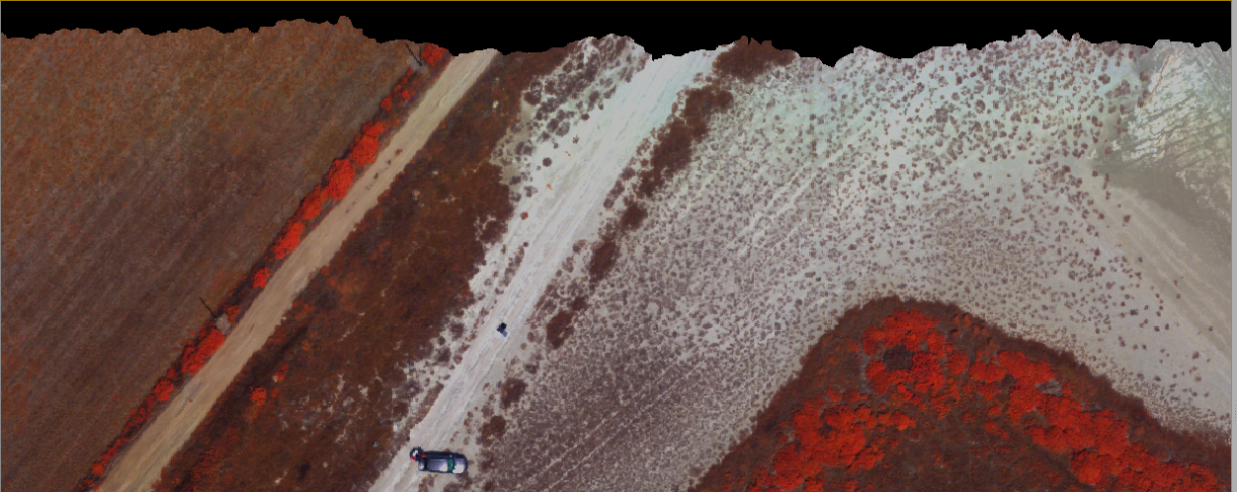
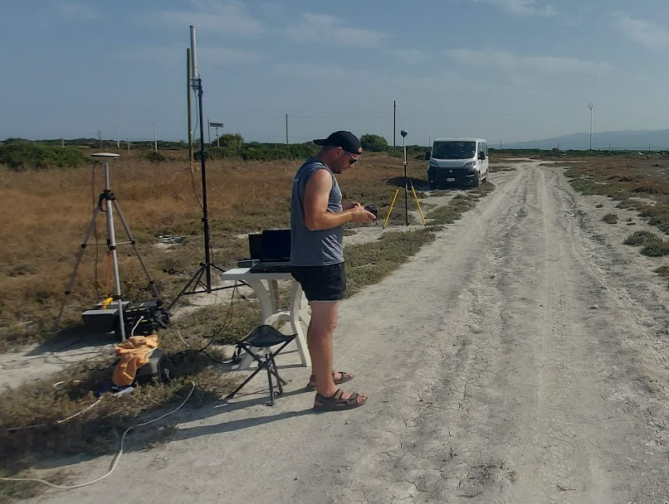
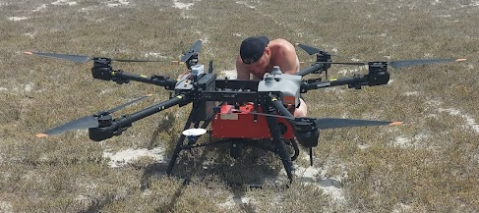
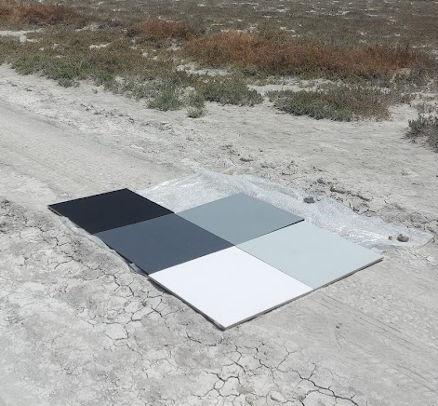
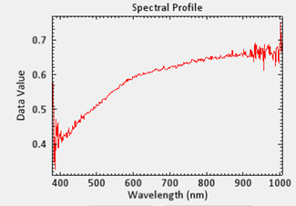
Hyperspectral data acquisition and processing
Stagno di Sal’e Porcus
18-20 July 2023
Michal Gallay, Ján Kaňuk, Ján Šašak, Katarína Onačillová

Slide 2
Description of UAV HS mission in the northern part of Salle Porcus, Sardegna, IRSS 2023
There were 2 UAV HS missions on Stagno di Salle Porcus, northern part
Tuesday 18.7.2023, sunny, grey sky with haze? of high cirrus, over 40C, between 11-13:00
Thursday 20.7.2023, sunny, blue sky, no visible cirrus, about 36C, between 11-14:00
Wednesday 19.7.2023, radiometric targets were spectraly measured in the field, they were put on the surface of the salt lake, ASD FieldSpec, by Maxximo from INGV Rome
Sensor: AISA Kestrel 10 by Specim
Above ground flying height: 80 m
Geospatial reference WGS 84 during acquisition,
after post-processing WSG 84 UTM 32 N
DSM for orthorectification: cell size 50 cm, derived from lidar VUX1 UAV scanning performed on 18/07/2023

Slide 3
Example of spatial accuracy with respect to orthophoto 2019 SardegnaSentieri.it
WSG 84 UTM 32 N

Slide 4
Flight trajectory and image line numbers
20 July 2023, spectral x spatial binning for data acquisition 2 x 2
Line 1
Line 2

Slide 5
Flight trajectory and image line numbers
20 July 2023, spectral x spatial binning for data acquisition 2 x 2
Line 3
Line 4
Line 5, includes radiom. targets
Line 6

Slide 6
Flight trajectory and image line numbers
18 July 2023, spectral x spatial binning for data acquisition 4 x 2
Line 7
Line 8
Line 9

Slide 7
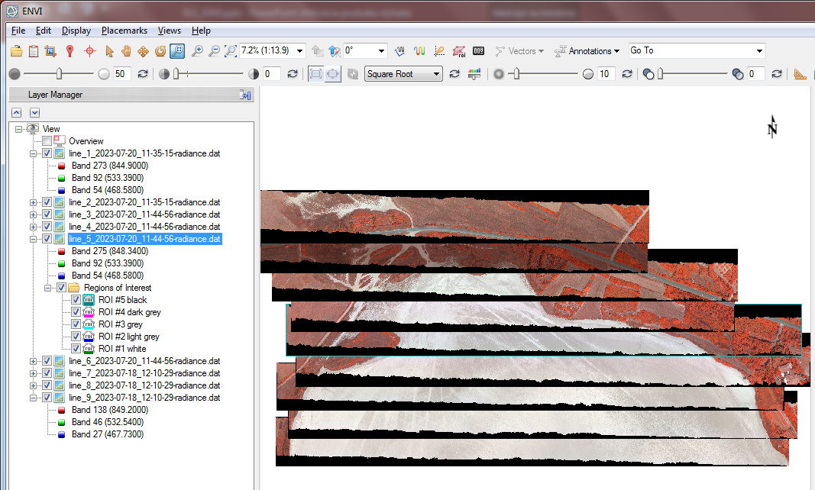
Line 1-6 acquired 20 July and lines 7,8,9 on 18 July 2023 raw data processed in CaligeoPro, a software by Specim
DN processed as raw data – dark current, then into radiance
Georeferenced AISA data file radiometrically corrected to radiance (mW/cm^2*str*um)*1000.00
Spectral x spatial
binning during acquisition flight
Line 1 : 2x2 – processed as 8x2
Line 2 : 2x2 – processed as 8x2
Line 3 : 2x2 – processed as 8x2
Line 4 : 2x2 – processed as 8x2
Line 5 : 2x2 – processed as 8x2
Line 6 : 2x2 – processed as 8x2
Line 7 : 4x2 – processed as 8x2
Line 8 : 4x2 – processed as 8x2
Line 9 : 4x2 – processed as 8x2
1
2
3
4
5
7
6
8
9

Slide 8
Spectral radiance
(mW/cm^2*str*um)*1000.00
The radiance was produced by:
Subtracting dark current values/signal from raw data
Calibrating the resulting DN to calculate radiance by 8 spectral x 2 spatial binning
Radiance values should be divided by 1000 to get mW/cm^2*str*um
resulting spatial resolution /pixel is 0.1 m
368 spectral bands from 380-1000 nm
Orthorectification was based on a lidar DSM of 0.5 m spatial resolution
This is the output from CALIGEO PRO software and should be used in ENVI for reflectance calculation
Resulting files DAT (image data), HDR (header info), for the image file, OPT (metadata about processing the raw data)

Slide 9
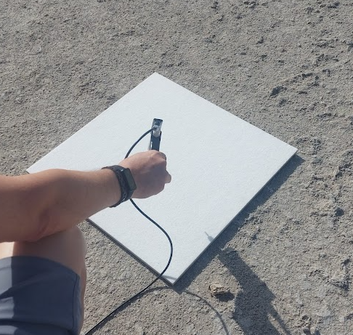
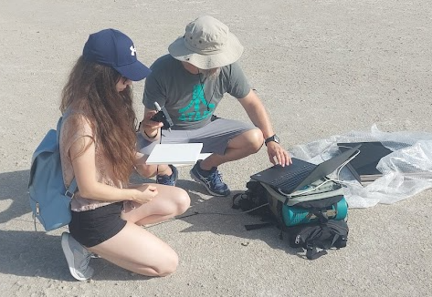
Empirical line correction to calculate reflectance
Spectral radiance data was used
Based on 5 radiometric targets made of felt
Reflectance of the targets measured in the field 19 July by ASD field spectrometer
This reflectance was used in ELC to calculate reflectance of lines 1-6 from radiance data
Spectralon reference panel

Slide 10
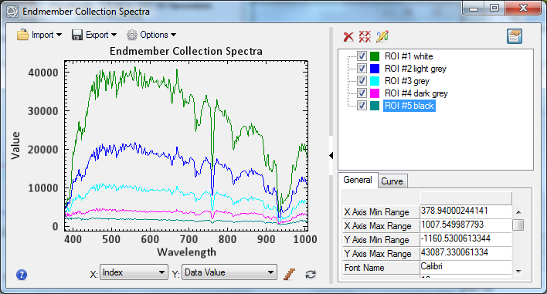
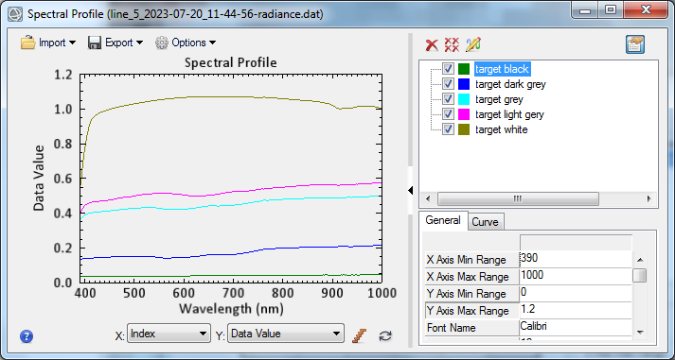
Radiometric targets in Line 5 with ASD field measured spectral reflectance
NB: ASD field measured reflectance of white target is higher than 1
Radiance of the radiometric targets, scale factor 1000
ASD field measured reflectance of the radiometric targets

Slide 11
Calibration factors – solar and path radiance calculated based on line 5 radiometric targets
Calibration factors file used to calculate reflectance of line 1,2,3,4,6
Lines 7,8,9 have different spectral and spatial binning during acquisition, therefore, could not be corrected with this ELC methods

Slide 12
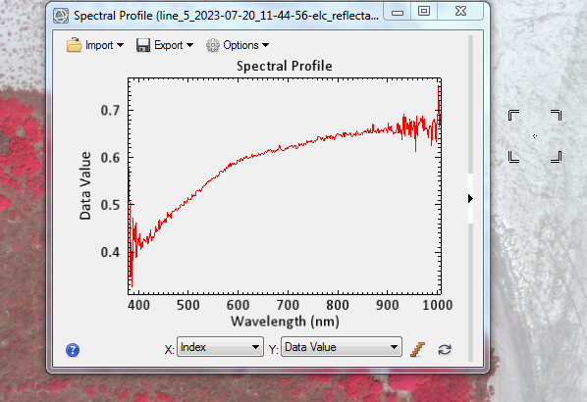
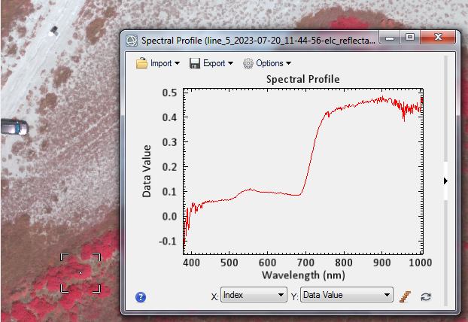
ELC reflectance

Slide 13
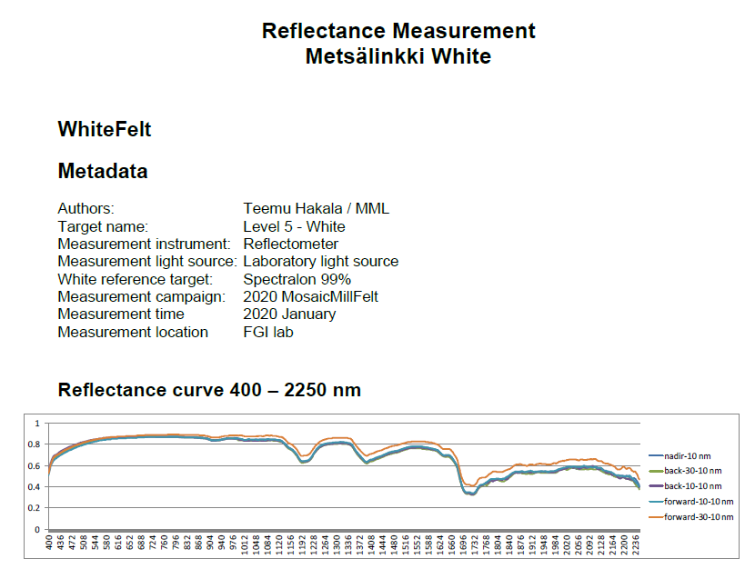
Empirical line correction (ELC)
Lines 7-9 were flown earlier on Tuesday with different spectral binning (4x2) which causes problem in applying ELC based on radiometric targets flow on Thursday at 2x2 binning
FLAASH could be used to derive reflectance
ELC reflectance in the image of line 5 is higher than 1 for the white target, as the field measurement was above 1 for this target.
The supplier of the radiometric targets (a Finish company) measured reflectance of the felt, and it is about 0.2 value lower than measured in the field by ASD spectrometer (compare it for the white target)
these laboratory measurements were not used to date, reflectance is calculated for lines 1-6 based on the ASD reflectance measurements of the targets in the field.
This issue should be tested.
ASD field measured reflectance of the radiometric targets

Slide 14
Hyperspectral data acquisition and processing
Stagno di Sal’e Porcus
18-20 July 2023
Contact: michal.gallay@upjs.sk, jan.kanuk@upjs.sk

