Slide 1
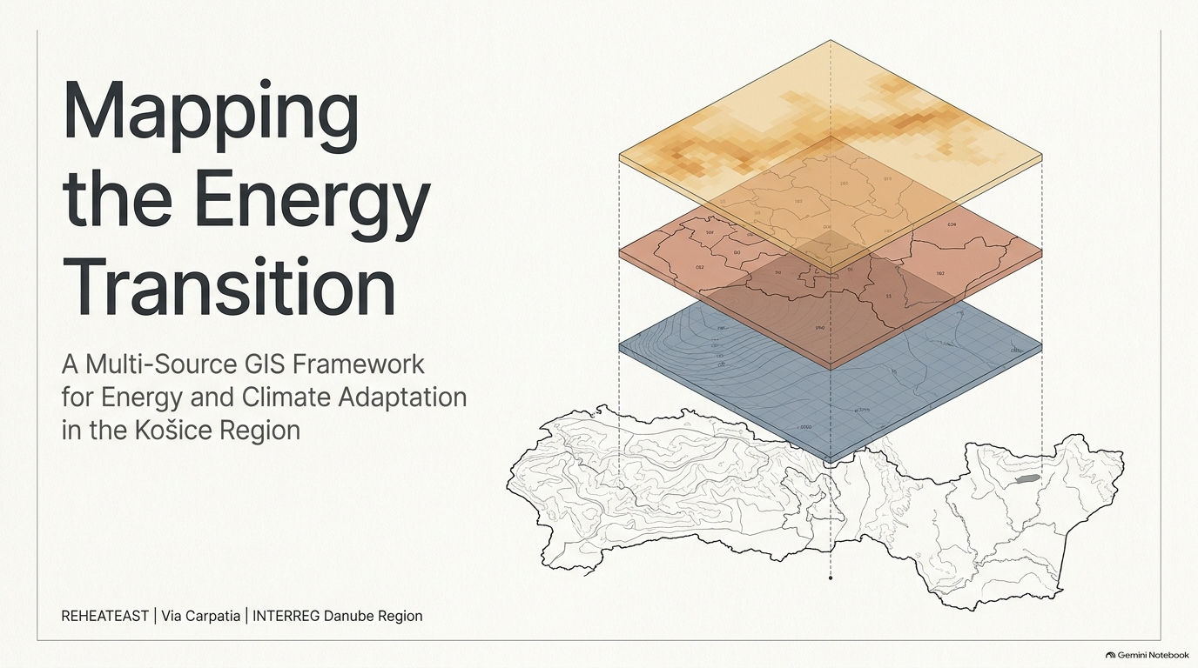





A Multi-Source GIS Framework for Mapping Energy and Climate Adaptation Potential in the Košice Self-Governing Region
Michal Gallay, Michaela Nováková, Ján Šašak,
Tomáš Fedor, Jaroslav Hofierka, Katarína Onačillová, Daniela Kolcunová, Pamela Valentová, Martin Pukančík
UPJŠ | Via Carpathia | KSK | INTERREG Danube Region

Slide 2
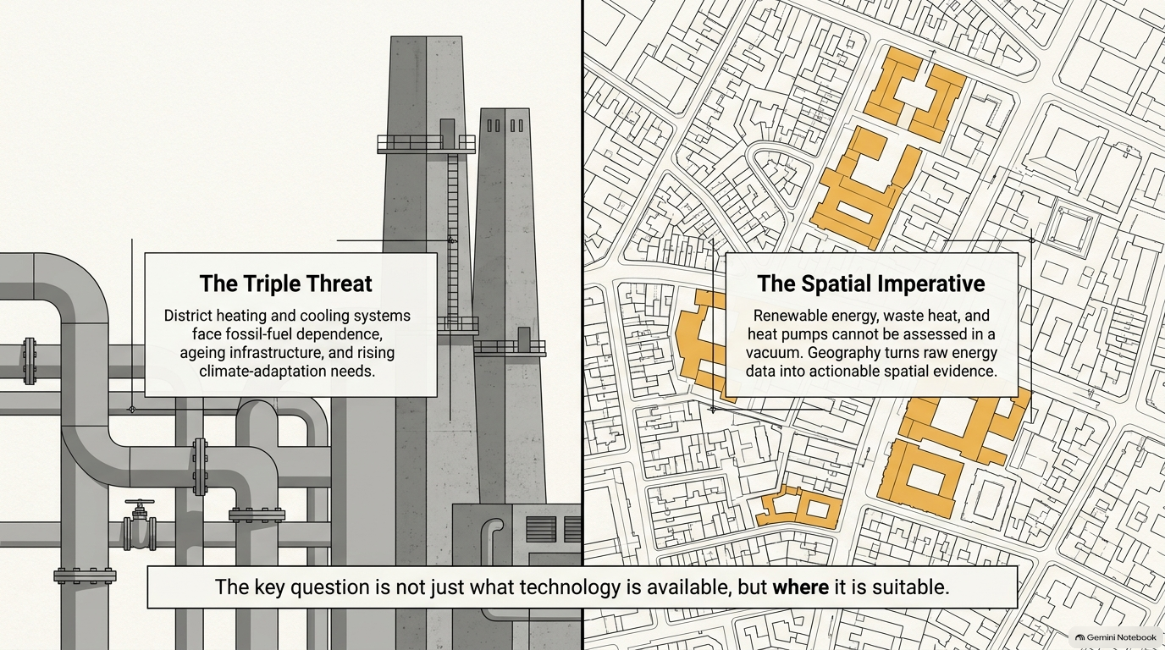

Slide 3
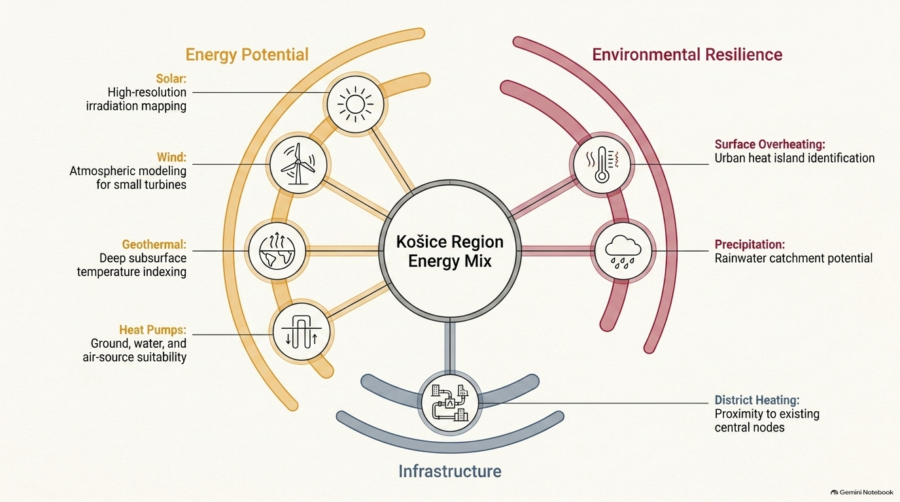

Slide 4
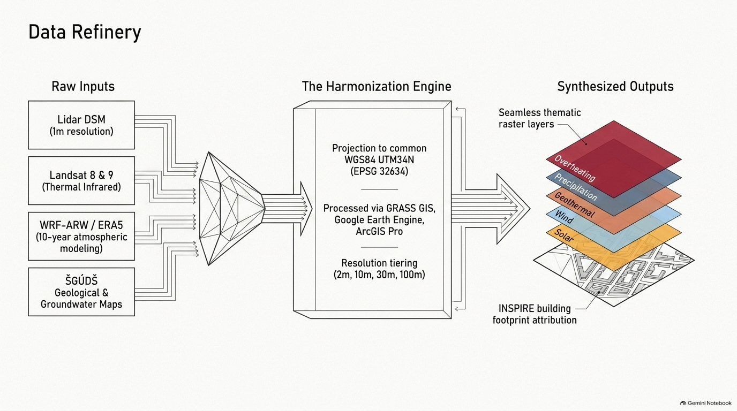
The map layers remain separate indicators; they are intended for comparison rather than a single opaque score.

Slide 5
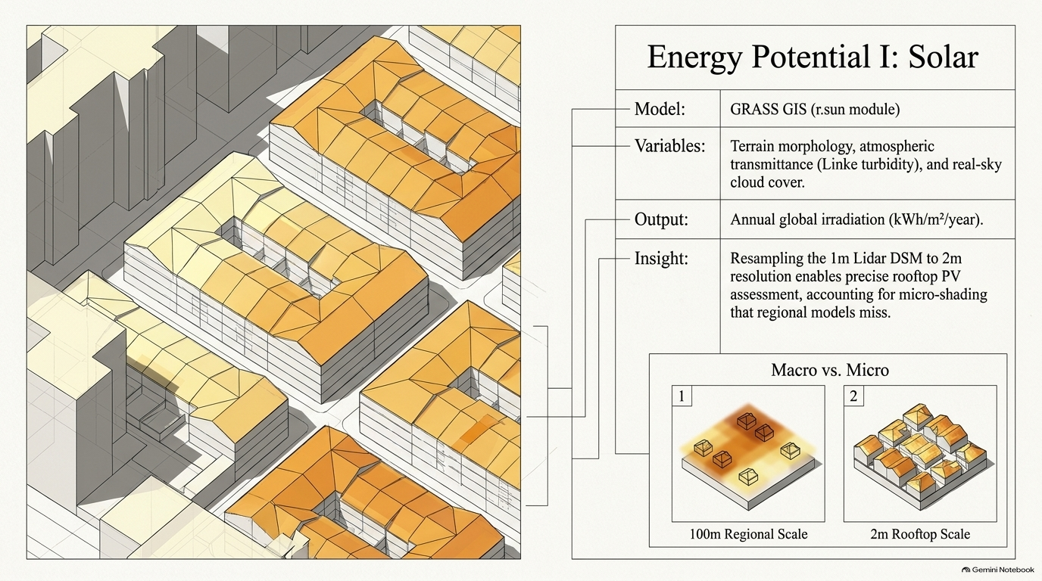

Slide 6
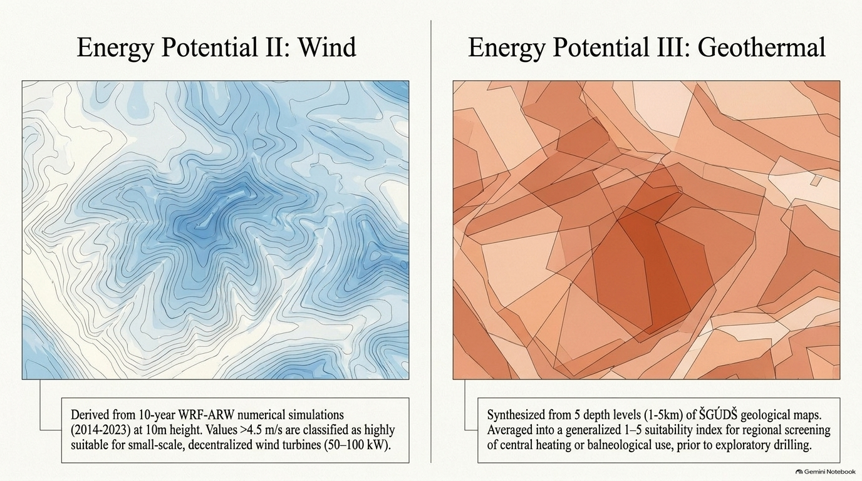
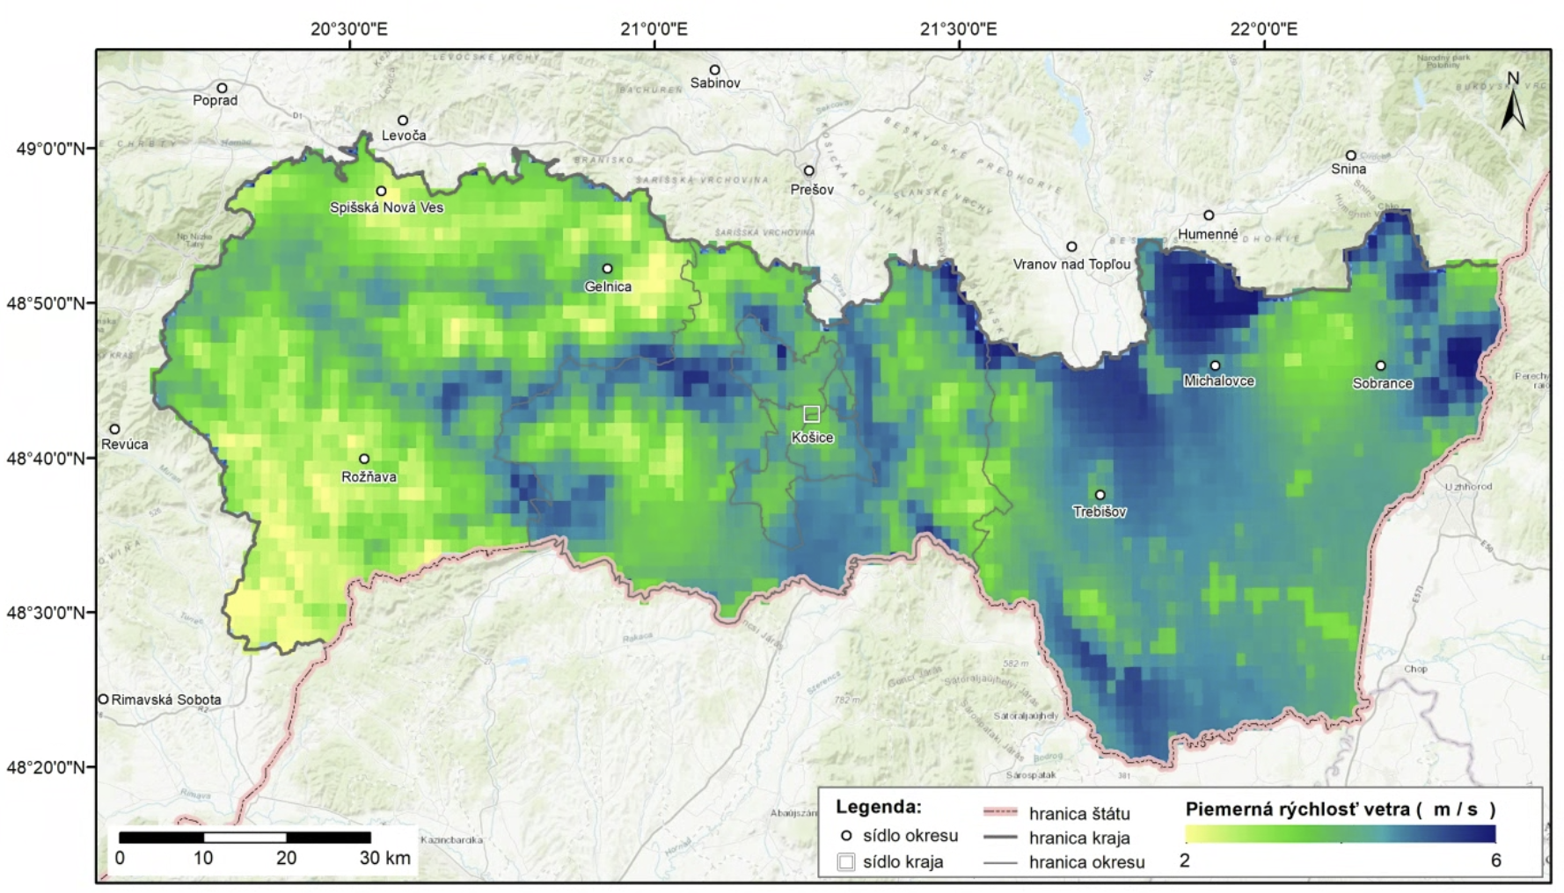
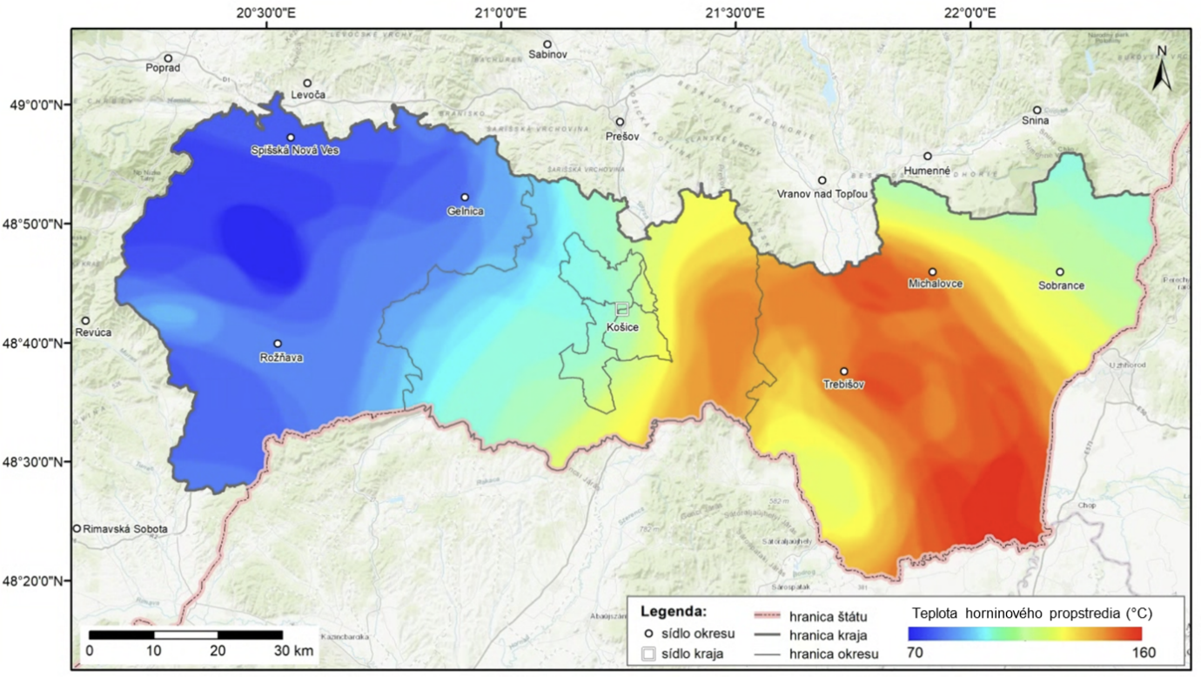

Slide 7
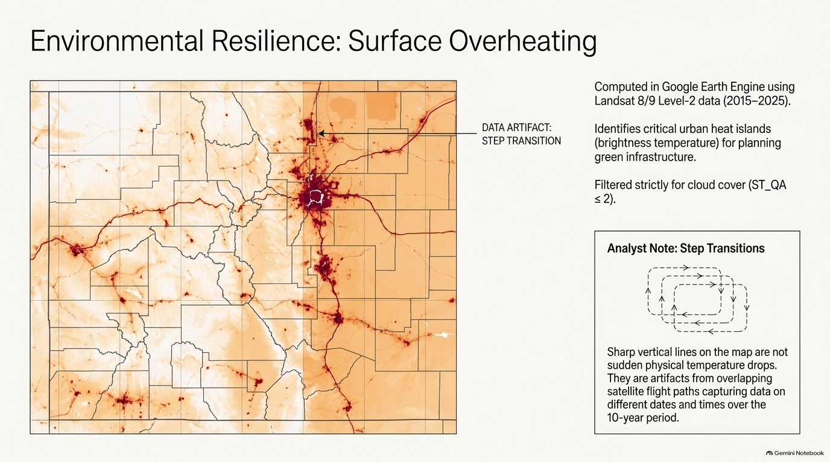
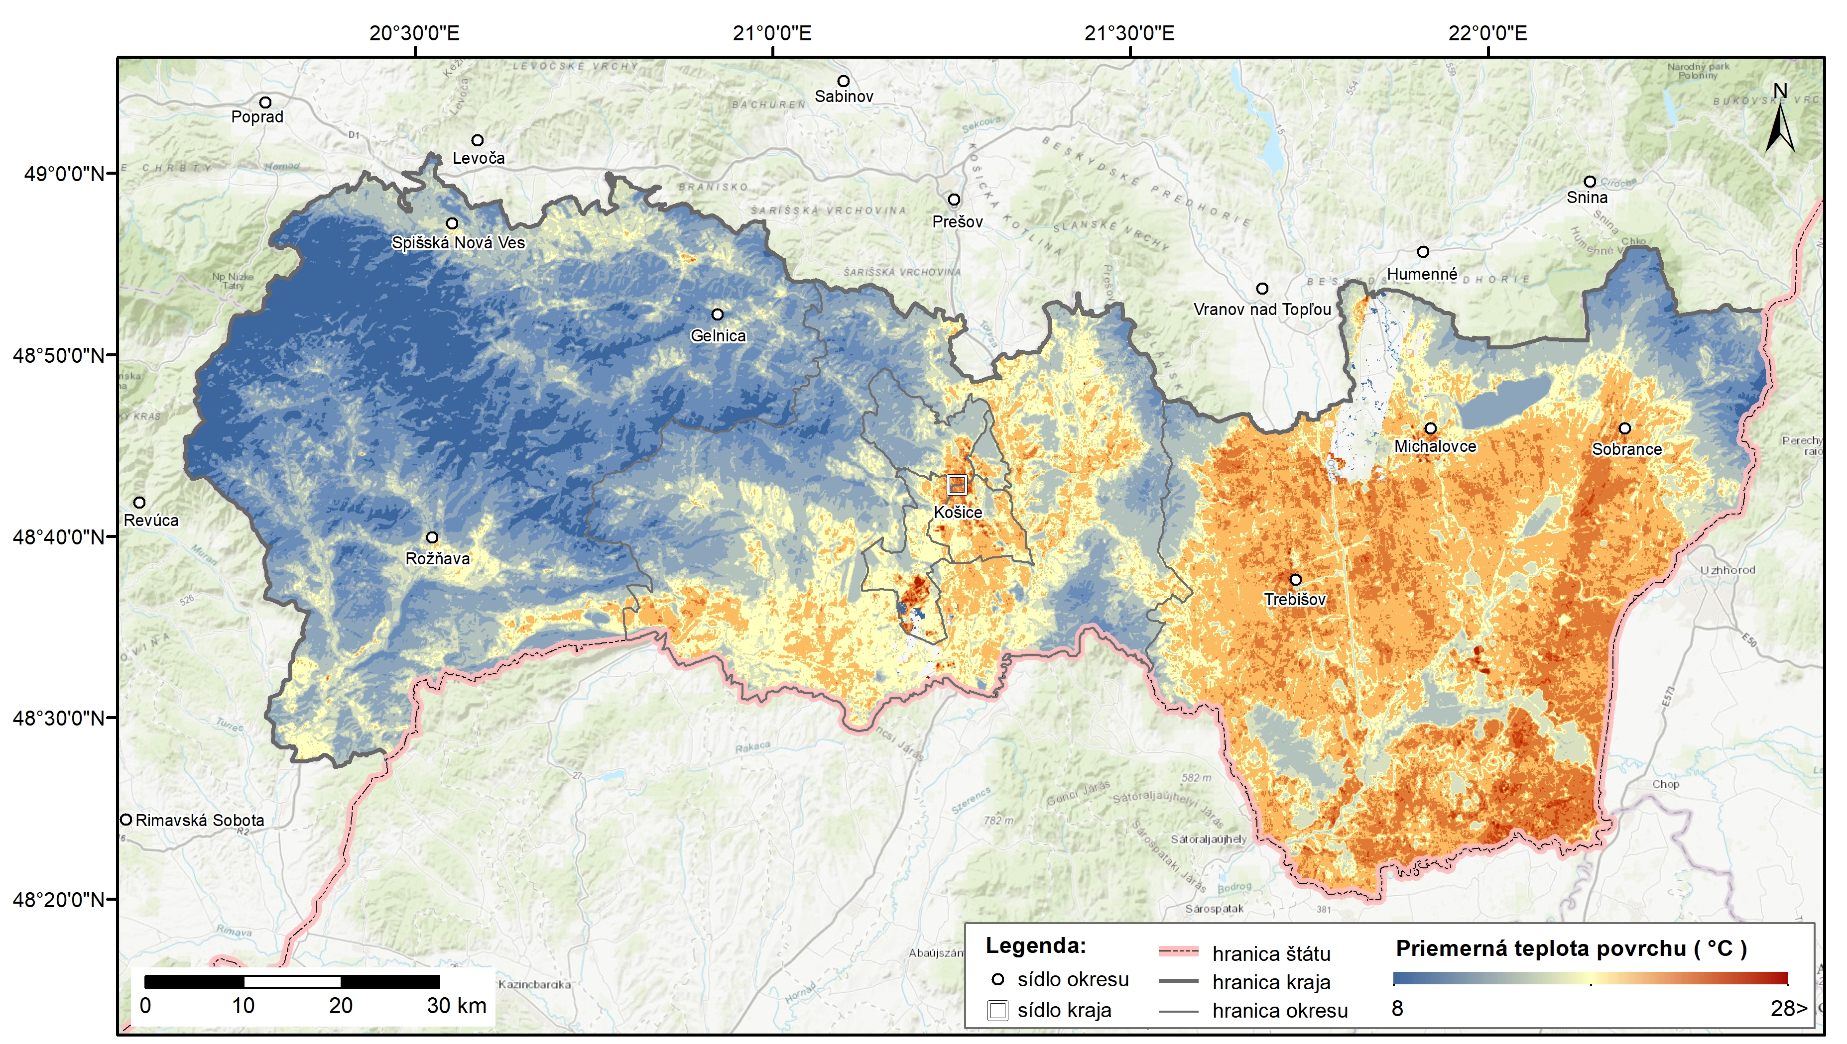
Average surface temperature:
Indirectly identifies the risk of surface overheating, e.g. for planning green/blue infrastructure

Slide 8
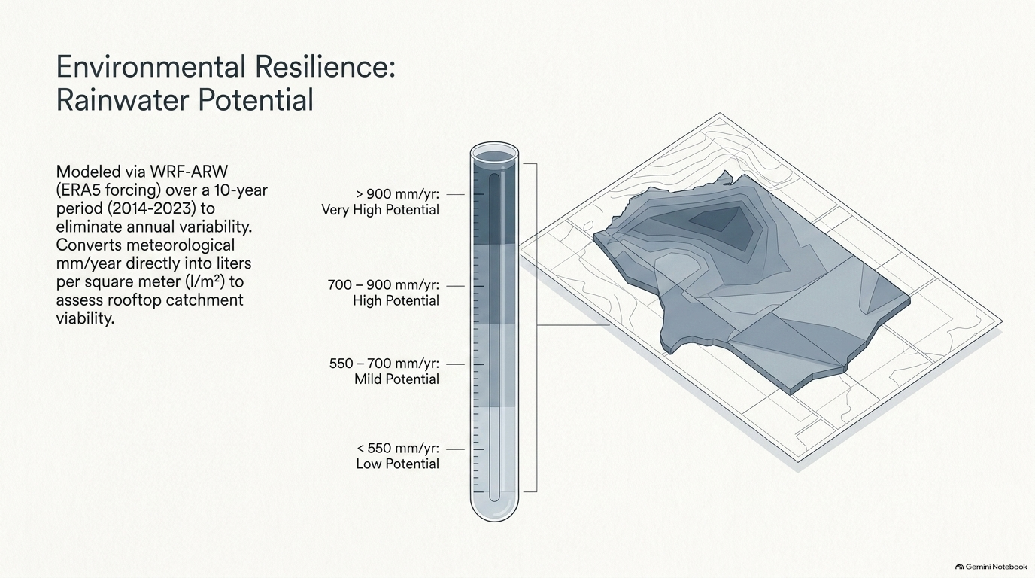
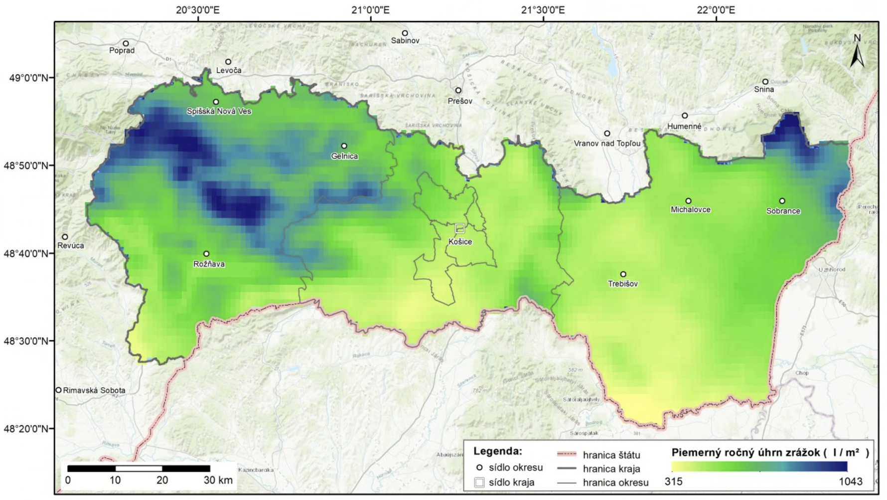
Precipitation-based rainwater availability indicator

Slide 9
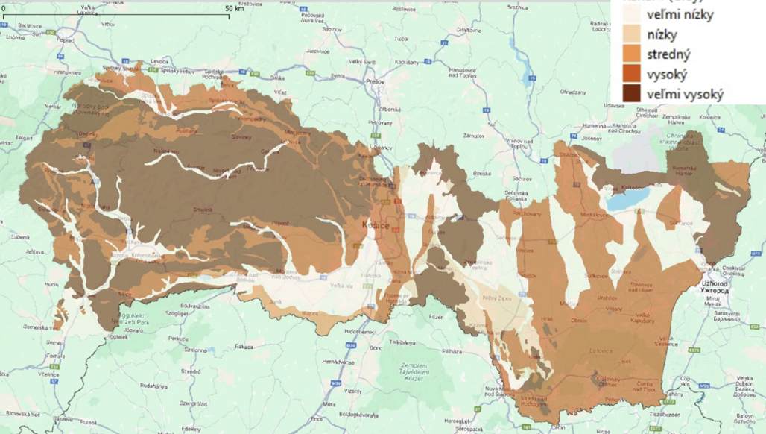
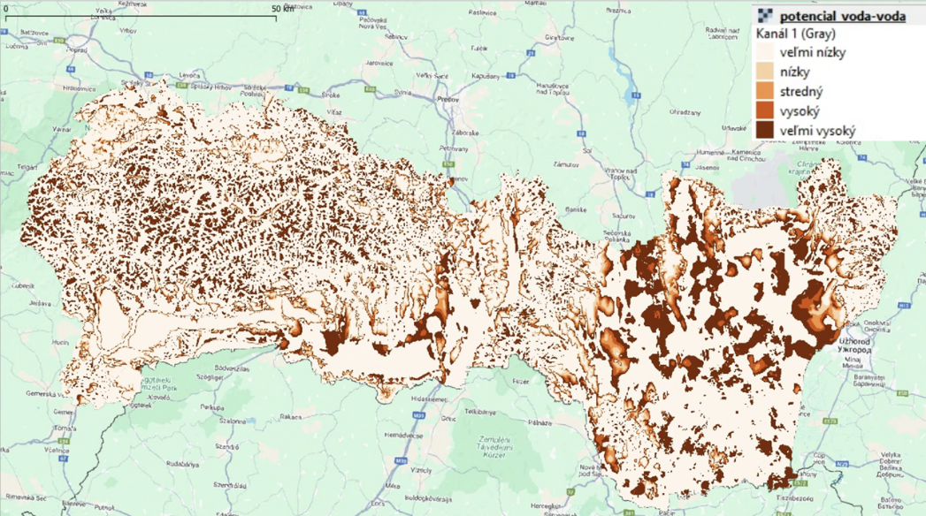
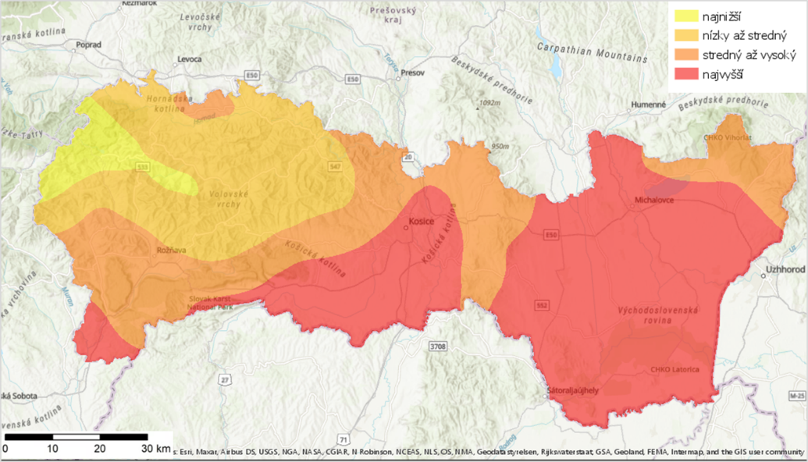
Heat Pump Suitability: Three Systems, Three Spatial Constraints
Ground-Source (Zem–Voda)
Water-Source (Voda–Voda)
Air-Source (Vzduch–Voda)
KEY VARIABLE
KEY VARIABLE
KEY VARIABLE
Geological thermal conductivity
Groundwater depth
Heating-season air temperature
HIGHER POTENTIAL
LOWER POTENTIAL
HIGHEST POTENTIAL
LOWER POTENTIAL
CLIMATE BASIS
REGIONAL RANGE
Compact rocks / stony soils
Sand & gravel
5–15 m
<5 m or >15–30 m
10-year WRF–ARW
2.6–8.6 °C
Data source: ŠGÚDŠ - Geologická mapa Slovenskej republiky, mierka 1 : 50 000. Digitálny priestorový dataset.
Data source: ŠGÚDŠ - Úroveň hladiny podzemnej vody pod terénom, mierka 1 : 50 000. Digitálny priestorový dataset.
T_{heating season} = T_{annual} − 4.5 °C

Slide 10
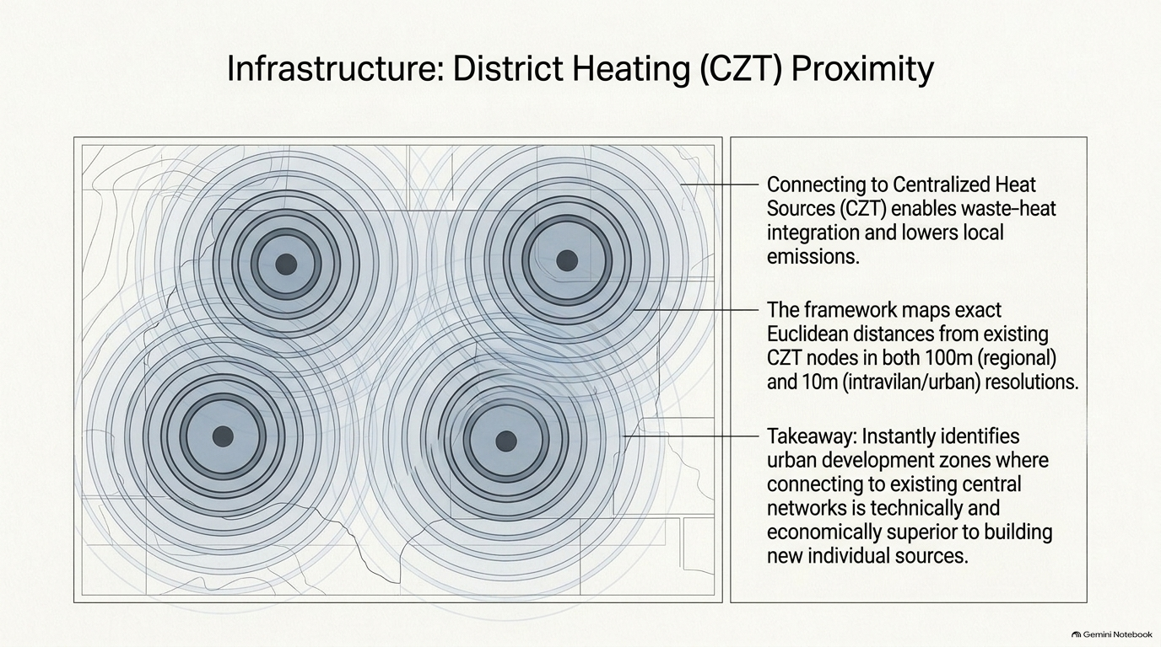
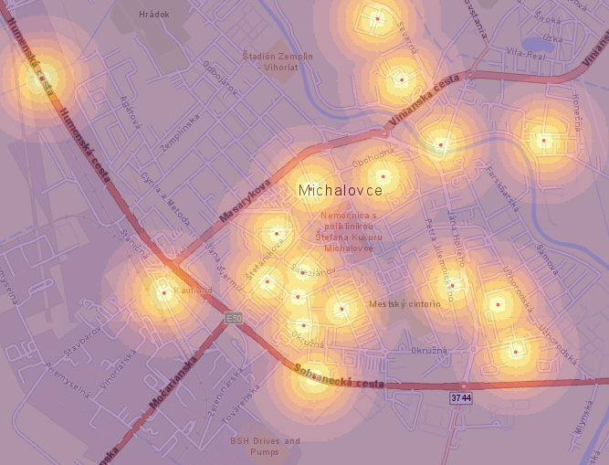
Source: SEIA, https://tepelnamapa.siea.sk/).
potentially more favourable for connection to existing district-heating infrastructure.

Slide 11
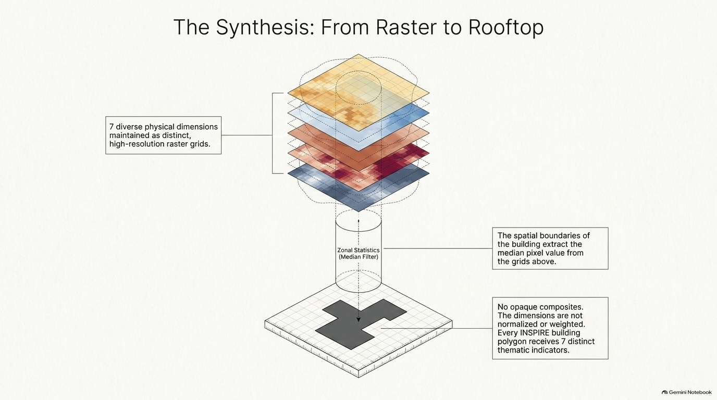
Notes:
The novelty is not in the individual maps, but in the transparent integration of heterogeneous, multi-scale spatial evidence into a common building-level decision framework.

Slide 12
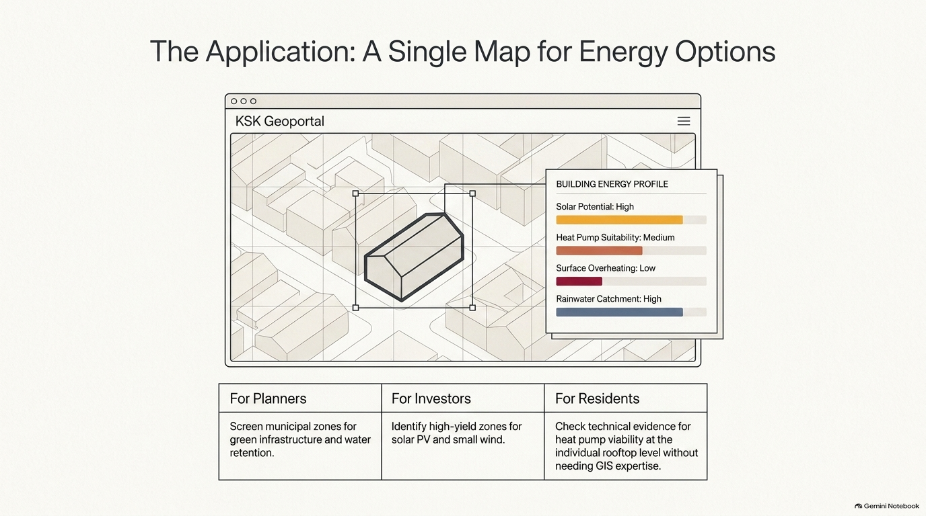
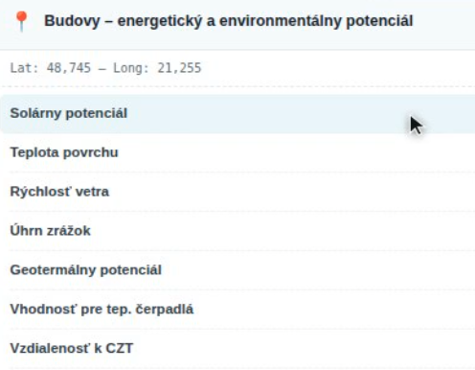
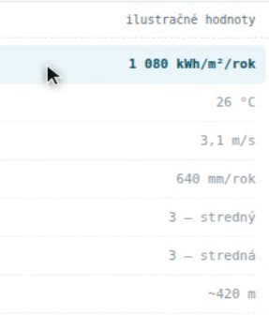
The Application: Multiple Indicators, One Spatial Interface

Slide 13
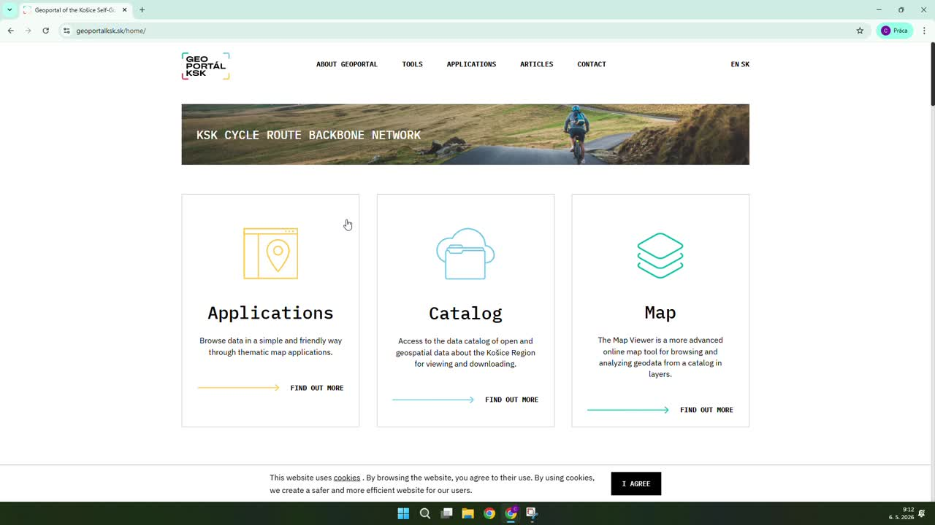

geoportalksk.sk

Slide 14

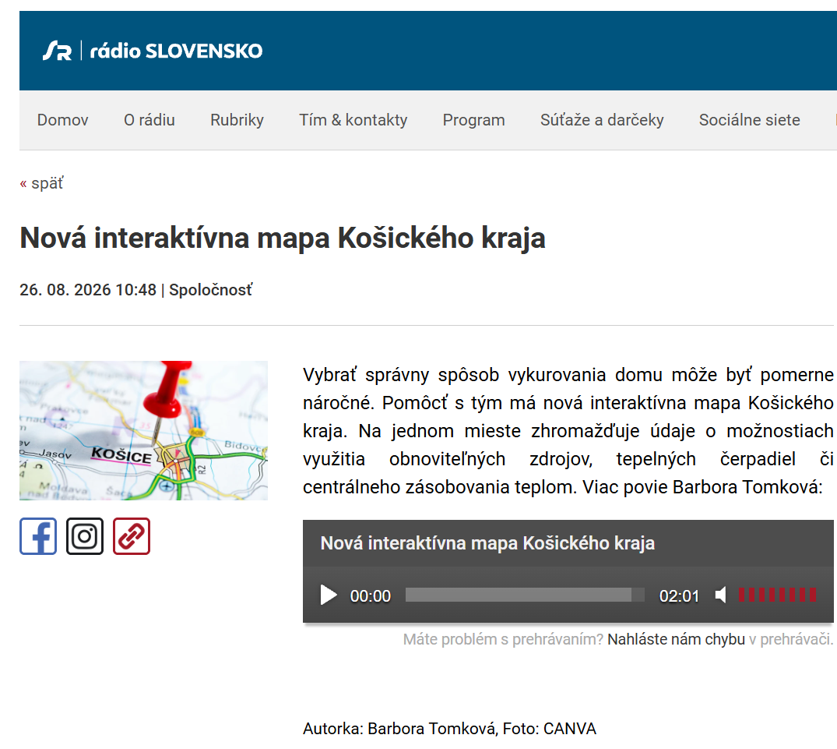

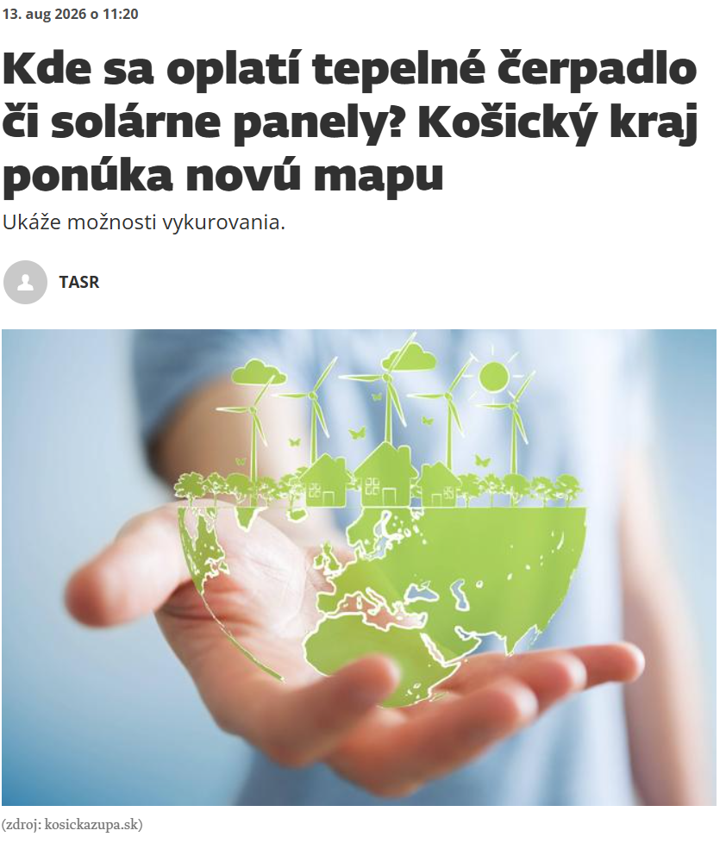

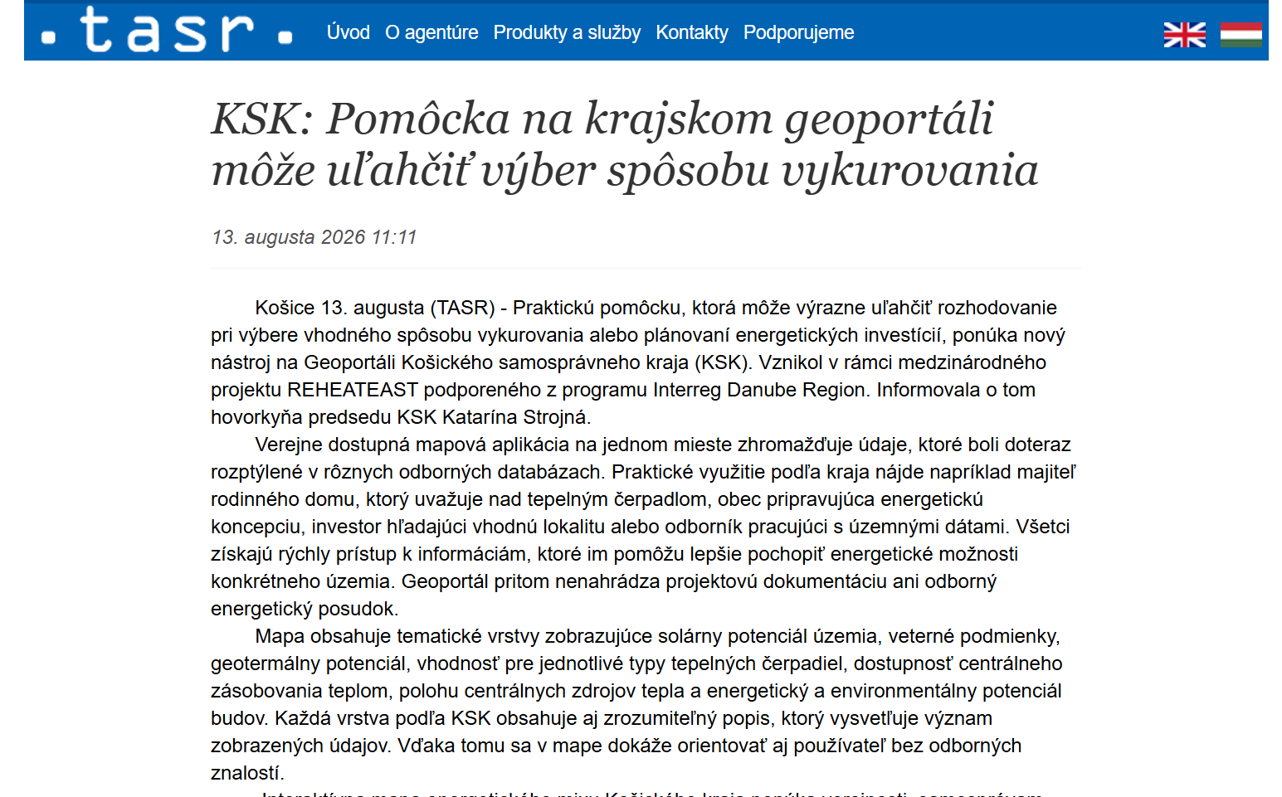
The outputs have also entered regional public discussion and stakeholder communication.

Slide 15
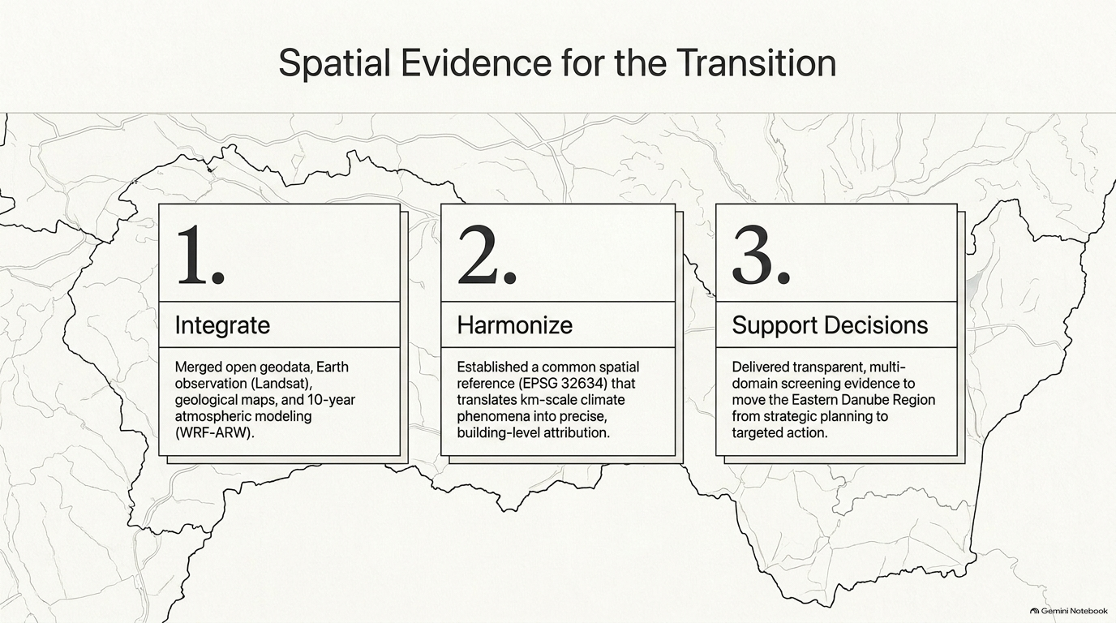
From heterogeneous regional data to transparent building-level spatial evidence.
Spatial screening indicators, not a techno-economic feasibility assessment.

Slide 16
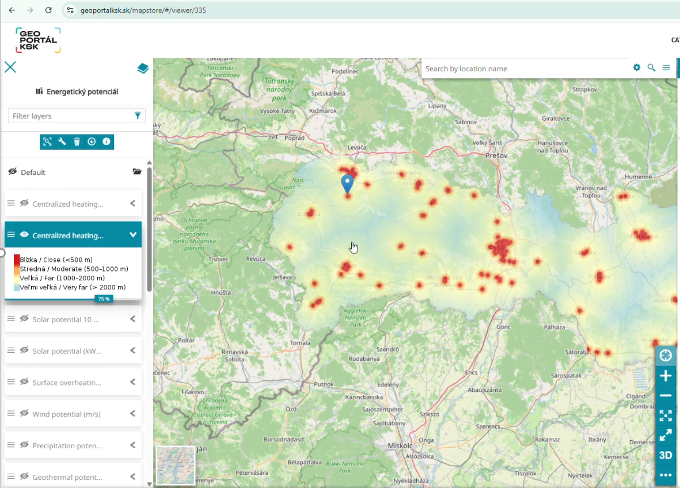
A Multi-Source GIS Framework for Mapping Energy and Climate Adaptation Potential in the Košice Self-Governing Region
Michal Gallay, Michaela Nováková, Ján Šašak,
Tomáš Fedor, Jaroslav Hofierka, Katarína Onačillová, Daniela Kolcunová, Pamela Valentová, Martin Pukančík
michal.gallay@upjs.sk
UPJŠ | Via Carpathia | KSK | INTERREG Danube Region
uge.science.upjs.sk | viacarpatia.eu | geoportalksk.sk | interreg-danube.eu/projects/reheateast

