Slide 1

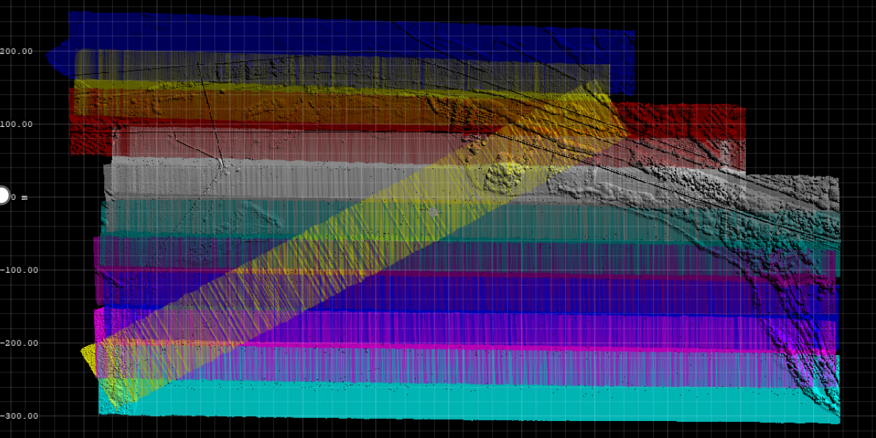
Airborne LiDAR data processing
Michal Gallay
INSTITUTE OF GEOGRAPHY, FACULTY OF SCIENCE, PAVOL JOZEF ŠAFÁRIK UNIVERSITY IN KOŠICE, SLOVAKIA
geografia.science.upjs.sk
michal.gallay@upjs.sk

Slide 2
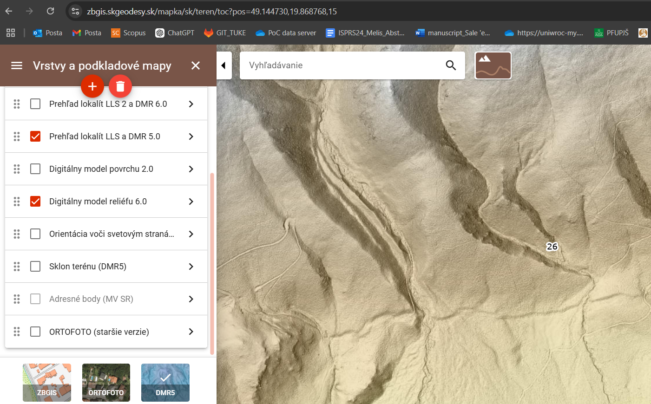
What general user needs?
Point clouds supplied georeferenced
Flight data strips relatively adjusted
Need for data filtering and classification
Generating DTM/DSM
Or
Already derived raster/gridded products, i.e. digital models of terrain (DTM) or land cover surface (DSM)

Slide 3


LAStools – fast processing of large LiDAR point clouds
What are LAStools?
LAStools is a popular suite of open-source tools designed for efficient processing of LiDAR (Light Detection and Ranging) data, especially point clouds in LAS/LAZ format.
It includes a variety of specialized utilities for point cloud classification, filtering, analysis, and raster generation.
Developed by Martin Isenburg, LAStools is widely used in geosciences, environmental sciences, forestrz, agriculture, remote sensing, and geomorphology, urban mapping/planning.
https://rapidlasso.de/

Slide 4
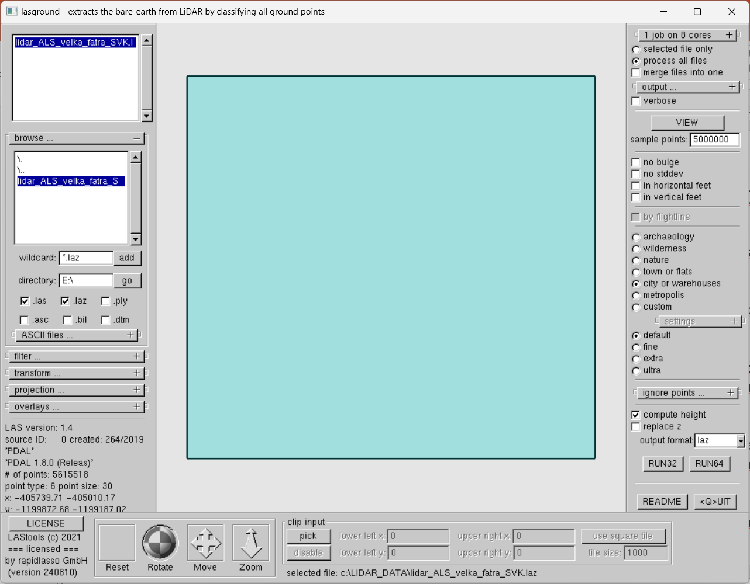
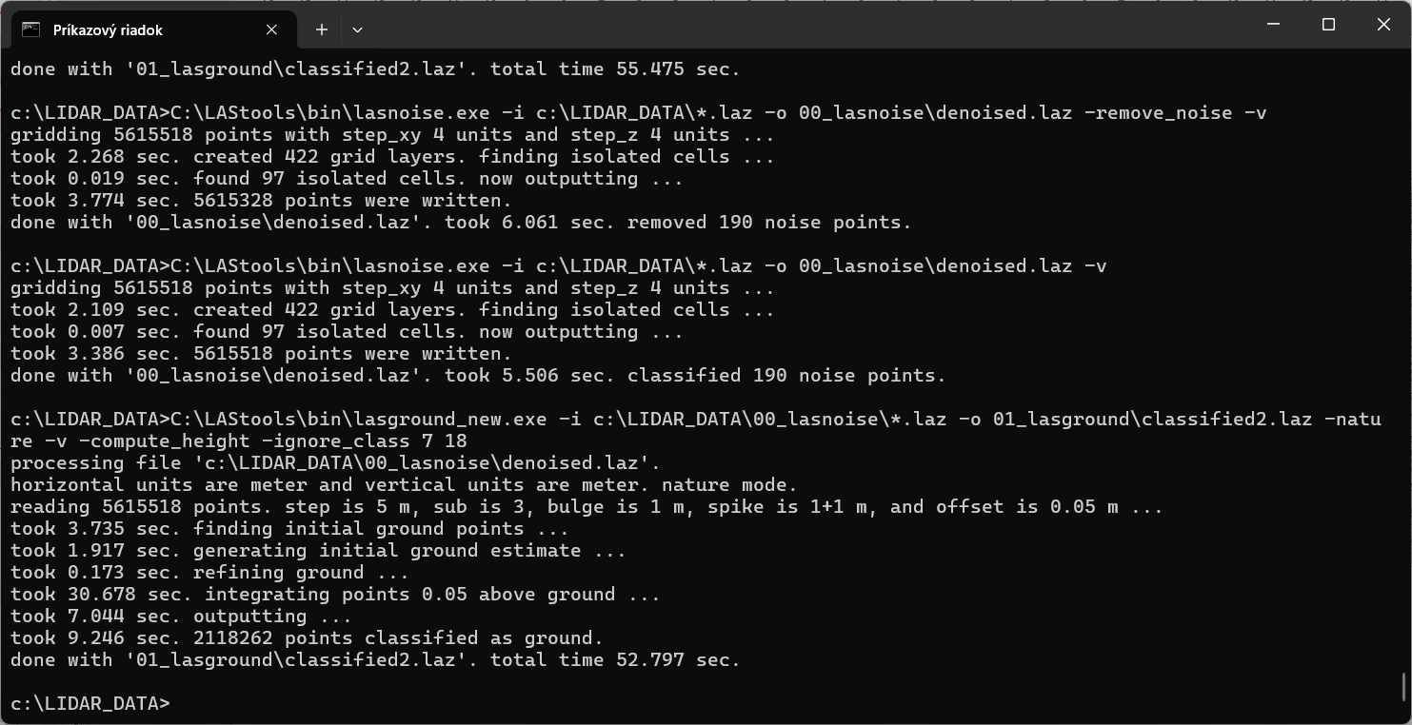
LAStools – fast processing of large LiDAR point clouds
Key Features of LAStools:
No need to install: use executable files straight away
Supports Industry Standard Formats: Works with LAS and LAZ (compressed LAS) formats, the most common formats for LiDAR data. Use ASPRS lidar point classes e.g. ground (2), vegetation (5), buildings (6), …
Speed and Efficiency: Optimized for high-performance processing of large datasets, even with millions of points on multiple cores/processor threads.
Wide Range of Tools: Includes utilities like: lasground.exe for ground classification. las2dem.exe for generating Digital Terrain Models (DTM) and Digital Surface Models (DSM). lasmerge.exe for combining multiple point cloud files. blast2dem.exe for creating DTM, DSM, Canopy Height Models (CHM).

Slide 5
Why use LAStools in Geology and Remote Sensing?
Efficient Processing of Large Datasets:
  LiDAR point clouds often contain millions of points, making manual analysis impractical. LAStools handles this efficiently.
Accurate Terrain Modeling:
  Tools like lasground.exe help extract ground points, essential for creating high-quality DTMs that are critical for geological analysis.
Versatility in Applications:
  Ideal for tasks such as where DTM is needed e.g. for landslide detection, erosion modeling, fault analysis, or DSM /CHM for vegetation structure studies.
Integration with Other GIS Software:
  LAStools outputs can be easily imported into popular GIS software (e.g., ArcGIS, QGIS) and remote sensing platforms, making it a flexible choice for diverse applications.
Accessible and User-Friendly:
  Command-line tools and batch processing scripts allow for automation, while GUI-based tools are also available for quick visual analysis.

Slide 6
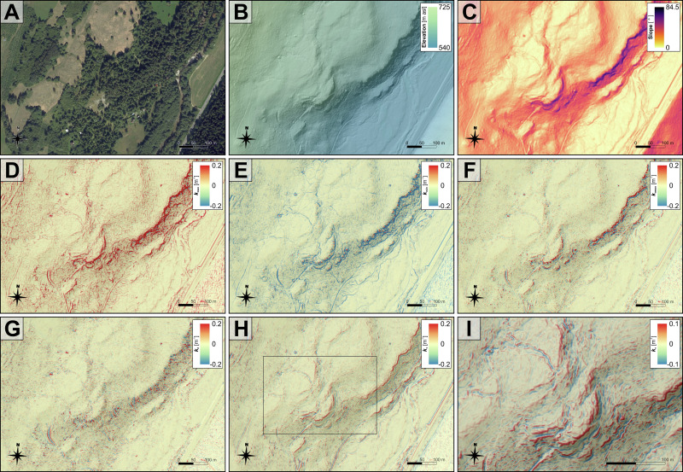
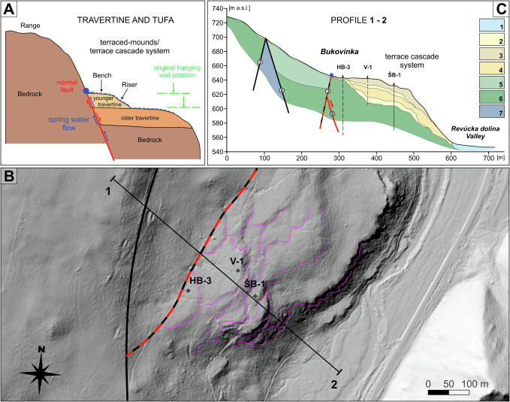
Background of the ALS sample data
Airborne lidar from Slovakia flow in 2022, freely available, © ÚGKK
The sample data represent a slope with quarternary travertine deposites
Geomorphometric analysis was used for identification of break lines / faults/ tectonic features
Bóna et al. 2024: https://doi.org/10.1016/j.geomorph.2024.109420

Slide 7
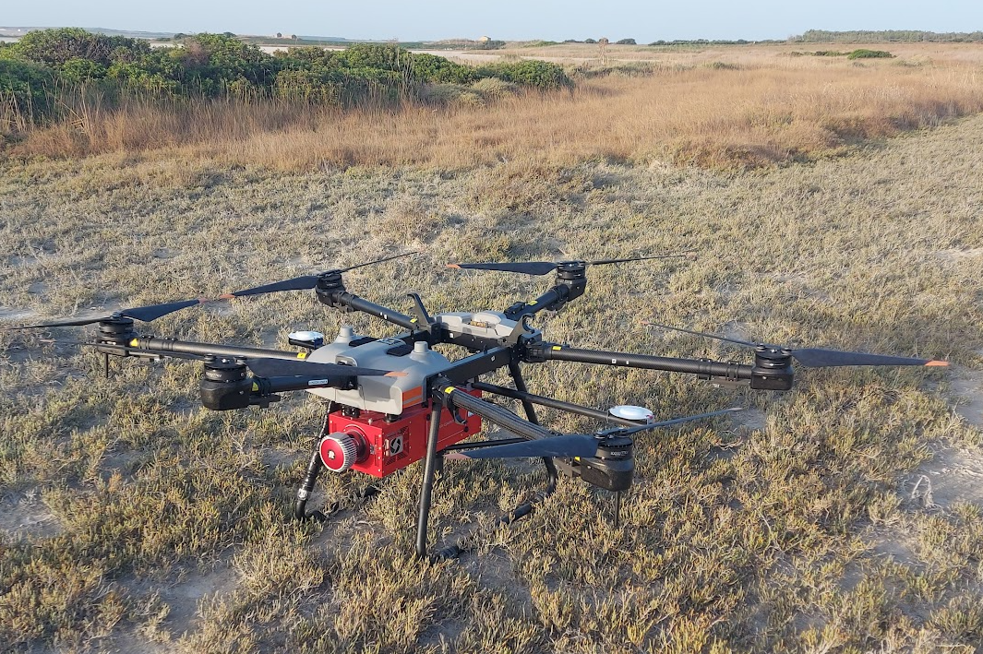
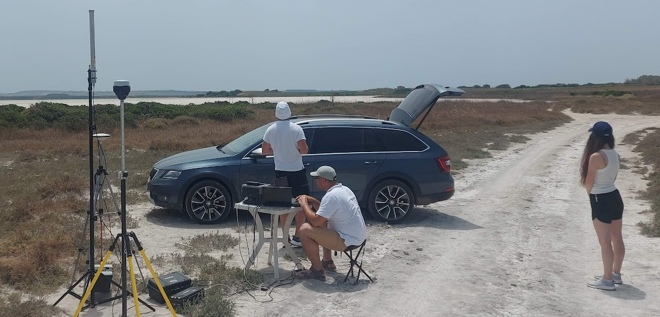
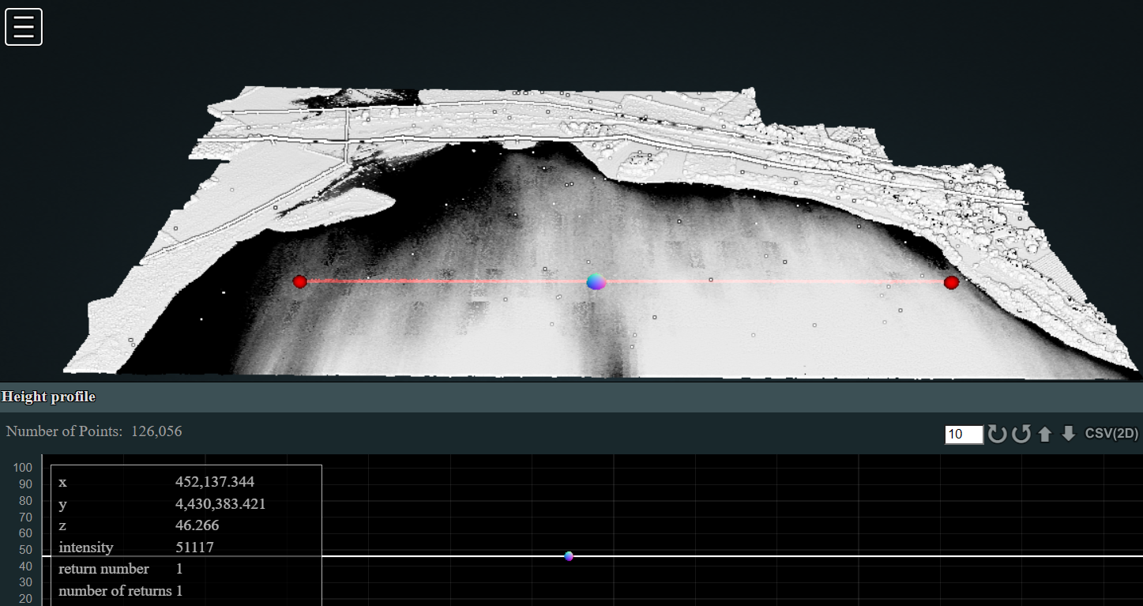
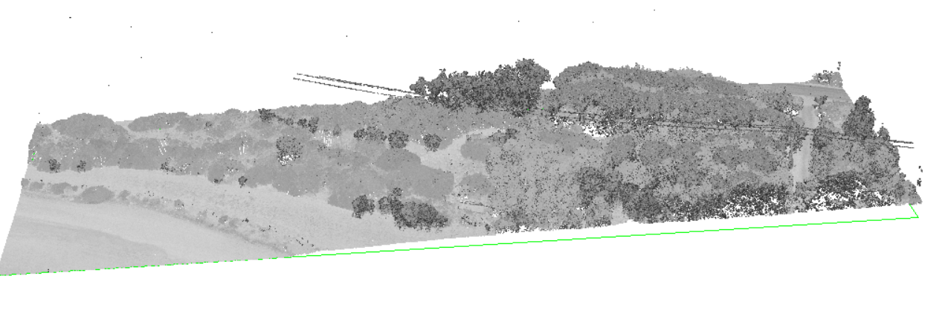
Background of the sample ULS data
Ultra high sampling density UAV lidar data from Sale Porcus salty lake, Sardinia
Acquired in July 2023 during IRSSS by a VUX-1 laser scanner manufactured by Riegl
Represent the NE edge of the dry salty
Useful to assess the flatness and land cover

Slide 8
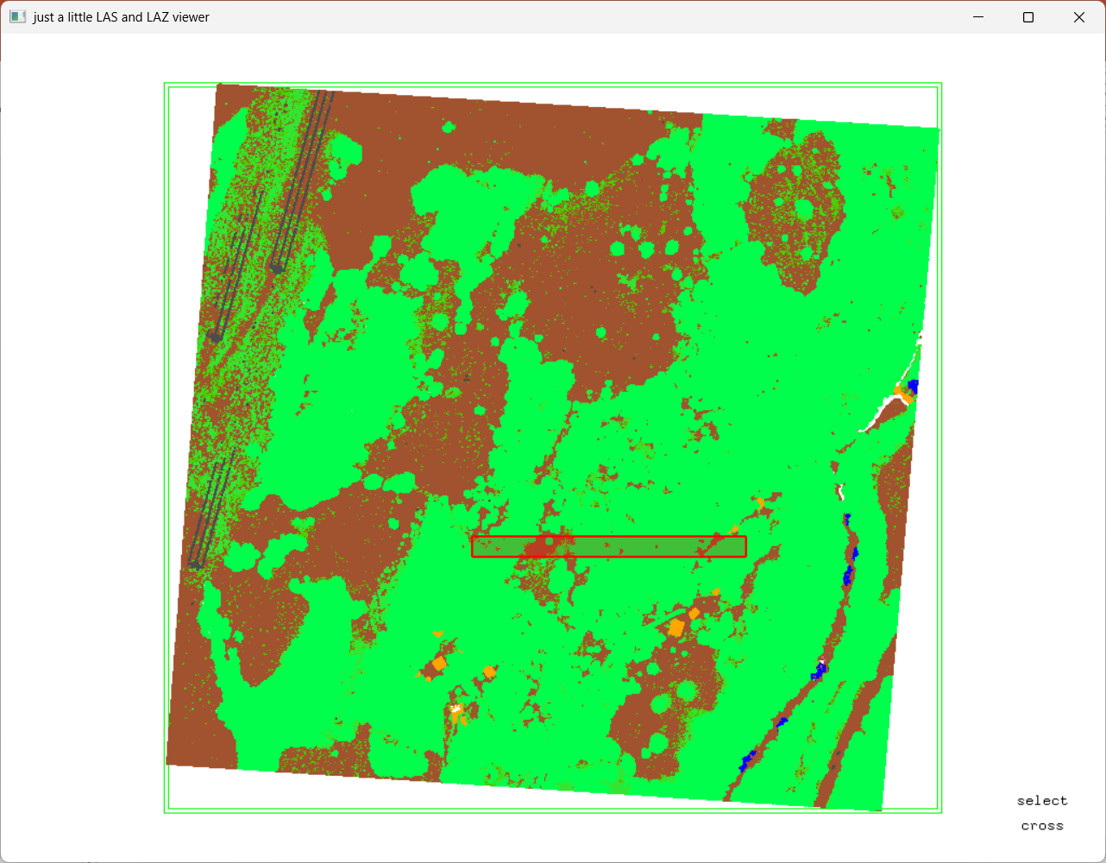
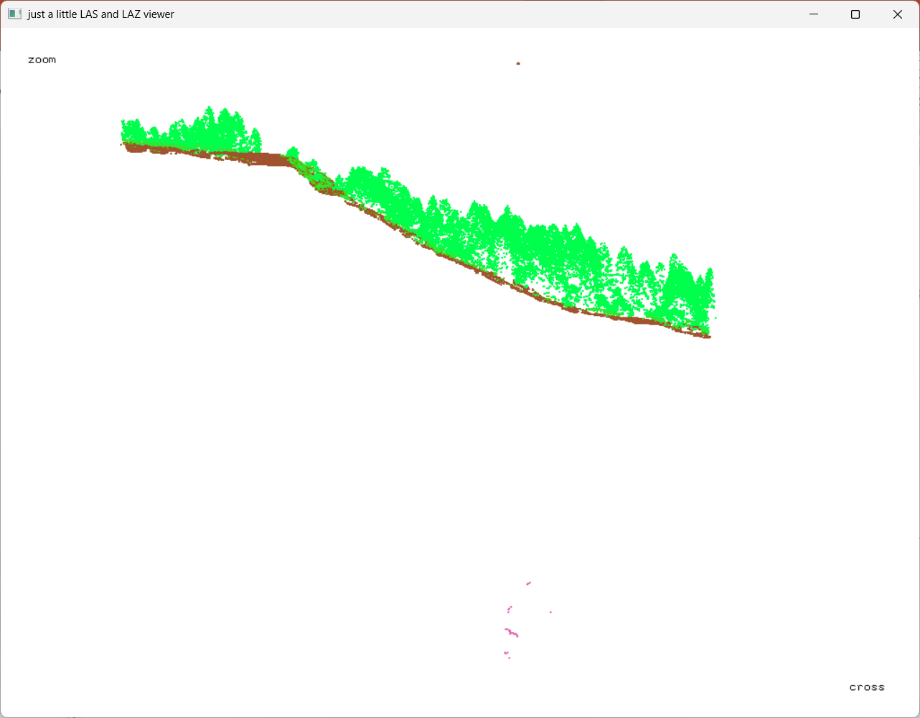
View data before processing
Via lasview.exe
Or set the software to open the LAS/LAZ files to lasview.exe
Right click on the file – Open in a programme – navigate to c:/LAStools/bin/lasview.exe
In the lasview,
Press “x” to define the cross-sections of the data and press “x” to view it,
Move the cross-section with arrows
press “c” to change colours, or right click anywhere in the window to open various options of display
Magnify the points with “=“, reduce the size with “-“
Read lasview_README.txt for custom settings

Slide 9
Workflow Summary
Tiling: Splits the input .laz file into manageable tiles with a buffer zone for seamless processing of DEMs.
Denoising: identifies outlier points and classifies them (7, 18)
Ground Classification: Processes each tile individually, classifies ground/terrain points (2) and computes height above the ground for the remaining (unclassified) points (8)
Classification of non-ground points: assigns classes of vegetation (5) and buildings (6) to the points unclassified in the previous step of ground classification
DTM and DSM, Generation: Creates raster models for each tile.
CHM Creation: Subtracts DTM from DSM to get the Canopy Height Model.
Optional Merging: Combines the DTM,DSM, CHM tiles into a single raster.

Slide 10
Workflow Summary
Tiling: Splits the input .laz file into manageable tiles with a buffer zone for seamless processing of DEMs. We skip this for today (but see Useful additions at the end of presentation)
Denoising: identifies outlier points and classifies them (7, 18)
Ground Classification: Processes each tile individually, classifies ground/terrain points (2) and computes height above the ground for the remaining (unclassified) points (8)
Classification of non-ground points: assigns classes of vegetation (5) and buildings (6) to the points unclassified in the previous step of ground classification
DTM and DSM, Generation: Creates raster models for each tile.
CHM Creation: Subtracts DTM from DSM to get the Canopy Height Model.
Optional Merging: Combines the DTM,DSM, CHM tiles into a single raster.

Slide 11
Assumptions before we start
Despite the ALS data are already assigned with classes
We will assume the data is not filtered nor classified
ULS data are not classified

Slide 12
we start here
Removing outlier/noise points
First check if outliers/noise points are present
If they do exist, filter them out with lasnoise.exe
cd c:\LIDAR_DATA\
mkdir 00_lasnoise
C:\LAStools\bin\lasnoise.exe -i c:\LIDAR_DATA\*.laz -o 00_lasnoise\denoised.laz -remove_noise –v
Especially for ground classification it is important that low noise points are excluded.
Read lasnoise_README.txt for custom settings

Slide 13
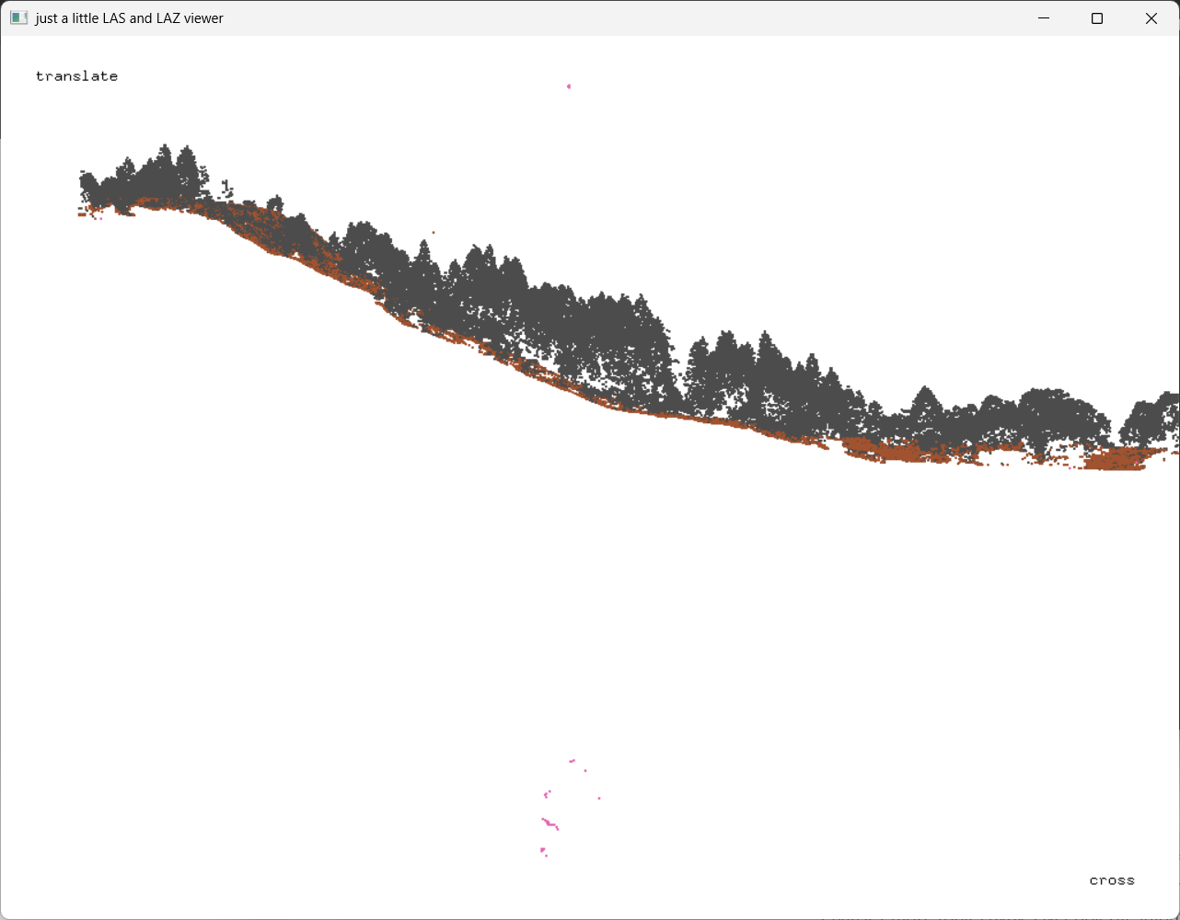
LiDAR data Classification
Tool: lasground
  extracts ground points from point cloud and splits the points into two categories – ground and unclassified points
  Parameters: landscape type - town or flats
  ignore points – low noise (7) and high noise (18)
  tick the option „compute height“
ground points
unclassified points
Notes:
With a push-broom spectrometer, full spectral image data are recorded simultaneously per line
However, each line of airborne pushbroom images is collected at different time instants. Perspective geometry varies with each pushbroom line, leading to different line displacement, and thus turning the rectification process more difficult

Slide 14
Filtering of ground points
Path to the LAStools C:\LAStools\bin\
Path to the folder with ALS point data c:\LIDAR_DATA\
Change folder to my data folder and
generate a new folder inside it, where the ouput is going to be stored
run filtering of ground points
mkdir 01_lasground
C:\LAStools\bin\lasground_new.exe -i c:\LIDAR_DATA\*.laz -o 01_lasground\classified.laz -nature -compute_height
If noise points are present and classified as 7:
C:\LAStools\bin\lasground_new.exe -i c:\LIDAR_DATA\00_lasnoise\*.laz -o 01_lasground\classified.laz -nature -v -compute_height -ignore_class 7 18

Slide 15
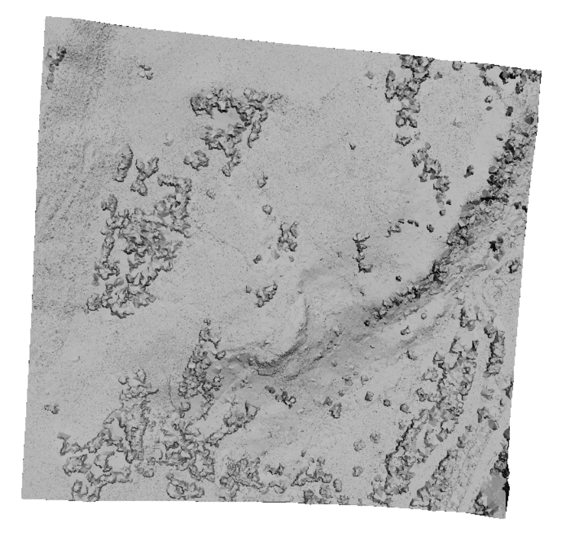
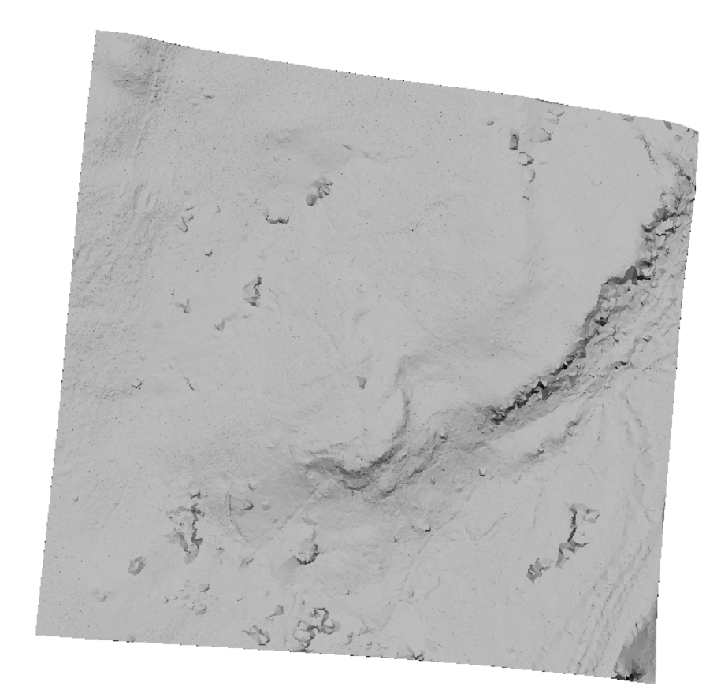
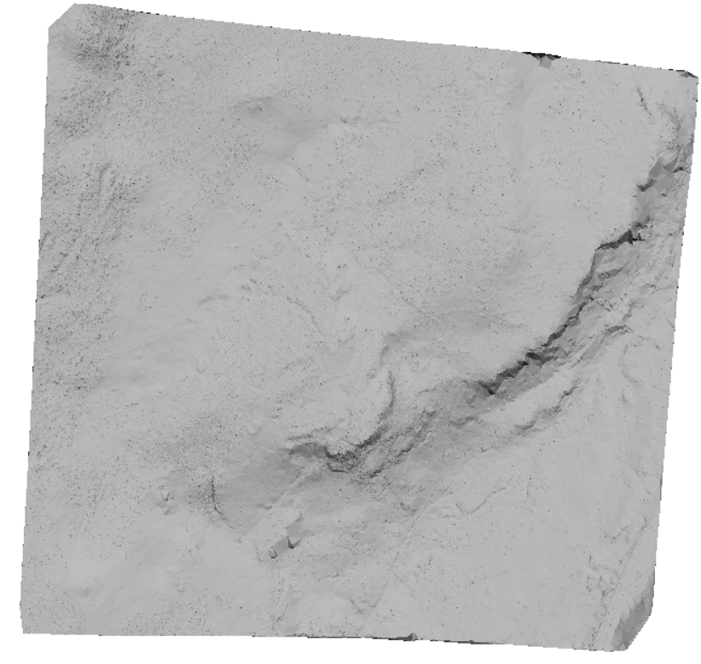
-wilderness
- step is 3 m, sub is 3, bulge is 1 m, spike is 1+1 m, and offset is 0.05 m
-nature
- step is 5 m, sub is 3, bulge is 0 m, spike is 1+1 m, and offset is 0.05 m
-nature
- step is 5 m, sub is 3, bulge is 1 m, spike is 1+1 m, and offset is 0.05 m

Slide 16
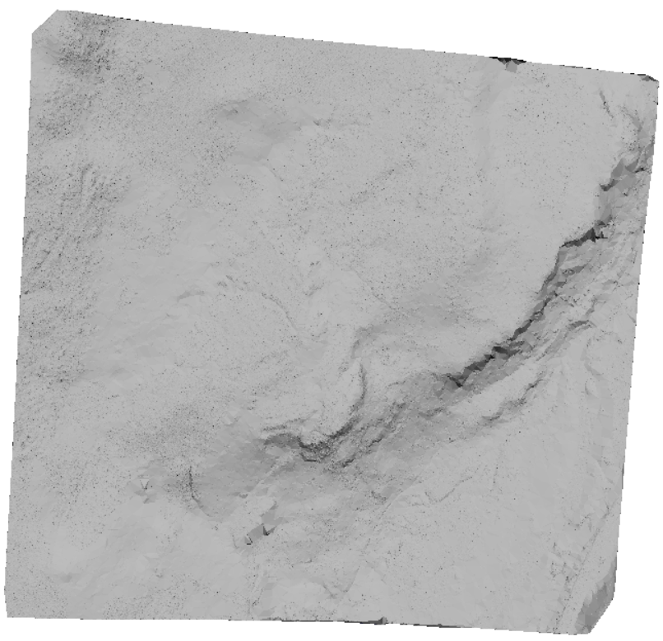
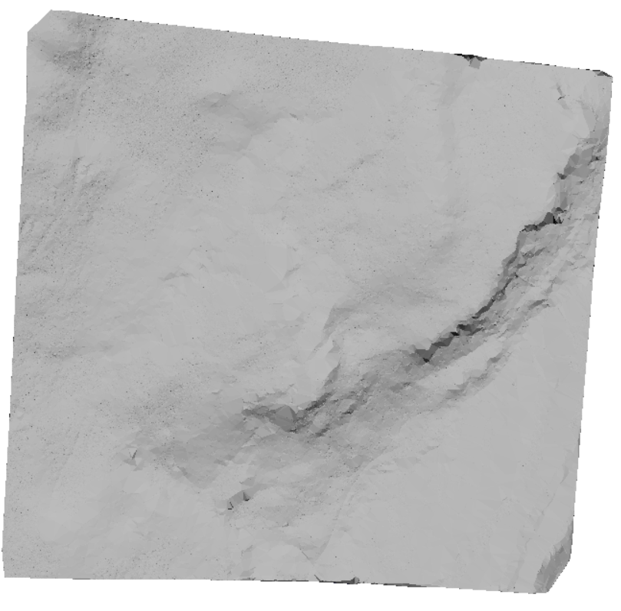
-city
step is 25 m, sub is 5, bulge is 2 m, spike is 1+1 m, and offset is 0.05 m
-city
step is 25 m, sub is 5, bulge is 0 m, spike is 1+1 m, and offset is 0.05 m

Slide 17
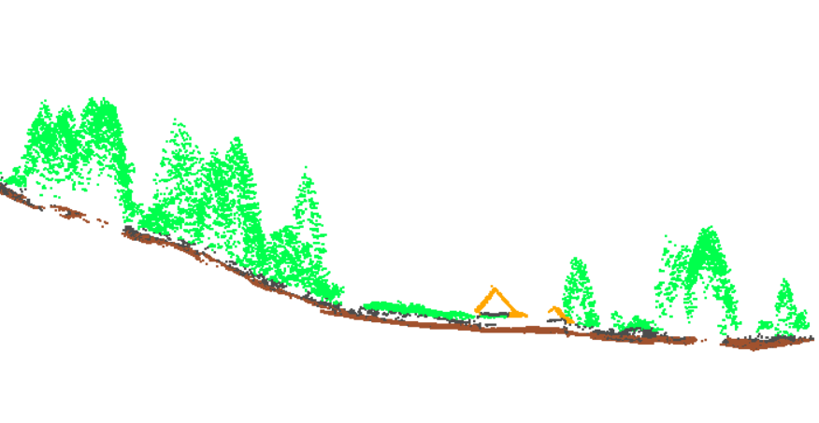
Classification of non-ground points
Uses geometric relationships, spatial density, and elevation differences between points to identify patterns that correspond to ground, vegetation, and buildings.
assigns classes of vegetation (5) and buildings/roofs (6) to the points unclassified in the previous step of ground classification. All points above 2 meters above the ground points are classified as vegetation or roofs.
mkdir 02_lasclassify
C:\LAStools\bin\lasclassify.exe -i c:\LIDAR_DATA\01_lasground\*.laz -o 02_lasclassify\classified_all_classes.laz -v -ignore_class 7 18
ground points (2)
unclassified points (8)
(high) vegetation (5)
roofs/buildings (6)

Slide 18

DTM and DSM creation
Creates raster models for each tile.
Subtracts DTM from DSM to get the Canopy Height Model.
mkdir 03_blast2dem
C:\LAStools\bin\blast2dem.exe -i c:\LIDAR_DATA\02_lasclassify\*.laz -o 03_blast2dem\dtm.tif -keep_classification 2 -elevation -step 1 –v
C:\LAStools\bin\blast2dem.exe -i c:\LIDAR_DATA\02_lasclassify\*.laz -o 03_blast2dem\dsm.tif -first_only -elevation -step 1 -drop_class 7 18 –v
-use_class 2:uses only ground points (class 2) to create a raster DTM rasters with a grid cell size of 1 m
-first_returns_only:uses first returns only to create a raster DSM rasters with a grid cell size of 1 m, but noise points (class 7, 18) need to be dropped out

Slide 19
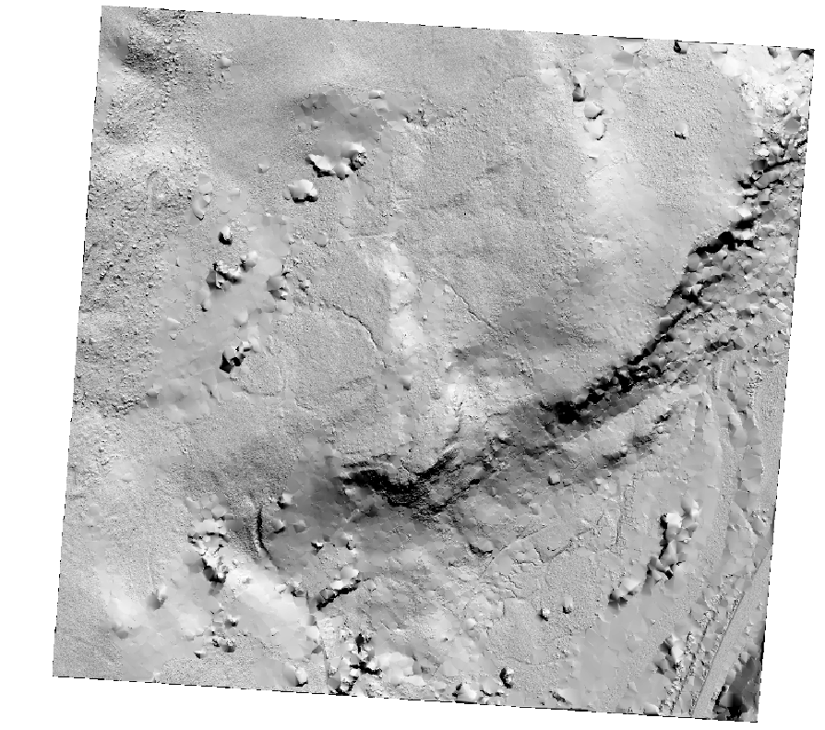
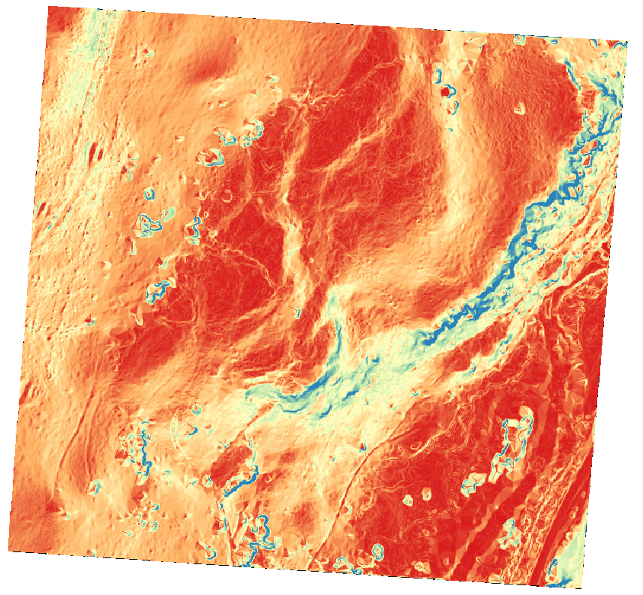
Optional: Slope, hillshade
Creates raster models for each tile.
Subtracts DTM from DSM to get the Canopy Height Model.
C:\LAStools\bin\blast2dem.exe -i c:\LIDAR_DATA\02_lasclassify\*.laz -o 03_blast2dem\dtm_hillshade.tif -keep_classification 2 -hillshade -step 1 –v
C:\LAStools\bin\blast2dem.exe -i c:\LIDAR_DATA\02_lasclassify\*.laz -o 03_blast2dem\dtm_slope.tif -keep_classification 2 -slope -step 1 –v
-use_class 2:uses only ground points (class 2) to create a raster DTM rasters with a grid cell size of 1 m
-first_returns_only:uses first returns only to create a raster DSM rasters with a grid cell size of 1 m, but noise points (class 7, 18) need to be dropped out

Slide 20
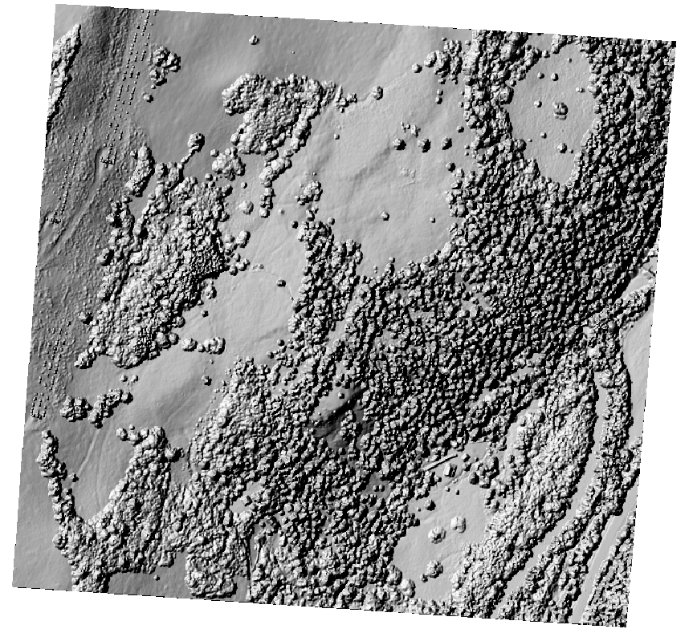
Compare the geomorphological interpretability
Shaded DSM
Shaded DTM

Slide 21
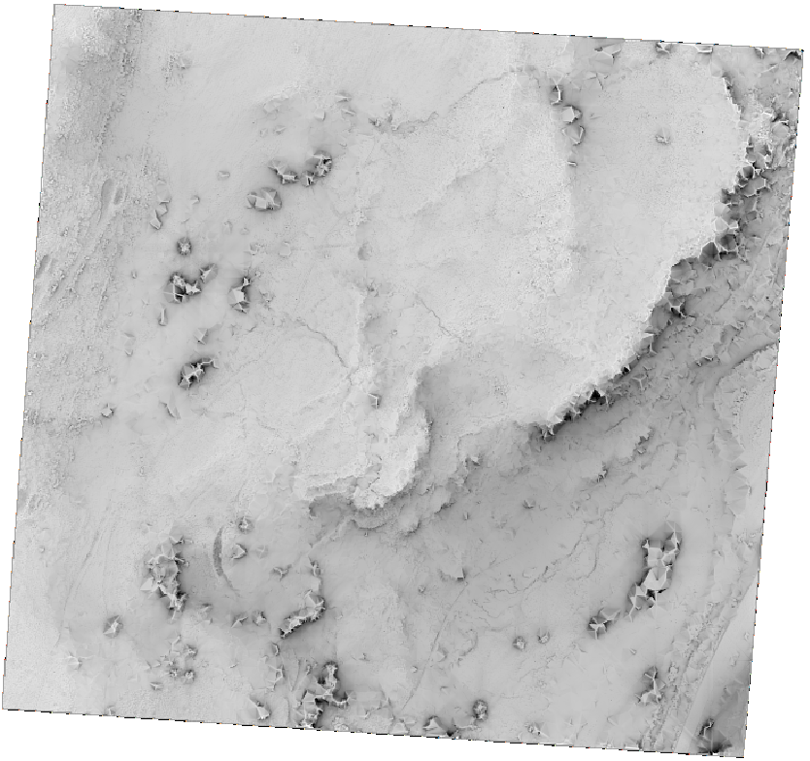
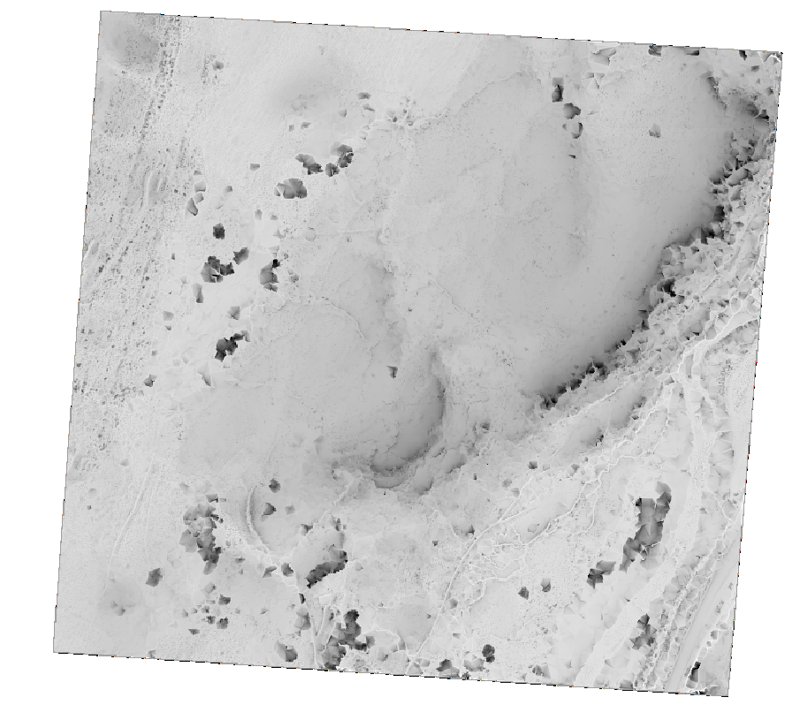
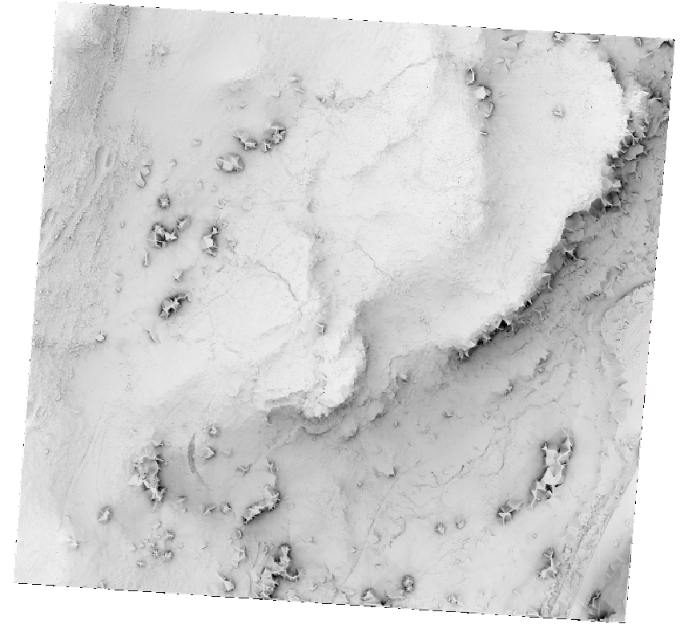
Compare the geomorphological interpretability
Generated in QGIS via SAGA tools
Positive openness
Negative openness
Sky view factor

Slide 22
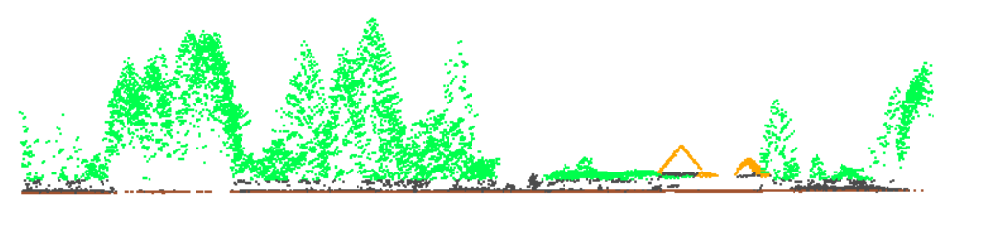
Creating model of normalized heights
Normalized height is the vertical distance of a point above the ground surface, calculated by subtracting the ground elevation (from a Digital Terrain Model, or DTM) from the point's absolute elevation (Z-coordinate).
It standardizes height measurements to reflect true heights relative to the ground, rather than absolute elevations.
Normalized height is crucial in vegetation analysis, building modeling, and creating Canopy Height Models (CHM).
In LAStools, before proceeding to CHM creation, elevation heights need to be replaced with normalized heights using lasheight.exe
C:\LAStools\bin\lasheight.exe -i c:\LIDAR_DATA\02_lasclassify\*.laz -o 02_lasclassify\classified_all_with_norm_hghts.laz -replace_z -v
C:\LAStools\bin\blast2dem.exe -i c:\LIDAR_DATA\02_lasclassify\classified_all_with_norm_hghts.laz -o 03_blast2dem\chm.tif -step 1 -drop_class 7 18 –v
Normalized Height = Z _{point} ​− Z_{ground}​
CHM=DSM−DTM

Slide 23
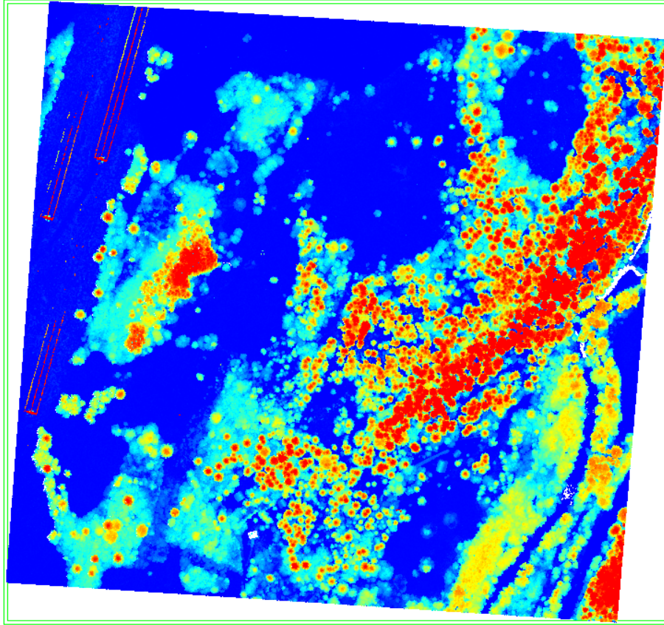
Creating model of normalized heights
nDSM – normalized digital surface model
The height of pixels above the ground elevation
Useful to measure the height of trees, buildings, wires
E.g. to estimate the biomass
Normalized Height = Z _{point} ​− Z_{ground}​
nDSM/CHM = DSM−DTM

Slide 24
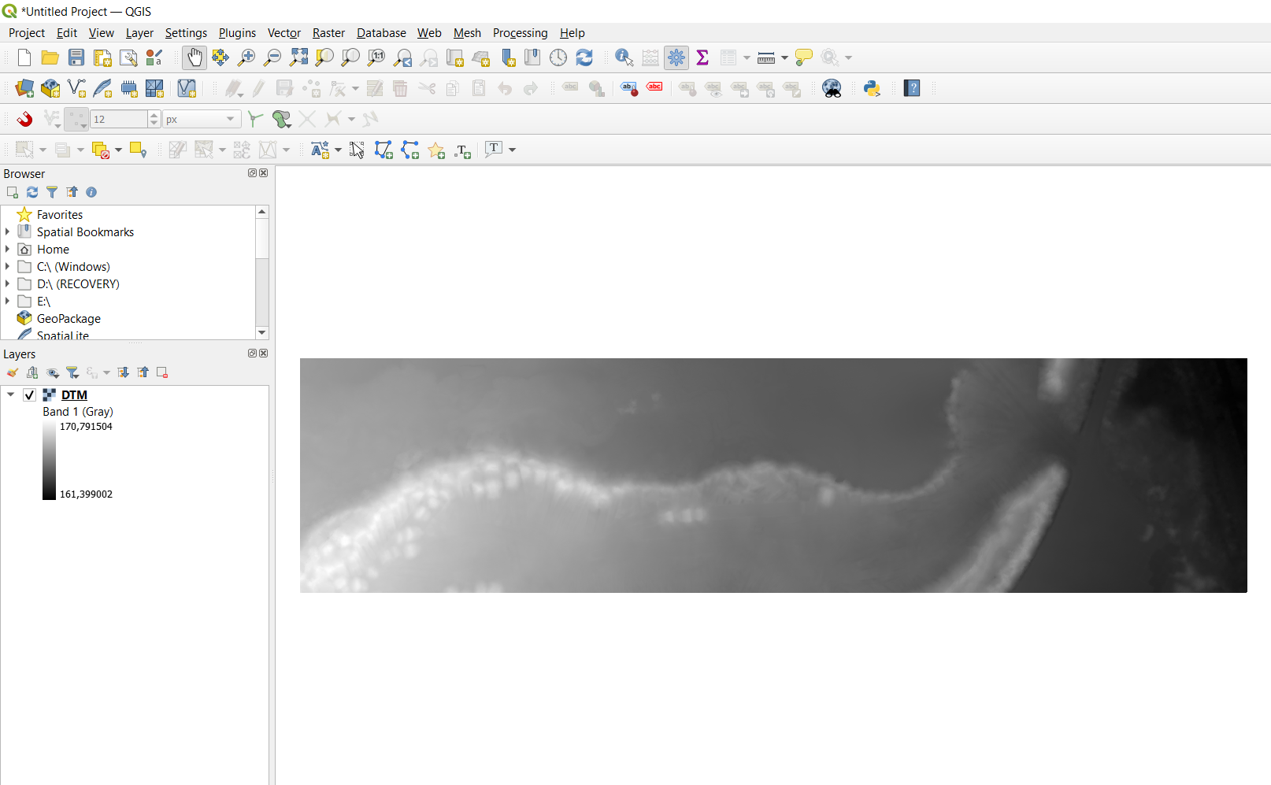
GEOmorphometric analysis
Software: QGIS
  data import: Drag & Drop/Layer - Add Layer - Add Raster Layer
Notes:
With a push-broom spectrometer, full spectral image data are recorded simultaneously per line
However, each line of airborne pushbroom images is collected at different time instants. Perspective geometry varies with each pushbroom line, leading to different line displacement, and thus turning the rectification process more difficult

Slide 25
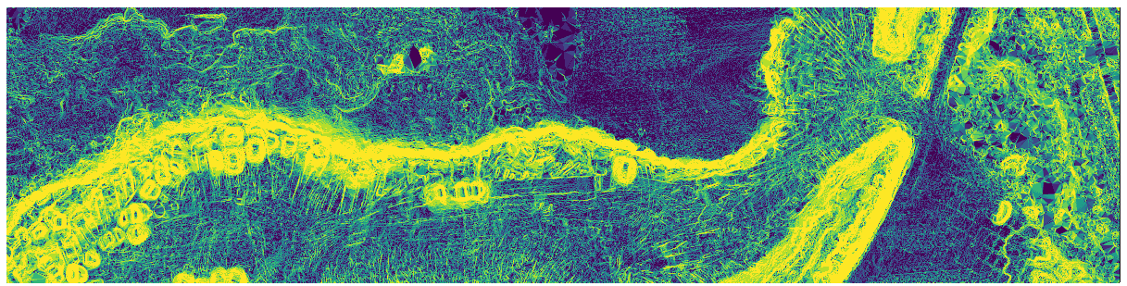
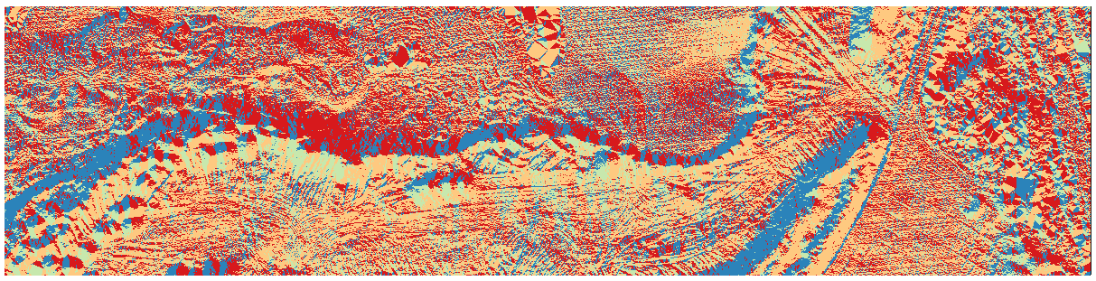
GEOmorphometric analysis
Software: QGIS
  geomorphometric analysis: Processing - Toolbox - Raster Terrain Analysis - Slope/Aspect
  Slope
  Aspect
Notes:
With a push-broom spectrometer, full spectral image data are recorded simultaneously per line
However, each line of airborne pushbroom images is collected at different time instants. Perspective geometry varies with each pushbroom line, leading to different line displacement, and thus turning the rectification process more difficult

Slide 26
Background of the sample data
The sample data represent a slope with quarternary travertine deposites
Geomorphometric analysis was used for identification of break lines / faults/ tectonic features
Bóna et al. 2024: https://doi.org/10.1016/j.geomorph.2024.109420

Slide 27
High Tatras: Neotectonic fault line – Late Quarternary

Slide 28
Useful additions

Slide 29
How to Run LAStools Executables from Any Directory in Windows
Find the Path to LAStools:
  Navigate to C:\LAStools\bin (where the executables are stored).
Add LAStools to Windows PATH:
  Press Win + R, type sysdm.cpl, and press Enter.
  Go to the Advanced tab and click Environment Variables.
  Under System Variables, find Path and click Edit.
  Click New and paste the path: C:\LAStools\bin.
  Click OK to save.
Test the Setup:
  Open a new Command Prompt.
  Type:
cmd
lasground.exe -h
  If you see the help message, it’s working!
This setup allows you to use LAStools commands from any folder, making it easier to process your lidar data.

Slide 30
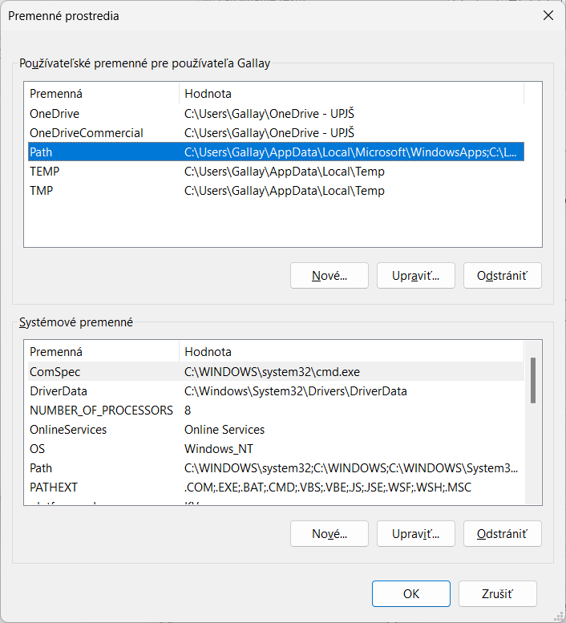
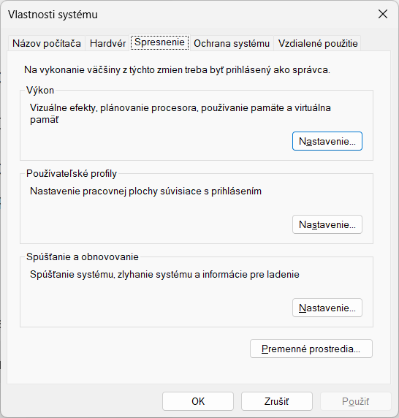
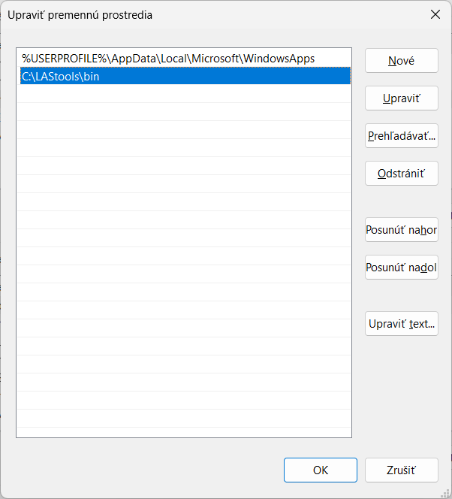
System properties – Advanced – Envir. variables

Slide 31
Processing lidar data using data tiles

Slide 32
LAStools: data tiling
The first step is to split the input point cloud into tiles for more efficient processing.
mkdir 00_lastile
C:\LAStools\bin\lastile.exe -i C:\LIDAR_DATA\*.laz -o 00_lastile\tile.laz -tile_size 200 -buffer 20 -flag_as_withheld -v
Explanation:
-tile_size 200 creates 200m x 200m tiles.
-buffer 20 adds a 20m buffer around each tile to ensure smooth processing at the edges. We choose 20 meters as this is larger than any building we expect in this area and slightly larger than the ‚-step‘ size we use later when classifying the points into ground and non-ground points with lasground
-olaz outputs the tiles in compressed .laz format.
-flag_as_withheld: Buffer points are additional points included around the edges of tiles to account for edge effects during processing. For example, when you create 200m x 200m tiles with a 20m buffer, each tile will include an extra 20m of data on all sides. ome tools and algorithms (e.g., DTM generation, CHM subtraction) can be sensitive to overlapping points. Including buffer points in analyses could lead to artifacts.
The tiles will be saved in the 00_lastile folder.
NB: Before delivering the classified LiDAR tiles to a customer or another user it is imperative to remove the buffers that were carried through all computations to avoid artifacts along the tile boundary. Use lastile fort this task.

Slide 33
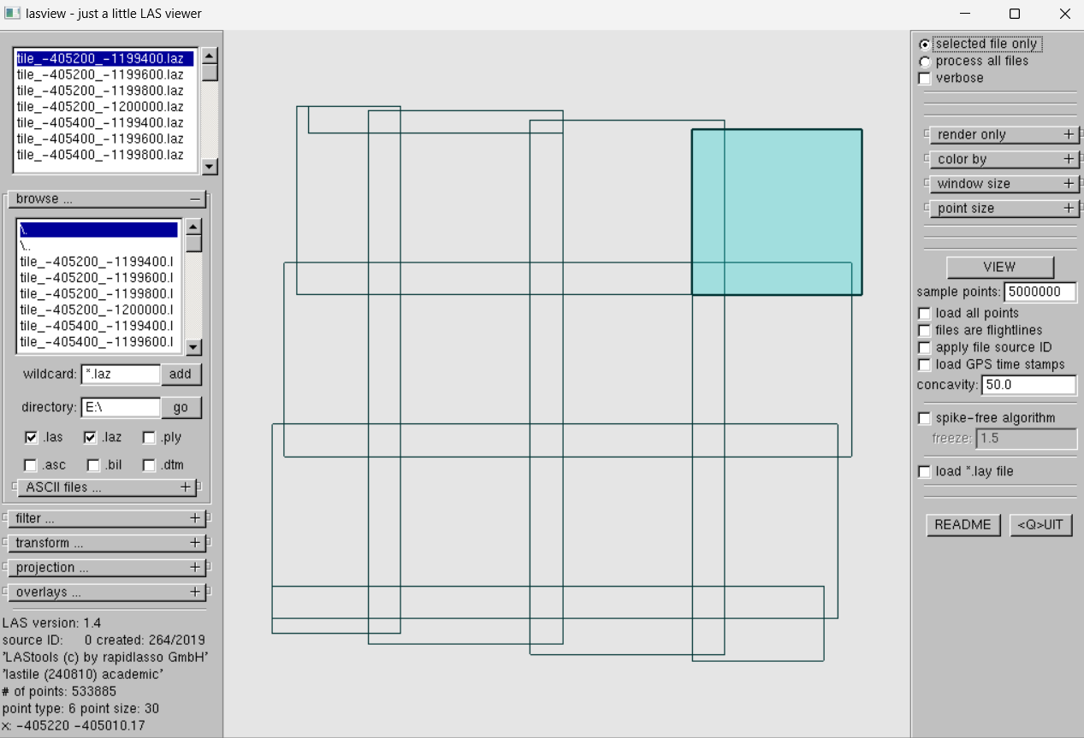
LAStools: data tiling
lasview C:\LIDAR_DATA\00_lastile\*.laz

Slide 34
Removing outlier/noise points
First check if outliers/noise points are present
If they do exist, filter them out with lasnoise.exe
mkdir 000_lasnoise
C:\LAStools\bin\lasnoise.exe -i c:\LIDAR_DATA\00_lastile\*.laz -odir c:\LIDAR_DATA\000_lasnoise\ -olaz -remove_noise -v
Especially for ground classification it is important that low noise points are excluded.
Tiles are treated individually and LAZ files are created
Read lasnoise_README.txt for custom settings

Slide 35
Filtering of ground points
Path to the LAStools C:\LAStools\bin\
Path to the folder with ALS point data c:\LIDAR_DATA\
Change folder to my data folder and
generate a new folder inside it, where the ouput is going to be stored
run filtering of ground points
mkdir 001_lasground
C:\LAStools\bin\lasground_new.exe -i c:\LIDAR_DATA\000_lasnoise\*.laz -odir c:\LIDAR_DATA\001_lasground\ -olaz -nature -v -compute_height -ignore_class 7 18

Slide 36
Classification of non-ground points
Uses geometric relationships, spatial density, and elevation differences between points to identify patterns that correspond to ground, vegetation, and buildings.
assigns classes of vegetation (5) and buildings/roofs (6) to the points unclassified in the previous step of ground classification. All points above 2 meters above the ground points are classified as vegetation or roofs. Ignores noise points
mkdir 002_lasclassify
C:\LAStools\bin\lasclassify.exe -i c:\LIDAR_DATA\001_lasground\*.laz -odir c:\LIDAR_DATA\002_lasclassify\ -olaz -v -ignore_class 7 18
ground points (2)
unclassified points (8)
(high) vegetation (5)
roofs/buildings (6)

Slide 37
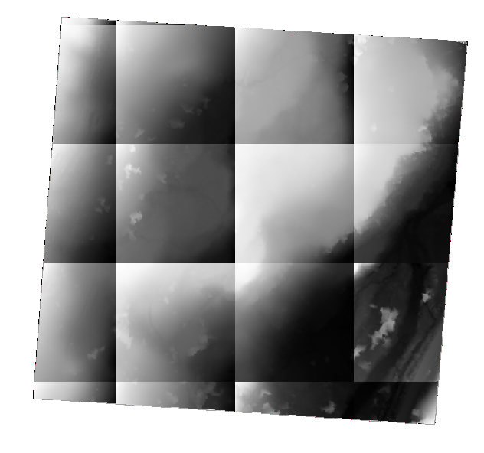
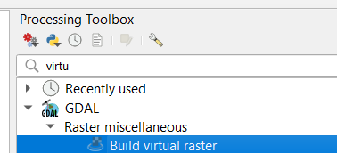

DTM and DSM creation
Creates raster models for each tile.
Subtracts DTM from DSM to get the Canopy Height Model.
mkdir 003_blast2dem
C:\LAStools\bin\blast2dem.exe -i c:\LIDAR_DATA\002_lasclassify\*.laz -odir c:\LIDAR_DATA\003_blast2dem\ -odix _dtm -use_tile_bb -otif -keep_classification 2 -elevation -step 1 –v
C:\LAStools\bin\blast2dem.exe -i c:\LIDAR_DATA\02_lasclassify\*.laz –odir c:\LIDAR_DATA\003_blast2dem\ -odix _dsm -otif -use_tile_bb -first_only -elevation -step 1 -drop_class 7 18 –v
-use_class 2:uses only ground points (class 2) to create a raster DTM rasters with a grid cell size of 1 m
-first_returns_only:uses first returns only to create a raster DSM rasters with a grid cell size of 1 m, but noise points (class 7, 18) need to be dropped out
Tiles of DTM / DSM files need to be merged together e.g. as a virtual raster in QGIS

Slide 38
Resources
Complete LiDAR Processing Pipeline: from raw Flightlines to final Products
  https://rapidlasso.de/complete-lidar-processing-pipeline-from-raw-flightlines-to-final-products/
Some of our online ALS visualisations:
  https://uge-share.science.upjs.sk/webshared/Laspublish/porcus/sale_e_porcus.html

Slide 39
Airborne LiDAR data processing
INSTITUTE OF GEOGRAPHY, FACULTY OF SCIENCE, PAVOL JOZEF ŠAFÁRIK UNIVERSITY IN KOŠICE, SLOVAKIA
geografia.science.upjs.sk
michal.gallay@upjs.sk

