Slide 1

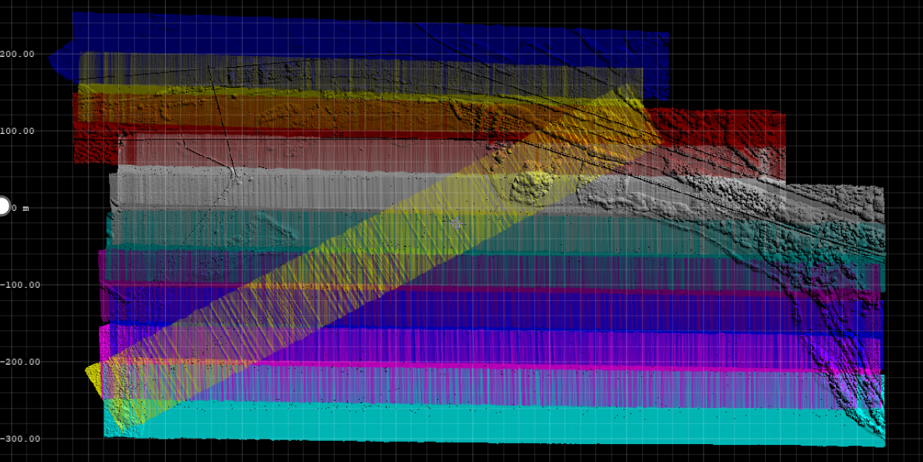
Introduction to airborne laser scanning (ALS)
airborne Light Detection And Ranging (LiDAR)
Michal Gallay
INSTITUTE OF GEOGRAPHY, FACULTY OF SCIENCE, PAVOL JOZEF ŠAFÁRIK UNIVERSITY IN KOŠICE, SLOVAKIA
geografia.science.upjs.sk
michal.gallay@upjs.sk

Slide 2
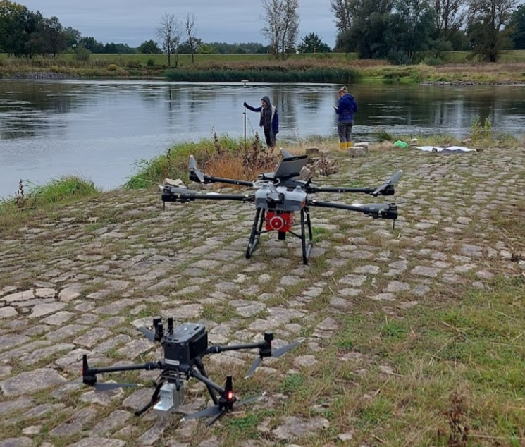
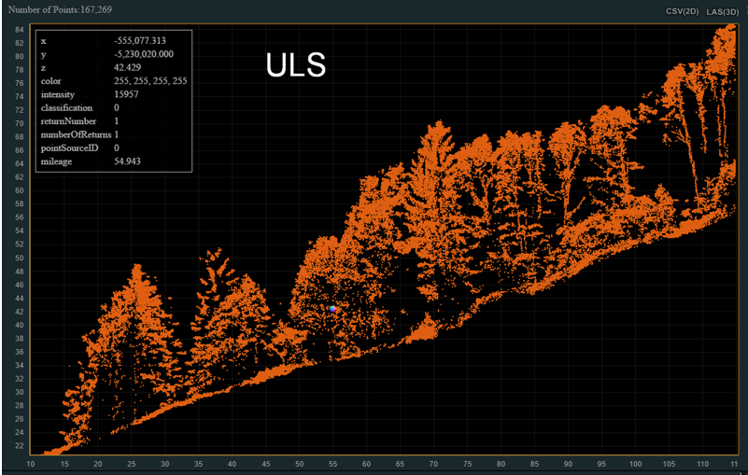
Introduction to UAV LiDAR Mapping
What is LiDAR?
Overview of UAV-based LiDAR mission planning
Applications in environmental studies
Forest in Alps
Odra river in Poland

Slide 3
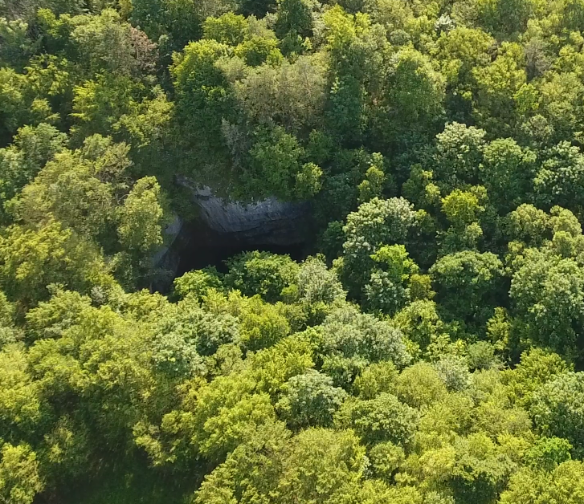
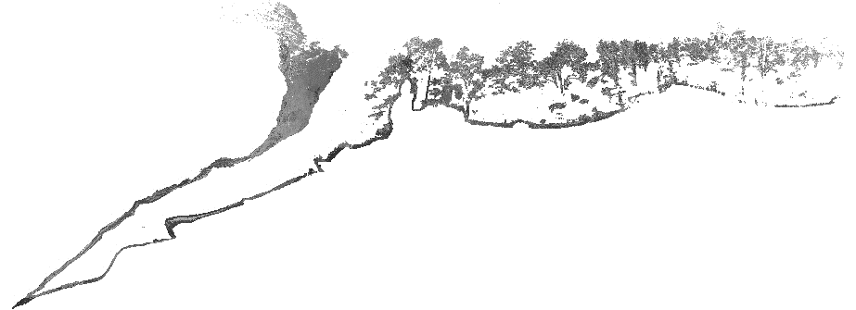
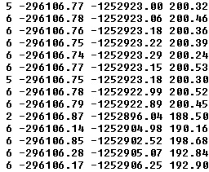
Topographic Laser Scanning
active method of remote sensing , emits laser pulses
Lidar uses coherent electromagnetic energy generated by a laser
Monochrome electromagnetic energy
Typical wavelengths: 900 or 1500 nm (landsurface mapping), 520 nm (underwater mapping)
the output is a cloud of points (x, y, z) + other attributes (intensity, scan angle, GNSS time, ...)
measurement of distance, recording scan angles of the beams
Resulting in calculation of 3D point coordinates
mapping of various surfaces with high spatial resolution types: air or ground
trees
Data structure
wall
grass
terrain
doline
cave
Terrestrial laser scanning
icefall

Slide 4
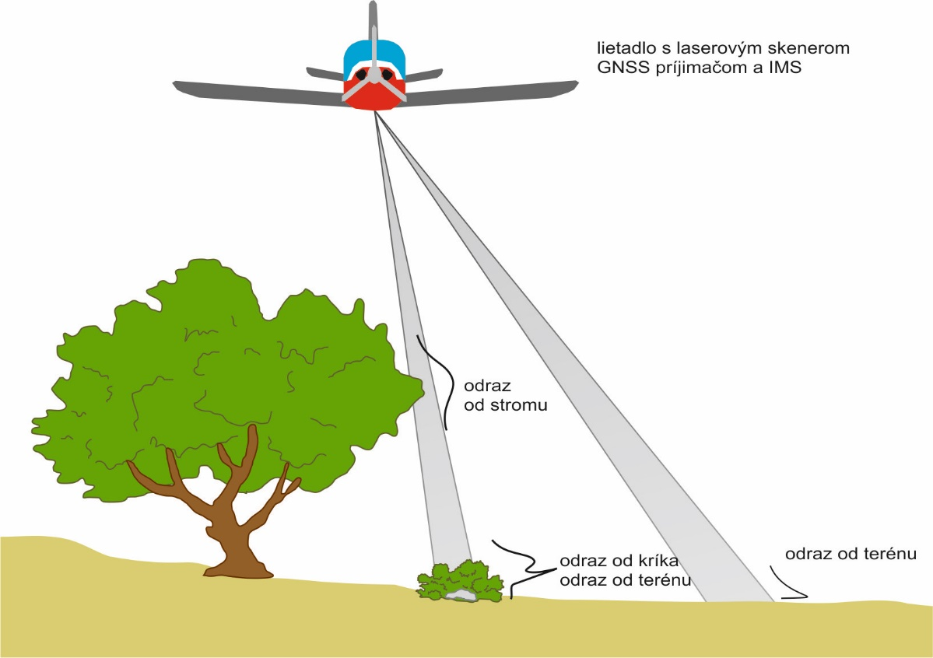
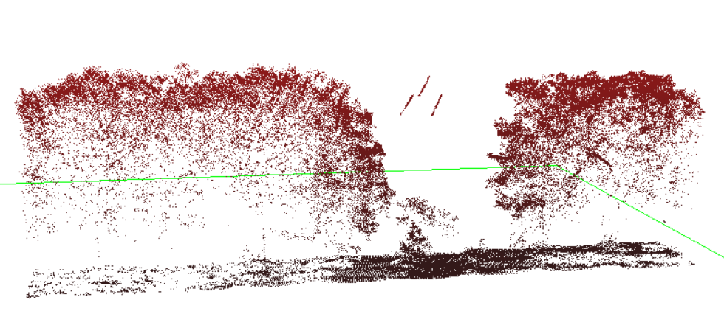
Topographic laser scanning: Airborne (ALS)
the record is created in the lines according to the flight plan
initial processing is based on flight trajectory reconstruction, (sub)vertical view angle
suitable for 3D mapping of larger areas, terrain under vegetation canopy + canopy
disadvantages of ALS – dense vegetation creates shadows, unsuitable for mapping walls, facades, caves, mines, ...
Tree canopy
Electric wires
Open ground
Under canopy ground

Slide 5
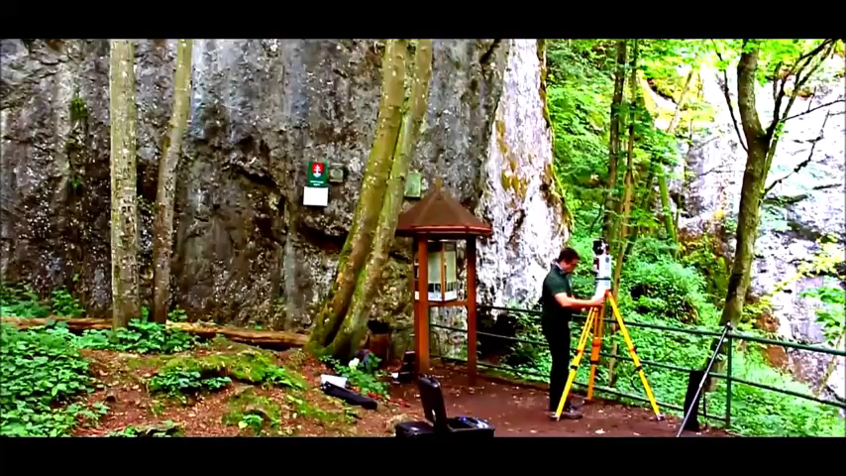
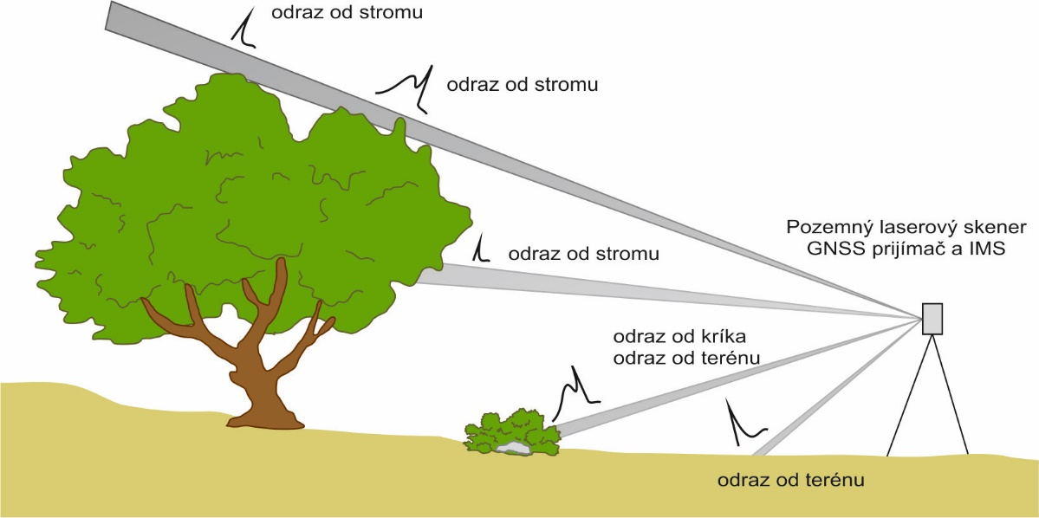
Topographic laser scanning: Terrestrial (TLS)
polar method of measurement, the need to register point clouds from individual scan positions, ( see also mobile scanning)
suitable for mapping smaller areas also under the ground, vertical walls and overhangs
high accuracy and presision, horizontal view angle
Disadvantages – the need to eliminate data shadows, smaller areas than ALS

Slide 6
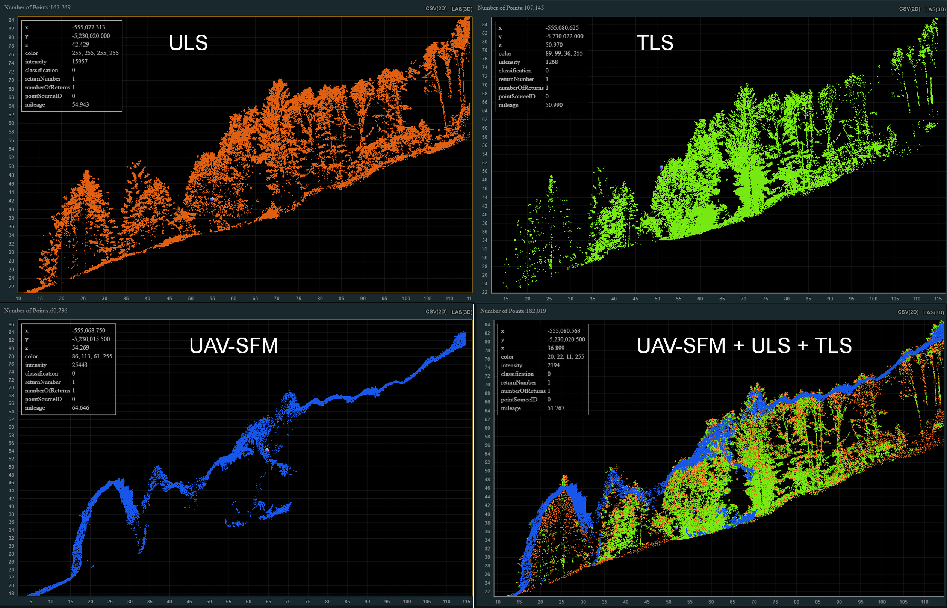
Comparison of different 3D mapping methods
increasing the spatial resolution of the resulting landscape models
ŠAŠAK, J., GALLAY, M., KAŇUK, J., HOFIERKA, J., MINÁR, J. (2019). Combined use of terrestrial laser scanning and UAV photogrammetry in mapping alpine terrain. Remote Sensing, 11 (18), 2154.
RUSNÁK, M., KAŇUK, J., KIDOVÁ, A., ŠAŠAK, J., LEHOTSKÝ, J., PÖPPL, R., ŠUPINSKÝ, J. (2020). Channel and cut-bluff failure connectivity in a river system: Case study of the braided-wandering Belá River, Western Carpathians, Slovakia. Science of The Total Environment, 733, 139409.
GALLAY, M., KAŇUK, J., ZGRAGGEN, C., IMBACH, B., ŠAŠAK, J., ŠUPINSKÝ, J., HOLLAUS, M. (2023). Unpiloted Airborne Laser Scanning of a Mixed Forest. A Case Study from the Alps, Austria. In: Meneely, J. (Ed.), 3D Imaging of the Environment: Mapping and Monitoring. 1-13.

Slide 7
Airborne LiDAR Basics
Components of Airborne LiDAR systems:
Laser scanner (e.g., RIEGL VUX-1): 500,000 points/sec, 200 scan lines/sec.
GNSS and IMU integration for precise georeferencing of points = Inertial navigation system (INS).
Data processing and storage unit
Suitable for large-area mapping with high resolution.
Notes:
Airborne LiDAR integrates GNSS and IMU for accurate mapping and is particularly useful for large-scale projects.

Slide 8
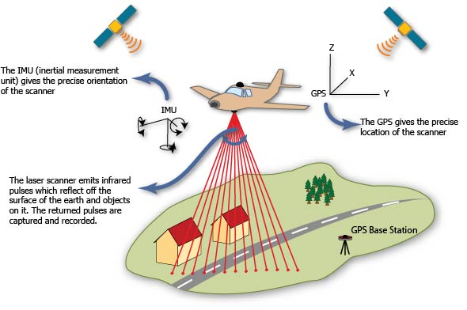
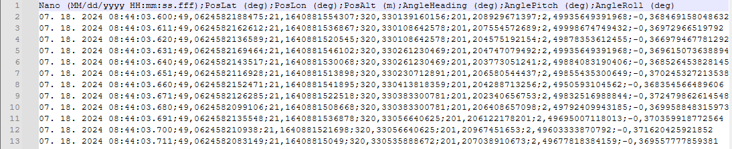
GNSS/IMU Integration = INS
Recording of position and orientation of the scanning device along the flight line

Slide 9
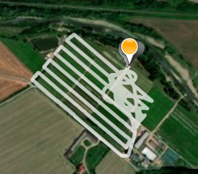
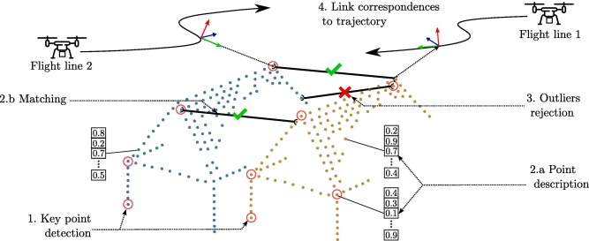
GNSS/IMU Integration = INS
Recording of position and orientation of the scanning device along the flight line
Ensures precise georeferencing of LiDAR points
Brun et al. 2022: https://doi.org/10.1016/j.isprsjprs.2022.04.027

Slide 10
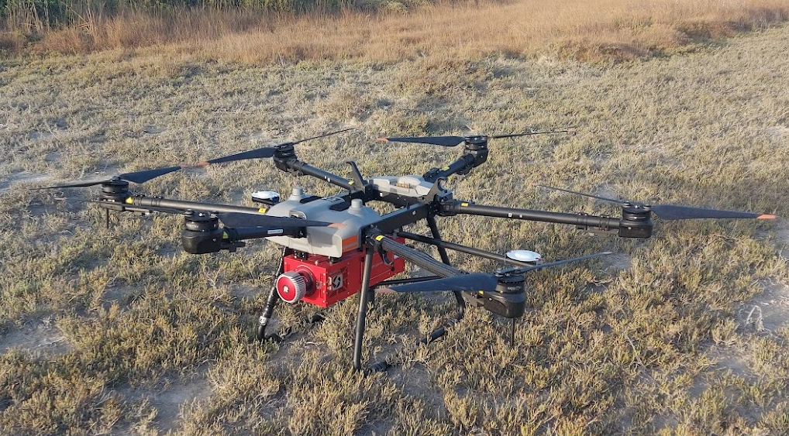
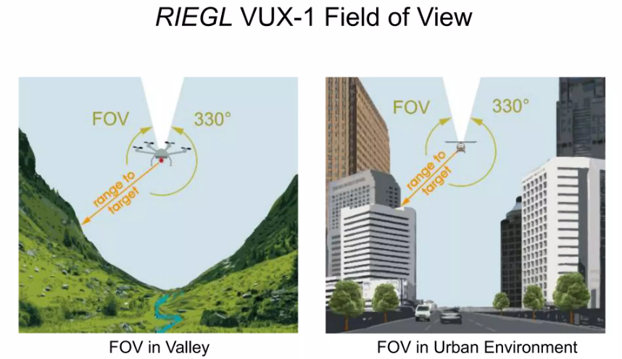
Example: the VUX-1 Laser Scanner by RIEGL
Weight: 3.5 kg
Payload: 12 kg (Lidar + INS + HDD + batteries)
The scanner VUX-1 by Riegl
500,000 points/second
200 scan lines/second
330 m max. operating altitude/range
330° field of view
Mounted on a DJI AGRAS T30 UAV – originally for spraying agricultural crops
Normally 60°, with overlaps

Slide 11
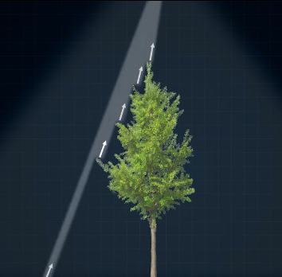
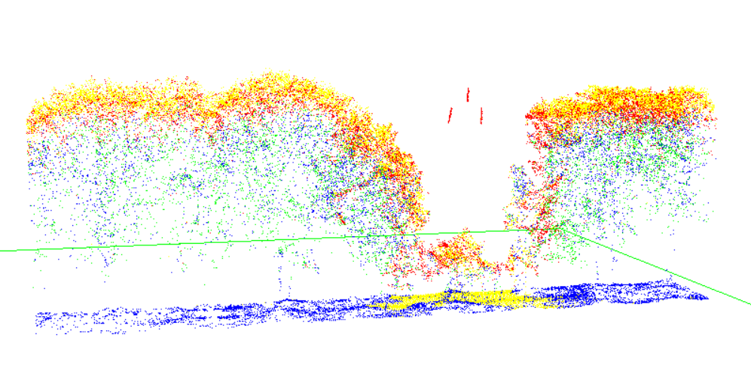
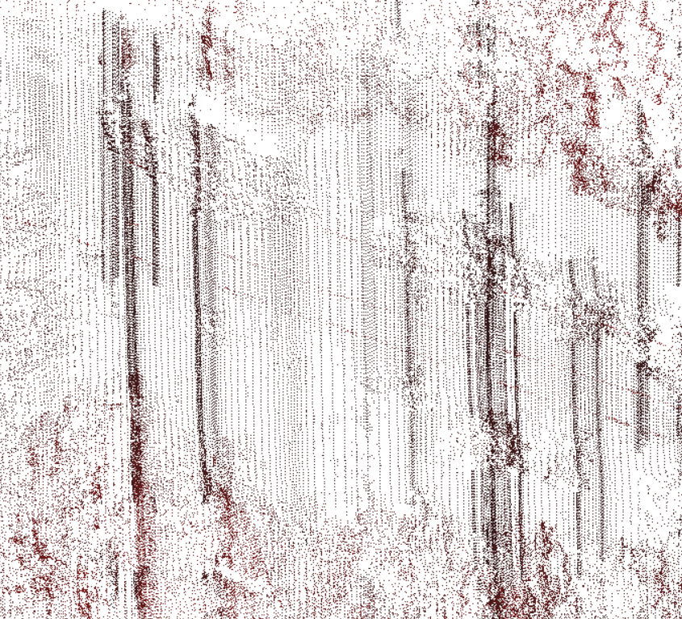
Key VUX-1 Scanner Features
5 returns
of a single laser pulse
Regular point pattern, parallel scan lines
Point density: 4 to 400 points/m2
Echo signal digitization and waveform processing, unlimited number of returns per laser pulse (advantage in dense vegetation)
Eg. DJI Zenmuse L2 max 5 returns per pulse (sufficient in urban, not in forest, shurbs)
From above / points along scan lines
many returns
of a single laser pulse

Slide 12
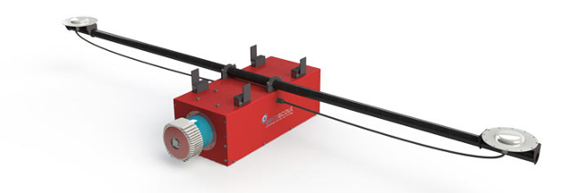
GNSS/IMU Integration = INS
Recording of position and orientation of the scanning device along the flight line
Ensures precise georeferencing of LiDAR points
OXTS xNAV 550 = inertial navigation system (INS = GNSS + IMU)
2 GPS antennas
GNSS for absolute position (1 Hz), IMU Roll/Pitch/Yaw (up to 250 Hz)
Kalman filtering is used to resample/increase the GNSS measurements density to the higher frequency of the IMU measurements, i.e. from 1 Hz to 250 Hz

Slide 13
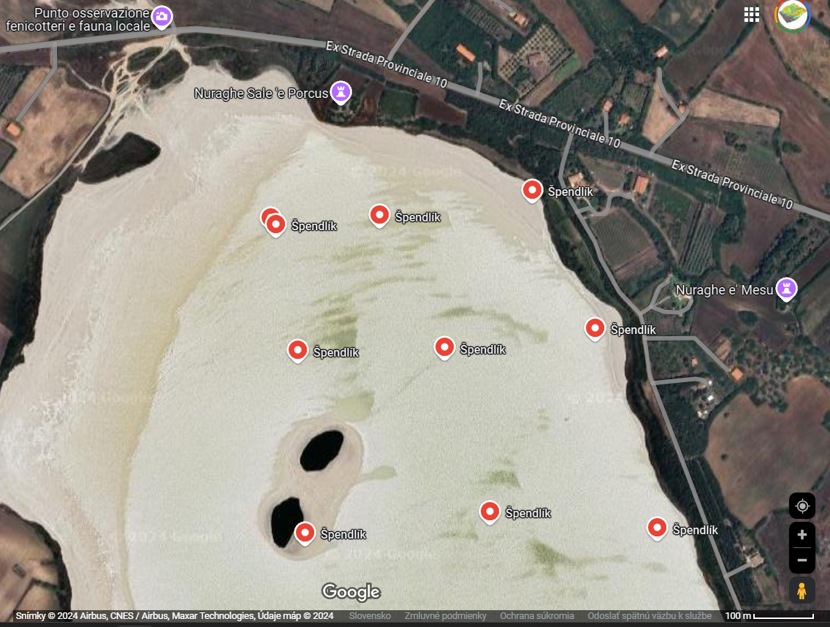
Data Collection Process
Mission planning: flight altitude, speed, weather
Setting scan parameters: point density, flight path
This summer school IRSSS 2024
700 x 600 m = 0,42 km2
2023
560 m
Lidar flight strips in 2023
2024
600 m
800 m

Slide 14
Determining Optimal Point Density
- Factors influencing point density:
1. Terrain complexity: Higher density for rugged areas.
2. Feature size: Match density with smallest features.
3. Application type: Urban, forestry, or geology.
Point density = number of points / area coverage [points per square metre]
Point spacing = SQRT(1/point density) [average distance between points in meters]
Notes:
Optimal point density depends on terrain, feature size, and application type, balancing quality with cost.

Slide 15
Shannon-Nyquist Theorem in LiDAR
A signal must be sampled at least twice its highest frequency.
Applicable in remote sensing to set the optimal spatial resolution
Application in LiDAR: Point spacing = 0.5 × smallest feature size.
Example: We want to distinguish 1 m-wide ditches/tectonic ruptures, point spacing 0.5 x 1m = 0.5 m.
Similar principle to set the pixel size of an image
Notes:
The Shannon-Nyquist theorem guides optimal point density selection to prevent aliasing in LiDAR data.

Slide 16
Data Processing Overview
Steps: Georeferencing, filtering, noise removal
Creating digital elevation models (DEMs) or 3D models
  DTM, DSM, CHM, nDSM
Common software: RiPROCESS, TerraScan, LASTools, CloudCompare, Blender, ArcGIS, QGIS, GRASS GIS, ...

Slide 17
Challenges in LiDAR Data Collection
What is the objective? Terrain, vegetation, both?
Factors: altitude, speed, vegetation, terrain, weather
GNSS signal quality can impact accuracy
Mitigating challenges: careful planning and sensor settings

Slide 18
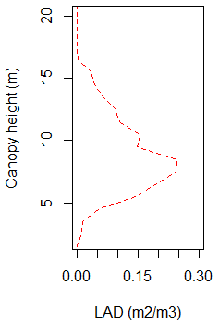
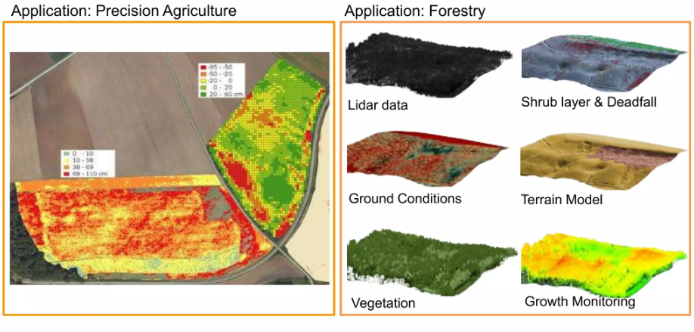
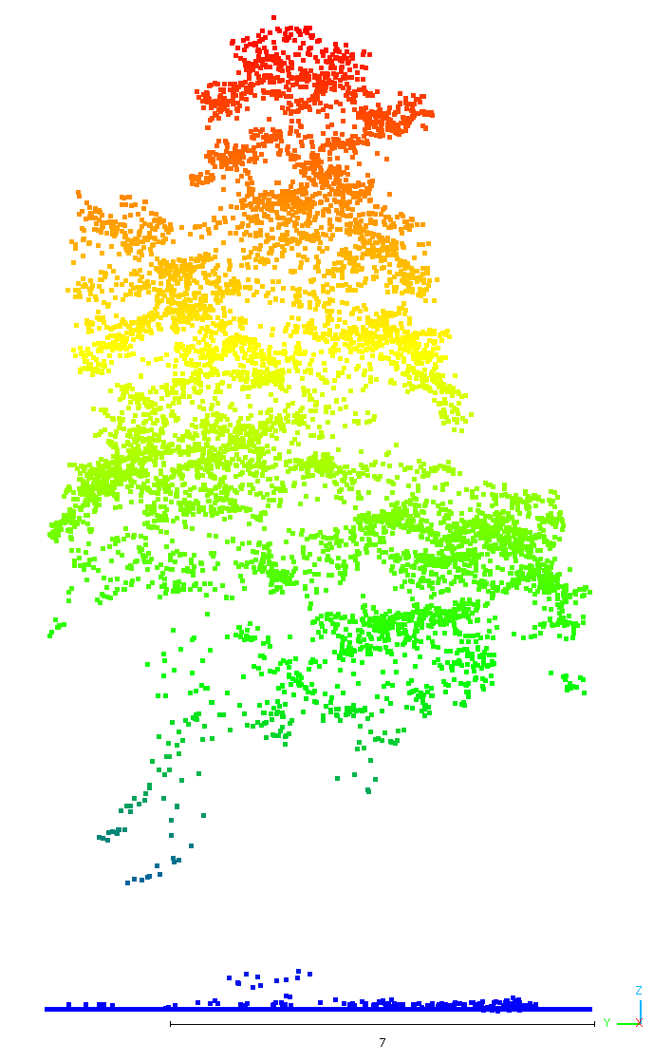
Applications of UAV LiDAR
Topographic mapping, geomorphology
Forestry and vegetation studies
Urban infrastructure monitoring
Leaf area density m2/m3
Tilia coradata

Slide 19
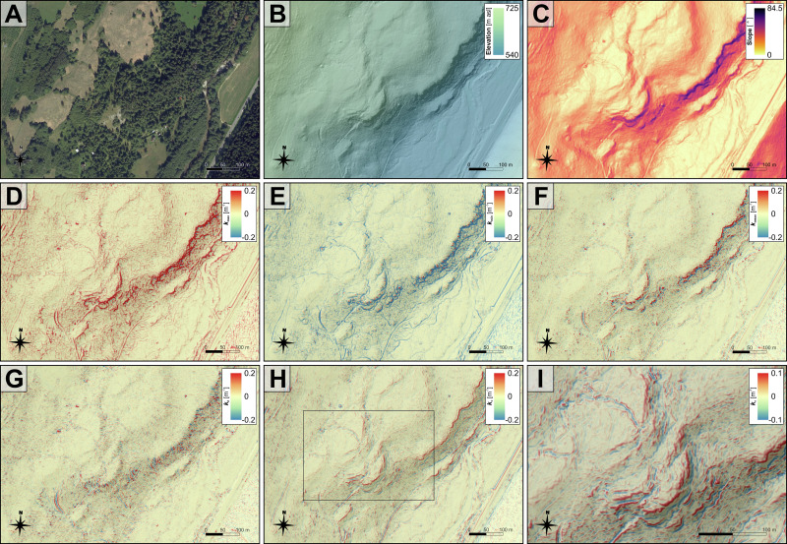
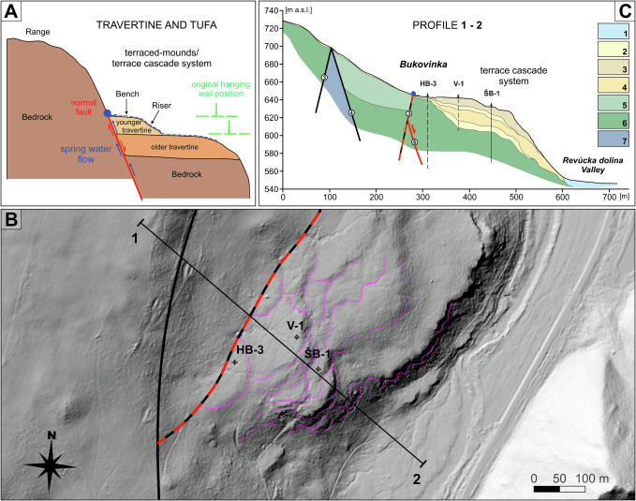
Applications of airborne LiDAR
Topographic mapping
E.g. geomorphometric parameters for identification of break lines/faults/tectonic features
Bóna et al. 2024: https://doi.org/10.1016/j.geomorph.2024.109420

Slide 20
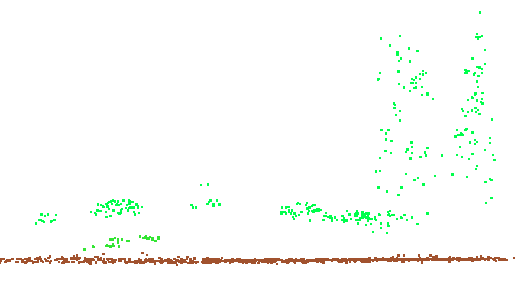
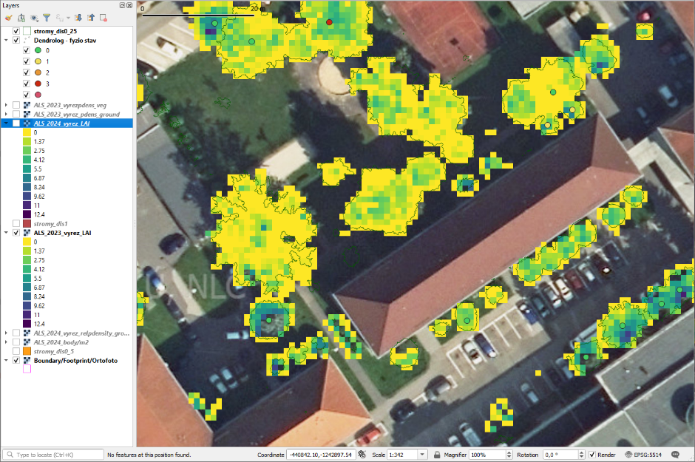
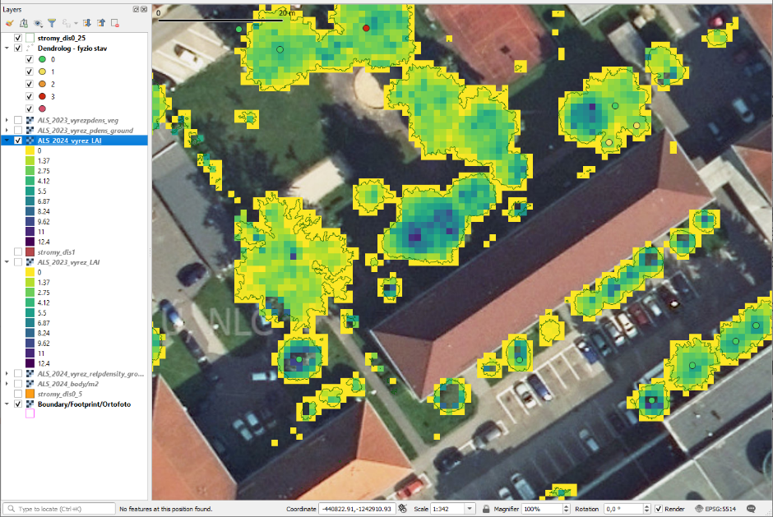
Assessing urban tree health
Leaf area index derived from airborne lidar to assess urban tree vitality
2023
2024
According to both 2023 and 2024 LAIs, this tree has a different/worse greater tree vitlity than its neighbors, which are the same tree species. Left/west is a healthy tree visited by a dendrologist.

Slide 21
Closing & Key Takeaways
Laser scanning generates millions of 3D points, even on and under vegetation canopy using green/red/infrared energy („light“)
Independent of daylight, ideally no rain/snow/dust weather
Importance of point density and GNSS/IMU integration
Standard users work with georeferenced and classified point cloud
LiDAR point cloud derived products: DSM, DTM, nDSM/CHM, 3D metrics

Slide 22
Discussion and Questions
Open the floor for questions or feedback.
Potential topics for exploration:
Integration with multispectral/hyperspectral/thermal imaging.
Lidar provides the height information which is typically not captured by multi/hyperspectral
Applications in hazard monitoring.
Notes:
Encourage students to ask questions and explore further applications of LiDAR.

Slide 23
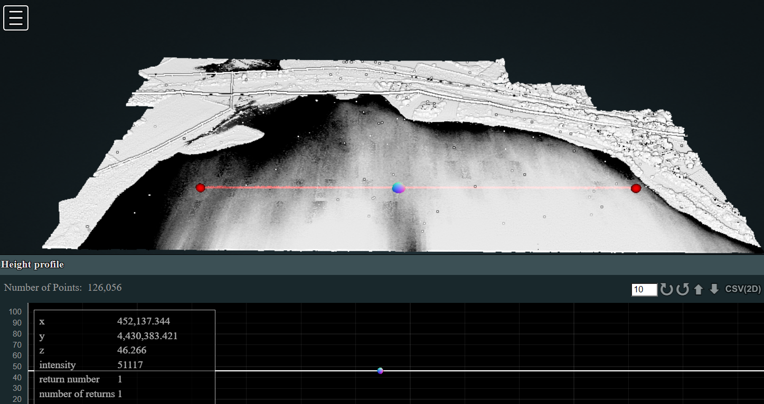
Intorduction to airborne laser scanning
(LiDAR , ALS)
INSTITUTE OF GEOGRAPHY, FACULTY OF SCIENCE, PAVOL JOZEF ŠAFÁRIK UNIVERSITY IN KOŠICE, SLOVAKIA
geografia.science.upjs.sk
michal.gallay@upjs.sk

