Slide 1

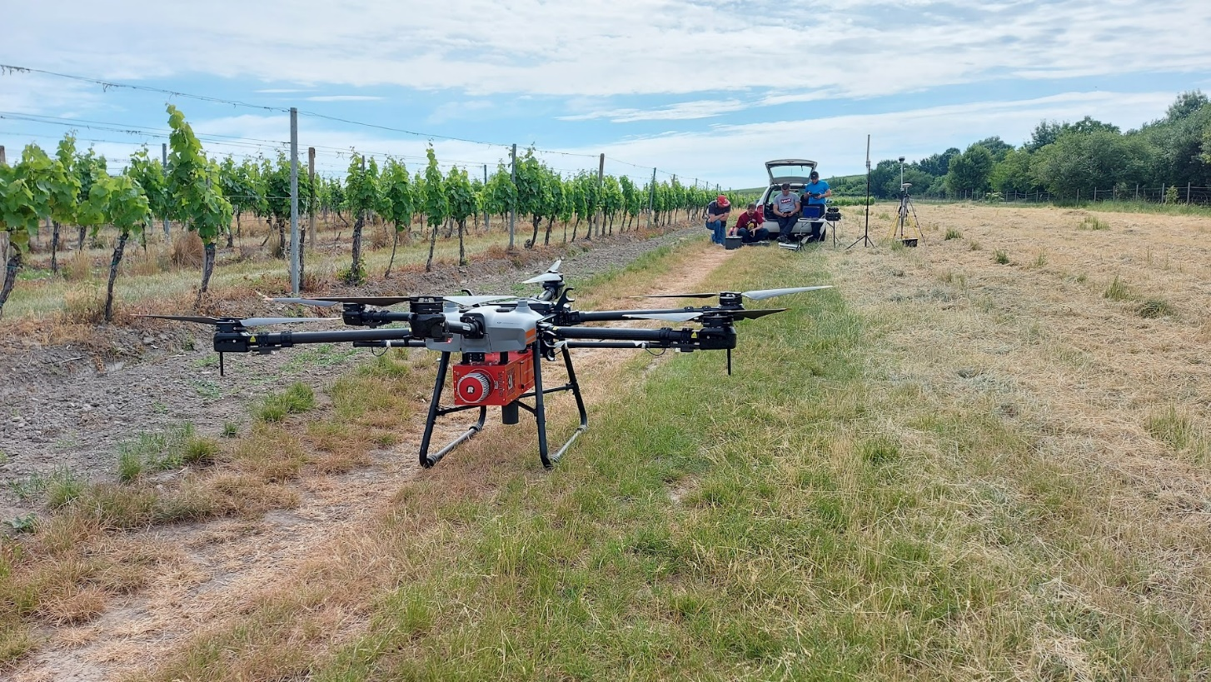
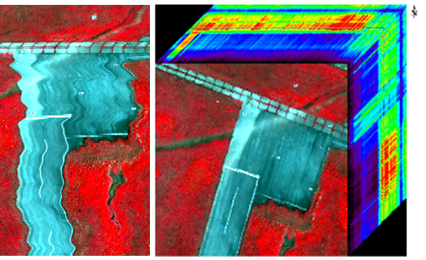


IRSSS 2026
Mountain river systems dynamics from
a multisensor and multiscale perspective
Stará Lesná, Tatry Mountains, Slovakia
19. 7. 2026 - 24. 7. 2026
Introducing the UAV hyperspectral scanning
Michal Gallay, Katarína Onačillová, Ján Kaňuk, Ján Šašak
INSTITUTE OF GEOGRAPHY, FACULTY OF SCIENCE, PAVOL JOZEF ŠAFÁRIK UNIVERSITY IN KOŠICE, SLOVAKIA
geografia.science.upjs.sk
michal.gallay@upjs.sk

Slide 2
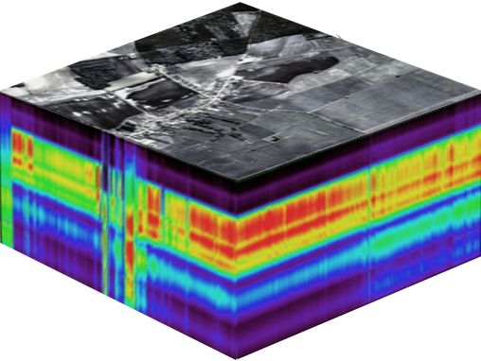
HYPERSPECTRAL CAMERA
Imaging spectrometer used for hyperspectral imaging is often called hyperspectral camera
With hyperspectral camera you can measure thousands or hundred of thousands of spectra
The collected spectra are used to form an image of the target, thus we get spectrum and location
Data that hyperspectral imaging provides is called a data cube
This is huge amount of accurate information
When hyperspectral camera moves relative to target we get our 3rd dimension, which is also location, but in perpendicular direction. This is why it’s called a cube.

Slide 3
Spectral Signatures
Spectral signatures can be compared to fingerprints
Since every material and compound reacts to light uniquely, their spectral signatures are unique too
Just like fingerprints can be used to identify a person, spectral signatures can be used to identify material
Spectrometer is an instrument that splits incoming light into a spectrum
In the example below light going throug h the spectcrometer
is reflected, and the result is called a reflectance spectrum

Slide 4
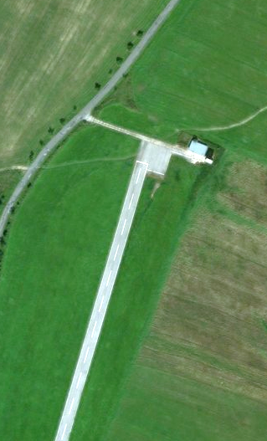
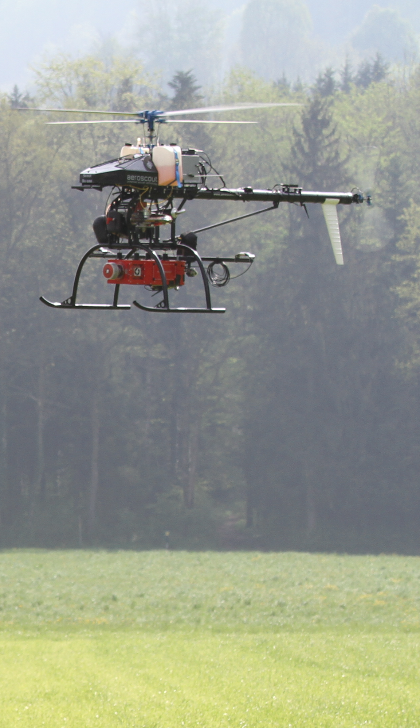
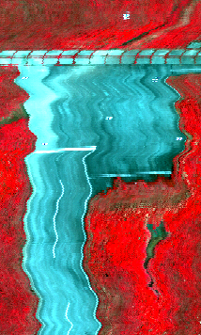
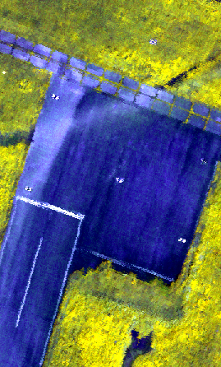
HYPERSPEctral DATA COLLECTION
PLANNING
DATA ACQUISITION
DATA PROCESSING
RESULTS

Slide 5
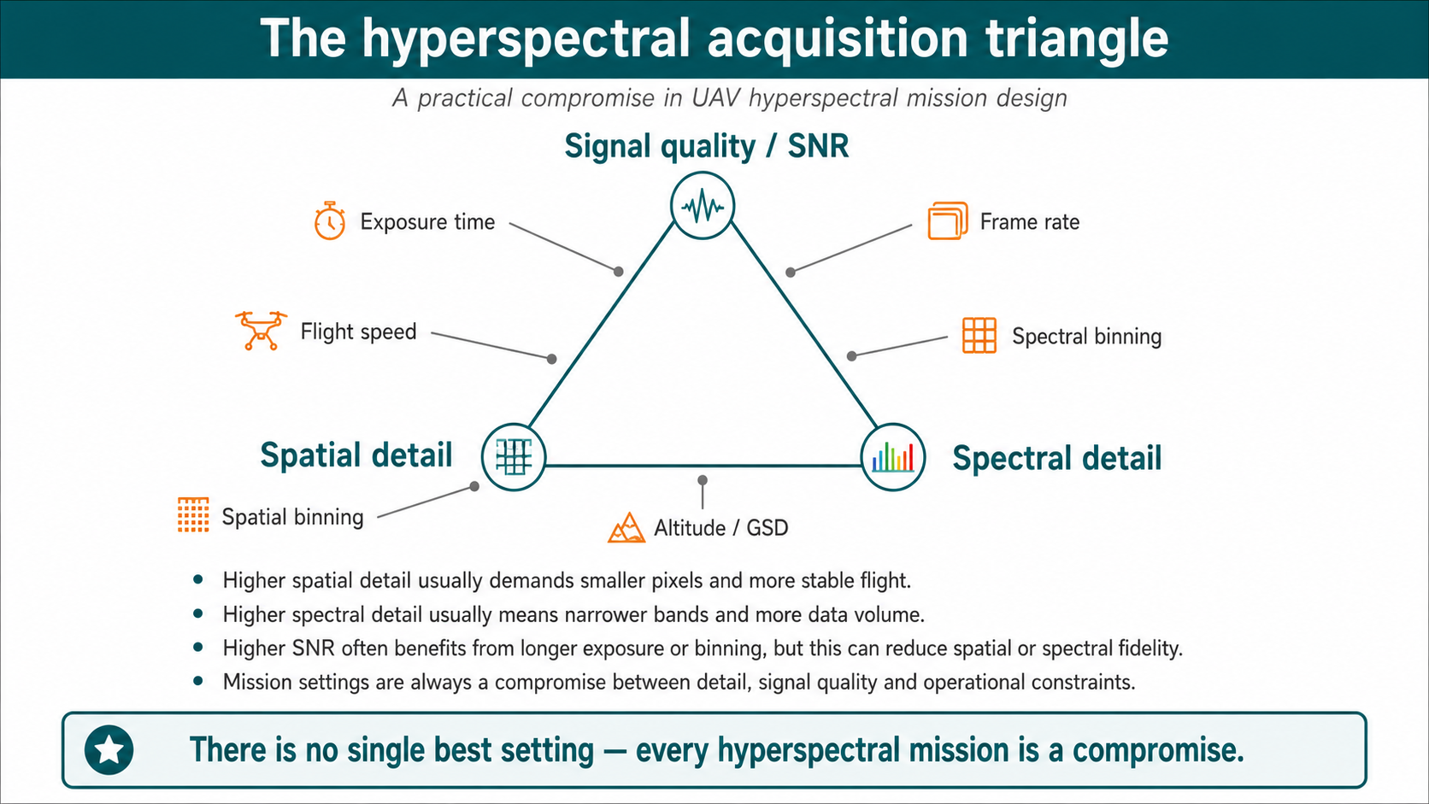

Slide 6
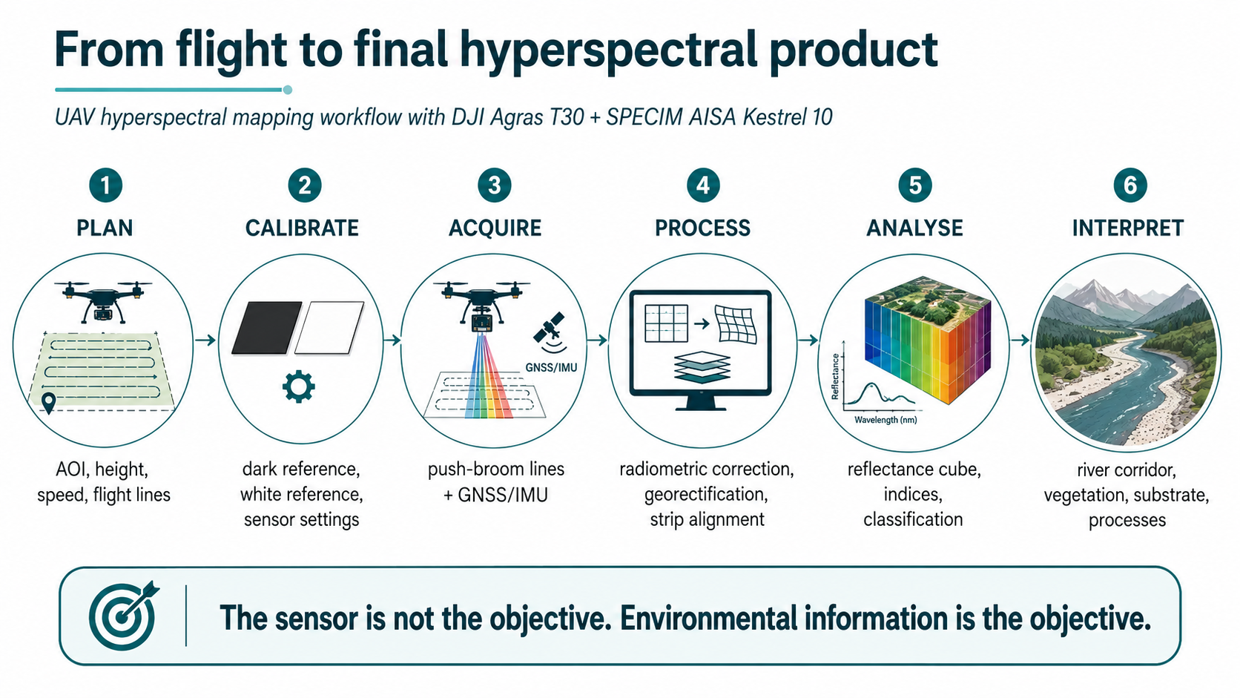

Slide 7
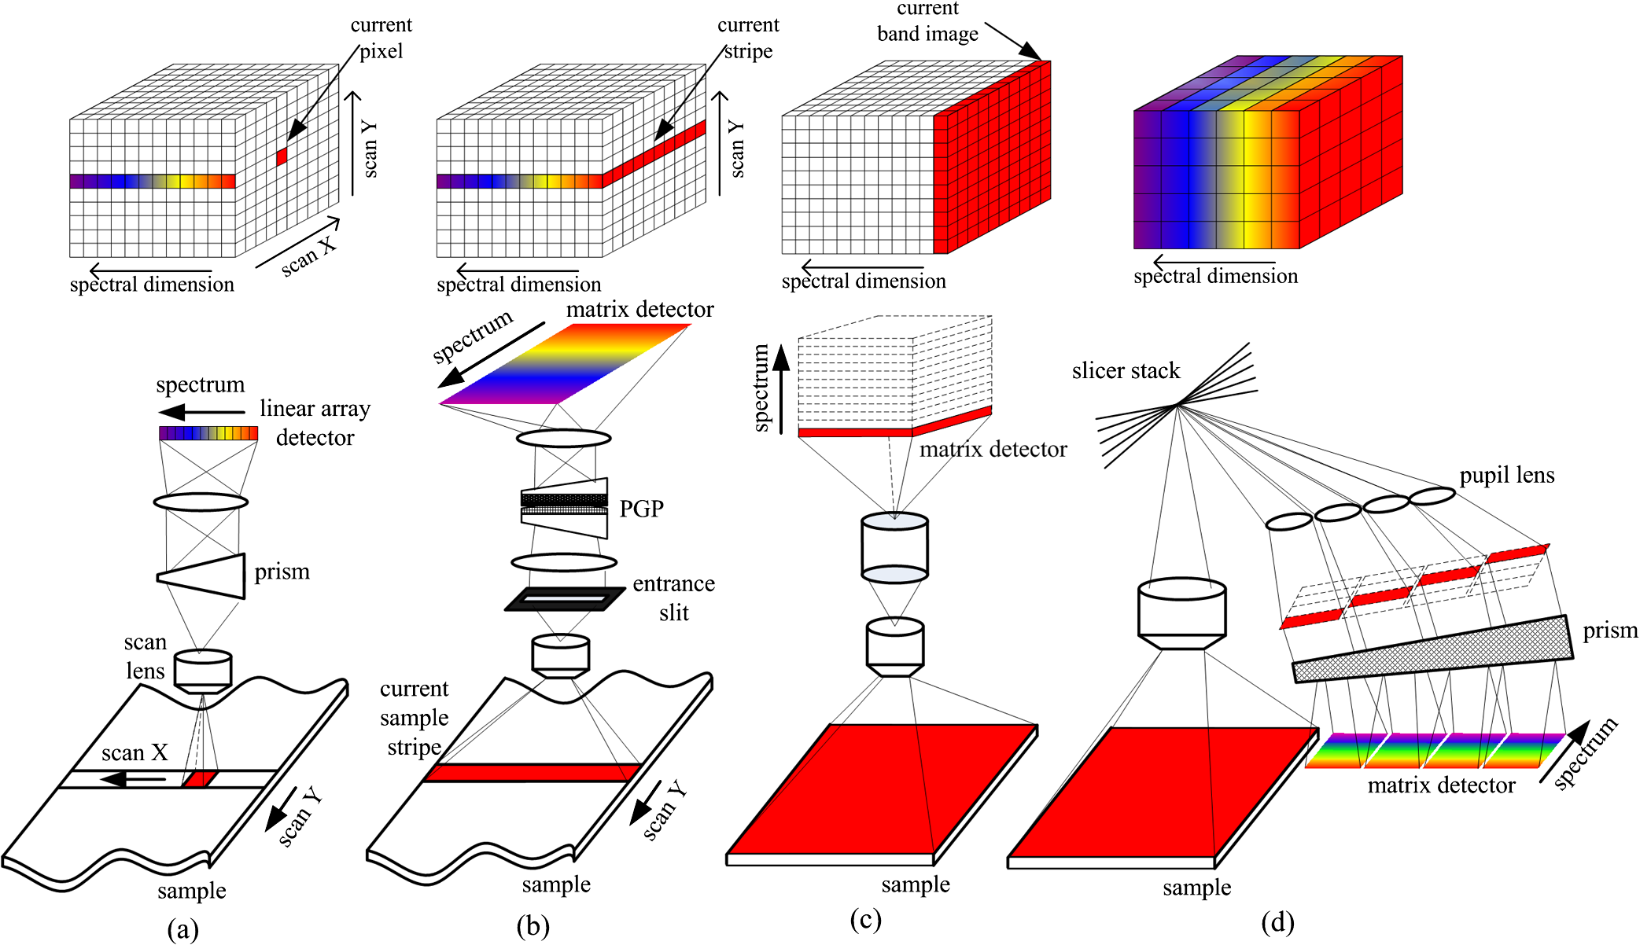
STATE-OF-THE-ART
Push-broom vs other typical spectral imaging approaches
PUSH-BROOM
Full spectral data simultaneously
Image is recorded per line, for all wavelenghts at the same time
Whiskbroom
Pushbroom
Staring
Snapshot
Quingly, L. et al (2013)
Notes:
“Pushbroom” spectrometers use a 2D detector array, and thus collect a vertical slice of the datacube at once so that only one spatial dimension needs to be scanned to fill out the cube.2 A filtered camera, constructed by placing a filter wheel or tunable spectral filter in front of a camera, collects a horizontal slice and thus needs to scan along the spectral dimension to complete the data set.
Pushbroom: Full spectral data simultaneously, with spatial line scanning over time. Imaging spectrograph + 2D array detector
The pushbroom approach, also known as line scanning, has been used by some earth observation satellite systems operating from space, such as the SPOT system. Different from the whiskbroom method that scans one point at a time, the pushbroom method can simultaneously. acquire a slit of spatial information, as well as spectral information corresponding to each spatial point in the slit for one scan, that is, a special y − λ image with one spatial dimension (y) and one spectral dimension (λ) can be taken at the same time with a matrix detector. As shown in Fig. 2(b), the pushbroom method collects a slit image from the object dispersed onto a 2-D detector, in which the spatial information is displayed along one axis and wavelength information along the other. Then the spectral image data cube can be obtained by scanning the slit in the direction of another spatial axis. A pushbroom scanner can get more light than the whiskbroom one, since it can stay at a particular area for a longer time providing a long exposure on the matrix detector and a relatively high spectral resolution as well. However, in most of the pushbroom imagers, either the camera or the object should move accordingly as one line of the image is acquired at each scan and the move should be synchronized with the frame acquisition rate of the array detector in order to ensure the measurement of a smooth image. Another approach to perform the pushbroom procedure is to put a movable slit aperture or a rolling shutter into the conjugate image plane to eliminate out-of-focus light. This method allows for higher illumination transmission while exhibiting only a slight increase in the confocal depth response, which has been widely used in multispectral line confocal imaging systems.

Slide 8
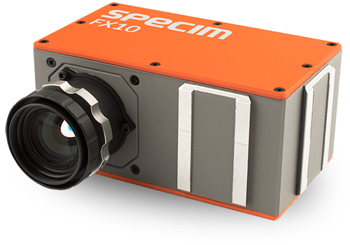
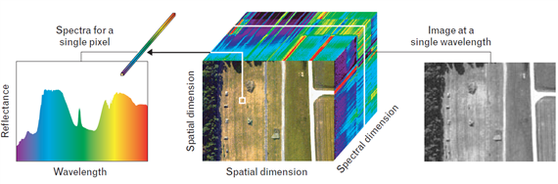
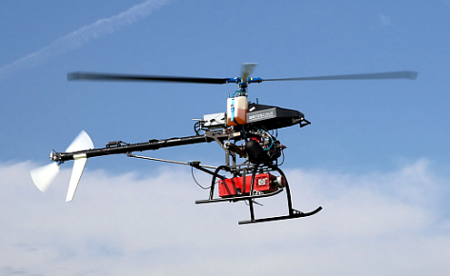


STATE-OF-THE-ART
Hyperspectral imaging sensors:
Capture reflected electromagnetic energy in hundreds of contiguous narrow spectral bands
Combined with UAS:
fast, flexible and non-destructive detection
of subtle spectral features
Chance to develop R&D infrastructure via
the EU structural funds
INSTITUTE OF GEOGRAPHY, FACULTY OF SCIENCE, PAVOL JOZEF ŠAFÁRIK UNIVERSITY IN KOŠICE, SLOVAKIA
geografia.science.upjs.sk
katarina.onacillova@upjs.sk
Notes:
While the photo cameras or multispectral cameras have been the most popular sensors for mini and small UAV systems, the integrated use of UAV hyperspectral imaging and/or laser scanning is a recent issue, because of reducing the size and weight of hyperspectral scanner allows for their integration on UAV platforms. Hyperspectral remote sensing, also known as imaging spectroscopy, is a relatively new technology for UAV platforms that has been used in detection of vegetation species and biomass (Aasen, H. et al., 2015) or precision agriculture (Zarco-Tejada et al., 2013; Bareth et al., 2015; Sima et al., 2016).
Hyperspectral imaging sensors (spectrometers) capture reflected electromagnetic energy in hundreds of contiguous narrow spectral bands with high spectral resolution, typically in visible and near-infrared spectrum. Such sensors combined with unpiloted aerial systems (UAS) enable fast, flexible and non-destructive detection of subtle spectral features and dynamics of landscape changes.
The power and value of hyperspectral imaging four our team is in its capability to - Identify, Quantify (Measure) and Map landscape properties in each pixel of the target image.

Slide 9
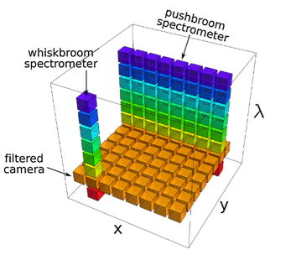

Our UAV HS system
Push-broom (line) imaging scanner
PUSH-BROOM
Full spectral data simultaneously
Image is recorded per line, for all wavelenghts at the same time
Notes:
“Pushbroom” spectrometers use a 2D detector array, and thus collect a vertical slice of the datacube at once so that only one spatial dimension needs to be scanned to fill out the cube.2 A filtered camera, constructed by placing a filter wheel or tunable spectral filter in front of a camera, collects a horizontal slice and thus needs to scan along the spectral dimension to complete the data set.
Pushbroom: Full spectral data simultaneously, with spatial line scanning over time. Imaging spectrograph + 2D array detector
The pushbroom approach, also known as line scanning, has been used by some earth observation satellite systems operating from space, such as the SPOT system. Different from the whiskbroom method that scans one point at a time, the pushbroom method can simultaneously. acquire a slit of spatial information, as well as spectral information corresponding to each spatial point in the slit for one scan, that is, a special y − λ image with one spatial dimension (y) and one spectral dimension (λ) can be taken at the same time with a matrix detector. As shown in Fig. 2(b), the pushbroom method collects a slit image from the object dispersed onto a 2-D detector, in which the spatial information is displayed along one axis and wavelength information along the other. Then the spectral image data cube can be obtained by scanning the slit in the direction of another spatial axis. A pushbroom scanner can get more light than the whiskbroom one, since it can stay at a particular area for a longer time providing a long exposure on the matrix detector and a relatively high spectral resolution as well. However, in most of the pushbroom imagers, either the camera or the object should move accordingly as one line of the image is acquired at each scan and the move should be synchronized with the frame acquisition rate of the array detector in order to ensure the measurement of a smooth image. Another approach to perform the pushbroom procedure is to put a movable slit aperture or a rolling shutter into the conjugate image plane to eliminate out-of-focus light. This method allows for higher illumination transmission while exhibiting only a slight increase in the confocal depth response, which has been widely used in multispectral line confocal imaging systems.

Slide 10
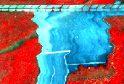
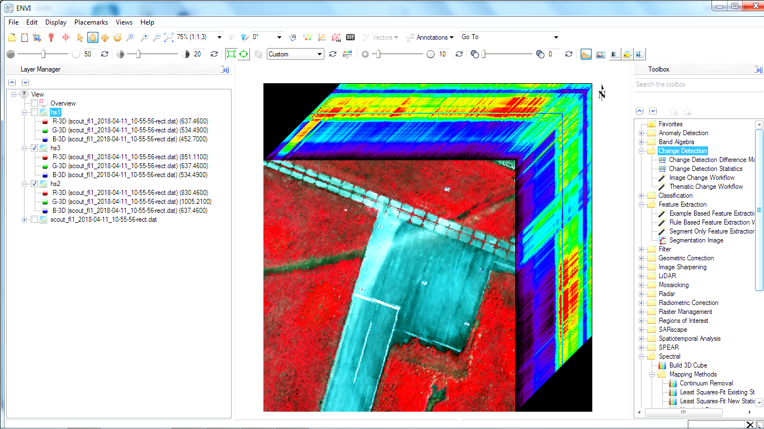
OUR UAV HS SYSTEM
Rectification process
  With a push-broom spectrometer, full spectral image is recorded per line
  However, each line of airborne pushbroom images is collected at different time instants
  perspective geometry varies with each line
  different line displacement
  Rectification process is needed
Notes:
With a push-broom spectrometer, full spectral image data are recorded simultaneously per line
However, each line of airborne pushbroom images is collected at different time instants. Perspective geometry varies with each pushbroom line, leading to different line displacement, and thus turning the rectification process more difficult

Slide 11
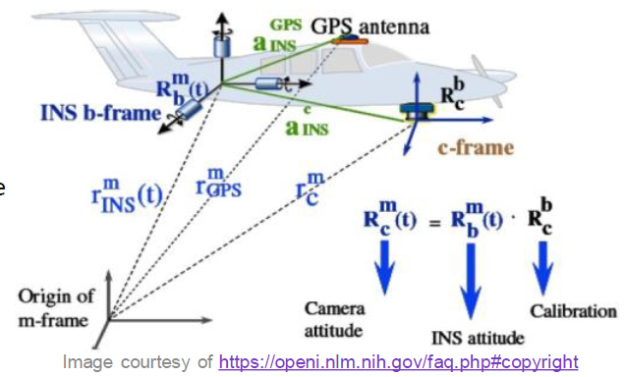
OUR UAV HS SYSTEM
Boresight calibration of push-broom sensor
  Rectification of the raw image data:
  requires measuring position and attitude of the sensor enabled by IMU/GNSS unit on-board the UAV
  Accurate alignment of overlapping data strips requires compensating for geometric distortions caused by boresight misalignment → BORESIGHT CALIBRATION
Notes:
Rectification of the raw image data requires measuring the position and attitude the sensor which is enabled by IMU/GNSS unit on-board the UAV
Accurate alignment of overlapping data strips requires compensating for geometric distortions caused by boresight misalignment - boresight calibration

Slide 12

OUR UAV HS SYSTEM
Hyperspectral payload
AISA Kestrel 10
  Push-broom camera, 4.75 kg
  F/2.4, FOV: 40°
  Spatial resolution: 1024 or 2048 pix.
  Spectral range: 400 – 1000 nm
  Spectral sampling: 1.75/3.5/7 nm
  Max. number of spectral bands: 342
  Radiometric res: 16bit unsigned integer
  Frame rate: <100 Hz
  SNR : 400-800
  Total system power: <41 W

Slide 13
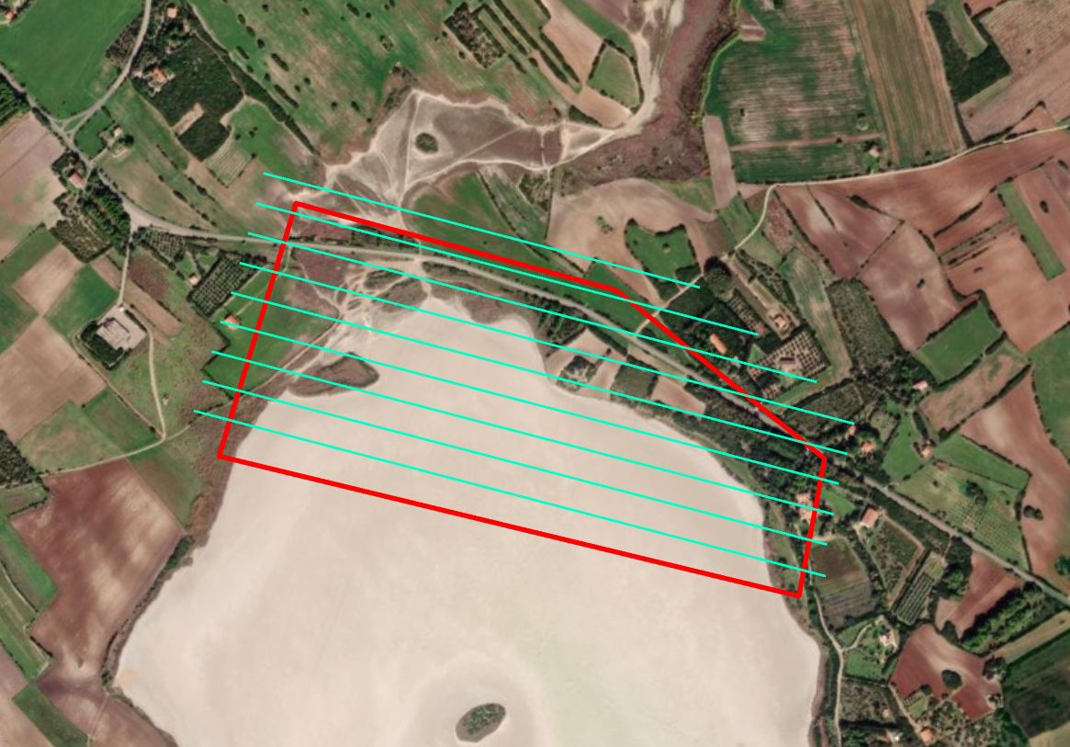
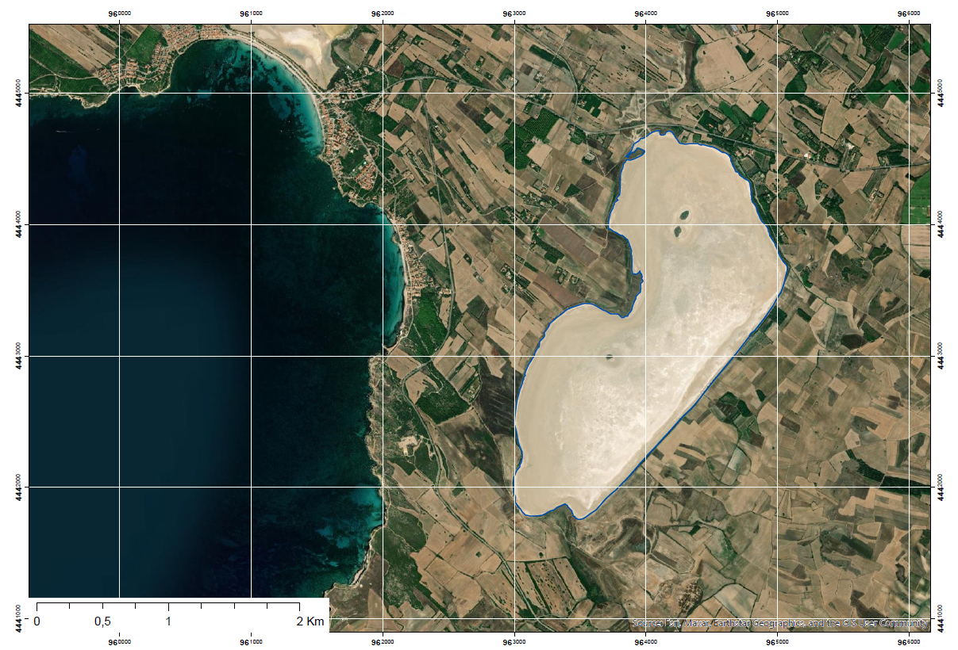
UAV flight mission: area of interest (AOI)
Stagno di Salede Porcus
Northern part, 500 x 1000 m
500 m
2000 m

Slide 14
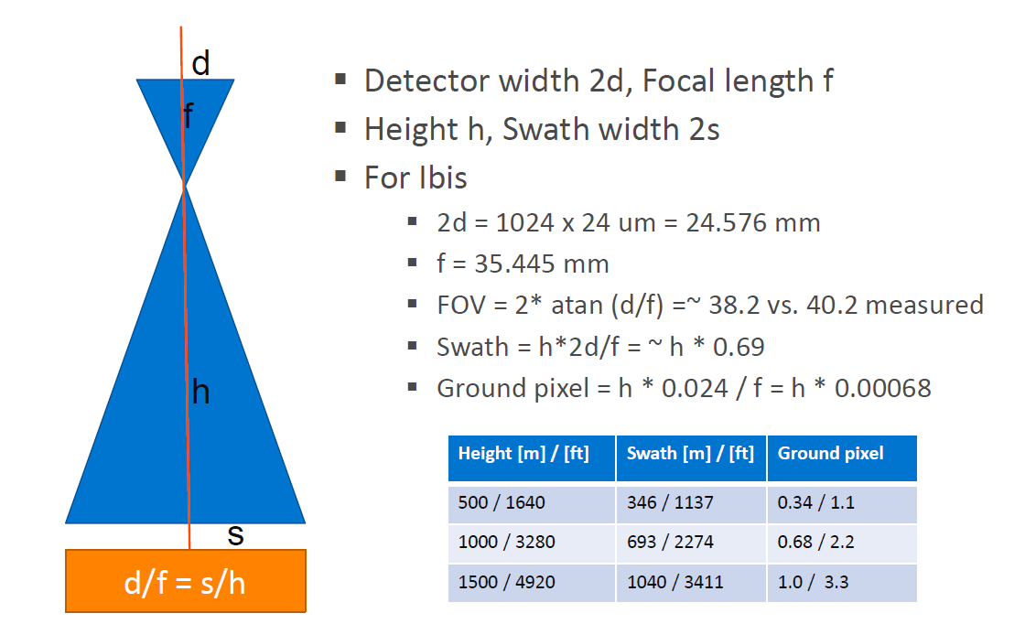
Flight mission parameters: FOV, swath width, spatial resolution
AISA Kestrel 10

Slide 15
Flight mission parameters: FOV, swath width, spatial resolution
Stagno di Salede Porcus
Northern part, 500 x 1000 m
HS camera FOV = 40°
Tan(40°/2) x 90 m flying height = 29,1 m, approx. 58 m swath width
If 1024 pixels per line: 58 : 1024 = 5,6 cm
Number of flight lines given a 450 m width of AOI, E-W direction:
450 m/58 m = 7.75 lines
Account for 20% flight line overlap:
7.75/0.80 = 9.68 so that 10 flight lines
450 m
1000 m
Frames Per Second : Flight speed/pixel size =
5 m/s / 0.056 m = 89.2 thus 90 FPS
Exposure time 1/FPS: 1/90 = 0.011 s = 11 ms

Slide 16
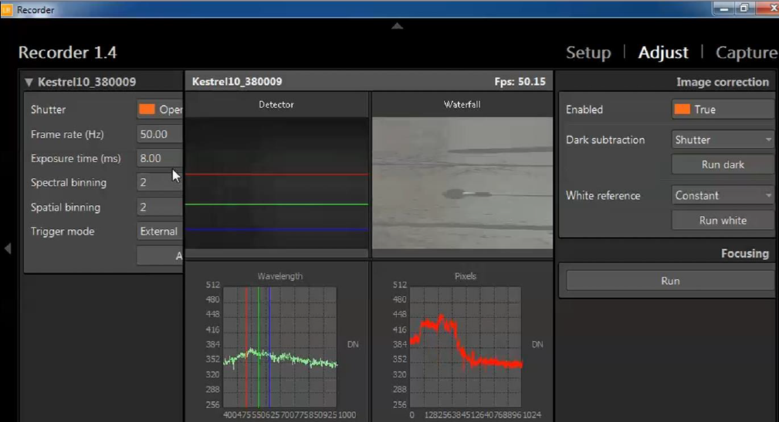
Settings of the HS camera before the mission

Slide 17
Frame rate and frame time
Frame rate, given in frame per second (fps) or Hz, defines
the pace for your target sampling
In airborne systems this is related to airspeed, or ground
speed to be more exact
If your ground speed is 60 m/s you get 1 m
sampling on the ground by using 60 fps
Our max. frame rate is 100 Hz, and max flight speed 10 m/s
Thus, with this speed we can sample at 10 cm

Slide 18
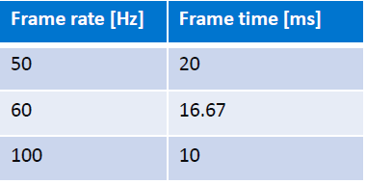
Frame rate and frame time
Frame time is also called frame interval
It is given in milliseconds (ms)
Frame time is inverse of frame rate (1/fps)
It helps you to understand the relationship between frame
rate and exposure time
For example:

Slide 19

Frame rate and frame time
Each imaging sensor type has a unique frame read-out time
This limits maximum exposure time to be used with frame rate
The data acquisition software takes care of this limitation automatically for you, but you need to understand the relationship.
Maximum Exposure time = Frame time - Frame readout time

Slide 20
Motion blur
Motion blur occurs when you have relative motion between
the sensor and target
The longer the exposure time, more blur there is
It makes the image to look ”softer” and less sharp
To maximise signal you would like to use as long exposure time as possible, but from blur perspective the shorter exposure time would be better. You need to compromise
Be careful of overexposure (more signal than can be recorded) underexposure (low signal and low SNR)
Rule of thumb: To set the suitable frame time, the recorded signal of a white target is at about 75% of capacity (there is some reserved capacity)

Slide 21
Spectral and spatial binning of the recorded signal
Binning is the procedure of combining the signal from a number of adjacent pixels into an output for a single pixel
Binning can be on-chip (summing) or off-chip (summing or averaging)
In all AISA instruments non-symmetrical (2x1, 2x4, 2x8) binning is preferred
Vertical binning setting defines spectral bandwidth
Horizontal binning controls spatial resolution
Frame rate is independent of binning
SNR improves by up to square root of the binning factor

Slide 22
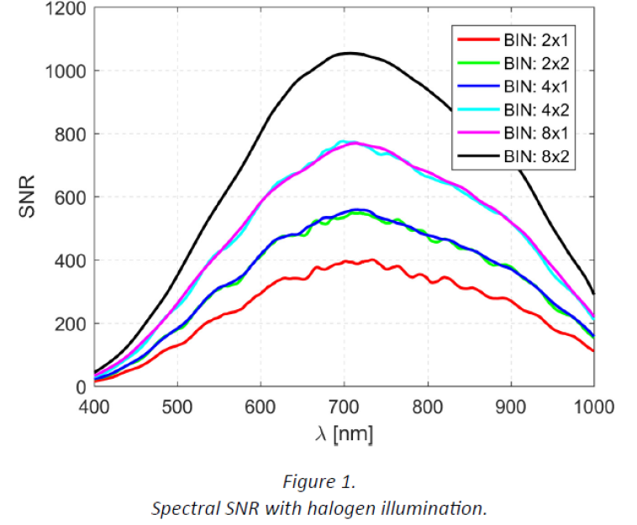
Spectral and spatial binning of the recorded signal
There are two primary benefits from binning
Improved SNR, due to less read noise, by up to a factor of binning
Increased frame rate, when vertical (spectral) binning is applied
Horizontal binning reduces spatial resolution

Slide 23
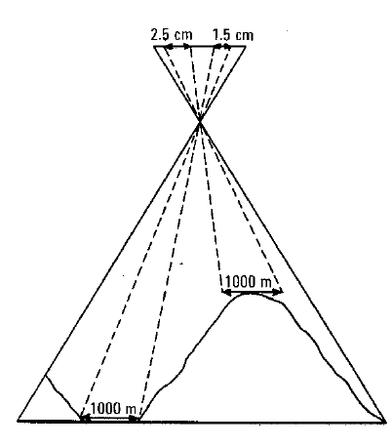
DSM and ortorectification
Often the ground elevation and height of objects on the ground varies relatively large amounts compared to height
In such a case it’s important to use Digital surface model (DSM) when processing the HS data, because target object size changes
For flat surfaces constant elevation can be used and is sufficient (no DSM)

Slide 24
Issues to consider for mission planning/flight
Flying with pushbroom sensor is different from 2D image cameras
Try to maintain as well as possible
Constant speed
Constant altitude
Constant heading vs. course ..., not so easy due to wind/UAV tilt
When acquiring data
Do not hover above target/area
Do not turn in-place

Slide 25
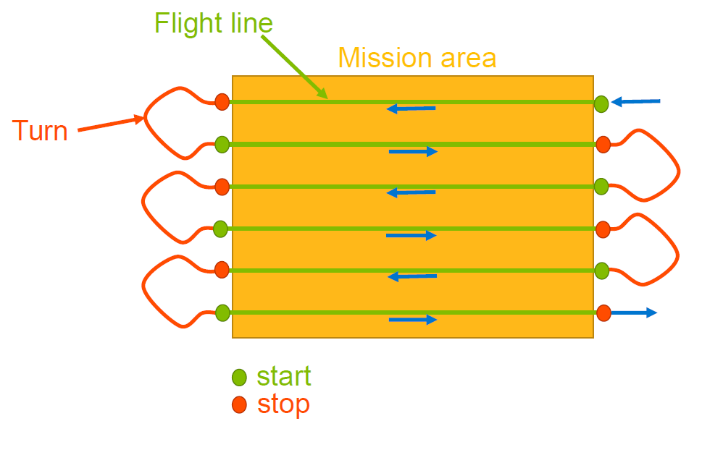
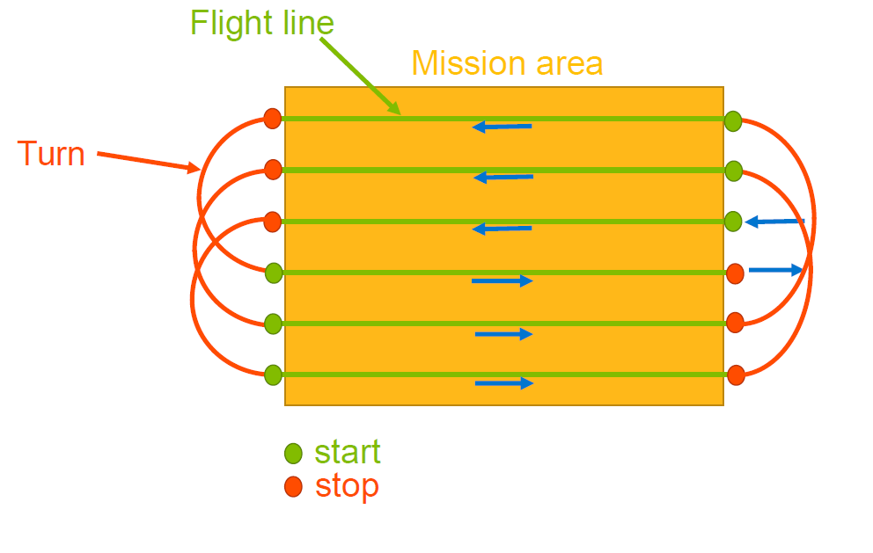
Ideal flight pattern

Slide 26
