Slide 1
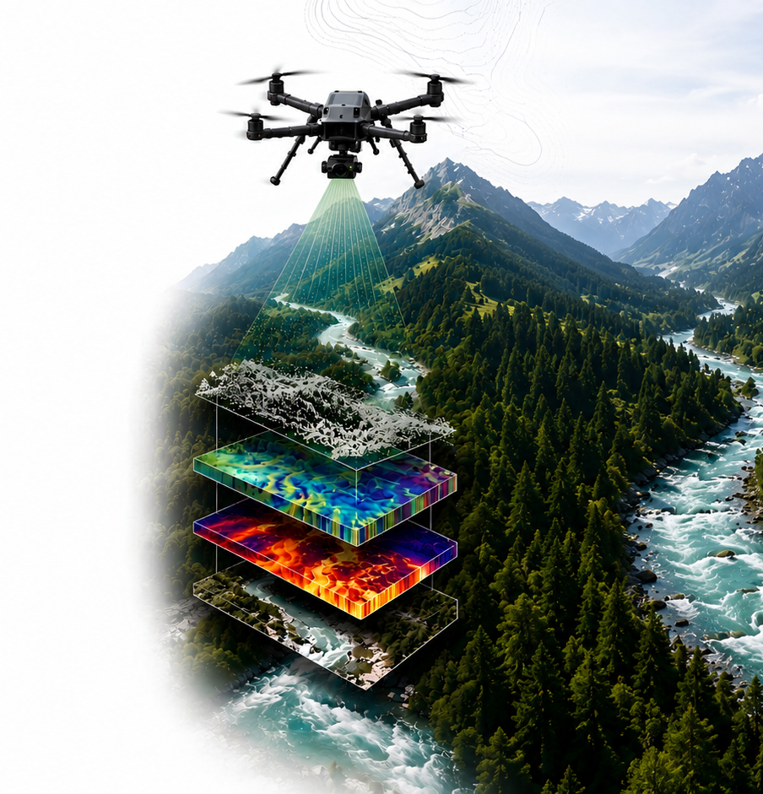
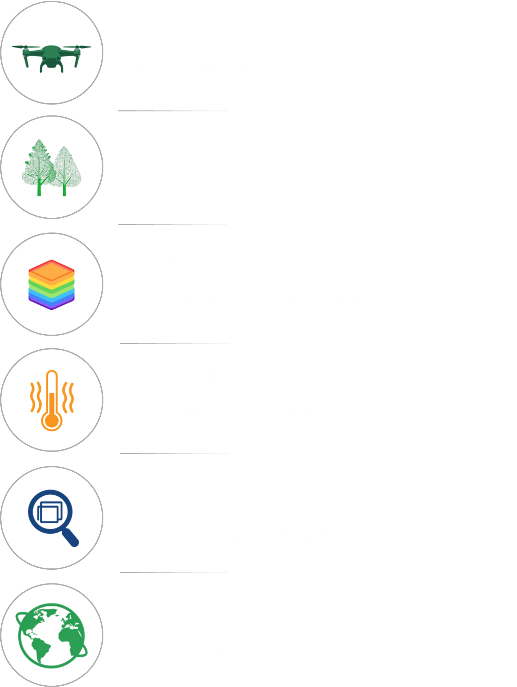










IRSSS
2026
INTERNATIONAL REMOTE SENSING SUMMER SCHOOL
Mountain river systems
dynamics from a multisensor
and multiscale perspective
Stará Lesná, Tatry Mountains, Slovakia
19. 7. 2026 - 24. 7. 2026
SEE MORE.
UNDERSTAND BETTER.
MANAGE SMARTER.
Notes:
Start personally rather than institutionally:
Good afternoon everyone, and welcome to Slovakia, to the High Tatras, and to IRSSS 2026.
My name is Michal Gallay, and on behalf of Pavol Jozef Šafárik University in Košice and the entire organizing team, I am very pleased to welcome you here in Stará Lesná.
Some of you have travelled quite a long way to be here, and I hope that after checking in you already have at least a little time to enjoy the surroundings.
We are very happy to see such an international group gathered here for this week. IRSSS is designed not simply as a series of lectures, but as an intensive week in which we will learn, collect data, work together, discuss our results and, hopefully, also build new professional and personal connections.
The High Tatras provide an excellent environment for this. During the week, we will connect remote sensing technologies with real questions concerning mountain landscapes and river systems.
I would therefore like to officially welcome you to the on-site part of IRSSS 2026 and wish all of us an interesting, productive and enjoyable week.
Then acknowledge your team briefly:
I would also like to thank all colleagues from UPJŠ and our partner institutions who have been preparing the school over the past months. You will meet everyone properly in a few minutes.

Slide 2
21 July 2026::Tuesday programme
SEE MORE.
UNDERSTAND BETTER.
MANAGE SMARTER.
21 July 2026
INGV / UPJŠ
Hyperspectral remote sensing & field spectrometry
IRSSS 2026
1
08:45–10:00
2
10:00–12:15
3
14:00–16:15
4
16:30–18:00
Set the spectral foundation
Rotation 1
Rotation 2
From spectra to classification
Opening + group rotation
DN → reflectance · calibration
atmospheric correction
Group A: field spectrometry
Group B: hyperspectral satellite data
Group A: hyperspectral satellite data
Group B: field spectrometry
UAV hyperspectral processing
MultiSpec simple classification
Joint wrap-up
Massimo Musacchio + Federico Rabuffi / INGV
Massimo Musacchio + Federico Rabuffi / INGV
Massimo Musacchio + Federico Rabuffi / INGV
Katarína Onačillová / UPJŠ
Tuesday workflow: Measure → Calibrate → Interpret → Classify → Connect field and image spectra
Notes:
Tuesday is built around one logic: connect field spectrometry with hyperspectral image interpretation. Explain the morning theory briefly, then emphasize the group rotation. Group A and Group B do both exercises, only in different order. The day ends with UAV hyperspectral processing in MultiSpec and a joint wrap-up connecting field spectra, spectral libraries and image classification.

Slide 3
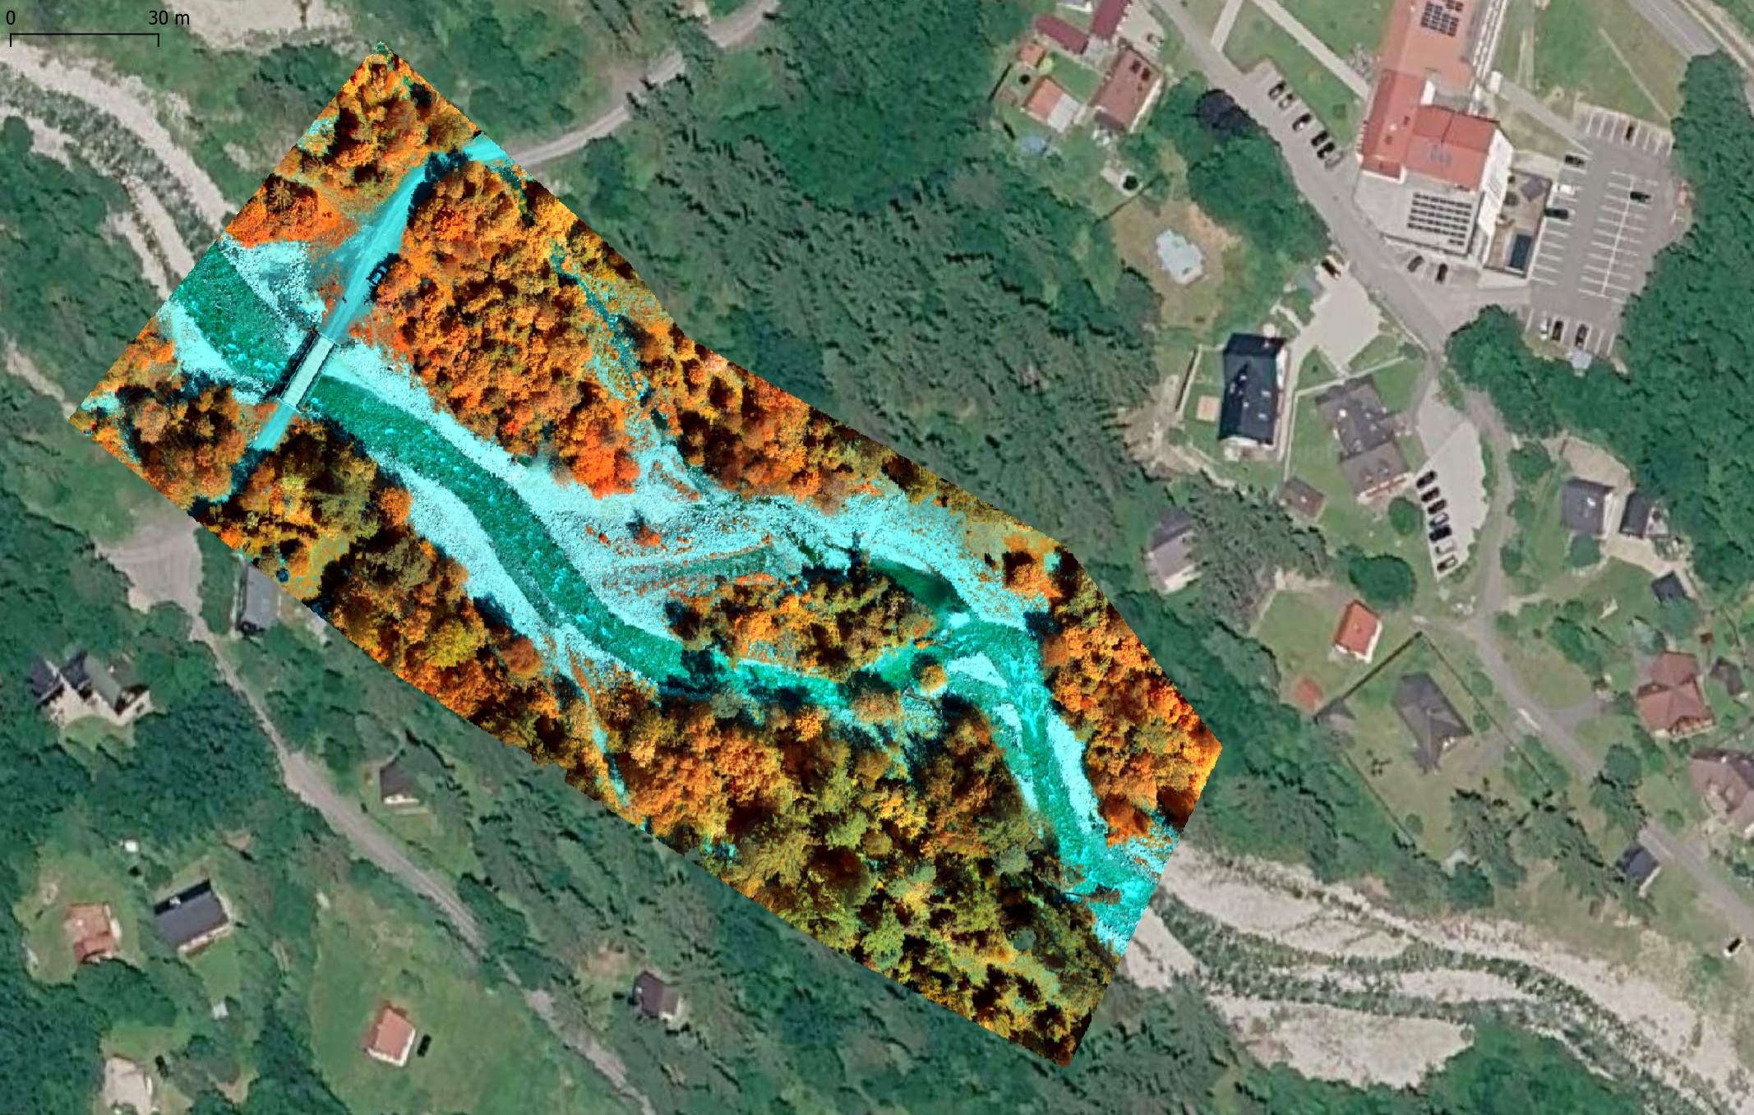
21 July 2026:Tuesday programme
SEE MORE.
UNDERSTAND BETTER.
MANAGE SMARTER.
21 July 2026
INGV / UPJŠ
UAV sample HS data
IRSSS 2026

Slide 4

IRSSS
2026
INTERNATIONAL REMOTE SENSING SUMMER SCHOOL
THANK YOU
for your attention !
SEE MORE. UNDERSTAND BETTER. MANAGE SMARTER.

