Slide 1
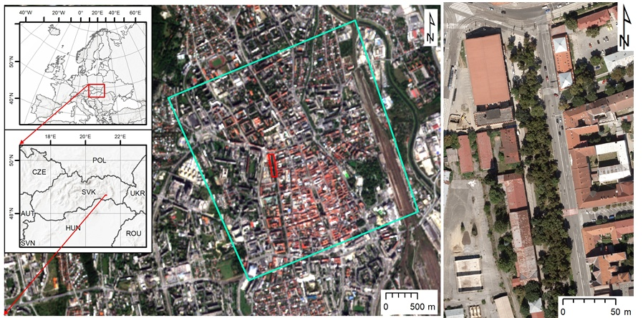
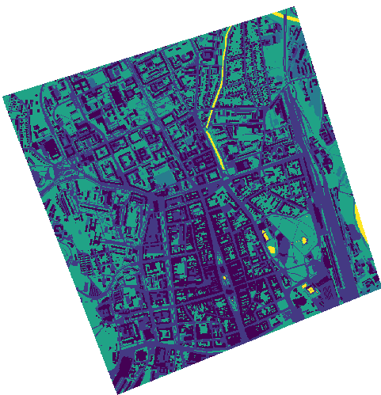
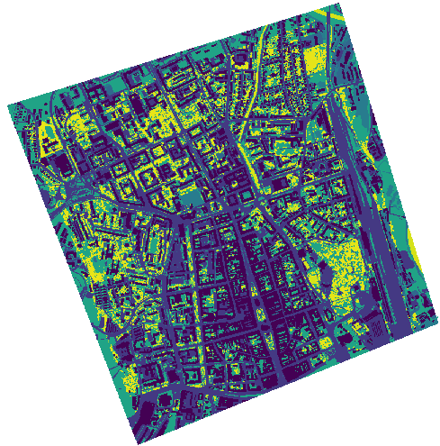
Mapping urban greenery to create the optimal cooling effect model
against solar radiation under the conditions of a smart city
Vladimír Sedlák – Katarína Onačillová – Michal Gallay – Jaroslav Hofierka – Ján Kaňuk – Ján Šašak – Jozef Šupinský
Institute of Geography, Pavol Jozef Šafárik University in Košice, Slovakia
Research overview
Current climate changes on a global scale require an optimal estimate of heat transfer in a complex urban environment as a part of the requirements for optimal urban planning in the conditions of a smart city. Urban greenery has a considerable impact on the cooling of the urban environment during thermal waves. The Sentinel-2 Earth observation mission of the European Space Agency provides global coverage of multispectral data with a relatively high spatial and temporal resolution. 3D city models derived from lidar or photogrammetric data can be used to model the 3D geometry in a very high spatial reosolution to asses the income of solar irradiation. Combining such data could become a means for quantified assessment different urban scenarios.
The presented research study focuses on exploiting the potential of Sentinel-2 data in simulating the cooling effect of urban greenery as to support the concept of a smart city and assess the life quality. The main objective was to define a methodical approach for land surface temperature modelling in selected urban areas based on the solar radiation modelling and parameterization of the land cover properties. While solar irradiation can be accurately calculated at a fine scale using virtual 3D city models, it is difficult to find other important parameters for ground surface modelling such as surface thermal emissivity, broadband albedo and evapotranspiration. These were estimated from the Sentinel 2 data.
Study area
The r.sun solar radiation model
1 km
h_{c}
(W.m⁻².K⁻¹)
The city of Košice in Eastern Slovakia is an example of urban space typical for a moderate climate of Central Europe which suffers from the phenomenon of urban heat island as big cities (Onačillová and Gallay 2018). For this study, we selected an area with a feasible size and sufficient diversity of urban greenery which would be suitable for ground-based mapping, airborne survey and large enough for monitoring by Earth observation missions such as Sentinel 2 and Landsat 8. The area comprises 4 km² of the central part of the Košice City.
35
24
Solar irradiance is the main source of energy contributing to LST. It consists of three components: beam (direct), diffuse and reflected irradiance. The most important component is beam irradiance because in average it represents about 50-60% of global irradiance and even more during summer sunny days. Beam irradiance depends on solar and local surface geometry. Diffuse irradiance is anisotropic, i.e., it varies over the sky depending on the direction of solar rays. It depends on topography and ground reflectance (albedo). The attenuation of beam irradiance reduces the amount of beam irradiance on ground beneath the canopy cover. Also, the cooling effects of urban greenery on LST are caused by various factors such as interception of solar radiation, shading and consuming latent heat via evapotranspiration. Spatial distribution of solar irradiance across the land surface depends on many factors that can be described by a set of equations creating a complex model such as r.sun (Šúri and Hofierka, 2004) that is capable of estimating the amount of global solar irradiance in all of its components for any point on land surface represented by a digital elevation model.
To assess the effects of high vegetation on LST, we used solar transmittance as a dimensionless parameter derived from Sentinel 2A data to increase the value of hc derived from land cover proportionally to the leaf area index (LAI) values of high vegetation using a simple linear model (Hofierka et al., 2019). This increase in h_{c} effectively accounts for evapotranspiration and moisture effects of vegetation leading to lower LST as documented by Amir et al. (2018).
The designed method for LST modelling is capable of calculating spatially distributed LST values on a much higher spatial resolution than recorded by the contemporary spaceborne thermal sensors. The results are demonstrated in 3 scenarios calculated for 30 June 2016 (9:20 GMT) with available Landsat 8 thermal data needed for comparison. The suggested algorithm (lst.stefan-boltzman.sh) implemented as a shell script in GRASS GIS was used to calculate LST. We used 10 iterations of the algorithm to get sufficiently accurate results of the LST values. The modelled temperatures are strongly associated with global irradiance, heat transfer coefficient and albedo values. Shadows casted by buildings or trees strongly decrease LST. Low values of heat transfer coefficient increase LST, higher albedo surfaces decreases LST.
To validate the modeled values of LST, we compared the LST calculated for scenario 3 with the radiometrically recorded LST by Landsat 8 TIRS Band 10 at 30 m spatial resolution. The original LST modeling was performed at 0.5 m spatial resolution, therefore to compare it with the Landsat 8 LST, we re-interpolated the modeled LST raster values to a lower spatial resolution of 30 m using v.surf.rst spatial interpolation module in GRASS GIS (GRASS, 2018). The differences in absolute LST values show that modelled LST is in a good agreement with the Landsat 8 LST with a range of differences within a few degrees of K. The Pearson’s correlation coefficient r = 0.88 demonstrates a strong correlation of the two datasets.
17
12
8
A
A
B
Location of the study area in the city of Košice, Slovakia with the surveyed sites. The cyan line outlines the area subject to airborne lidar and photogrammetric mapping in a single mission, time series of the Sentinel-2 image coverage. The red outline delineates four sites selected for repeated terrestrial laser scanning of urban vegetation. The background maps are © Copernicus, Sentinel-2A image acquired on September 7, 2016
Spatially distributed convective heat transfer coefficient hc for the entire study area and the smaller site (Moyzesova street, delineated by the white outline) assigned to the objects (A) of the land cover of the ground and (B) increased for high vegetation based on leaf area index and expert judgement.
Airborne laser scanning and photogrammetry
Global solar irradiance (W.m-2) of DSM calculated by the r.sun model for June 30 at 10:20 zonal time for the smaller site as (A) scenario 1, (B) scenario 2, (C) scenario 3. See Fig. 3 for perspective views of the input DSMs and text for explanations of the three scenarios.
The results of our LST modelling in the city of Košice showed great spatial variations that cannot be captured by current satellite sensors. However, we have demonstrated that it can be modelled by proper software tools and input data such as LiDAR and satellite imagery (e.g., Sentinel 2A). The proposed algorithm is a novel contribution to modelling the land surface temperature in a GIS environment where tools for calculating temperature of surface have not been implemented to our knowledge to date.
The photogrammetric and airborne laser scanning (ALS) data were used to generate a 3-D city model, digital surface models and land cover maps. ALS and photogrammetry data were acquired in leaf-on conditions during late summer of 2016 to build 3-D city model with a level of detail (LoD) 2 consisting of buildings, urban greenery and terrain (Hofierka et al. 2017) provide more details. The ALS point density was 91 and 15 points/m² of all returns and ground returns, respectively. The points were processed in LAStools (Isenburg, 2018) by filtering and classifying them in ground, trees and shurbs (high vegetation), buildings and other returns. Two types of digital surface modesl (DSM) were derived at 0.5 m cell size including buildings and vegetation. They were used in for modelling solar irradiance.
Perspective 3-D view of the entire study area with 3-D buildings (grey) and point cloud of high vegetation (green points) on a lidar-based digital terrain model colored by elevation.
Modelling the land surface temperature
Modelled land surface temperature in degrees Kelvin for the entire study area and the smaller site in the black outline as (A) scenario 1, (B) scenario 2 and (C) scenario 3.
Detailed view of the source data for the smaller site (Moyzesova street) comprising 3-D models of buildings (LoD2), lidar based digital terrain and point cloud of high vegetation (green points) (A) which were used to derive a raster-based digital surface model (DSM) including buildings (B), and high vegetation (C). The area size is 200 m by 400 m. DSM cell size is 0.50 m.
The two types of land cover layers were derived from airborne photogrammetric orthoimagery including the high vegetation and excluding it. High vegetation taller than 1.5 meter was treated as additional category not belonging to the ground cover.
Based on the airborne photogrammetric and laser scanning data the identified green vegetation covers about 23% of the study area. The land cover layers were used to assess spatial differentiation of albedo, emissivity and convective heat transfer coefficient hc within the city. Values of the heat transfer coefficient h_{c} were based on expert judgment supported by the values reported by Mirsadeghi et al. (2013), Liu et al. (2015), Vollaro et al. (2015) and Amir et al. (2018). The resulting raster data layers were derived at 0.50 m spatial resolution. The data represent thermal properties of the ground cover.
Land cover interpreted from aerial orthoimagery and by field inspection (A) of the ground below the high vegetation and (B) including the high vegetation in the entire study area and in the smaller site (Moyzesova street) - black outline.
Spaceborne multispectral scanning
Spaceborne multispectral imagery of Sentinel 2A satellite was used to derive land surface albedo by the approach used by Vanino et al. (2018) and calculated as the integration of at-surface reflectance across the shortwave spectrum (D'Urso and Calera, 2006) and specific vegetation metrics for the LST model. We used Sentinel 2A level 1C product (granule UEU, 29 June 2016, scene center time 9:40:32 GMT) which was downloaded via Copernicus Open Access Hub. Landsat 8 data (USGS, 2018) were used to compare Landsat-derived LST with the results of our modeling of LST values.
Comparison of differences between the Landsat 8 LST and the modelled LST in degrees Kelvin, and their linear relationship portrayed as a scatterplot with regression parameters. Linear trend is shown by the red solid line, black dashed line denotes 1:1 relationship. The spatial resolution of the raster layers is 30 m.
Broad-band albedo derived from atmospherically corrected Sentinel 2A data as a zonal mean for (A) objects of the ground land cover and (B) objects of the land cover (including high vegetation). Two versions of albedo were generated to show the cooling effect of urban greenery on the LST.
References
Acknowledgements
AMIR, A. K., KATOH, Y., KATSURAYAMA, H., KOGANEI., M., MIZUNUMA, M., 2018. Effects of convection heat transfer on Sunagoke moss green roof: A laboratory study. Energy and Buildings 158, 1417–1428.
D'URSO, G., CALERA, B., 2006. Operative approaches to determine crop water requirements from Earth observation data: Methodologies and applications. AIP conference proceedings, 852, 14-25.
GRASS, 2018. GRASS GIS. http://grass.osgeo.org/ (accessed 26 January 2019).
HOFIERKA, J., GALLAY, M., KAŇUK, J., ŠUPINSKÝ, J., ŠAŠAK, J., (2017). High-resolution urban greenery mapping for micro-climate modelling based on 3-D city models. The International Archives of the Photogrammetry, Remote Sensing and Spatial Information Sciences (ISPRS Archives), XLII-4/W7, pp. 7–12.
HOFIERKA, J., GALLAY, M., ONAČILLOVÁ, K., HOFIERKA, J. JR. 2019: Physically-based land surface temperature modeling in urban areas using a 3-D city model and multispectral satellite data. Urban Climate (accepted manuscript).
ISENBURG, M., 2018. LAStools - efficient LiDAR processing software. (version190114, licensed), obtained from http://rapidlasso.com/ LAStools.
LIU, J., HEIDARINEJAD, M., GRACI, S., SREBRIC, J., 2015. The impact of exterior surface convective heat transfer coefficients on the building energy consumption in urban neighborhoods with different plan area densities. Energy and buildings 86, 449–463.
MIRSADEGHI, M., COSTOLA, D., BLOCKEN, B., HENSEN, J.L.M., 2013. Review of external convective heat transfer coefficient models in building energy simulation programs: implementation and uncertainty, Applied Thermal Engineering 56, 134–151.
ONAČILLOVÁ, K., GALLAY, M., 2018. Spatio-temporal analysis of surface urban heat island based on LANDSAT ETM+ and OLI/TIRS imagery in the city of Košice, Slovakia. Carpathian Journal of Earth and Environmental Sciences 13, 395–408.
ŠÚRI, M., HOFIERKA, J., 2004. A new GIS-based solar radiation model and its application to photovoltaic assessments. Transactions in GIS 8, 175–190.
USGS, 2018. Landsat 8 Data Users Handbook. LSDS-1574 Version 3.0, 18 October 2018. Department of the Interior U.S. Geological Survey. EROS, Sioux Falls, South Dakota, USA. https://www.usgs.gov/media/ files/landsat-8-data-users-handbook(accessed 21 December 2018).
VANINO, S., NINO, P., DE MICHELE, C., BOLOGNESI, S. F., D'URSO, G., DI BENE, C., PENNELLI, B., VUOLO, F., FARINA, R., PULIGHE, G.,
VOLLARO, A., GALLI, G., VALLATI, A., 2015. CFD Analysis of Convective Heat Transfer Coefficient on External Surfaces of Buildings. Sustainability 7, 9088–9099. https://doi.org/10.3390/su7079088.
The presented research study was granted by projects APVV SK-CN-RD-18-0015, KEGA 007UPJŠ-4/2017 and VEGA 1/0839/18 solved at the Institute of Geography of the Faculty of Science, Pavol Jozef Šafárik University in Košice, Slovakia.

