Slide 1

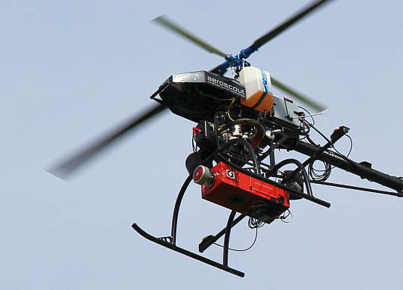

THE UNPILOTED
HELICOPTER SYSTEM
SCOUT B1-100
Ústav geografie, Prírodovedecká fakulta
Univerzita Pavla Jozefa Šafárika v Košiciach
Jesenná 5, Košice
Summer school on exploring the landscape
with dynamic visualization,
tangible interaction,
and UAV-lidar.
15. - 18. July 2019
Michal GALLAY
Ján KAŇUK
Eduard
DVORNÝ
geografia.science.upjs.sk
michal.gallay@upjs.sk
Notes:
Dear Ladies and gentleman, in my talk I would like to present a custum integration of high-end laser scanning system and hyperspectral system within a small UAV platform. It is the result of joint effort of two teams. One of the teams is based Slovakia, in the city of Košice, Institute of Geography, Pavol Jozef Šafárik University. The other team is based in Switzerland, in the city of Luzern and represents the manufacturer of the UAS, the Aeroscout company.

Slide 2
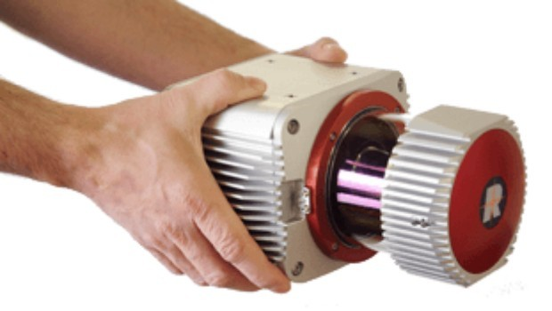
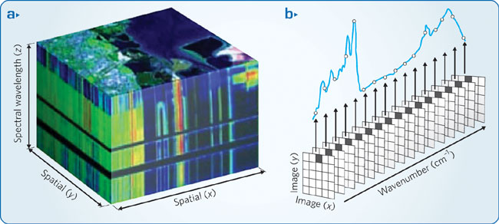
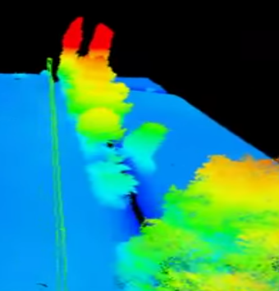



MOtivation
Recent developments in sensors and UAV technology
Smaller size/lower weight
High-accuracy, high-resolution
Challenge of integrating high-end lidar hyperspectral, and photogrammetric payload on a UAV platform
Opportunity of funding via the EU structural funds for R&D, Slovakian government, university resources.
  preparations since 2012
Notes:
Last but very important, in 2012, we had a unique opportunity to improve our research infrastructure in a project funded by the European Union structural fundds for research and development. Our project was initiated in 2013 and it took 2 years to achieve deliverables mainly for budget administration constraints.

Slide 3

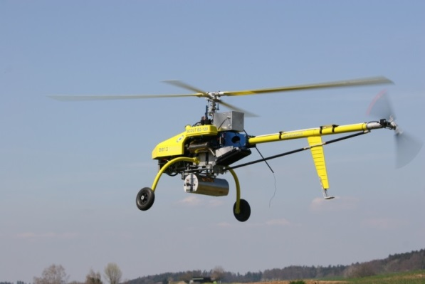
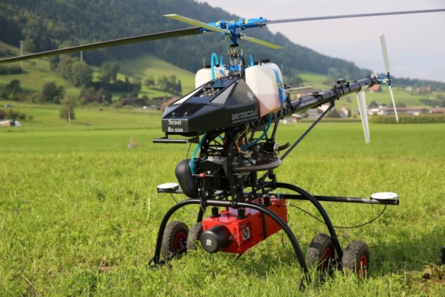
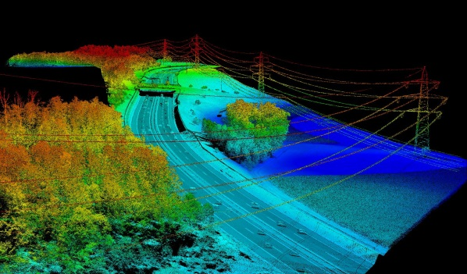
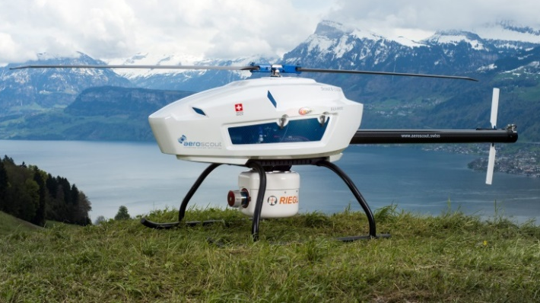
Aeroscout, LUZERN, CH
Scout B2-120
Founding of Aeroscout GmbH
Spin-off: Swiss Federal Institute of Technology (ETH)
2005
2008
Partnership with RIEGL LMS, Austria
RIEGL becomes minority shareholder of Aeroscout
2012
Scout B1-100 &
Laser Scanner Payload
2015
2016
2018
Multi Sensor Payload: Inspection
of power transmissionlines
Scout B-330 UAV

Slide 4
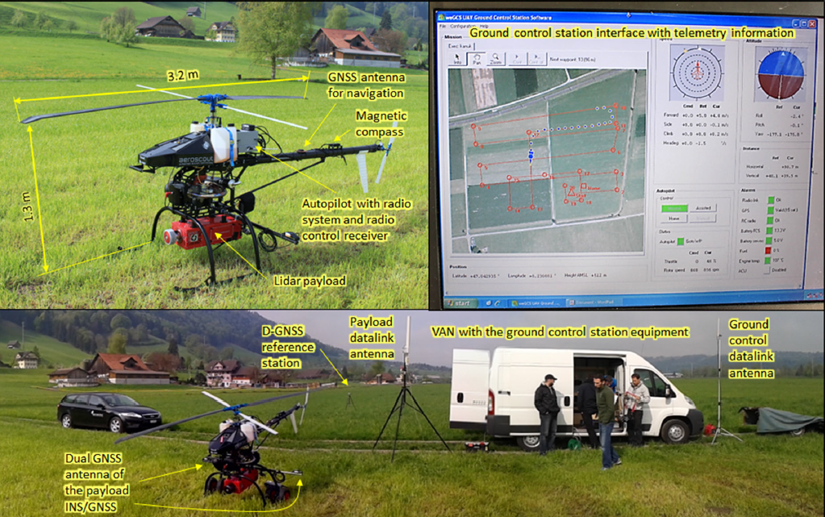
UAS: Scout B1-100
Notes:
The UAV platform is manufactured since 2010 by the Aeroscout company in Switzerland. We opted for this platform for the payload capacity, reliability, and price vs. performance. It is a rotary wing UAV with maximum TOW of almost 80 kg, and the payload capacity of 18 kg.
The flight performance of the helicopter is superior to experienced helicopter pilots and landing within submetre accuracy is possible. Due to the classical helicopter configuration, the scanning performance and homogeneity of data collection in continuous forward flight are superior to multirotor aircraft, in particular under changing wind conditions (wind gusts, side wind, etc.).
Empty weight: 42 kg
Max. TOW: 75 kg
Payload capacity: 18 kg
Gasoline engine 100 cm³, air-cooled
Main rotor speed: 860 rpm
Engine power: 18 PS
Electric starter: 16V
Fuel tank: 2 x 5 litres
Carbon fibre blades
Aluminum body
Speed: 0 up to 15 m/s
Flight endurance: 90 min.
-7 °C to +40 °C
Light rain, wind <10 m/s

Slide 5
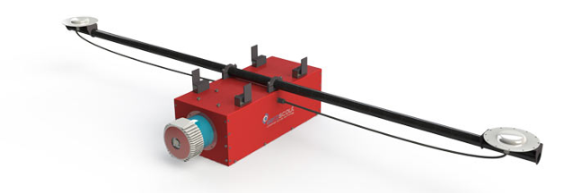
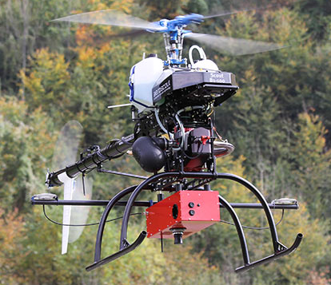



UAV Payload
two independent payloads
Riegl VUX-1 laser scanner + Sony A6000 E-Mount photo camera +
AISA Kestrel 10 hyperspectral camera by Specim +
dual GPS antenna and INS unit xNAV550 by OXTS for the sensor attitude and position
Notes:
The UAS integrates two kinds of payloads which can be altered. Both payloads integrate a GPS/IMU xNAV550 with dual GPS antenna configuration provided by OXTS for accurate navigation data, i.e. position and attitude measurements of the sensor during the data acquisition flight.

Slide 6
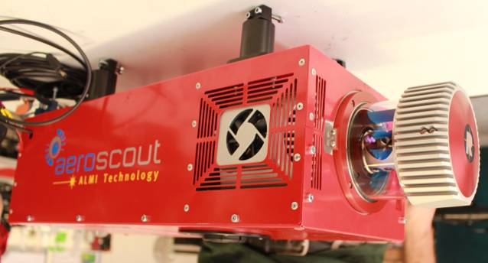
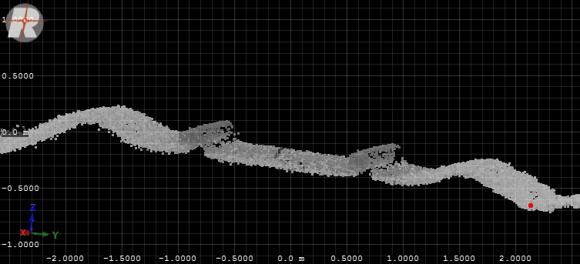
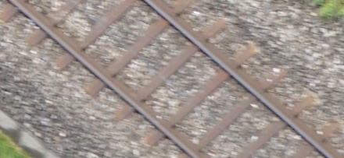
LiDAR Payload
VUX-1 laser scanner by RIEGL
  Scanner 3.5 kg, Payload 12 kg
  <500,000 measurements per second
  <200 scan lines per second
  <330 m operating flight altitude
  regular point pattern, parallel scan lines
  point density ca. 4 to 400 pts/m²
  echo signal digitization
  online waveform processing
SONY A6000 photo camera
  f = 20 mm
  24 Mpix CMOS
  Simultaneous acquisition of photoimagery
Notes:
The first payload is dedicated for LiDAR data acquisition coupled with visible high resolution imagery. It comprises a VUX-1 laser scanner by RIEGL and a Sony A6000 E-Mount photo camera (Fig. 2). The laser scanner is capable of up to 550,000 measurements per second and demonstrates the cutting edge LiDAR technology of online waveform processing and multiple-time-around processing which provides echo signal digitization of practically unlimited number of targets echoes.

Slide 7
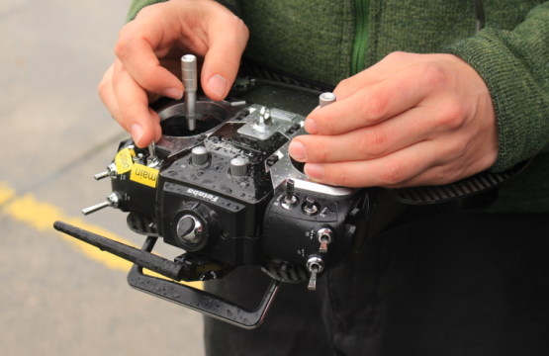
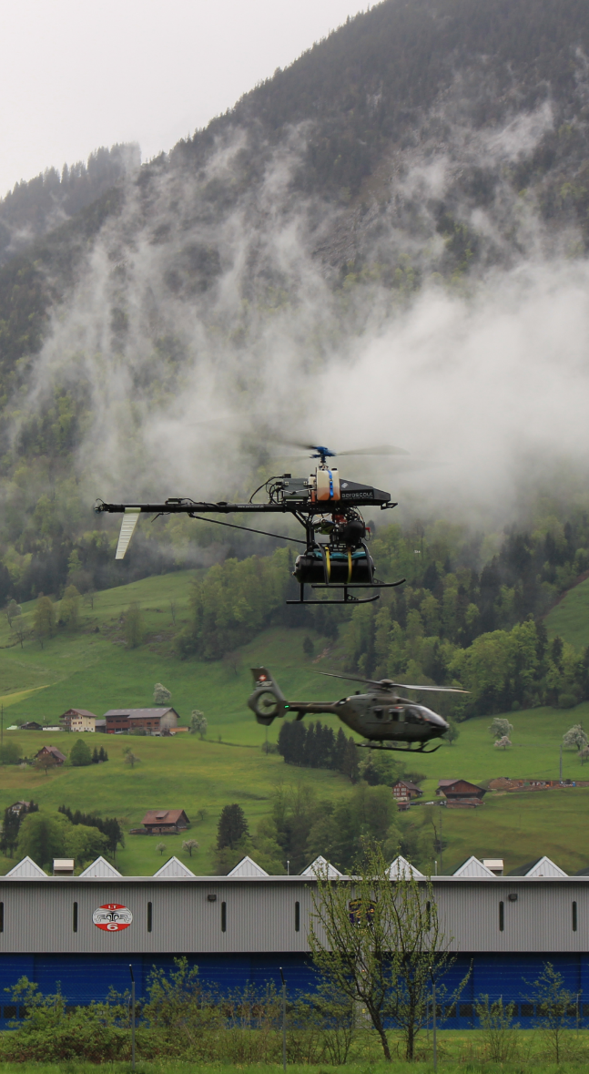
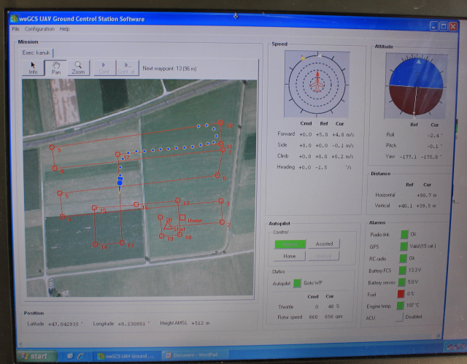
OPERATION: Scout B1-100
Automatic or manual VTOL
Autonomous flight
INS/GPS controlled
wePilot3000 autopilot system
weGCS ground station screen
Notes:
The system is capable of automatic or manual vertical take off and landing, fully autonomous flight according to the mission plan or commands from the ground station. The wePilot 3000 autopilot system controls the flight parameters.

Slide 8
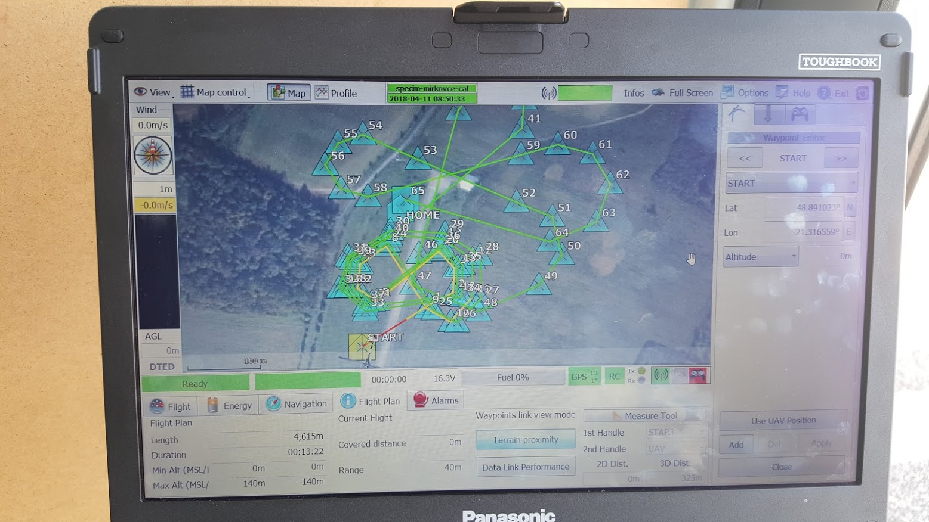
OPERATION: Scout B1-100
Carefull planing before the mission
Simulation of the mission before the real take-off
Notes:
The system is capable of automatic or manual vertical take off and landing, fully autonomous flight according to the mission plan or commands from the ground station. The wePilot 3000 autopilot system controls the flight parameters.

Slide 9
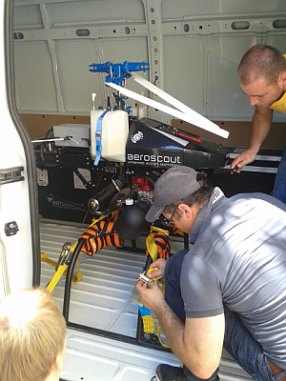
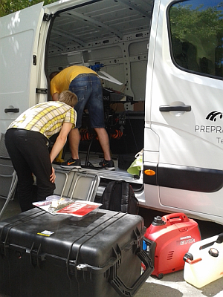
TRANSPORATION: Scout B1-100
Careful packing, we need to rent a VAN vehicle

Slide 10
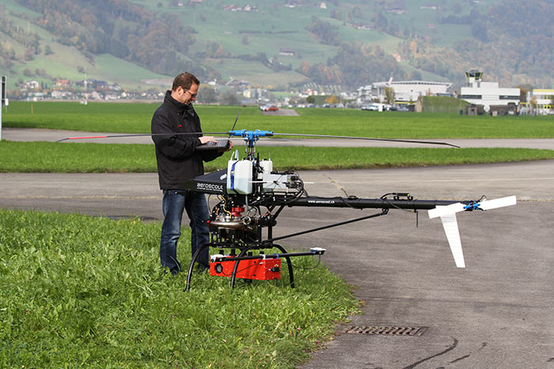
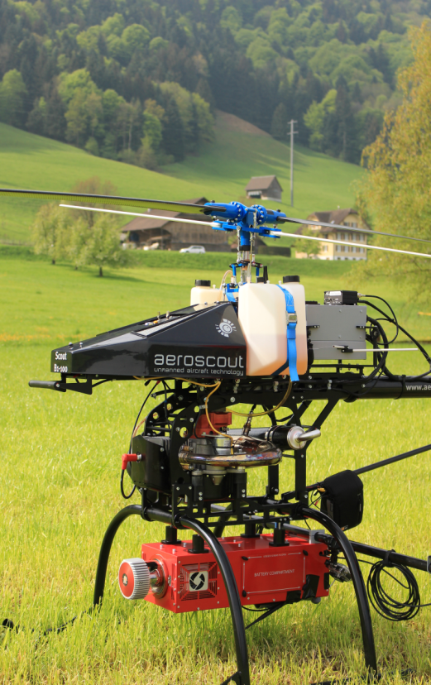
Scout B1-100 UAS
System completion in October 2015
First tests of data acquisition near Luzern, Switzerland

Slide 11
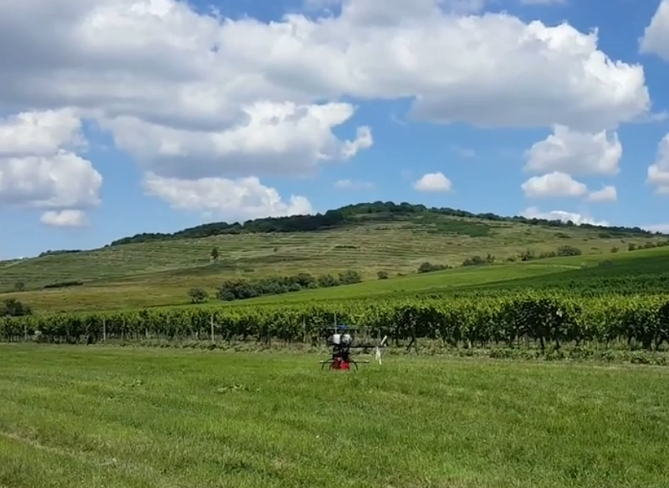
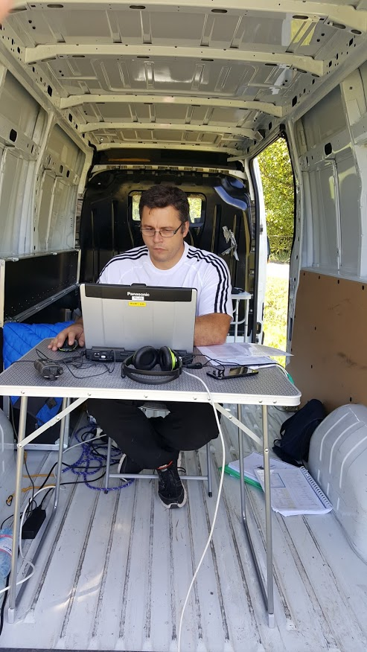
Automatic TAKE-OFF
Malá Tŕňa
3.7.2018
TOKAJGIS
INTERREG SK-HU
Ground control station pilot controls the take-off

Slide 12
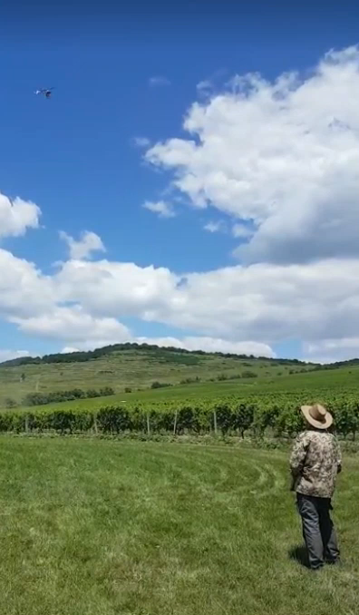
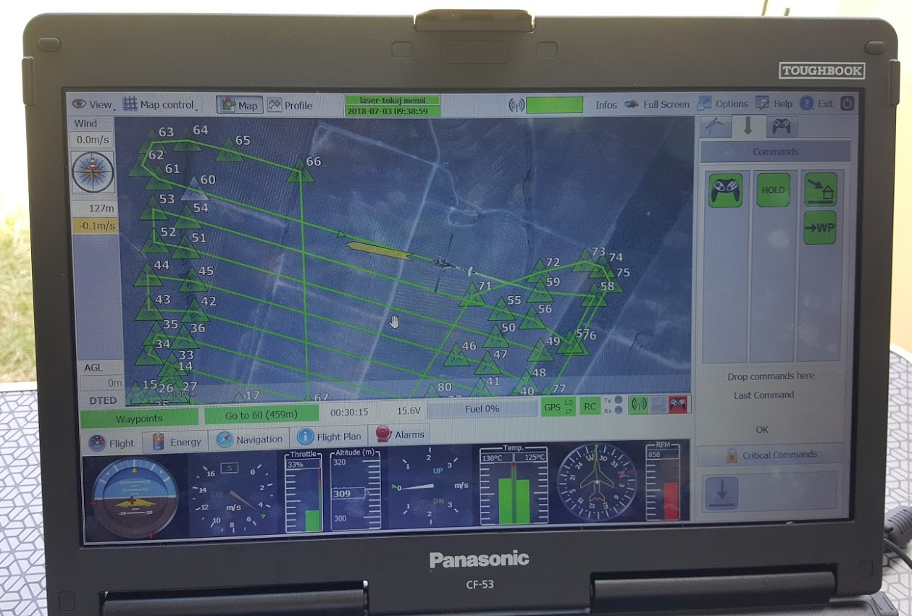
Automatic flight MIssion
The UAV flies the mission according to the planned trajectory.
Malá Tŕňa
3.7.2018
TOKAJGIS
INTERREG SK-HU

Slide 13
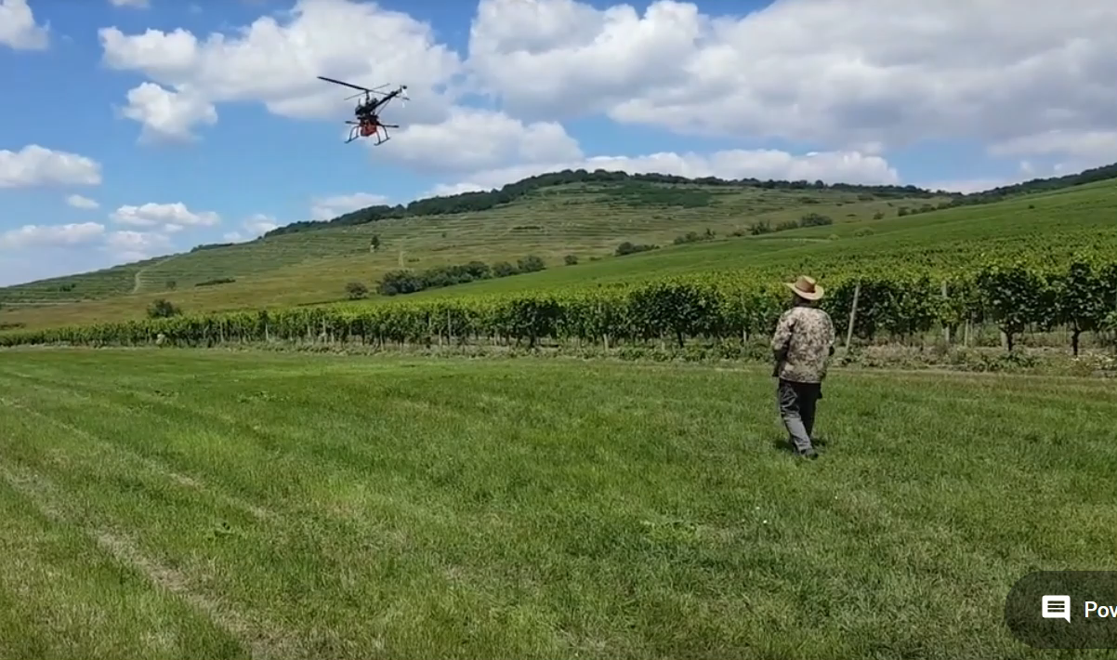
Automatic LANDING
Malá Tŕňa
3.7.2018
TOKAJGIS
INTERREG SK-HU
Manual pilot flies the UAV over the landing point, the ground control station pilot controls the actual automatic landing.

Slide 14
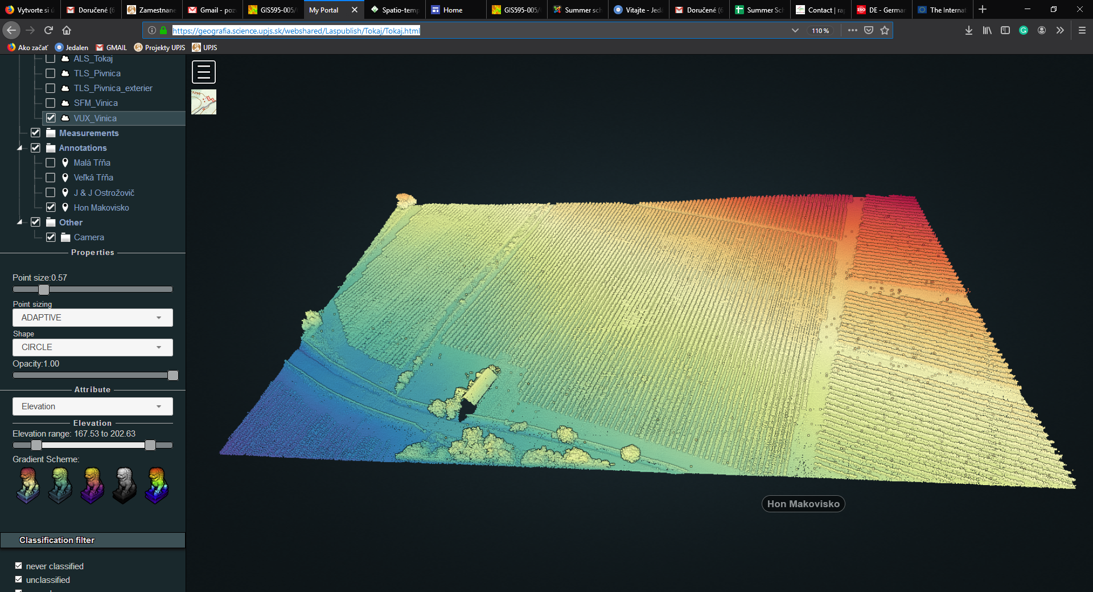

Final DATA ON THE WEB
Potree/Laspublish interface of the vineyard UAV-VUX1 lidar dataset, Mála Tŕňa
ca. 1000 points/ sq. m
ca. 3 cm spacing
https://geografia.science.upjs.sk/webshared/Laspublish/Tokaj/Tokaj.html

Slide 15
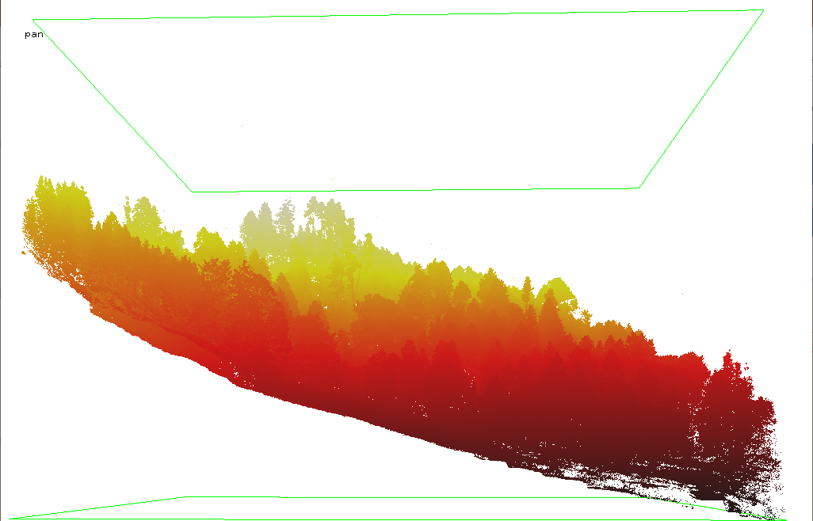
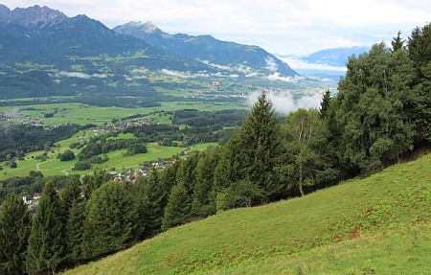
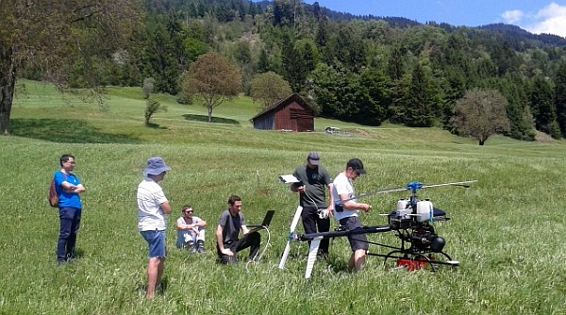
Dunserberg, AUSTRIA
AEROSCOUT+ TU VIENNA + UPJŠ
Alpine forest on a steep slope, subject to landsliding
https://geografia.science.upjs.sk/index.php/19-zo-zivota-ustavu/405-bezpilotnou-helikopterou-sme-mapovali-alpske-svahy-v-rakusku

Slide 16
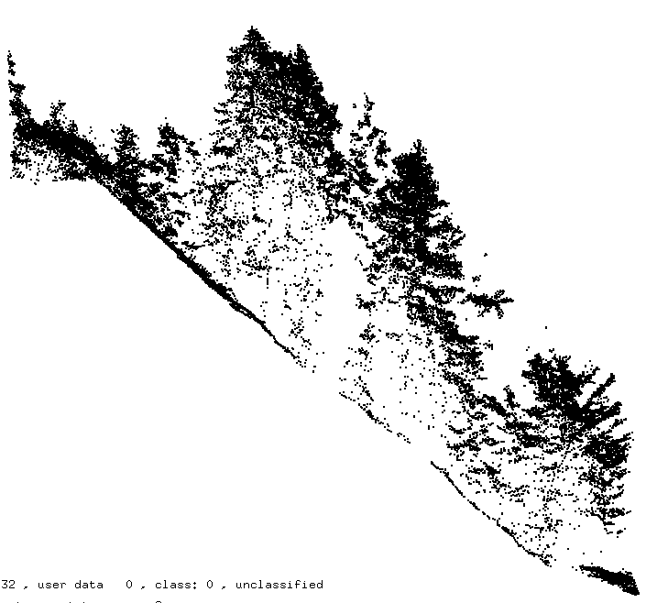
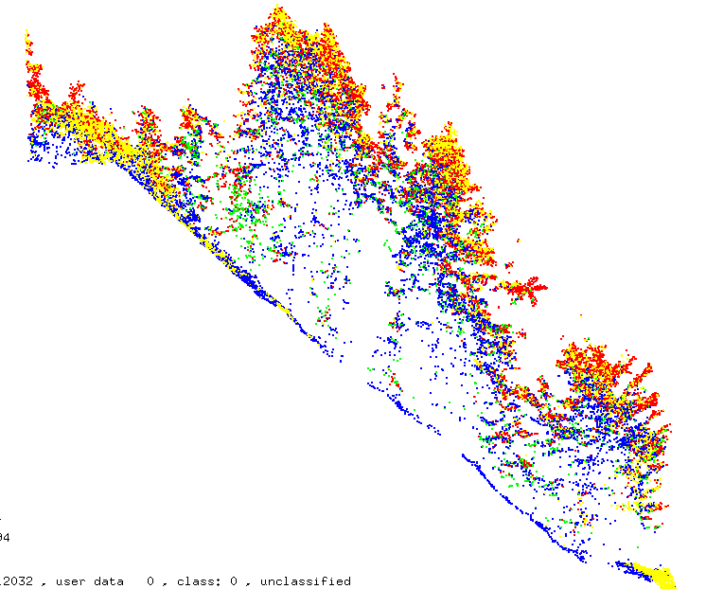
Dunserberg, AUSTRIA
AEROSCOUT+ TU VIENNA + UPJŠ
Alpine forest on a steep slope, subject to landsliding
ca. 400 points/ sq. m
ca. 5 cm spacing

Slide 17
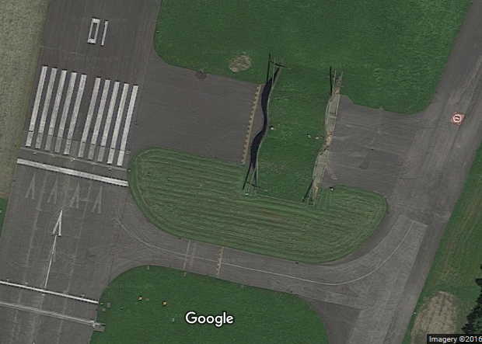
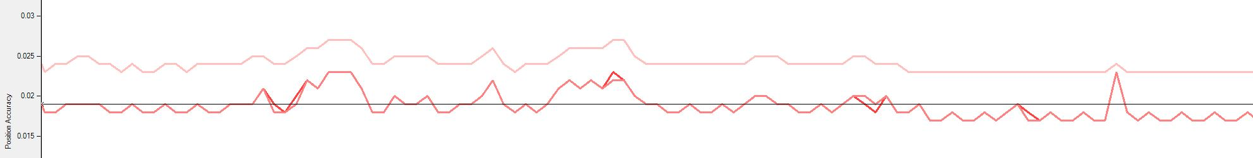
LIDAR missions: Airport in Alpnachstadt, CH
Airport in Alpnachstadt, CH
Flying height | 30 m
Area | 2 ha
Laser scanning rate | 550 kHz
Lidar point density | 1,111 points/ m²
Photo camera exposure station baseline | 8 m
Flight line accuracy post-proccesed (XY/Z) | 0.02 m / 0.025 m
Orientation acc. post-proccesed (roll/pitch/yaw) | 0.05°/0.05°/0.11°
Scan strip adjustment (sd) | 0.05 m
30 m
airplane hangar
Flight line accuracy after post-proccesing
Z
XY
Notes:
The first tests of the LiDAR payload were conducted in April 2015 over two hectares of an airport near Lucerne. The recorded point cloud data represent a part of the runway with adjacent meadow and a hangar covered by grass. The results demonstrate high quality of the final point cloud and orthoimagery and are comparable with other similar systems also according to the positional, vertical, and orientation accuracy of the post-processed flight line and scan strip adjustment.

Slide 18
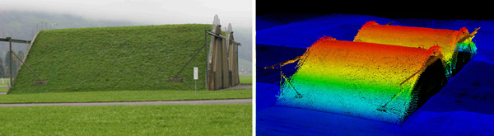
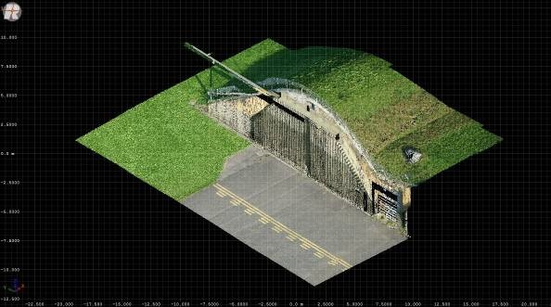
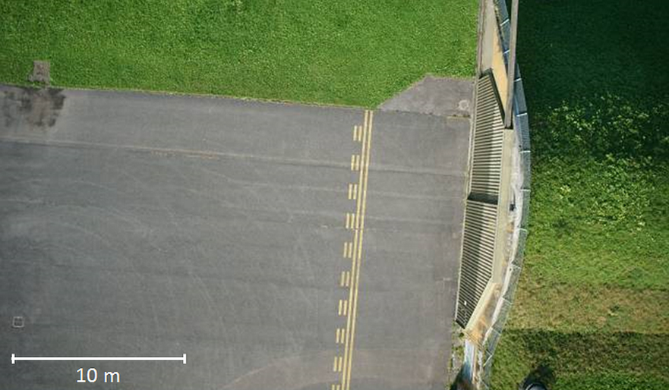
LIDAR missions: airport, Switzerland
Lidar point cloud by elevation values
Oblique photograph
Lidar point cloud coloured with natural colours from aerial
imagery.
Natural colours orthoimage
Notes:
A part of the scene is shown in Fig. 5 in the processed orthoimagery. This scene is depicted as a 3D colorized point cloud in Fig. 6.

Slide 19
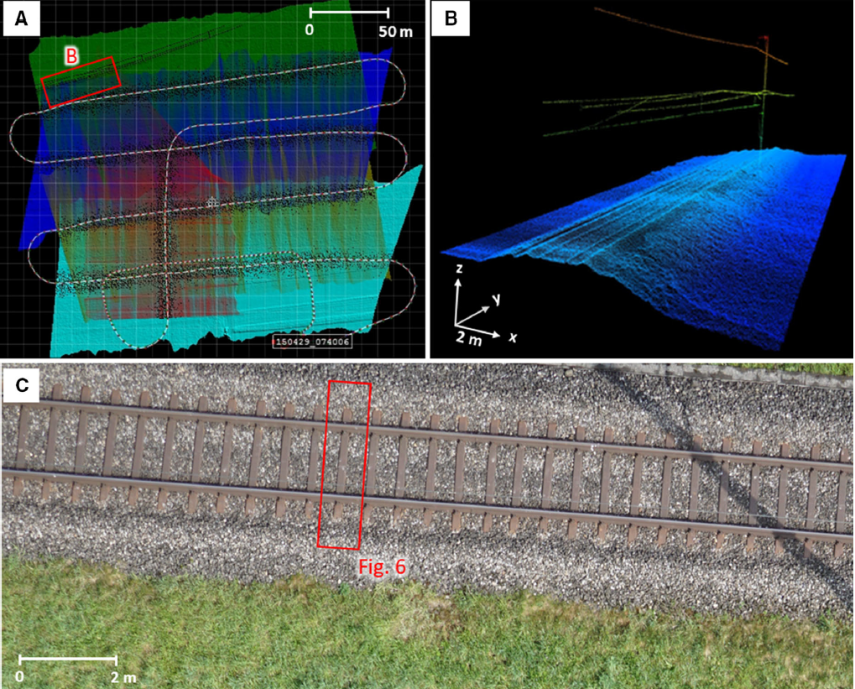
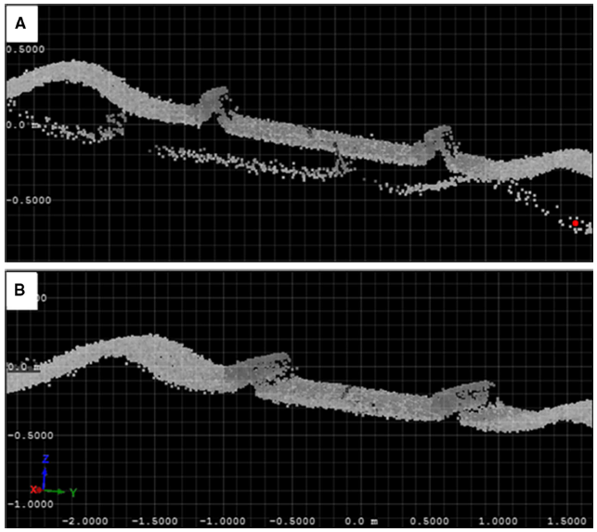
LIDAR missions: railway, Switzerland
Cross-sections of railway embankment demonstrate the scanning accuracy
Before strip adjustment
After strip adjustment
Notes:
A part of the scene is shown in Fig. 5 in the processed orthoimagery. This scene is depicted as a 3D colorized point cloud in Fig. 6.

Slide 20
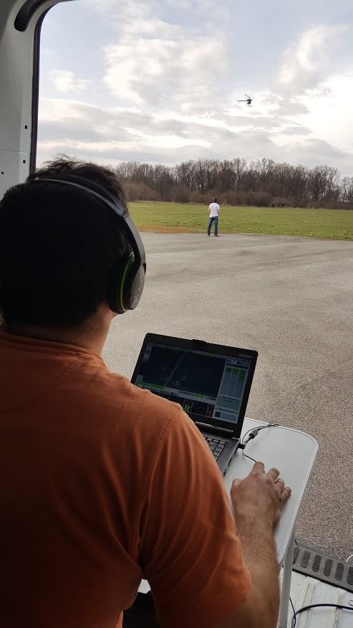
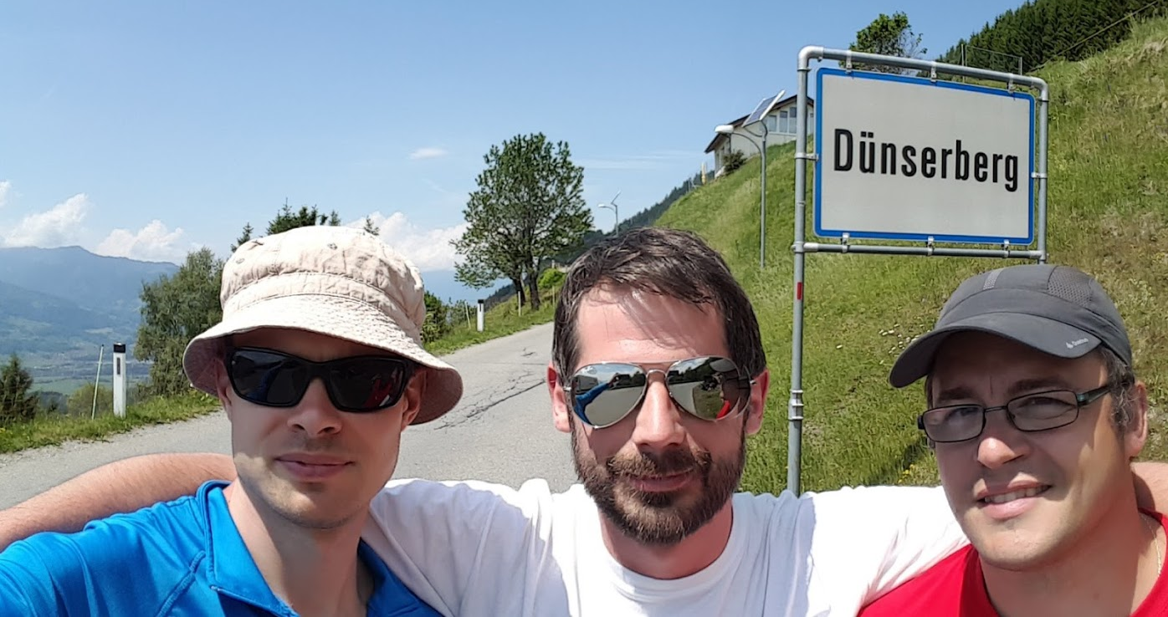
PRACTICALITIES
At least 3 UAS operators needed
payload operator, manual backup pilot, ground control pilot

Slide 21
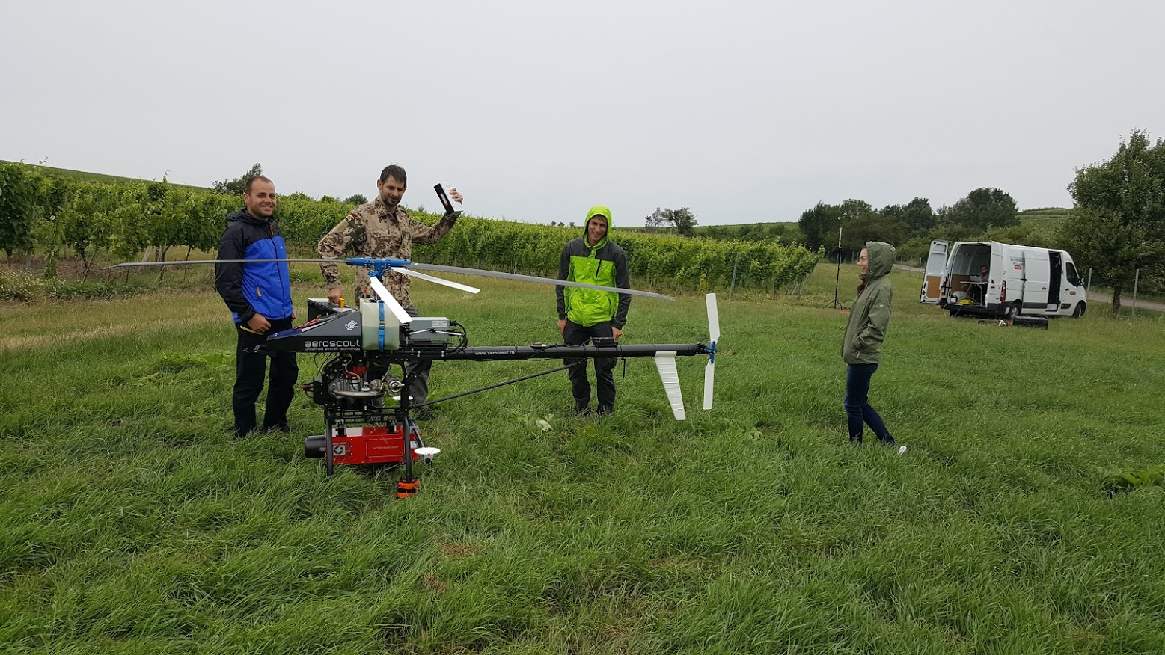
PRACTICALITIES
weather, transport, planning

Slide 22
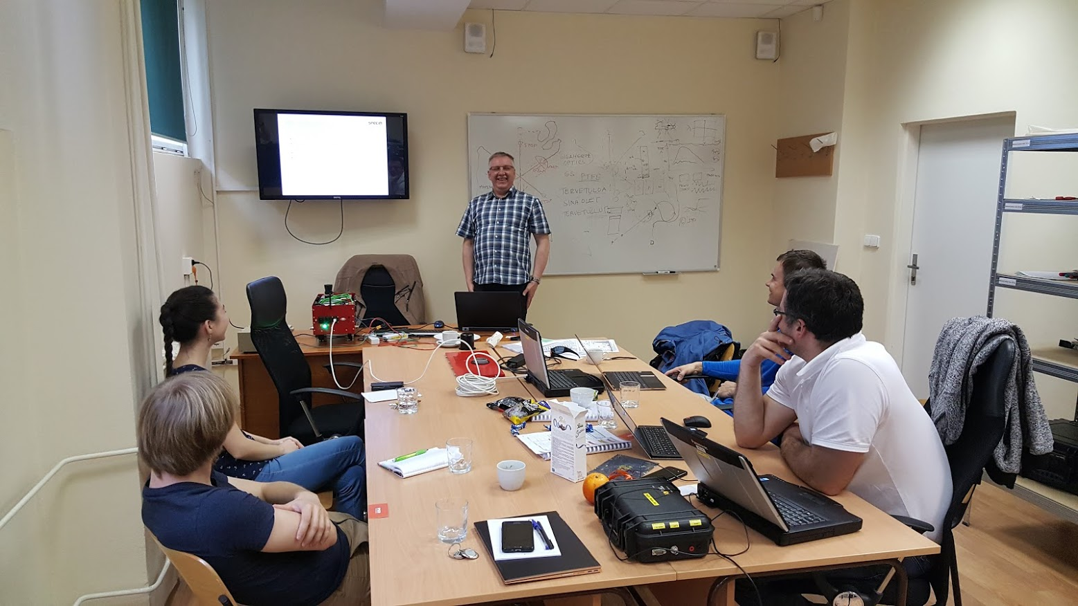
PRACTICALITIES
training

Slide 23
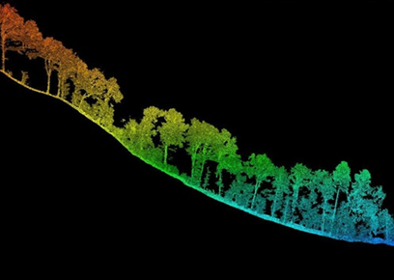
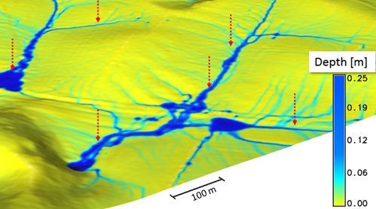
COnclusions
UAS is complex to operate
Delivers high-end products
Main applicability in research of various aspects of landscape dynamics on local scale, such as monitoring landslides, soil erosion, vegetation growth, forest structure, phenology, etc.
Such applications of the UAS will be addressed in future research.
Some success achieved already in Switzerland, Austria, Slovakia

Slide 24



Acknowledgements
Research funding under projects
University Science Park Technicom – TUKE, UPJS, PU
Physically based segmentation of georelief - APVV-15-0054
Simulation and dynamic visualization of geospatial processes - VEGA 1/0474/16
Landscape dynamics in high resolution - VEGA 1/0963/17
Interreg V-A Slovakia-Hungary: TOKAJGIS - SKHU/1601/4.1/052

Slide 25
Thank YOu!
THE UNPILOTED
HELICOPTER SYSTEM
SCOUT B1-100
geografia.science.upjs.sk Michal.gallay@upjs.sk
Michal GALLAY
Ján KAŇUK
Eduard
DVORNÝ
KAŇUK, J., GALLAY, M., ECK, C., ZGRAGGEN, C., DVORNÝ, E. (2018). Technical Report: Unmanned Helicopter Solution for Survey-Grade Lidar and Hyperspectral Mapping. Pure and Applied Geophysics. 175(9), 3357-3373.
GALLAY, M., ECK, C., ZGRAGGEN, C., KAŇUK, J., DVORNÝ, E. (2016). High resolution airborne laser scanning and hyperspectral imaging with a small uav platform. ISPRS Archives, XLI-B1, 823-827.

Slide 26

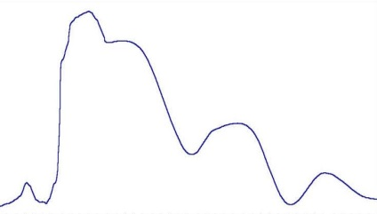
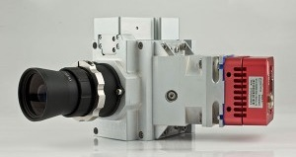
HYPERSPECTRAL Payload
AISA Kestrel 10
  push-broom camera, 4.75 kg
  F/2.4, FOV: 40°
  Spatial resolution: 1024 or 2048 pix.
  Spectral range: 400 – 1000 nm
  Spectral sampling: 1.75/3.5/7 nm
  Max. number of spectral bands: 342
  Frame rate: <130 Hz
  S/N peak: 400-800
  Total system power: <41 W
Flight direction
Pixel Spectrum
Intensity
Image pixel
Swath
width
Wavelength
Spectral bands
One image frame
Frames collected inflight
Bannon (2009)
Notes:
The second payload is dedicated for hyperspectral scanning in the spectral range of 400-1000 nm. It comprises an AISA KESTREL 10 camera by SPECIM which is a push-broom imager with high light throughput with an outstanding spatial resolution of 2048 pixels per line. The payload provides radiometrically and spectrally stable data and high signal-to-noise ratio in variable real world remote sensing conditions. Exactly simultaneous acquisition of all spectral bands. The KESTREL camera is a new generation of low-weight hyperspectral cameras intended for UAV’s and other platforms of limited payload weight and volume.

Slide 27
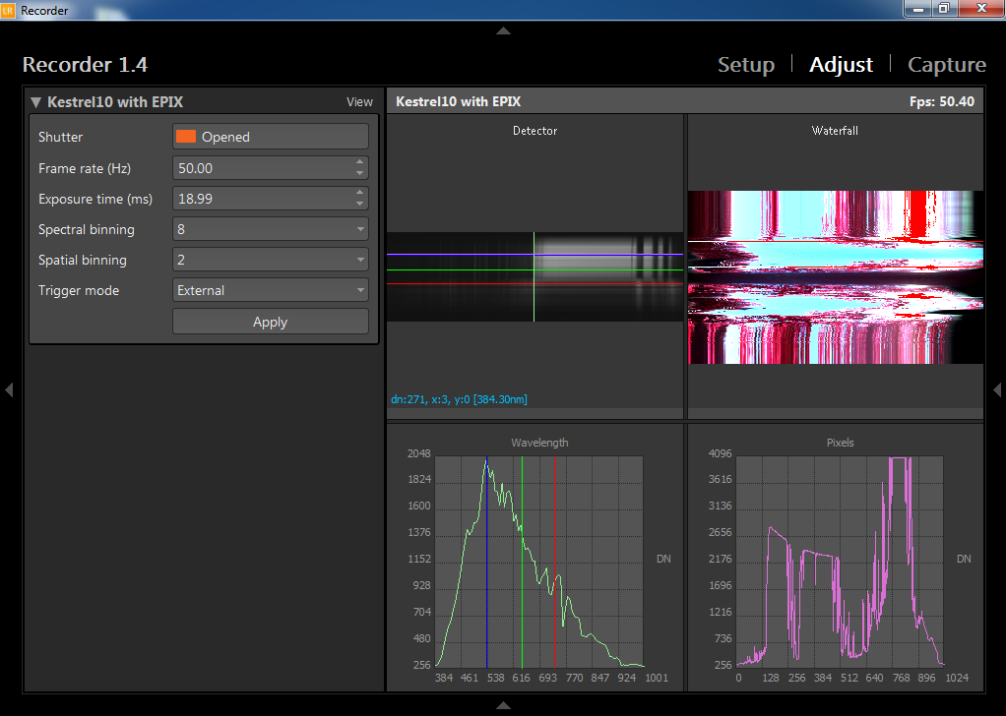
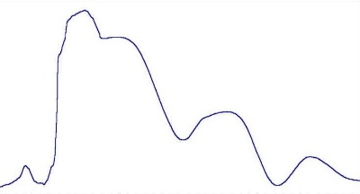
Hyperspectral mission: recording
Payload GCS
LUMO Recorder
LUMO Ground Station
Flight direction
Pixel Spectrum
Intensity
Image pixel
Swath
width
Wavelength
Spectral bands
One image frame
Frames collected inflight
Notes:
The data acqusition set up and controlled by the on-board Lumo Recorder softwere run on the acquisition computer, which is usually located in a UAV or
other aircraft. This software is operated and controlled by the Lumo GroundStation software installed on the payload laptop.

Slide 28

Hyperspectral mission: PLAN
Meadows near Rothenburg
3 individual trips for boresight calibration
100 m
Flying height | 140 m
Area | 2 ha
Range of terrain elevation | 3 m
Number of spectral bins | 92
Integration time | 19 ms
Frame rate | 50 Hz
Width of spectral bands | 6.9 nm
GSD/resolution | 0.1 m
Notes:
The hyperspectral mission was flown in October 2015 in a rural area in this formation of 3 individual strips for camera boresight calibration purposes with 140 m of flying height and spectral resolution of 92 band with 7 nanometres bandwidth. Ground sampling distances was 10 centimetres.

Slide 29



Hyperspectral mission: DATA Processing
Raw data - non-georectified DN numbers
Preprocessing – CaliGeoPRO by Specim - georectified radiances
Atmospheric correction - ENVI - QUAC model – THOR spectral smoothing - georectified reflectances
100 m
Notes:
As it is a pushbroom scanner the raw hyperspectral imagery is not directly suitable for application and must be geo/rectified and converted to reflectances. As you can see, the post-processed result with the data of the flight line from time synchronized on-board IMU/GPS navigation sensor. Images produced with CaliGeoPRO were ready for atmospheric correction, if required, and application requirements. GPS/IMU system is very good.
The hyperspectral raw data were converted to radiance data and geocorrected data using the CaliGeoPRO pre-processing tools by SPECIM. The radiance data were atmospherically corrected using the QUAC tools of the Harris ENVI software. The results were smoothed using a filter width of 4 and a degree of smoothing polynomial of 2 of the THOR Spectral Smoothing tools of ENVI.

Slide 30

Hyperspectral mission: RESULTS
orthorectified image in natural colours
seamless merge of three image data strips
100 m
Flying height | 140 m
Area | 2 ha
Range of terrain elevation | 3 m
Number of spectral bins | 92
Integration time | 19 ms
Frame rate | 50 Hz
Width of spectral bands | 6.9 nm
GSD/resolution | 0.1 m
Flight line acc. post-proccesed (XY/Z) | 0.02 m / 0.25 m
Orientation acc. post-proccesed (roll/pitch/yaw) | 0.05°/0.05°/0.11°
Notes:
Regions of interest (ROIs) were extracted from the image to account for the spectral variation in the scene. The Spectral Angle Mapper implementation of ENVI software was used to classify the image using the ROIs. In the georeferencing process, the flight line image was placed on its actual position on the ground. Georectification and georeferencing of the AISA flight line images was performed by using the position and attitude data collected from the time synchronized on-board IMU/GPS navigation sensor. Images produced with CaliGeoPRO were ready for atmospheric correction, if required, and application requirements. Verification of the time synchronization between IMU/GPS navigation sensor and hyperspectral camera data.
part of the sensed area in false colours as a combination of two bands from visible and one from near infrared spectrum depicting the differences between vegetation cover. The accuracy of the flight line trajectory was similar as reported for the lidar mission and it is demonstrated by the seamless merge of three image data strips which accurately preserved the geometry of landscape features such as roads

