Slide 1





1. Úvod do ESA diaľkového prieskumu Zeme a jeho vývoj
– ESA DPZ údaje na webe
ESA UNCLASSIFIED

Slide 2



1 | Exercise outline
In this exercise, we will:
acquire skills in retrieving satellite imagery from both ESA and third-party missions
conduct specific analyses utilizing the EO Browser
install ESA SNAP and execute fundamental image operations
explore the spectral curve of various surface types

Slide 3
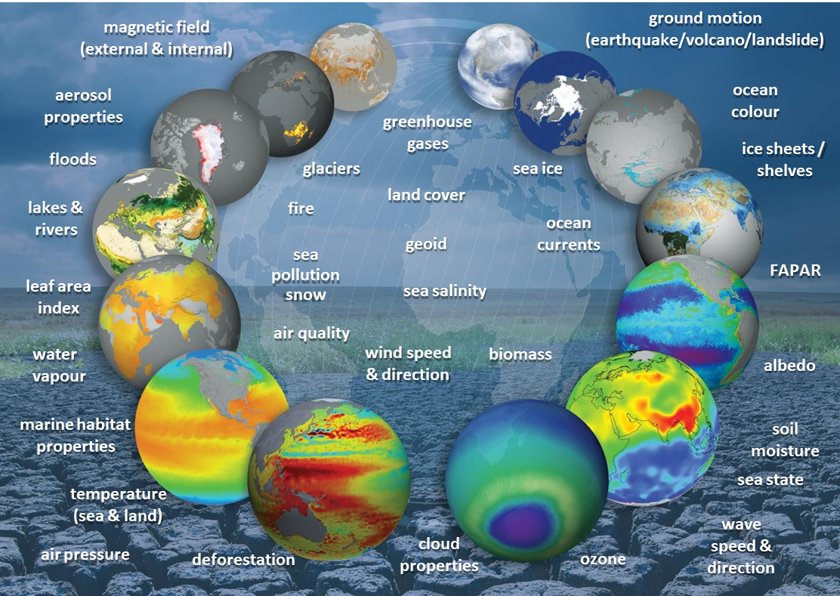
2 | Background
The European Space Agency (ESA) has several key mission programs covering various areas of space exploration, Earth observation, scientific research, and international collaboration. Some of the main mission programs include:
Earth Observation (EO) Programs: ESA has a comprehensive portfolio of EO missions aimed at monitoring and understanding various aspects of the Earth's environment. Examples include the Copernicus program, which has developed Sentinel missions to manage the environment, understand and tackle the effects of climate change, and safeguard everyday lives, Earth Explorers designed to improve our understanding of Earth, and the Living Planet Program.
ESA provides EO mission data addressing almost all parameters retrievable by EO satellites

Slide 4
Exploration Programs: ESA conducts various scientific missions to explore the cosmos and increase our understanding of the universe. This includes missions like the Hubble Space Telescope, the Gaia mission for astrometry, and the Planck mission for studying the cosmic microwave background. ESA is actively involved in space exploration initiatives, including the ExoMars program in collaboration with Roscosmos, which aims to search for signs of past or present life on Mars. Additionally, ESA contributes to lunar exploration efforts, robotic missions, international collaborations with agencies like NASA, human spaceflight missions in collaboration with the International Space Station (ISS). The agency contributes astronauts, research, and technology to advance human space exploration.
Telecommunications and Integrated Applications: ESA focuses on developing advanced satellite communication technologies and applications. This includes programs such as the Advanced Research in Telecommunications Systems (ARTES) program.
Navigation Programs: ESA is involved in satellite navigation programs, such as the Galileo program, which aims to provide Europe with its global navigation satellite system (GNSS).
It's important to note that the specifics of ESA's mission programs may evolve over time, and new programs may be initiated. Within this course, we will focus mainly on the field of EO Programs.

Slide 5
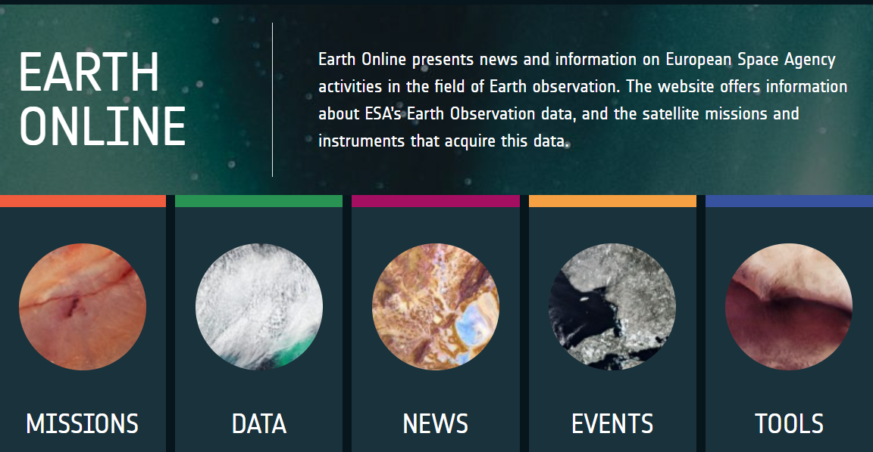
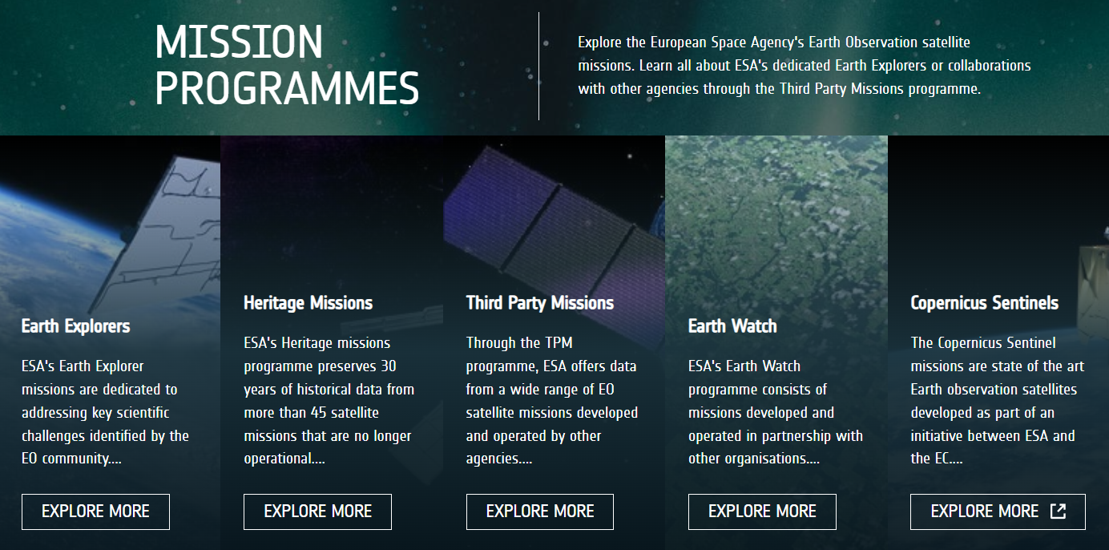
3 | EO Mission Programmes
https://earth.esa.int/eogateway
ESA's EO Mission Programme is dedicated to several ongoing and past Earth Observation satellite missions. Users can learn all about ESA's dedicated Earth Explorers, Copernicus Sentinels, Heritage Missions or collaborations with other agencies through the Third Party Missions programme by accessing the dedicated Earth Online website that presents news and information on ESA activities in the field of Earth observation. The website offers information about ESA’s Earth Observation data, along with insights into the satellite missions and instruments that acquire this data.

Slide 6
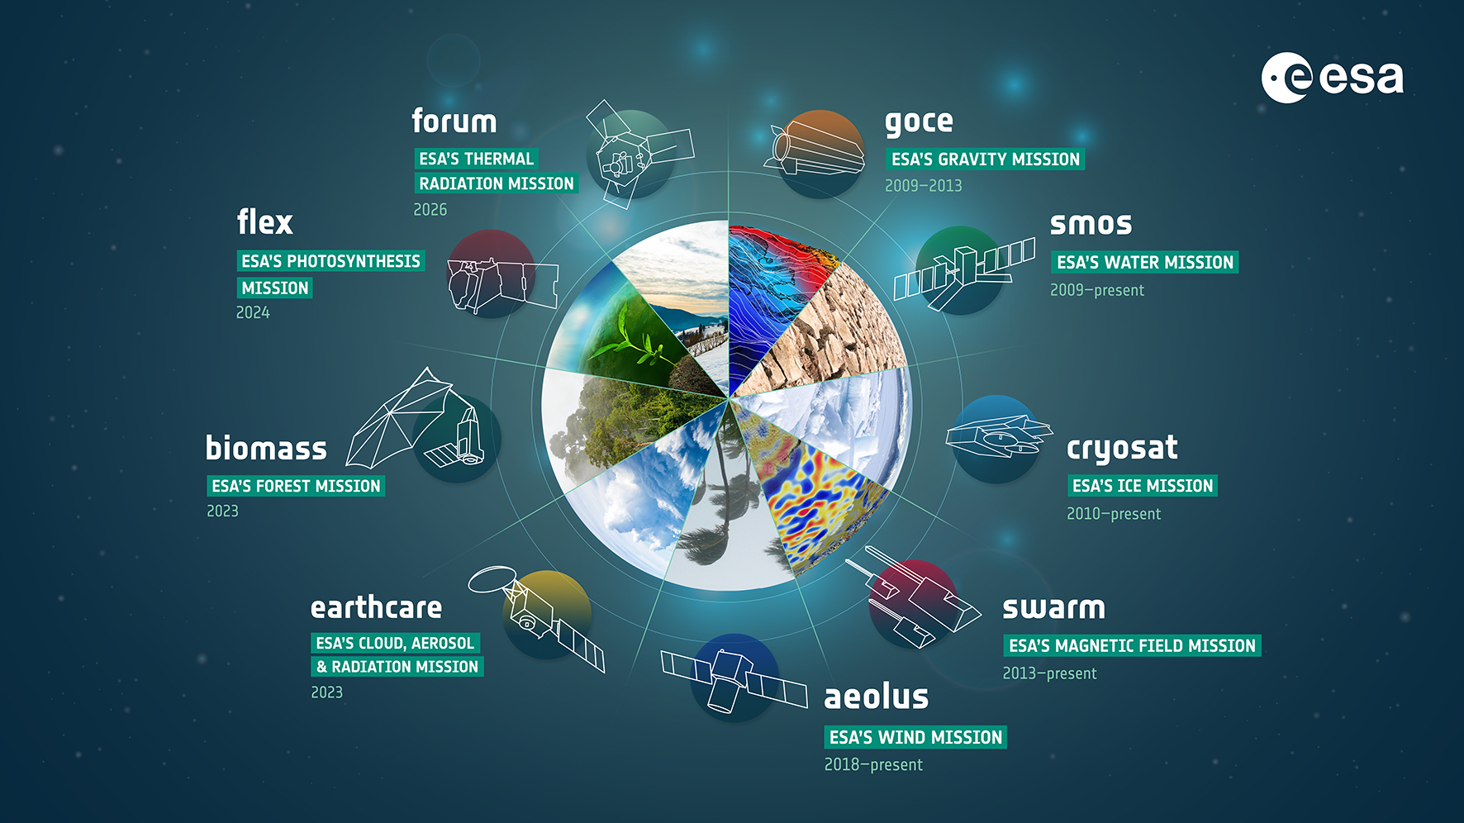
3.1 Earth Explorers
The Earth Explorers program comprises a set of satellites united in their mission to enhance Earth science by addressing fundamental scientific inquiries through the observation of crucial Earth systems.
Each Earth Explorer is specifically designed to monitor distinct facets of the Earth's system, including the Cryosphere, Hydrosphere, Atmosphere, Ionosphere, and the Earth's interior. The primary aim of these missions is to gain insight into the Earth as a geosphere and comprehend the intricate interactions among spheres and sub-spheres
Current Earth Explorer missions include Aeolus, CryoSat, SMOS, and Swarm. Future expansions will introduce new missions like EarthCARE, Biomass, and FLEX.

Slide 7
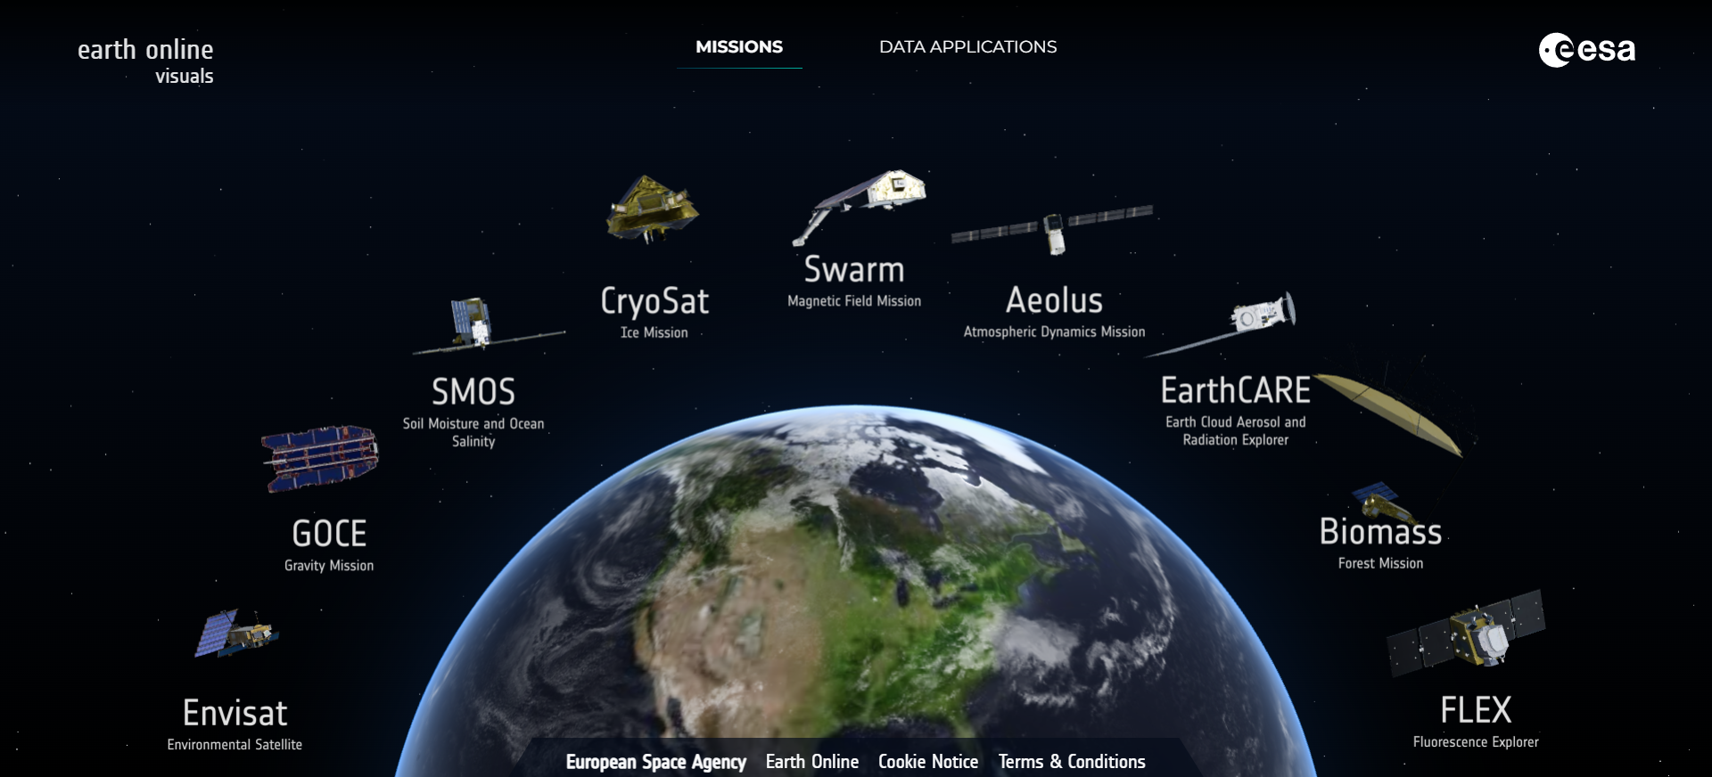
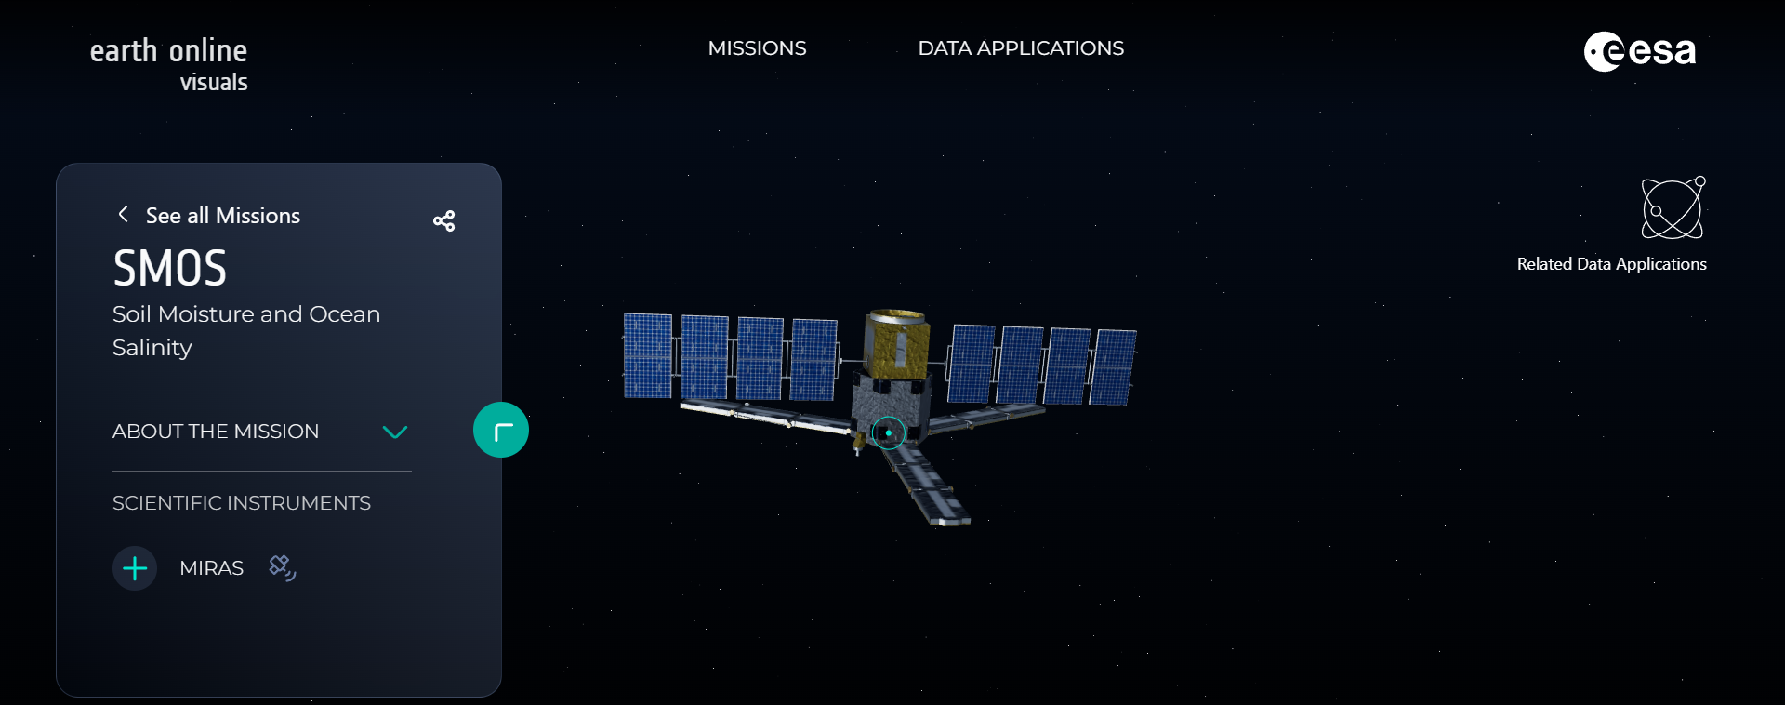
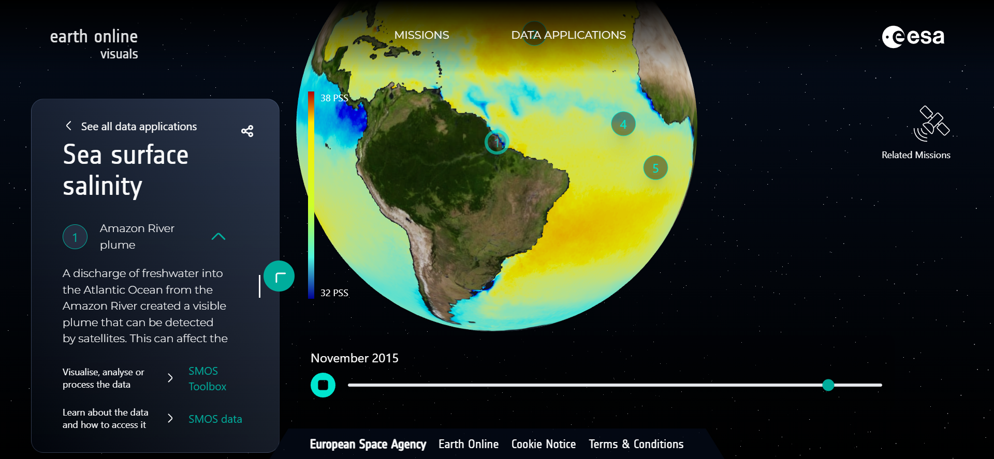
Users have the ability to engage with three-dimensional representations of ESA satellites and payloads via the link: https://visuals.earth.esa.int/ Additionally, users can explore case studies that showcase practical applications of the satellite data.
See data application
3D model of ESA SMOS satellite
Information about the mission and its instruments
Interactive visualisation
Further visualisation and analysis options, information on data access

Slide 8
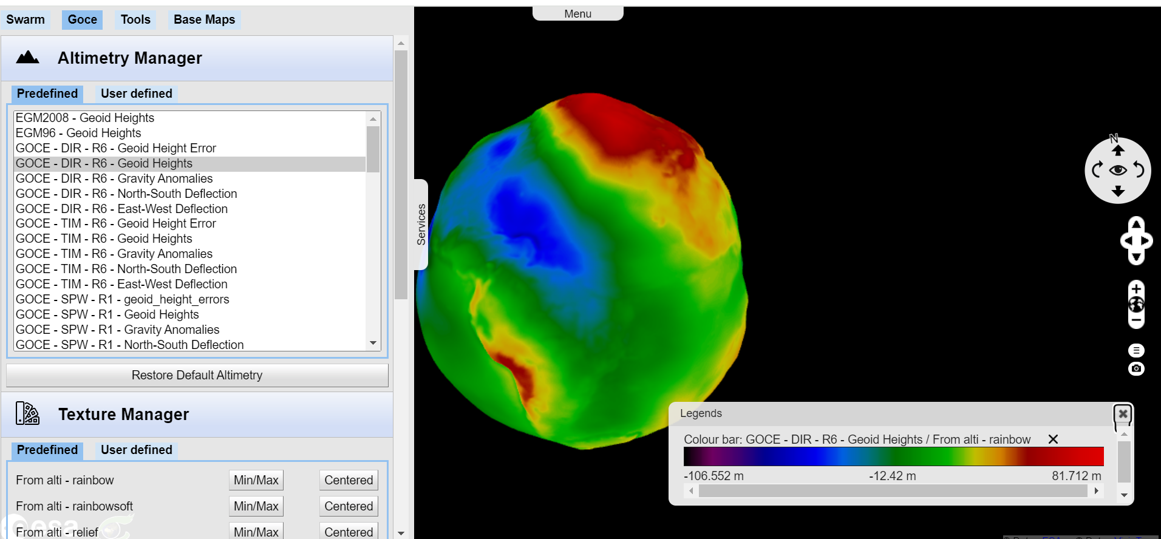
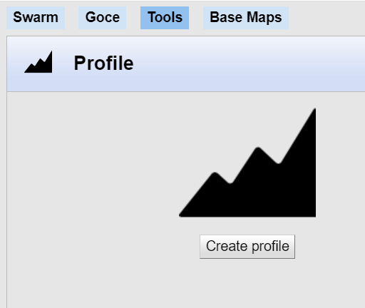
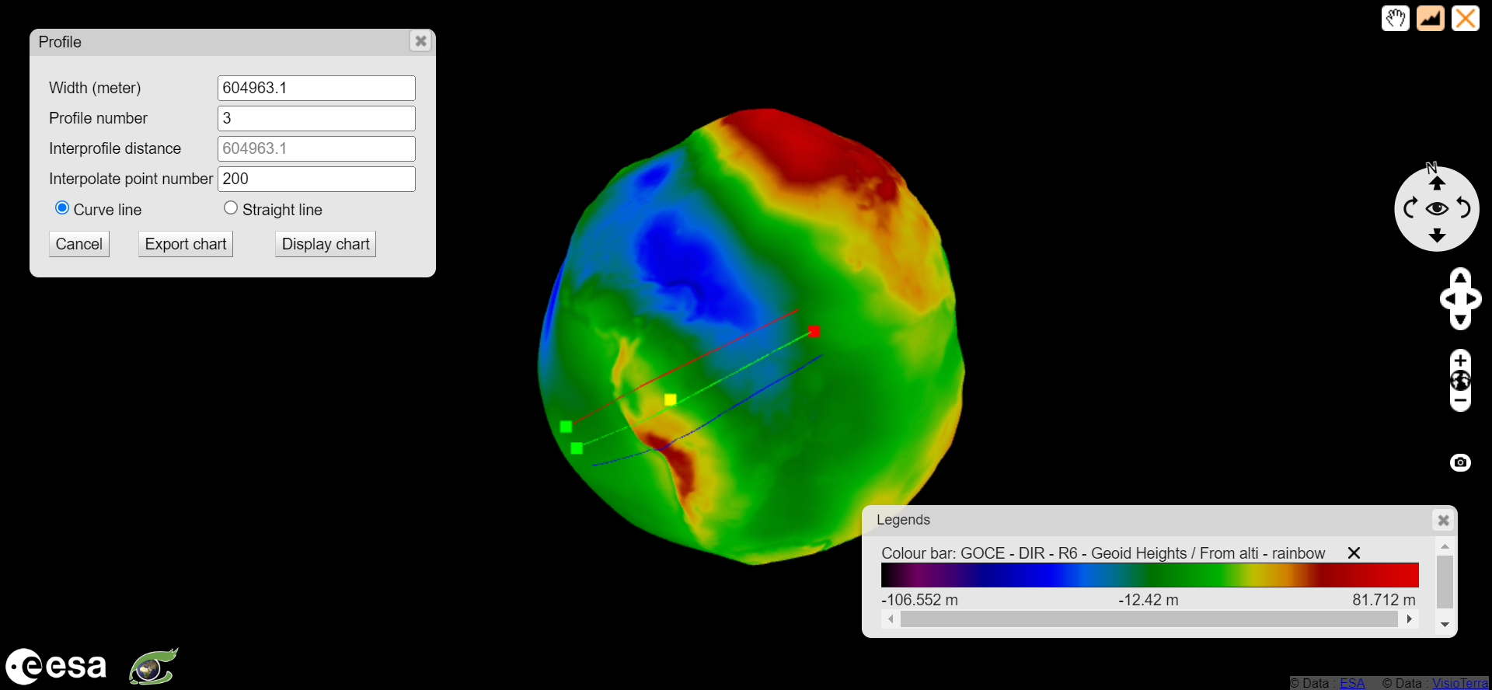
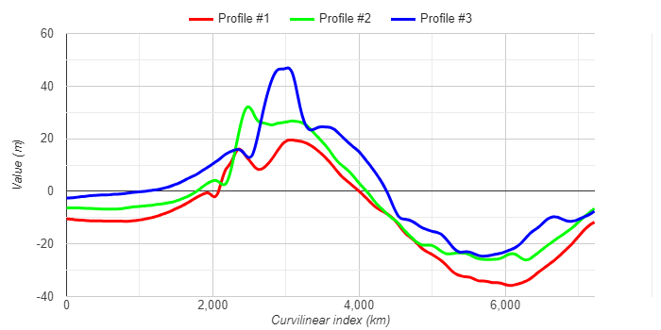
VisioTerrra
VisioTerra is a French company that focuses on scientific consulting in the field of Earth observation as an independent entity. It enables access to online visualisation of GOCE altimetry and SWARM products.
Visualisation options
Set profile parameters
Draw profile
and display it

Slide 9
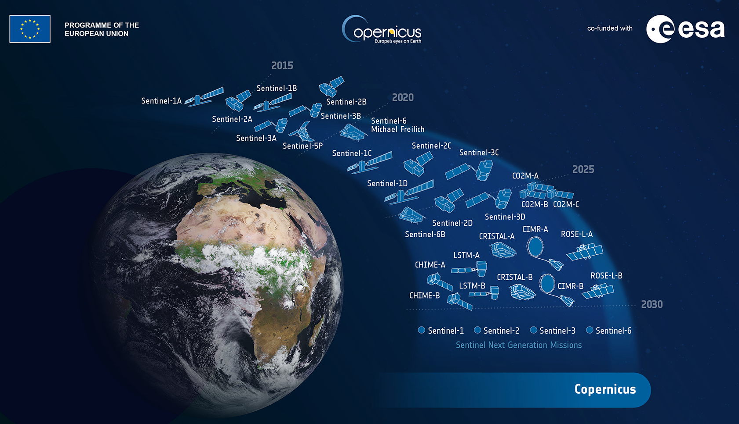
3.2 Sentinel Online - Copernicus Sentinels
https://sentinels.copernicus.eu/web/sentinel
https://sentinel.esa.int/web/sentinel/home
Copernicus stands as the most ambitious Earth observation program to date, aiming to deliver precise, timely, and readily available information to enhance environmental management, comprehend and alleviate the impacts of climate change, and ensure civil security.
ESA developed the Sentinel satellite family to meet Copernicus program needs. The Copernicus Ground Segment oversees operations, data acquisition, and distribution. Currently, three two-satellite constellations orbit, with two individual satellites, including Sentinel-5P. After Sentinel-1B, Sentinel-1C will restore the Sentinel-1 constellation.
Sentinels offer diverse observations, from Sentinel-1's all-weather radar images (2014, 2016) to Sentinel-2A's high-res optical images (2015). Sentinel-3 satellites (2016, 2018) provide ocean and land data, with Sentinel-3 marine operated by EUMETSAT and Sentinel-3 land by ESA. Sentinel-5P, launched on October 13, 2017, is the first Copernicus mission dedicated to atmospheric monitoring, reducing data gaps.
Sentinel Online aims to offer extensive information to prospective users regarding the Sentinel program, including its specific missions, operational priorities, and the Copernicus Thematic domains it caters to. The technical platform prioritizes in-depth explanations covering instruments, performance of data products, scientific applications, Ground Segment processing, and guidance on how to access Sentinel data.

Slide 10
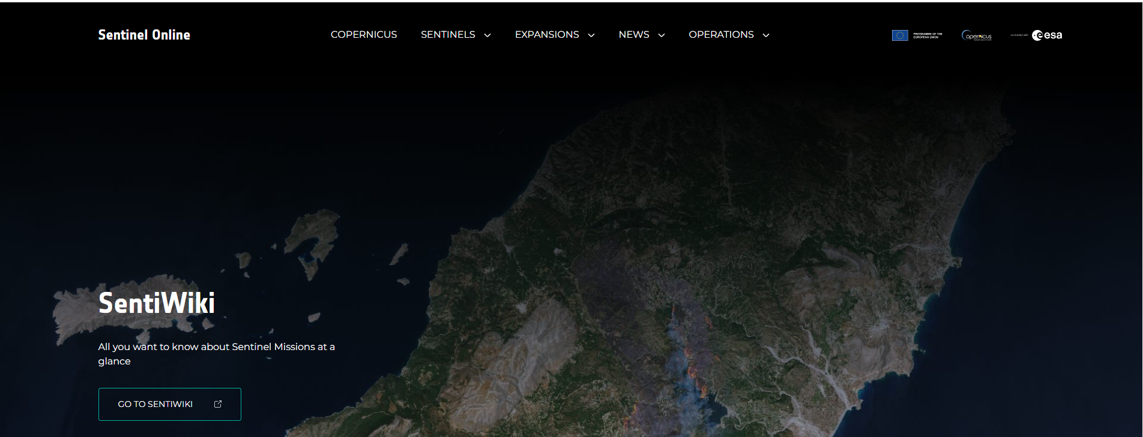
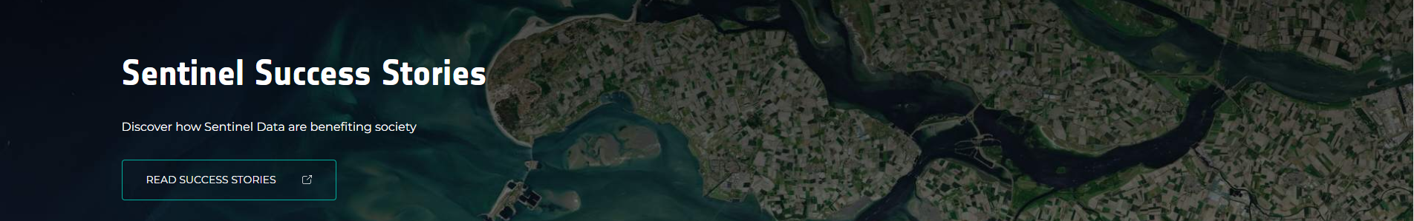
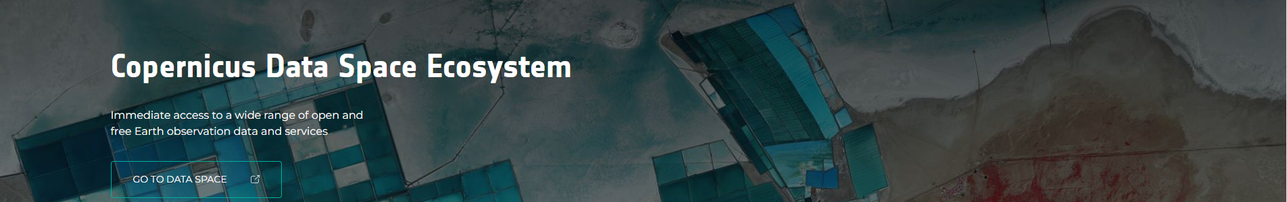
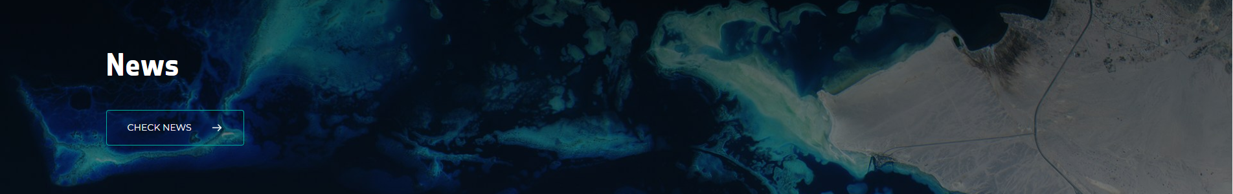
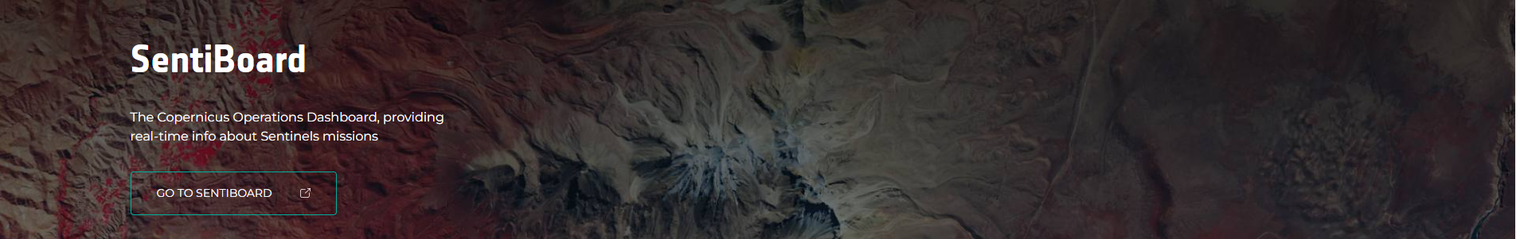
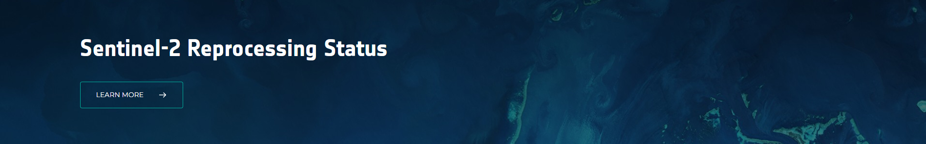
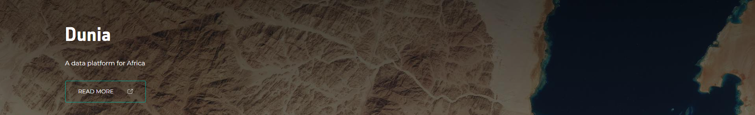
Users can explore Copernicus Sentinel missions and instruments through SentiWiki, applications through Sentinel Success Stories, get an immediate access to a wide range of open and free EO data and services through Copernicus Data Space Ecosystem, check News, real-time info about Sentinels missions through SentiBoard, Sentinel-2 Reprocessing Status or explore Dunia – data platform for Africa.

Slide 11
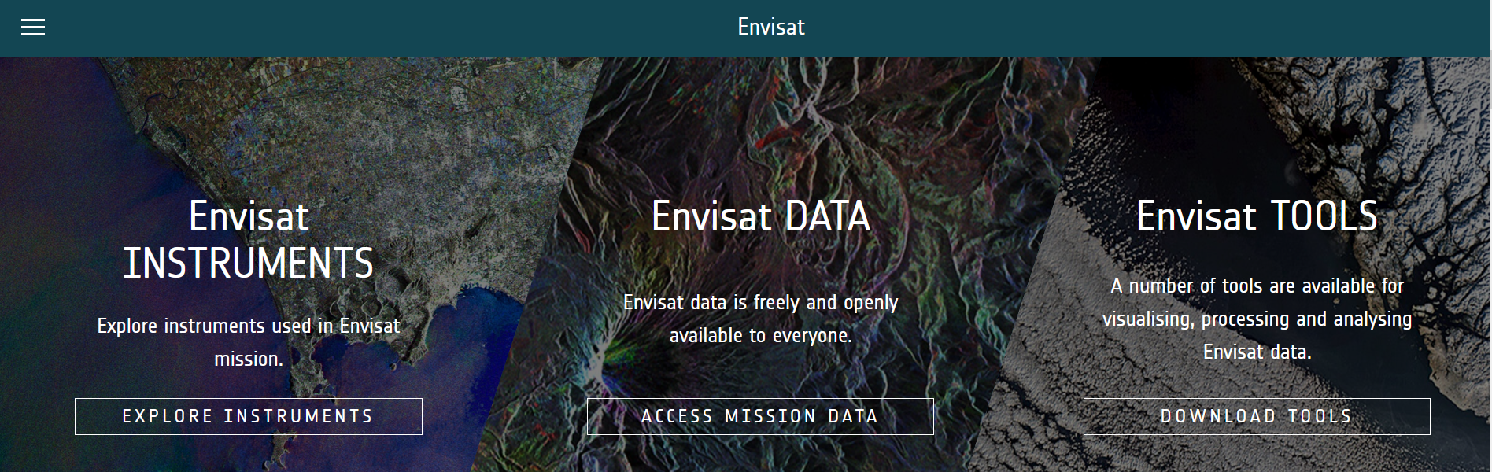
3.3 Heritage missions
https://earth.esa.int/eogateway/missions/heritage-missions
ESA's Heritage Space Programme is dedicated to safeguarding, ensuring accessibility to, and managing over four decades of Earth Observation heritage data. This extensive dataset originates from more than 45 satellite missions that are no longer in operation, as well as from dedicated Earth Observation campaigns conducted by ESA.
Included in the program are significant missions such as the European Remote Sensing satellites (ERS-1 and ERS-2), Envisat, and the Gravity Field and Ocean Circulation Explorer (GOCE).
The user can discover the instruments used in each of these featured missions, access mission data and explore A number of tools that are available for visualising, processing and analyzing.

Slide 12
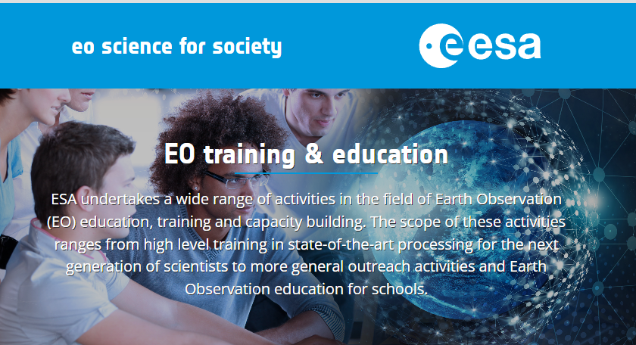
4 | EO Training and Education
ESA is involved in a diverse array of initiatives related to education, training, and capacity building in the field of Earth Observation (EO). These efforts span from advanced training in state-of-the-art processing techniques for the upcoming generation of scientists to broader outreach activities and EO education for schools.
4.1 Earth Observation for Society (EO4Society)
https://eo4society.esa.int/training-education/
EO4Society is a program that focuses on utilizing Earth observation data to address societal challenges. The EO4Society program aims to promote the use of Earth observation data for various societal benefits, including environmental monitoring, climate change studies, disaster management, agriculture, and urban planning, among others.
Within this platform ESA has developed Massive Open Online Courses (MOOCs) on various topics related to space exploration, science, and technology. These courses are inclusive, accommodating individuals from diverse backgrounds, such as scientists, policy-makers, educators, professionals, students at schools or universities, and casual learners. Each course lasts several weeks, challenging the traditional educational framework by integrating data, video content, applications, and online materials.

Slide 13
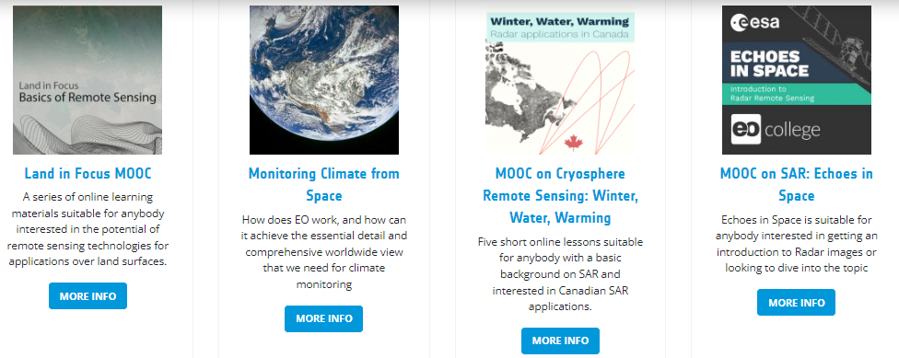
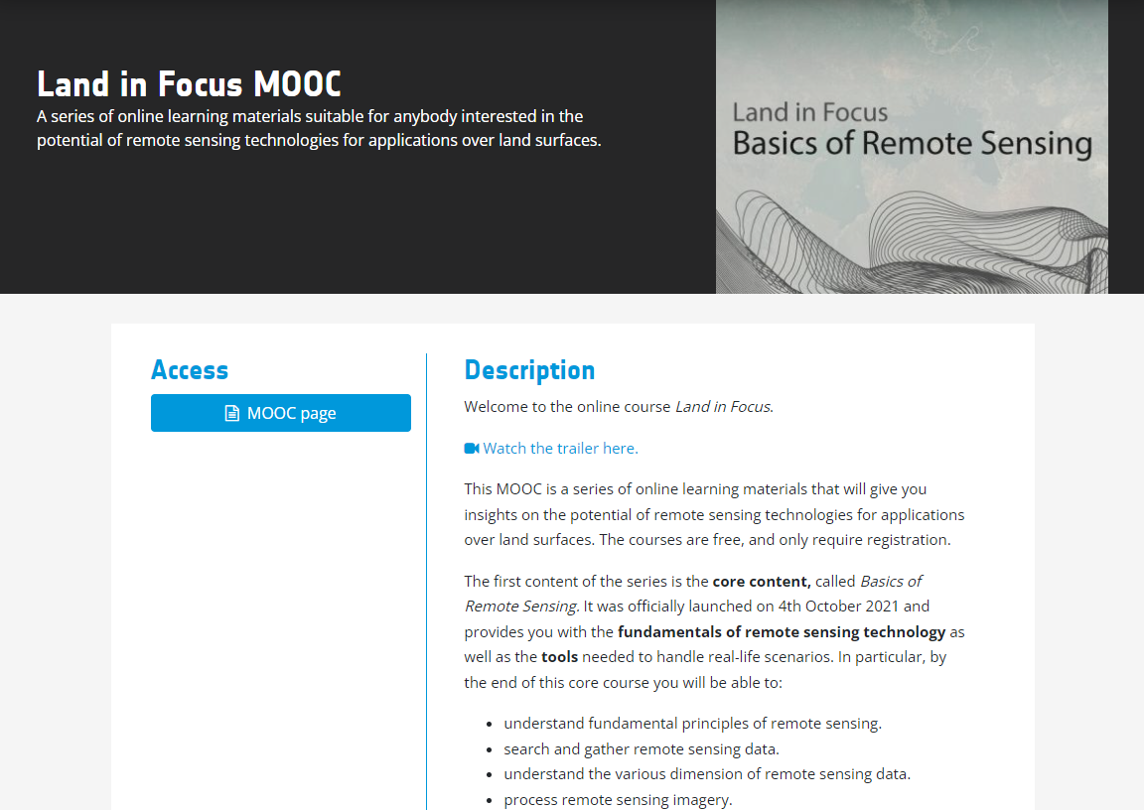
The educational journey can be tailored to individual preferences due to its social dimension, which includes online discussions and feedback from educators, along with the incorporation of optional materials. Each MOOC training course has its dedicated page with learning materials.
Link: https://eo4society.esa.int/training-education/massive-open-online-courses-moocs/
Thematic Exploitation Platforms (TEPs)
Another result of EO4SocietyTEPs are collaborative and virtual workspaces that grant access to Earth Observation (EO) data, along with the necessary tools, processors, and information and communication technology resources essential for effectively working with them. These resources are made accessible through a unified and cohesive interface. TEPs are adressing following topics: Coastal, Forestry, Hydrology, Geohazards, Polar, Urban themes, Food Security

Slide 14
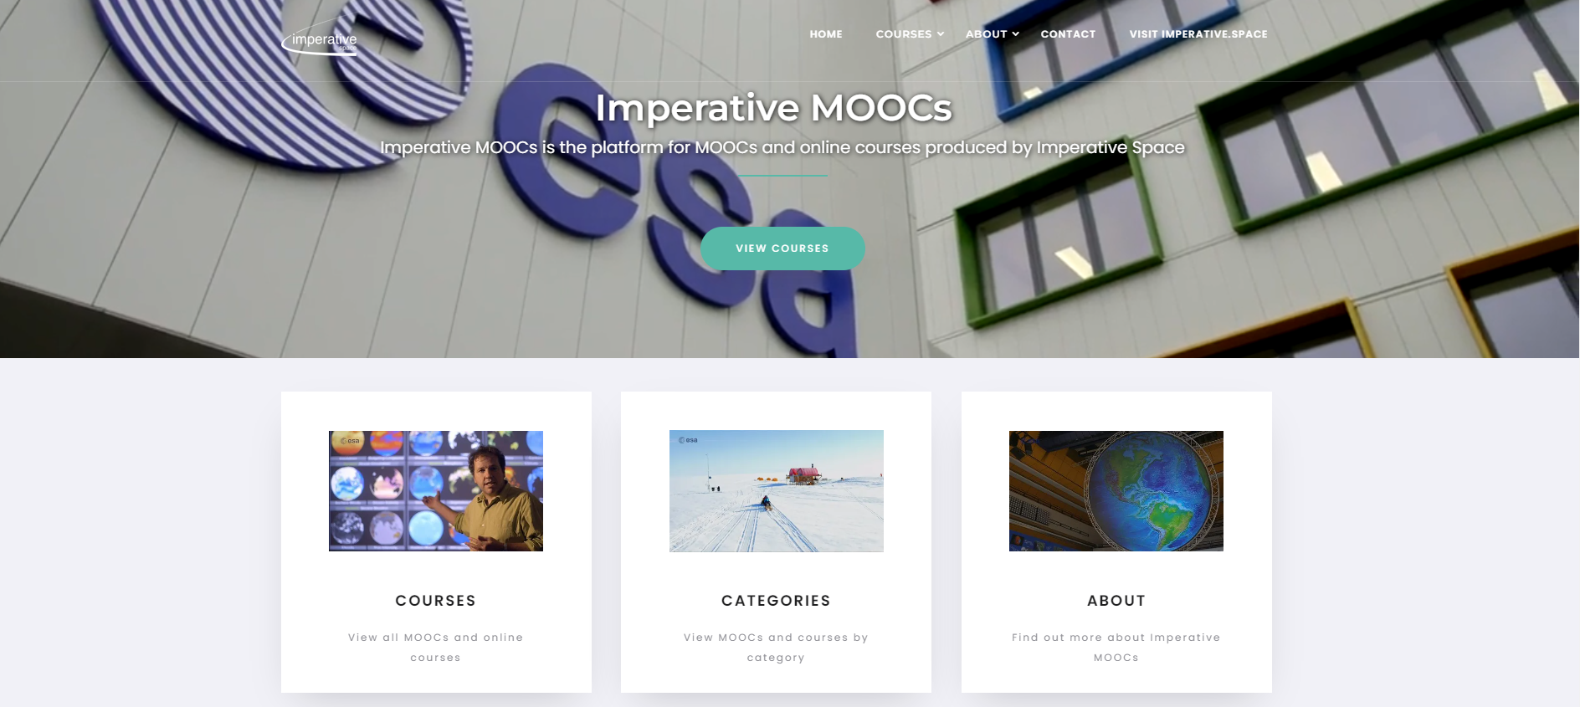

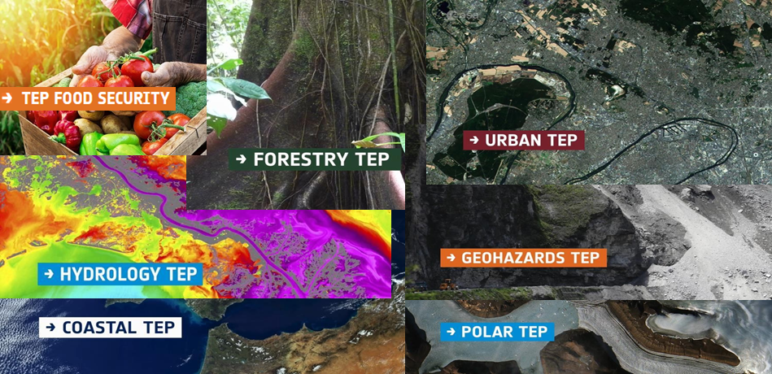
4.1.1 Imperative MOOCs
https://www.imperativemoocs.com/
Imperative MOOCs is the platform for MOOCs and online learning projects produced by Imperative Space whose one of the clients is also ESA. Its Earth Observation courses have created innovative new approaches to training and knowledge exchange in this field, and are supported by purpose-built data apps-
4.1.2 Thematic Exploitation Platforms (TEPs)
Another result of EO4SocietyTEPs are collaborative and virtual workspaces that grant access to Earth Observation (EO) data, along with the necessary tools, processors, and information and communication technology resources essential for effectively working with them. These resources are made accessible through a unified and cohesive interface. TEPs are adressing following topics: Coastal, Forestry, Hydrology, Geohazards, Polar, Urban themes, Food Security.

Slide 15
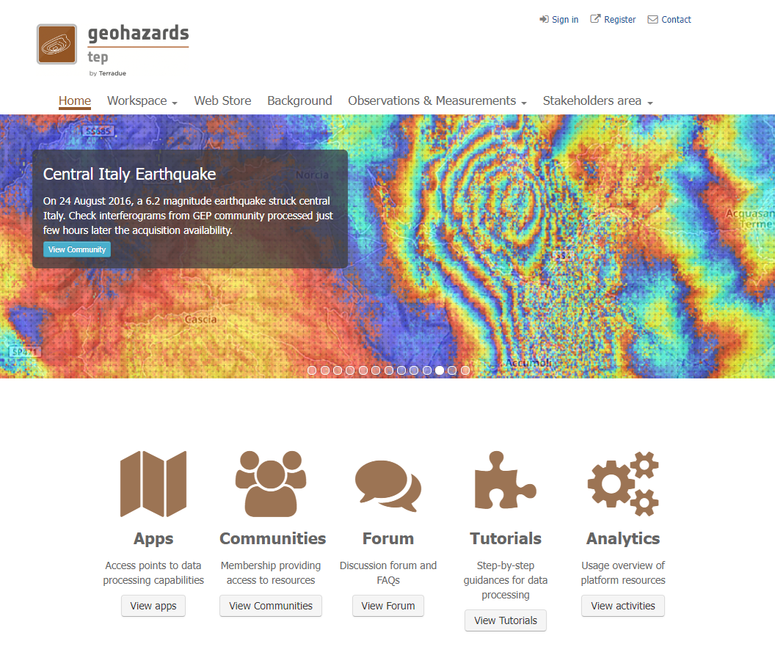
E.g. the Geohazards TEP (G-TEP) platform is built on the virtualization and federation of satellite EO data and methods. Its primary goal is to offer innovative solutions to the geohazards community's needs. By utilizing advanced services for both Optical and Synthetic Aperture Radar (SAR) data, it provides on-demand and systematic processing services tailored to the specific requirements of user communities. The platform seamlessly connects to extensive Copernicus Sentinels-1/2/3 repositories, High-Resolution Optical imagery, and over 70 terabytes of EO data from archives like ERS and ENVISAT. Additionally, it interfaces with specific data collections from missions such as JAXA’s ALOS-2, ASI’s Cosmo-Skymed, and DLR’s TerraSAR-X, all made available through special arrangements within the framework of the CEOS WG Disaster and GSNL. This integration allows the platform to efficiently address the challenges of monitoring tectonic areas globally by tapping into significant compute power on multi-tenant Cloud Computing resources.

Slide 16
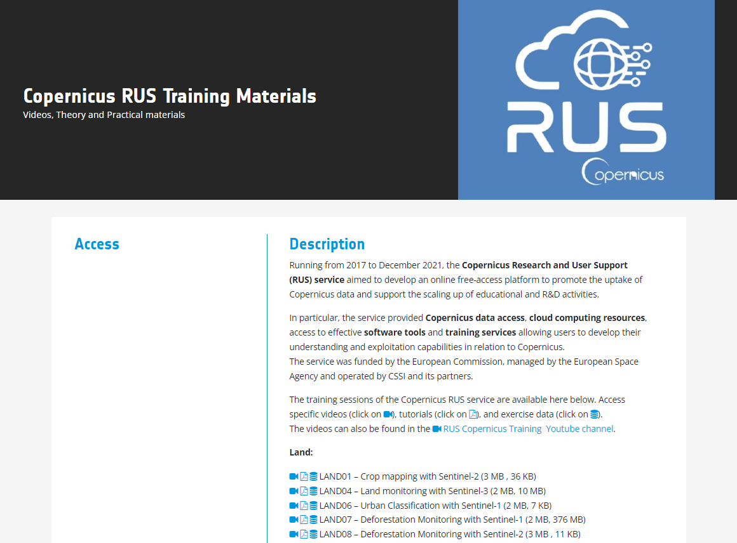
4.1.3 Copernicus RUS Training Materials
https://eo4society.esa.int/resources/copernicus-rus-training-materials/
Operating from 2017 until December 2021, the Copernicus Research and User Support (RUS) service sought to create an open-access online platform with the goal of fostering the utilization of Copernicus data and facilitating the expansion of educational and research and development (R&D) initiatives. The primary objective of the RUS Service was to encourage the utilization of Copernicus data and facilitate the expansion of research and development (R&D) endeavors, including the advancement of pre-commercial processing chains. This service is structured within a scalable cloud environment, allowing for the remote storage and processing of Earth Observation (EO) data.
Additionally, the RUS Service extended its support through on-site training sessions, webinars, and online resources. Notably, this service is accessible to a diverse user community and various types of institutions at no charge.
Nowadays, the training sessions of the Copernicus RUS service are available at EO4Society website.

Slide 17
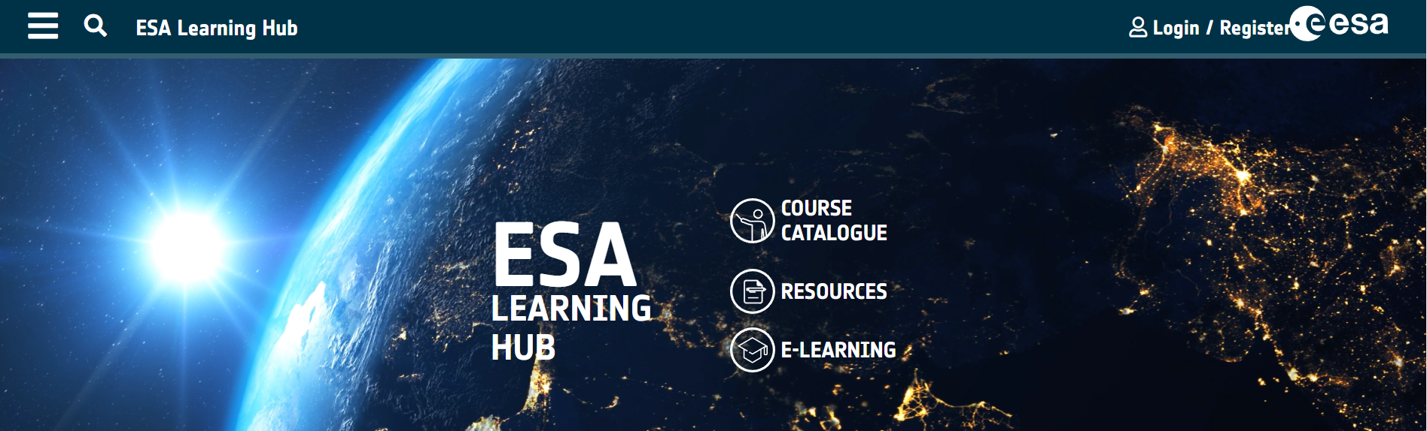
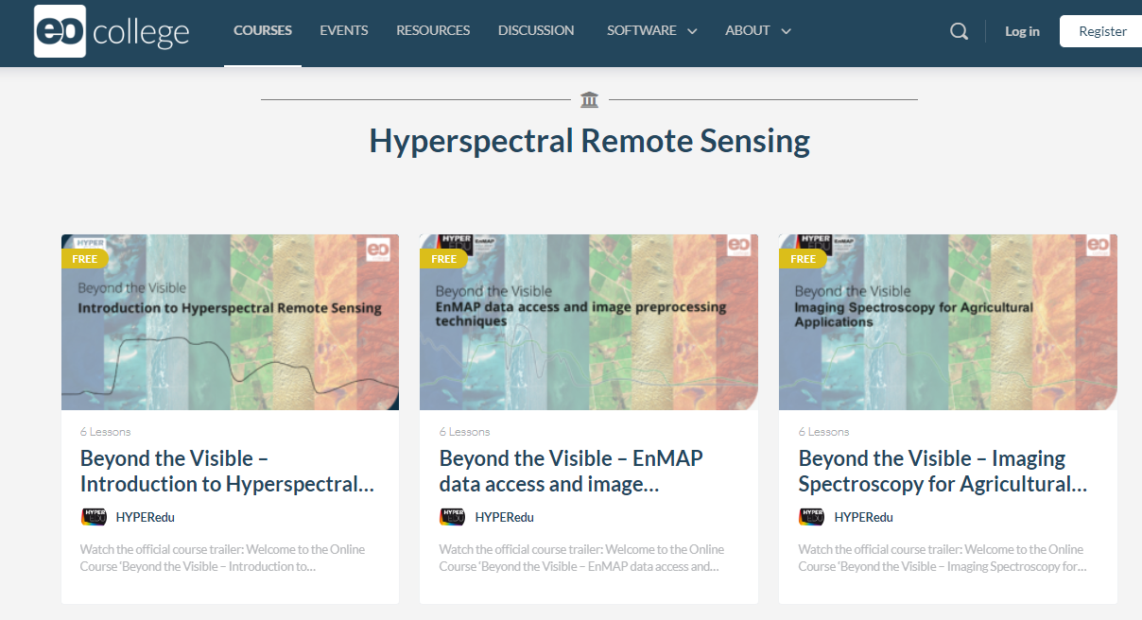
4.2 ESA Learning Hub
https://learninghub.esa.int/
The ESA Learning Hub, managed by the SME section in ESA's Directorate of Commercialisation, Industry, and Procurement, is an online platform providing industry stakeholders and delegations access to training courses and materials associated with ESA programs. As a central repository aligned with ESA activities, it aims to enhance European industry growth by supplementing core knowledge, competencies, and overall competitiveness.
4.3 EO College
https://eo-college.org/
The EO College serves as a central hub for digital learning content focused on Earth observation, remote sensing, and related subjects. This platform is specifically designed to function as a repository for open educational resources and online courses. In essence, it acts as a comprehensive source for individuals seeking to enhance their knowledge and skills in the field of EO through digital learning materials.

Slide 18
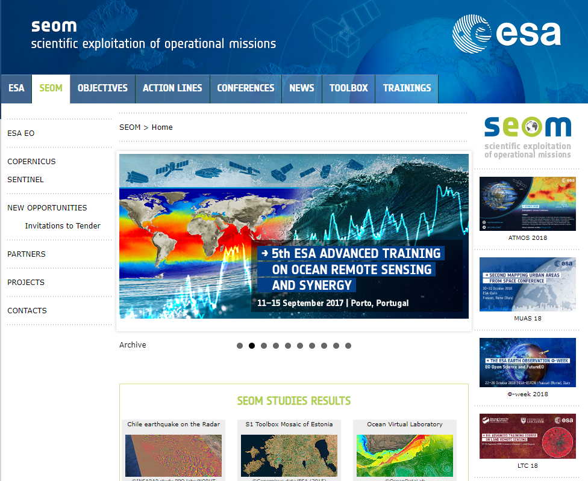
4.4 SEOM (Scientific Exploitation of Operational Missions)
https://seom.esa.int/
The primary goal of the SEOM component within the Earth Observation Envelope Program 4 is to unite, assist, and extend the extensive international research community established through the ERS, ENVISAT, and Envelope programs over the past two decades. Its objective is to enhance the global leadership of the European Earth Observation research community by facilitating comprehensive utilization of observations from upcoming European operational EO missions. SEOM aims to empower the scientific community to explore numerous new avenues of research made possible by the free and open access to data from operational EO missions.

Slide 19
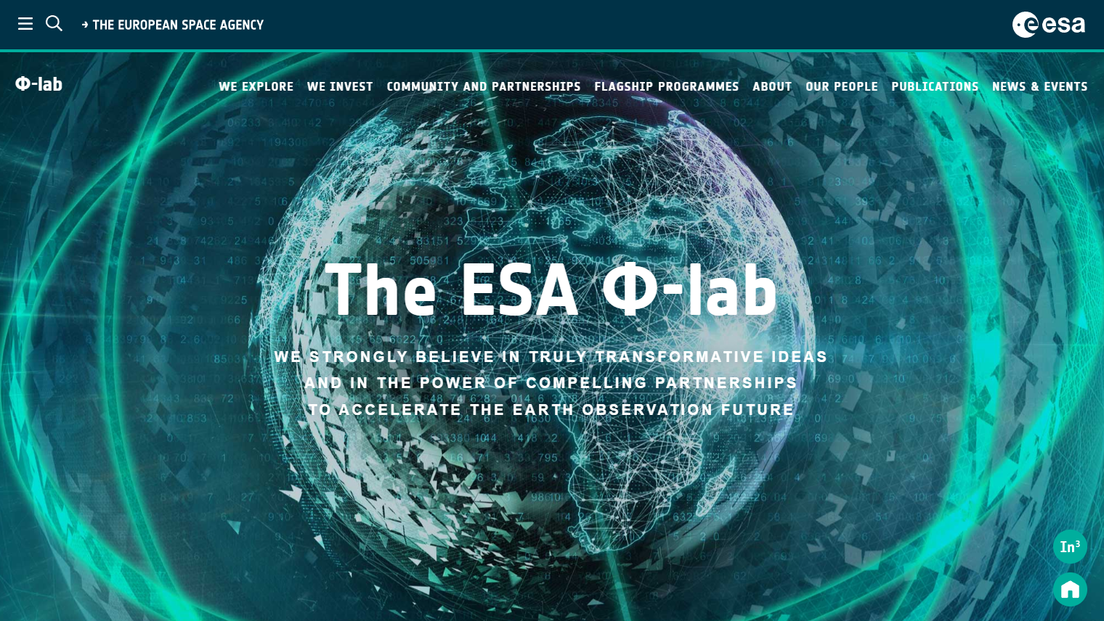
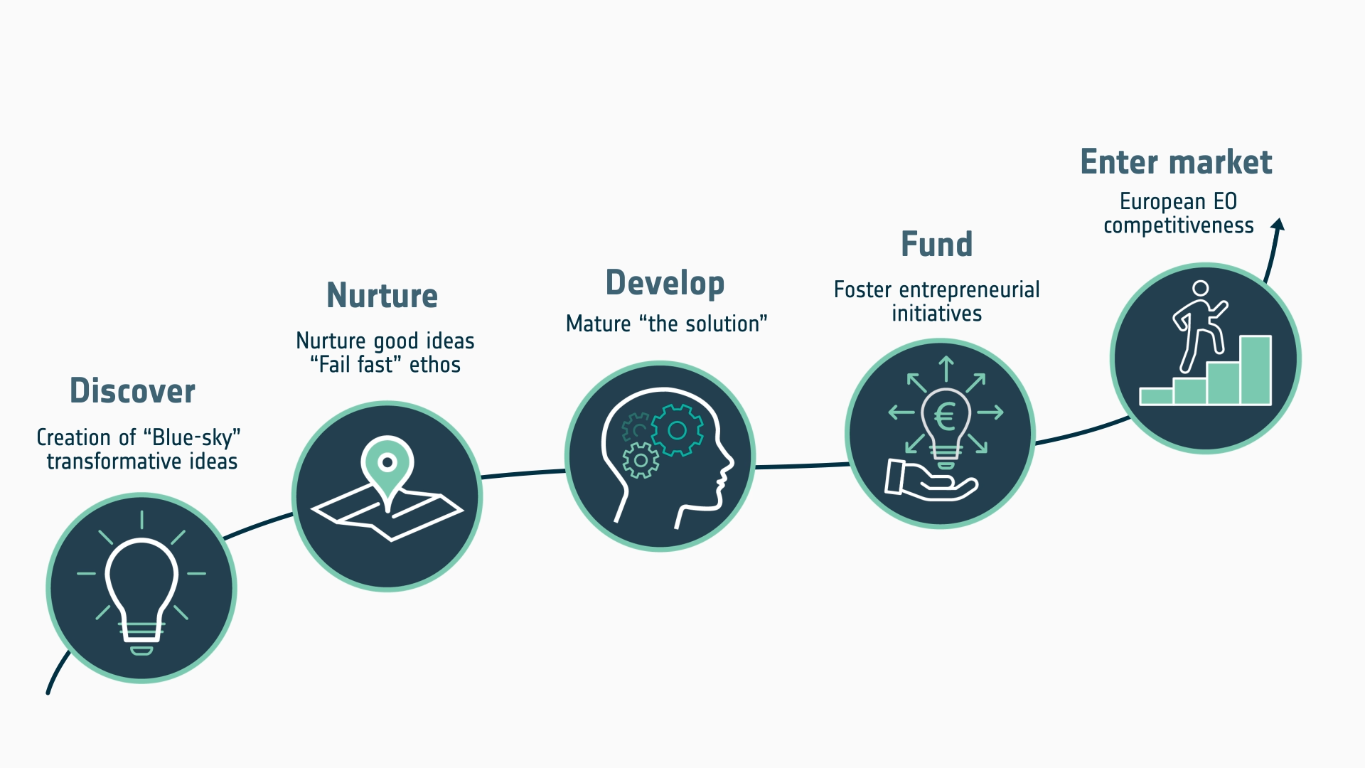
5 | Future of EO - ESA Φ-lab
The primary objective of ESA's Φ-lab initiative is to accelerate the future of Earth Observation (EO) by fostering transformative innovations. These innovations have the potential to revolutionize or establish entire industries through novel technologies, ultimately enhancing the global competitiveness of the European EO industrial and research sectors.

Slide 20
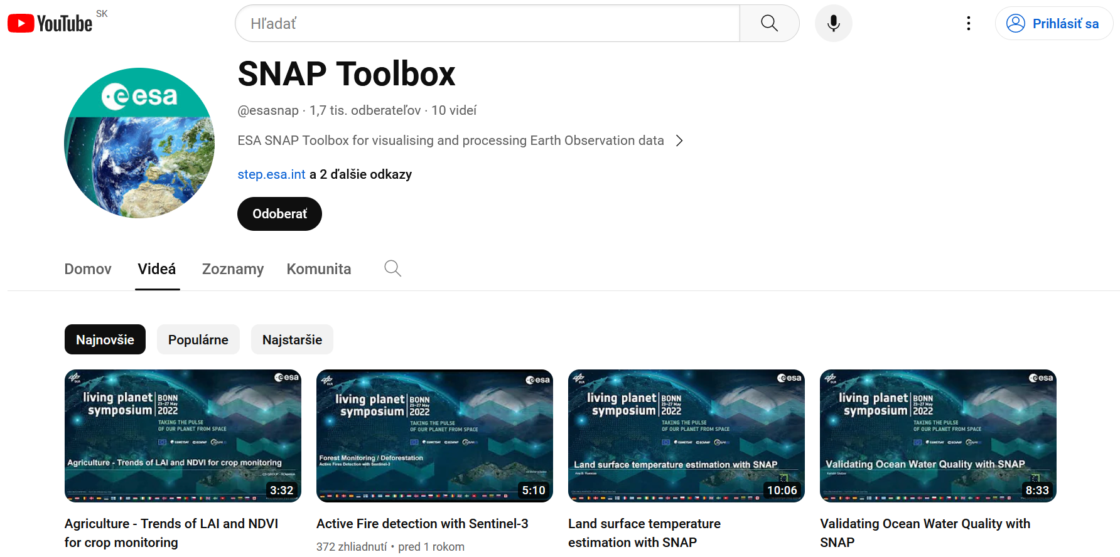

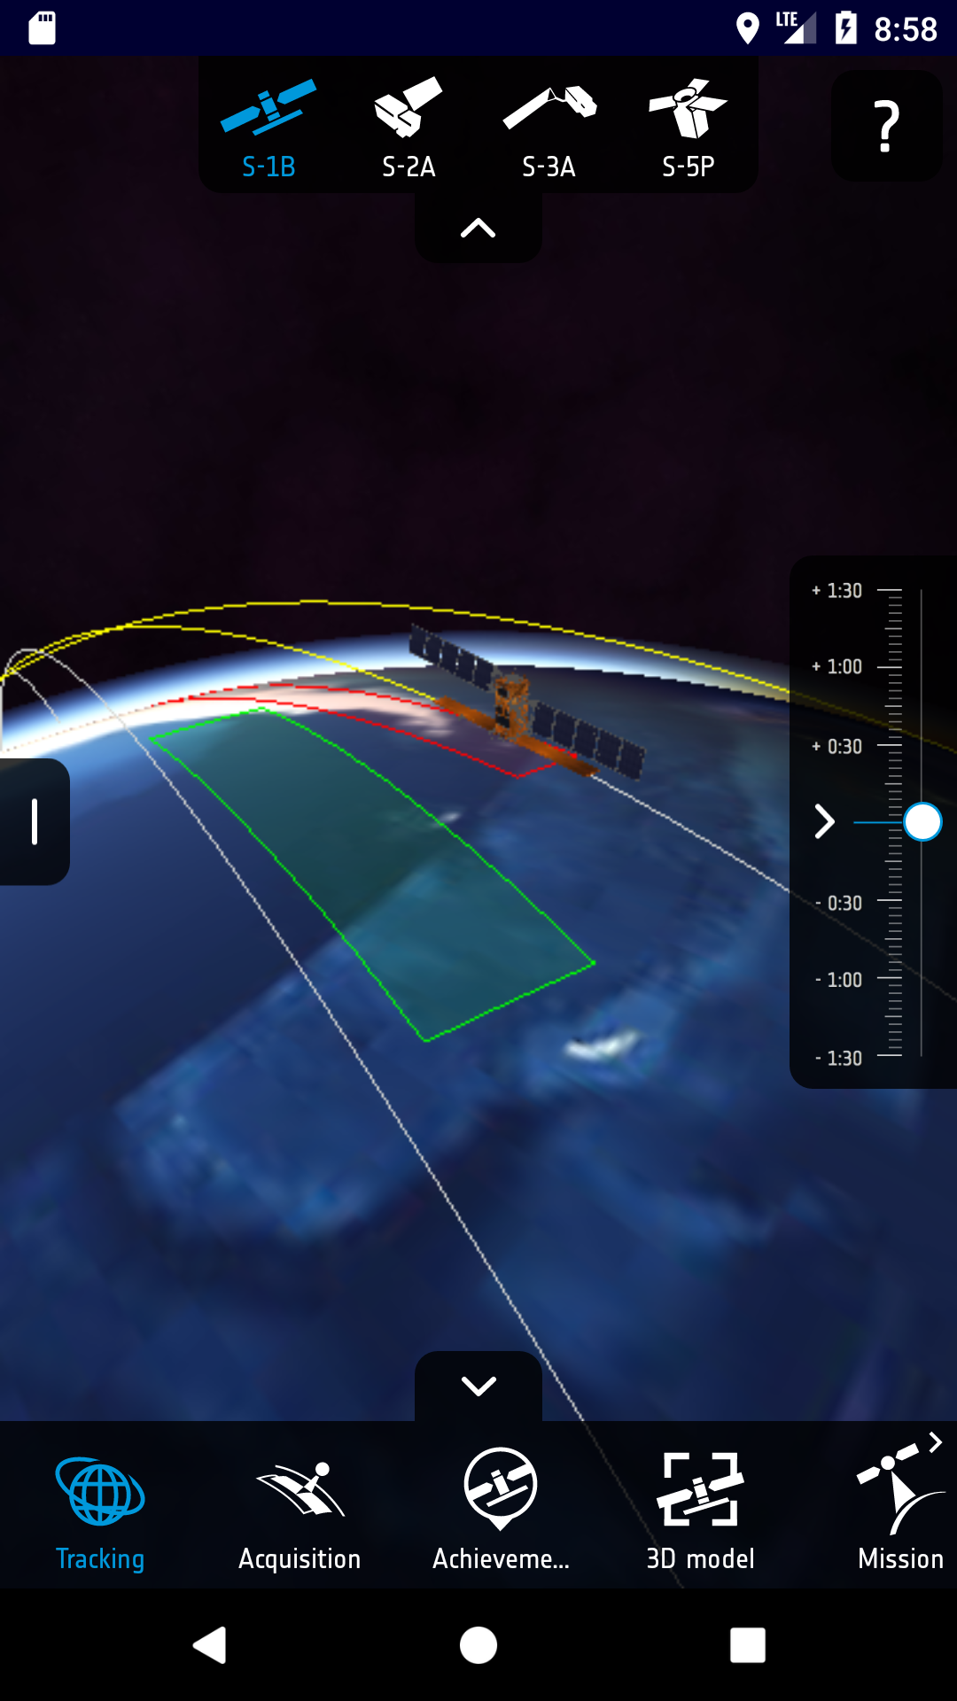
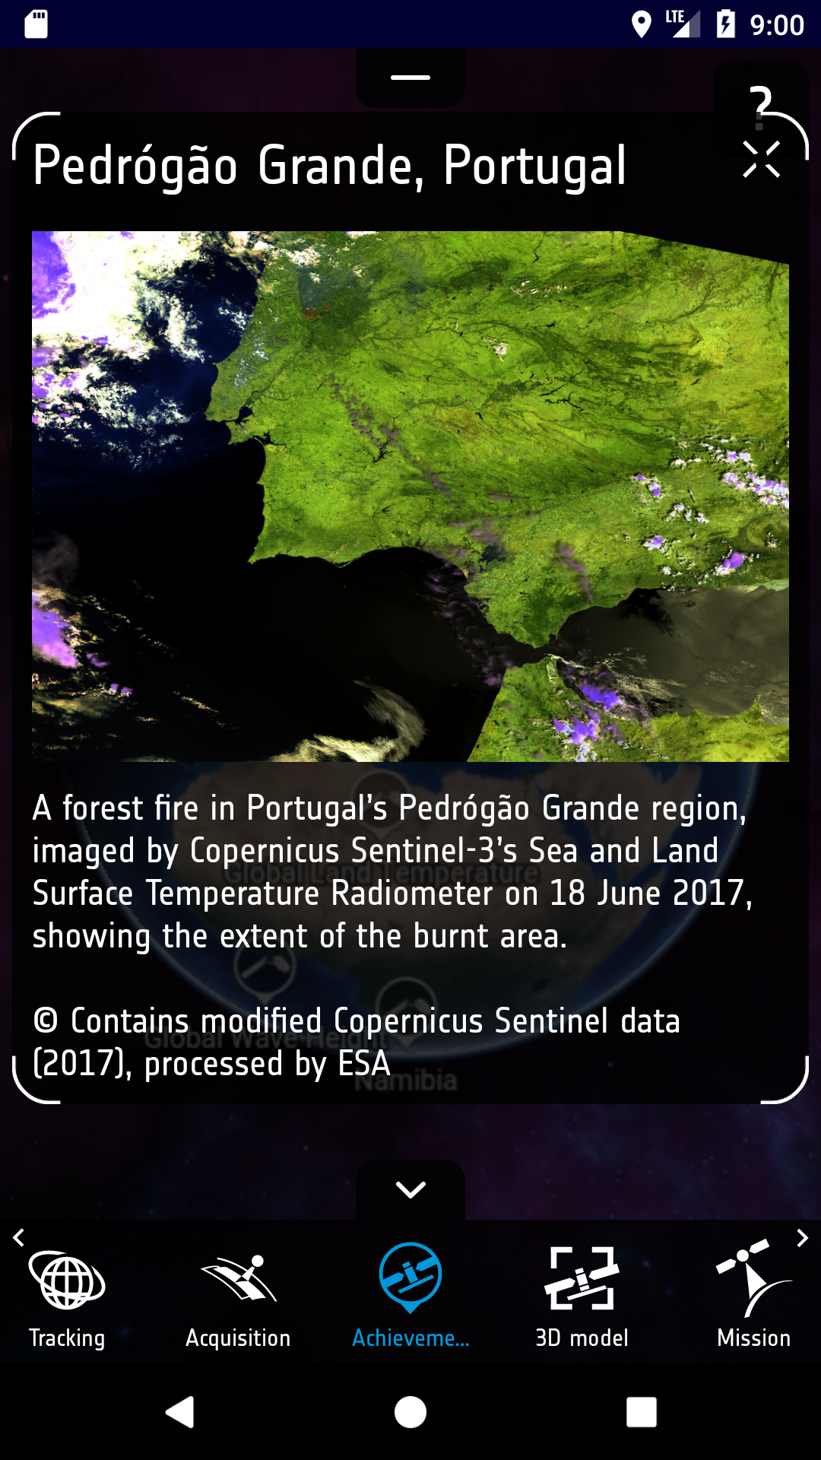
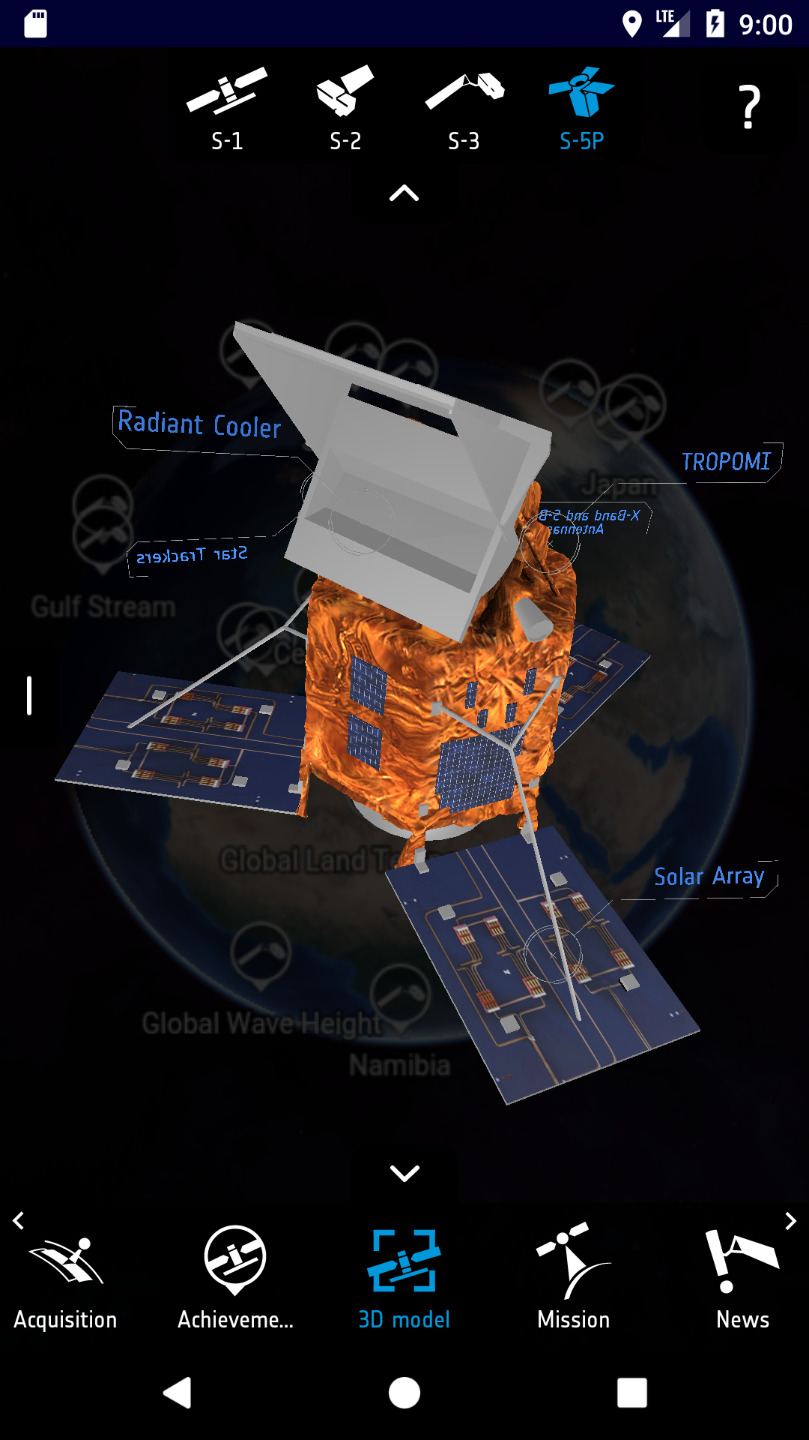


6 | Video lectures and tutorials, Sentinel App
SNAP Toolbox
There are various tutorials and guides available on YouTube that cover the use of the SNAP (Sentinel Application Platform) toolbox, such as SNAP Toolbox. SNAP is developed by the European Space Agency (ESA) and is used for the analysis and processing of remote sensing data, particularly data from the Sentinel missions.
Sentinel App
The Sentinel App serves as a portal for gaining insights into the Copernicus Sentinel satellites. It enables users to monitor the satellites in real-time, access information on their essential features, stay updated with the latest news, and delve into details about their offerings. Among its features, users can explore intricate 3D representations of the satellites, observe the past and upcoming instances when the satellites will be visible from their location, etc.
THANK YOU FOR FOLLOWING THE EXERCISE!

Slide 21

ESA contract 4000140187/23/NL/SC/rp (ENEUM)
FUNDED BY EUROPEAN SPACE AGENCY UNDER THE PLAN FOR EUROPEAN COOPERATING STATES, 7TH CALL FOR SLOVAKIA

