Slide 1


SURGE: Simulating the cooling effect of urban greenery based on solar radiation modeling and a new generation of ESA sensors.
Pavol Jozef Šafárik University in Košice (UPJŠ), Slovakia
Jaroslav Hofierka , Michal Gallay jaroslav.hofierka@upjs.sk, michal.gallay@upsj.sk, +421552342453
INSTITUTE OF GEOGRAPHY
Faculty of Science UPJŠ Košice
PECS Progress Presentation
Final Review
15 November 2018

Slide 2







<Insert Project Name>
Pavol Jozef Šafárik University in Košice, Šrobárova 2, 041 54
Košice, Slovakia, fax: +421-55-6222124, tel.: +421-55-234-2453
ESA Budget:
Co-funded Budget:
50 k€
0 k€
Contract No.: 4000117034/16/NL/Nde / Proposal: SK1-04
Year of Contract: 2016
ESA TO: Maite Trujillo (IPL-IPS)
TRL
Initial: 2
Achieved: 3
Target TRL: 3 Date: 09/2018
Background and justification: Estimating heat transfer in complex urban environment is a highly demanded task for urban planning while the contemporary climate changes on global scale. Urban greenery has a considerable effect on cooling the urban environment during heat waves. Sentinel 2 (S2) mission could become a potential means for quantified assessment of different urban scenarios where vegetation plays essential role as the S2 data provide higher spatial and temporal resolution than is enabled by other similar missions. This feasibility study is na important step towards exploiting the potential of S2 in connection with virtual 3D city models for simulating the cooling effect of urban greenery.
Objective(s): The main objective was to define a methodical approach for spatial modelling of land surface temperature based on modelling the solar irradiation and parameterizing the land cover properties from S2 data. While solar irradiation can be precisely calculated on a fine scale using virtual 3D city models other important parameters for land surface temperature modelling are difficult to ascertain, such as surface thermal emissivity, broad-band albedo and evapotranspiration. The approach was tested in an area comprising 4 sq. km of the central part of the Košice City in Slovakia.
Achievements and status: Virtual 3D city model of the study area was generated from airborne lidar and photogrammetric data acquired in a single mission. A time-series of Sentinel 2 data was gathered to be compared with a reference time-series of terrestrial lidar (TLS) data of urban greenery on 4 small sites. Statistical linear relationship was defined between the vegetation metrics derived from Sentinel 2 and TLS data. A geobotanical database of urban trees was generated based on field survey. Algorithmic structure of a toolbox for modelling the land surface temperature in GRASS GIS was developed based on the Stefan-Boltzmann law and Kirchhoff rule. The use of Sentinel 2 data for estimating albedo, emissivity and solar transmittance was demonstrated. Roadmap for implementing the toolbox into the open-source GRASS GIS was proposed.
Benefits: The primary benefits are in the developed algorithm for estimating the land surface temperature in a GIS environment providing a unique platform (i) for integrating various kinds of datasets to become usable in urban planning and (ii) for exploitation of the Sentinel 2 data in mitigation of the urban heat island.
Next steps: The following phase will be in development of a compact specialized software toolbox to be implemented in open-source GRASS GIS. The roadmap suggest a 2-year period for including software design and coding, software testing and verification using validation datasets and implementation in GRASS GIS. We suggest further development based on the Tangible Landscape concept that should improve the communication and data interaction between user and model leading to increased applicability of the model in urban planning and city management

Slide 3
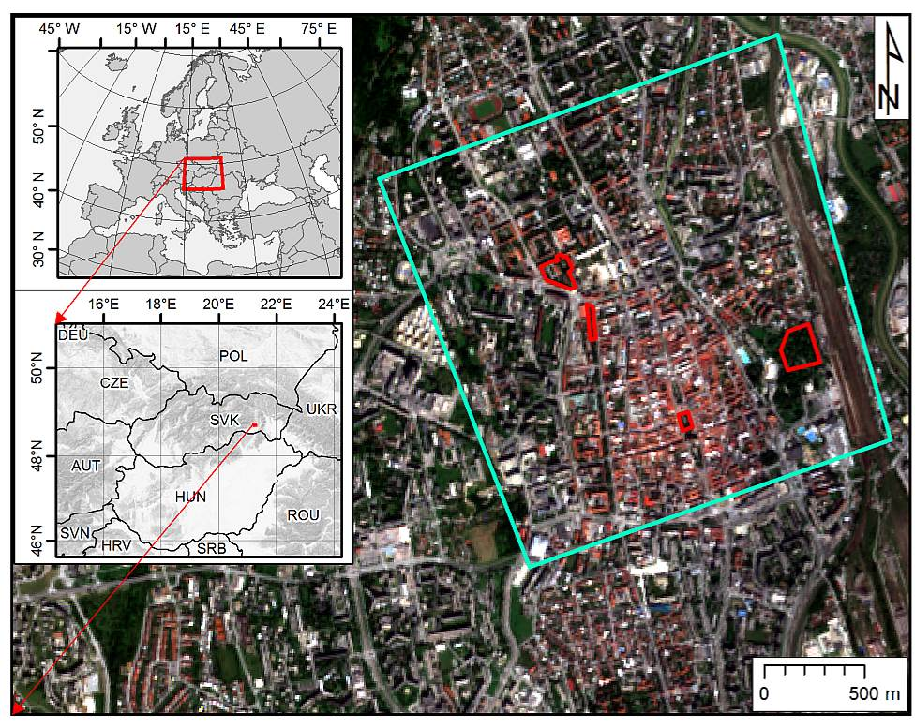
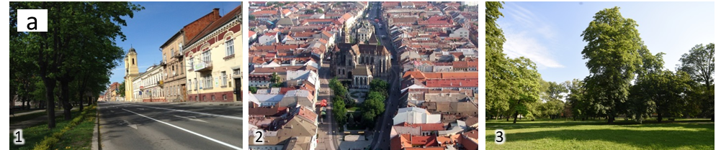
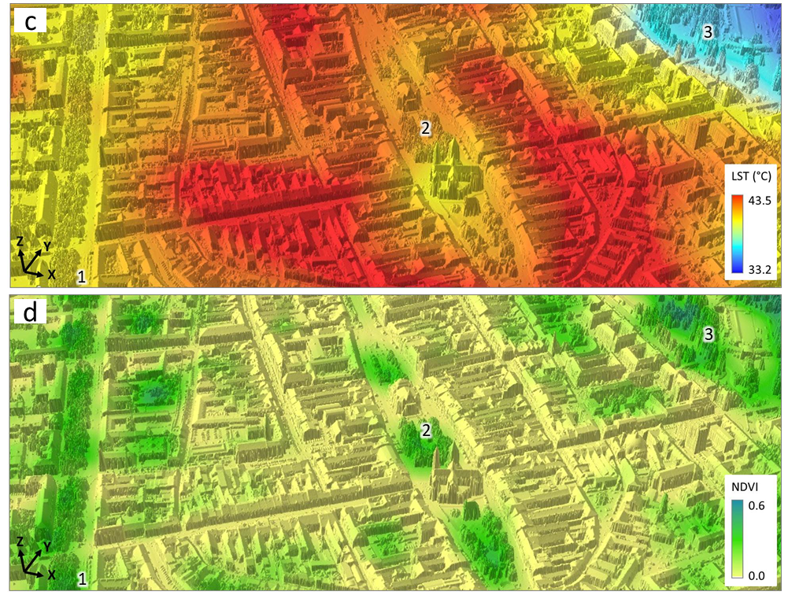
Summary of Objectives
Simulate the cooling effects of urban greenery via modelling the spatial distribution of solar irradiation in a complex urban environment represented by a virtual 3-D city model and data derived from Sentinel 2 multispectral imagery.
Košice: city centre

Slide 4
Summary of Objectives
Technical objectives
Evaluation of Sentinel-2 data for urban greenery periodic mapping;
Generate a high-resolution virtual 3-D city model and time series of 3-D models of urban greenery;
Derive reference vegetation metrics based on the time series of 3-D models of urban greenery and define their correlation with vegetation metrics based on multispectral Sentinel 2 satellite imagery;
Downscale the S2 vegetation metrics to a higher resolution based on the 3-D city model and 3-D greenery time series;
Develop an algorithm to calculate land surface temperature exploiting the potential of Sentinel 2 imagery and 3D city model. Simulate the cooling effect of urban greenery in a GIS environment (proof-of-concept).

Slide 5
Contract Schedule

Slide 6

Contract Schedule

Slide 7
Main Technical Developments
Virtual 3D city model of the study area was generated.
Multispectral data products of the Sentinel 2A and Landsat 8 sensors downloaded, applicability analysed.
Time series of terrestrial laser scanning data representing of urban vegetation on four smaller sites with high resolution and high accuracy.
Algorithmic structure for spatial modelling of land surface temperature and simulating the cooling effect of vegetation
Road map for validation and implementation of the algorithm
Partial results of the SURGE project were presented on international conferences, events and got published.

Slide 8
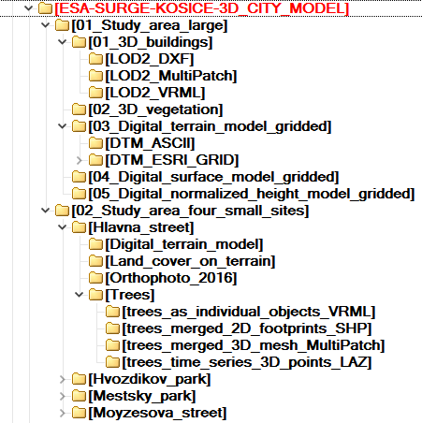
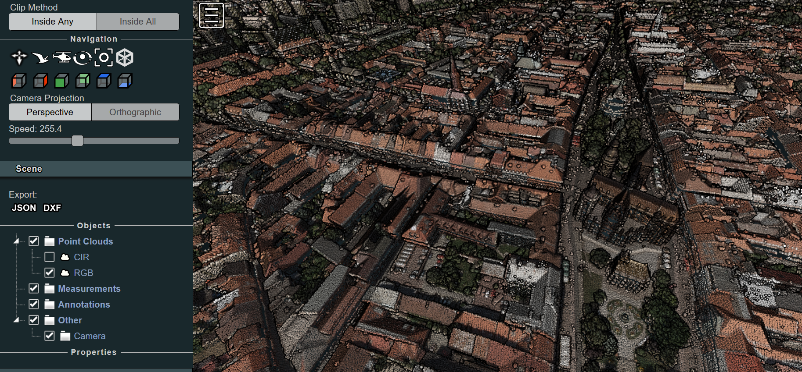
Main Technical Developments: WP2
Virtual 3D city model of the study area
The acquired airborne laser scanning data, photogrammetric orthoimagery, and vector based 3-D city model were integrated and harmonized into a geodatabase covering the study area.
https://uge.science.upjs.sk/webshared/ESA_Publish/ESA_Kosice.html

Slide 9
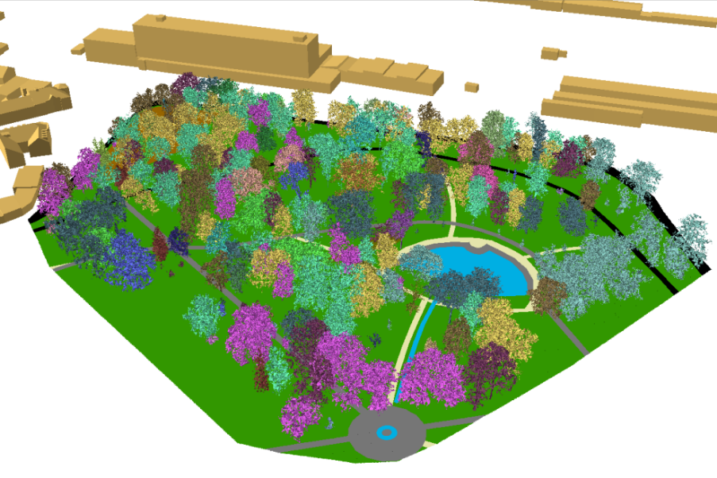
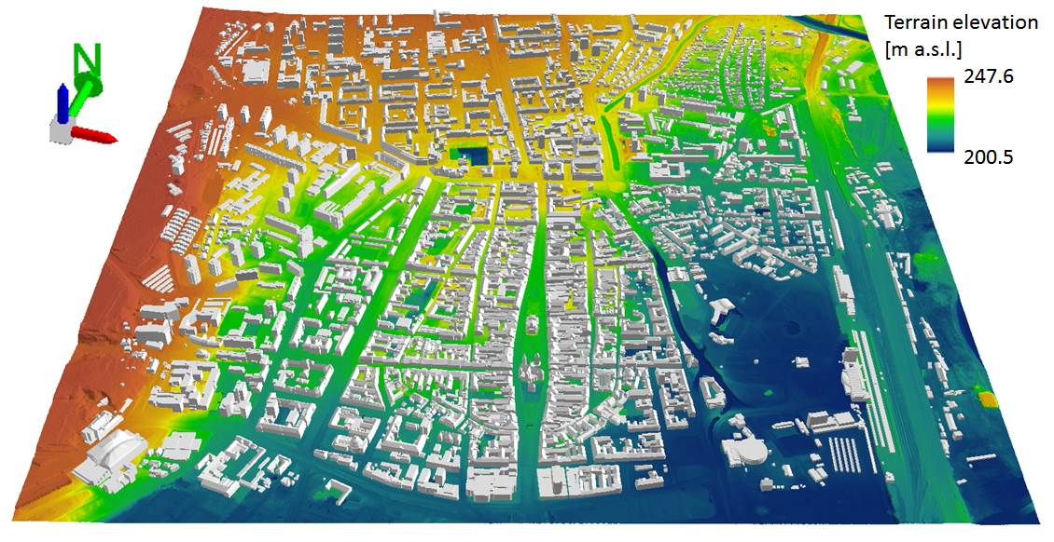
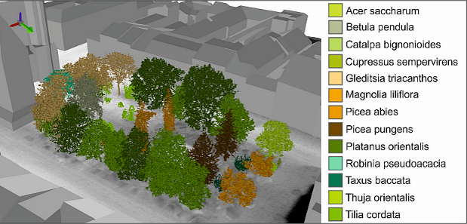
Main Technical Developments: WP2
Virtual 3D city model of the study area

Slide 10
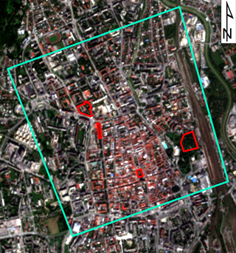
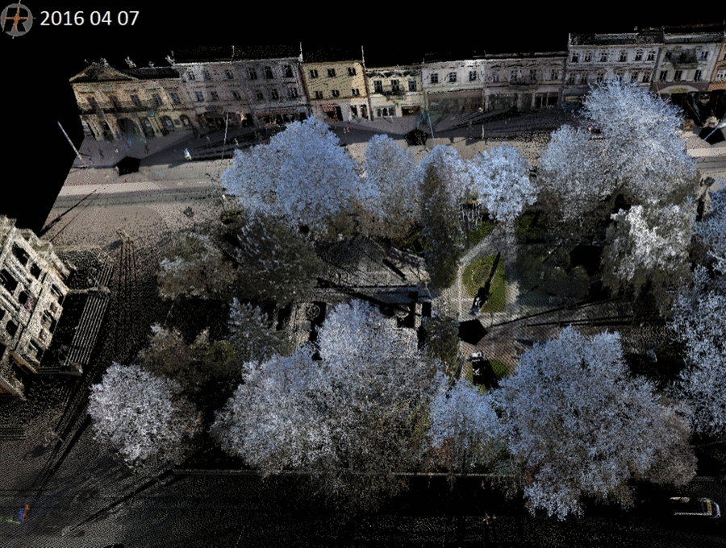
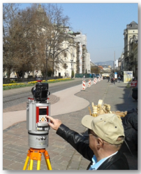
Main Technical Developments: WP2
Time series of terrestrial laser scanning data
representing of urban vegetation on four smaller sites with high resolution and high accuracy. Synchronised with Sentinel 2A +/- 1-2 days.
RIEGL VZ-1000

Slide 11
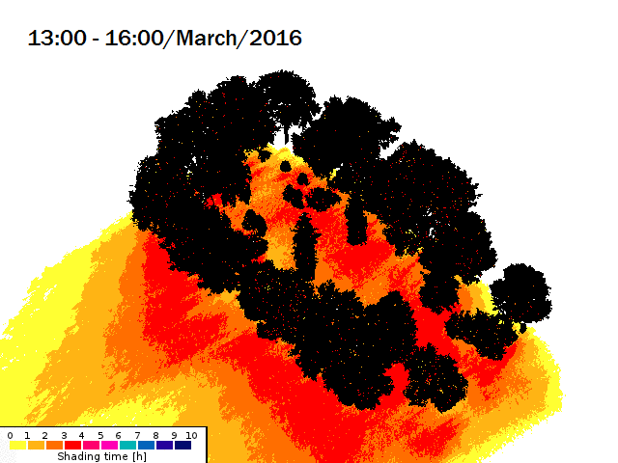
Main Technical Developments: WP2
Time series of terrestrial laser scanning data
Simulation of shadowing effects by 3D tree models
Time of area in shadow
Hlavná ulica, Košice
HOFIERKA, J., GALLAY, M., KAŇUK, J., ŠUPINSKÝ, J., ŠAŠAK, J. (2017). High-resolution urban greenery mapping for micro-climate modelling based on 3D city models. ISPRS Archives, XLII-4/W7, 7-12. (3D Geoinfo Conference, Melbourne, Australia)

Slide 12
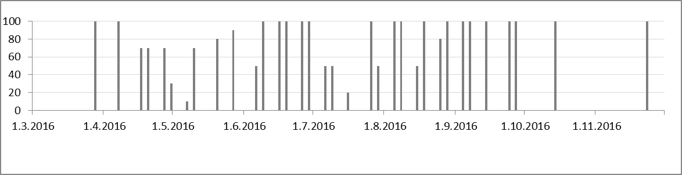
Main Technical Developments: WP2
Košice
Multispectral data products of the Sentinel 2A and Landsat 8 sensors downloaded, applicability analysed.
Sentinel 2 data time series for vegetation metrics calculation.

Slide 13
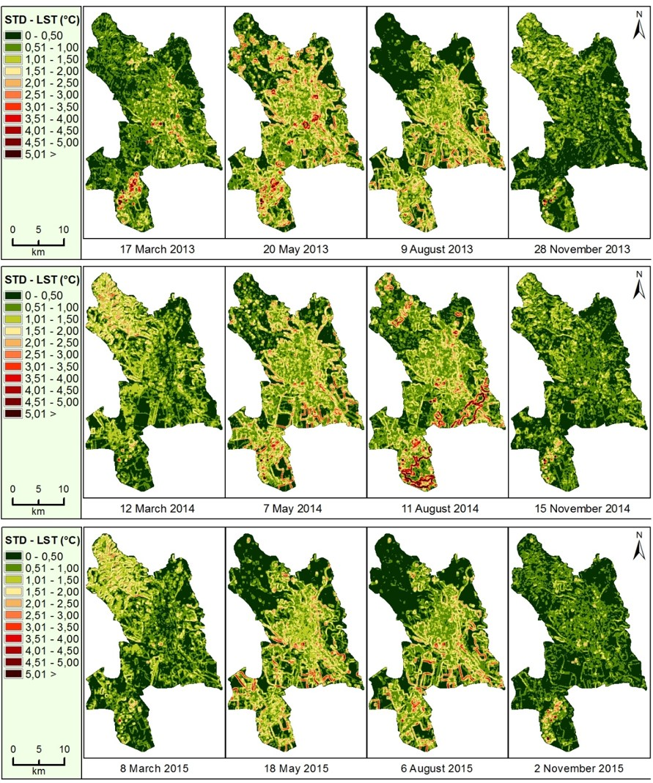
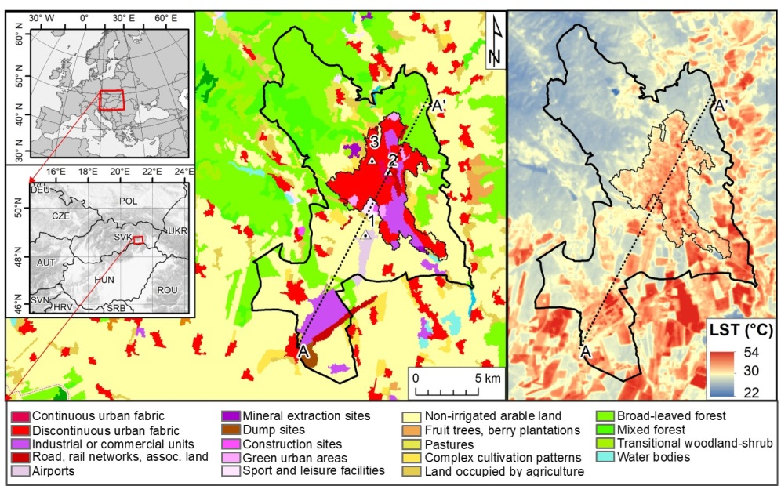
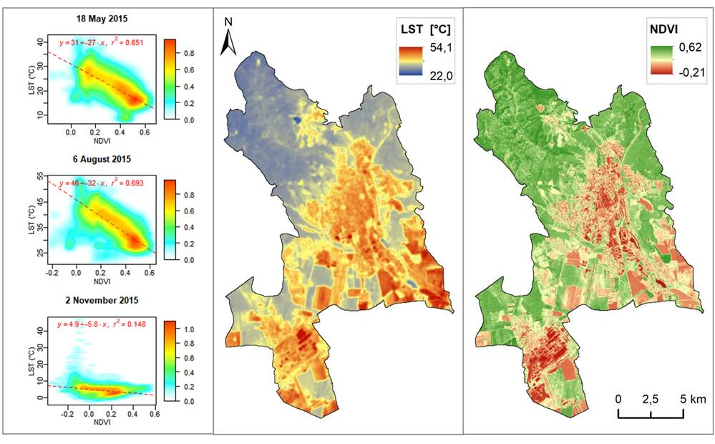
Main Technical Developments: WP2
Multispectral data products of the Sentinel 2A and Landsat 8 sensors downloaded, applicability analysed.
Košice
ONAČILLOVÁ, K., GALLAY, M. 2018. Spatio-temporal analysis of surface urban heat island based on LANDSAT ETM+ and OLI/TIRS imagery in the city of Košice, Slovakia. Carpathian Journal of Earth and Environmental Sciences. 13(2), 395 - 408.

Slide 14
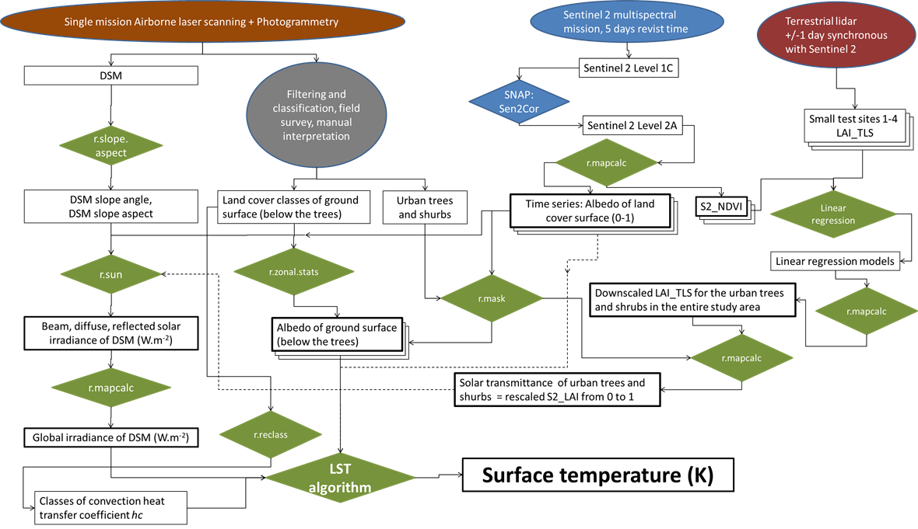
Main Technical Developments:WP3
Novel algorithmic structure for spatial modelling of land surface temperature and simulating the cooling effect of vegetation
procedure is based on the Stefan-Boltzmann Law, which describes the power radiated from a black body in terms of its temperature.
The key inputs of the LST calculation comprise spatially distributed global solar irradiation of a DSM, convective heat transfer coefficient of the surface material, albedo of the surface and the emissivity of the material.
We assumed ideal atmospheric conditions for deriving LST in various scenarios with and without urban greenery.

Slide 15
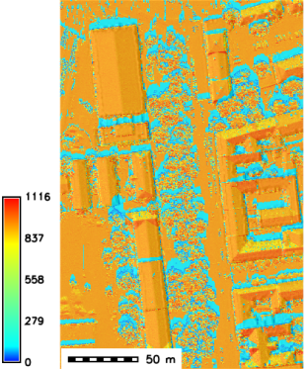
Main Technical Developments: WP3
Novel algorithmic structure for spatial modelling of land surface temperature and simulating the cooling effect of vegetation
Surface albedo and surface emissivity derived from Sentinel 2 Level 1C product for the site 1 for 14 September 2016.
Inputs: Lidar based digital surface model (DSM) of the area of Moyzesova street in Košice (site 1 in Fig. 1) including buildings (upper row) and vegetation (bottom row) which was used to calculate global solar irradiance. The area size is 200 m by 400 m. DSM cell size 0.50 m.
Stefan-Boltzmann Law
Global clear-sky irradiance [W.m -2]

Slide 16
Main Technical Developments: WP3
Novel algorithmic structure for spatial modelling of land surface temperature and simulating the cooling effect of vegetation
Modelled temperature of ground surface (kelvins) in site 1 - Moyzesova street, without and with implementing vegetation transmittance downscaled from linear regression model os S2_NDVI vs. LAI_TLS for 30 June 2016 at 9:20 AM of UTC, 10:20 zonal time.
In the first two images DSM of terrain and building surface is used and albedo is derived for the ground land cover below the trees. In the latter two images, DSM of terrain, buildings and trees is used and albedo of the land cover canopy surface was used.
HOFIERKA, GALLAY, ... 2019: New tool for physically based land surface temperature modelling in GIS. IEEE Geoscience and Remote Sensing Letters. In preparation.

Slide 17
Main Technical Developments: WP3
Novel algorithmic structure for spatial modelling of land surface temperature and simulating the cooling effect of vegetation
Modelled temperature of ground surface (kelvins) in the entire study area of Košice without and with implementing vegetation transmittance downscaled from linear regression model os S2_NDVI vs. LAI_TLS for 30 June 2016 at 9:20 AM of UTC, 10:20 zonal time.

Slide 18
Main Technical Developments: WP4
Roadmap for a future GRASS GIS module that will simulate land surface temperature using the methodology developed in this project.

Slide 19

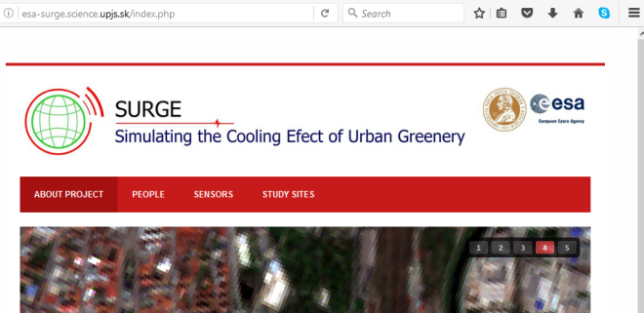
Main Technical Developments WP1: Study management
Team meetings
June 2016
Sept 2017
Jan. 2017
May 2017
Sept. 2017
April. 2018
GIS Ostrava 2017
Conference, CZE
3D geoInfo Conference
Melbourne, Australia
GIS Ostrava 2018
Conference, CZE
Order/Delivery of airborne lidar/photogrammetry data for 3D city modelling
Copernicus Users Forum May 2017, Prague, CZE
Copernicus Day
Bratislava 2018, SVK
Project web-site
https://esa-surge.science.upjs.sk

Slide 20

Main Technical Developments WP1: Study management
Team meetings
April. 2018
Sep. 2018
Oct. 2018
D5, D6 – finished, submitted
D7-D9 - delayed submission of Final report, Executive Summary and Technical Data Package

Slide 21
Status of Technical Notes - Submission
Work package / Responsible person | Activities/Tasks | Status | Date due
WP1: Study management Jaroslav Hofierka | Meetings of the project team | Finished | Sept. 2018
 | WP1 Progress report 1 & 2 (D3) WP1 Technical data Package (D7) WP1 Final report (D8) WP1 Executive sumamry report (D9) | Finished In progress | Dec. 2016 Nov. 2018
WP2: Data, methods and architecture of the system Michal Gallay | Review of the state-of-the-art on vegetation transmittance (D1) | Finished | Dec. 2016
 | Generated 3D city model (D2) | Finished | May 2016
 | Generation of 3D time series of urban greenery | Finished | Sep. 2017
 | Gathering of Sentinel 2A imagery | Finished | Dec. 2017
 | Preparing input data for 3D solar modelling | Finished | March 2018
 | Report on derivation of satellite based vegetation metrics and downscaling to high-resolution data (D4) | Finished | April 2018
WP3 - Testing, validation and viability of the system/model Jaroslav Hofierka | Report on definition of algorithmic structure of the toolbox (D5) | Finished | Sept. 2018
WP4 - Roadmap for further implementation Jaroslav Hofierka | Roadmap report on implementation of the toolbox (D6) | Finished | Sept. 2018

Slide 22
Summary of Main Achievements
Virtual 3D city model of the Košice City centre (4 km²)
  buildings LoD2
  geobotanical geodatabase of urban greenery
Time series of TLS 3D point clouds representing urban greenery
Novel algorithm of spatial distributed and physically based modelling of land surface temperature in GIS (proof-of-concept)
  Sentinel 2 data useful for estimating albedo and thermal emissivity
  Sentinel 2 data useful for estimating solar transmittance of urban greenery

Slide 23
Summary of Main Achievements
Presentations: Copernicus Days – Czech Republic 2017, Slovakia 2018
Publications:
HOFIERKA, J., GALLAY, M., KAŇUK, J., ŠUPINSKÝ, J., ŠAŠAK, J. (2017). High-resolution urban greenery mapping for micro-climate modelling based on 3D city models. The International Archives of the Photogrammetry, Remote Sensing and Spatial Information Sciences (ISPRS Archives), XLII-4/W7, 7-12. (3D Geoinfo Conference, Melbourne, Australia)
KAŇUK, J., GALLAY, M., HOFIERKA, J., ŠAŠAK, J., ŠUPINSKÝ, J., SEDLÁK, V., GESSERT, A., 2017. Monitoring dynamics of urban greenery for more accurate solar radiation mdoelling in urban landscape. In: Inspektor, T., Horák, J., Růžička, J. (Eds.) Symposium GIS Ostrava 2017, Geoinformatika v pohybu, 22. - 24. March 2017. VŠB - Technická univerzita Ostrava, Czech Republic.
ONAČILLOVÁ, K., GALLAY, M. 2018. Spatio-temporal analysis of surface urban heat island based on LANDSAT ETM+ and OLI/TIRS imagery in the city of Košice, Slovakia. Carpathian Journal of Earth and Environmental Sciences. 13(2), 395 - 408.
ONAČILLOVÁ, K., GALLAY, M. 2018 : Analysing relation of vegetation metrics derived from Sentinel 2 data and laser scanning data. GIS Ostrava 2018.
HOFIERKA, GALLAY, ... 2019: New tool for physically based land surface temperature modelling in GIS. IEEE Geoscience and Remote Sensing Letters. In preparation.

Slide 24
Vision of the future
The proposed approach requires validation of resulting data layers
  Reference land surface temperature data
  More realistic heat transfer coefficient values
Implementation possible based on the proposed roadmap
  for a future GRASS GIS module that will simulate land surface temperature using the methodology developed in this project.
We are academic and research institution
Contribution for ESA foreseen in application and validation of Earth observation data, developing GIS tools for modelling natural phenomena with the data

