Slide 1
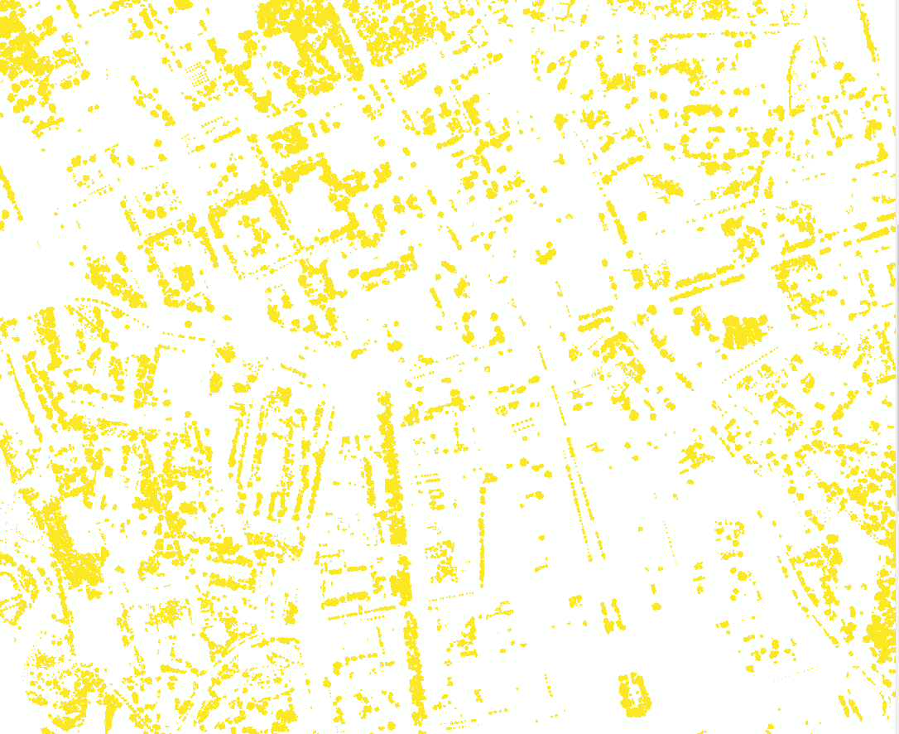
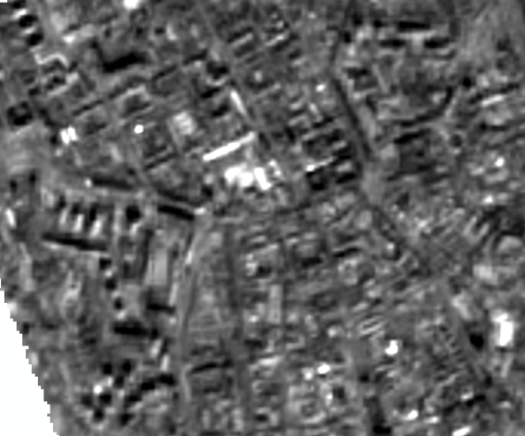
Con(IsNull("urban_trees_ALS_grid_05m_binary.tif"),"S2albedovanino20160914_sjtsk05.tif")

Slide 2
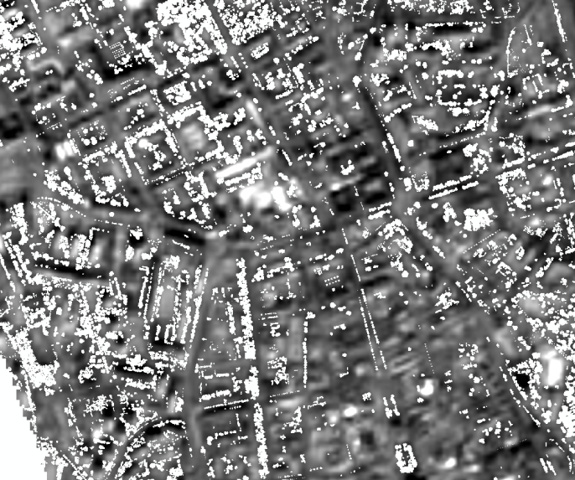
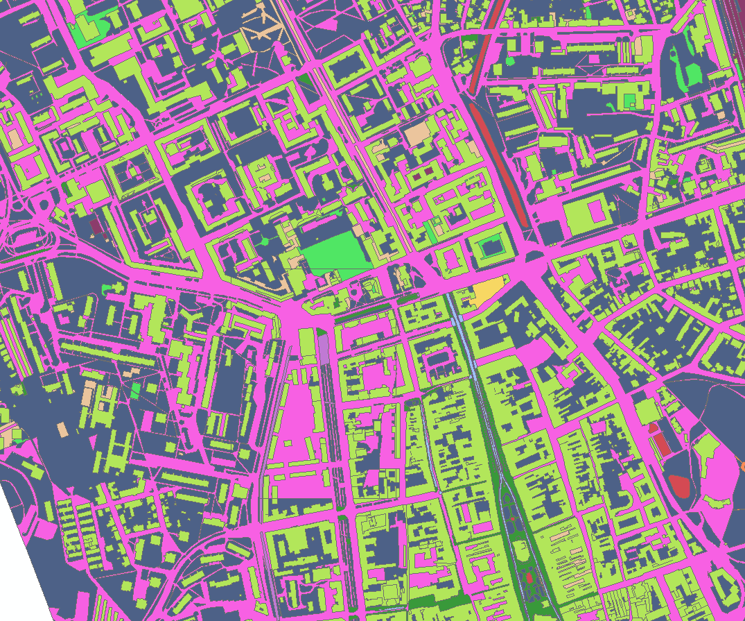
Mean albedo of land cover ground classes excluding the pixels of trees, based on Vanino 2018 approach for Sentinel 2

Slide 3
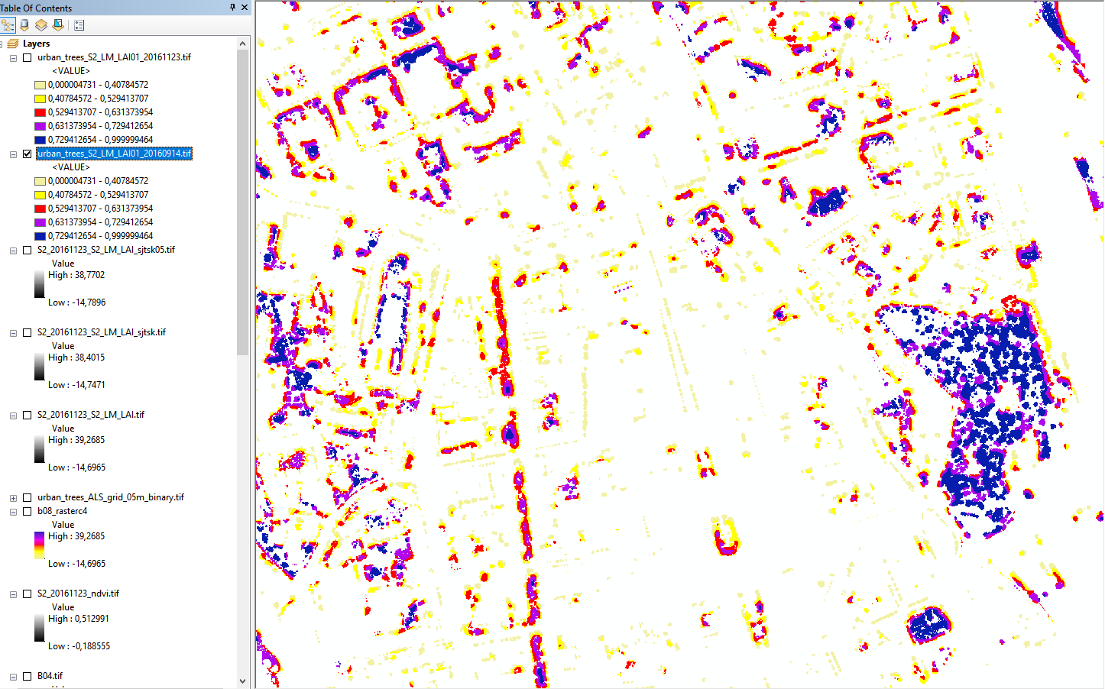
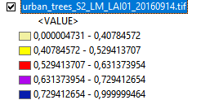
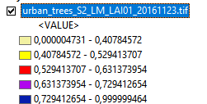
Transmitance from scaled LAI ((„urban-trees-S2-LAI" + max) * (1 - 0) / (max - min)) + 0
September
200 m
November
200 m
200 m

