Slide 1




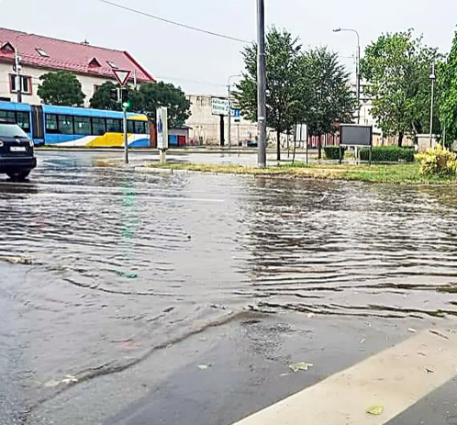
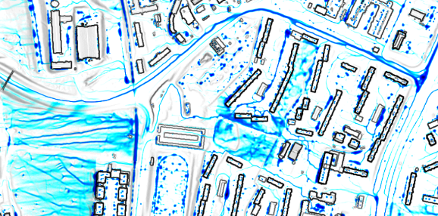

#AquaUrban Project: Innovative water retention solutions for improved quality of life in cities of Košice and Nyíregyháza
Project workshop, 16 May 2025, University of Nyíregyháza, Hungary
Simulating flash floods in Košice:
The role of geospatial modelling in innovative urban water management
Michal Gallay, Jozef Šupinský, Ján Šašak,
Petra Dávidová, Anton Uhrin
Institute of Geography, Faculty of Science
Pavol Jozef Šafárik University in Košice (UPJŠ)

Slide 2
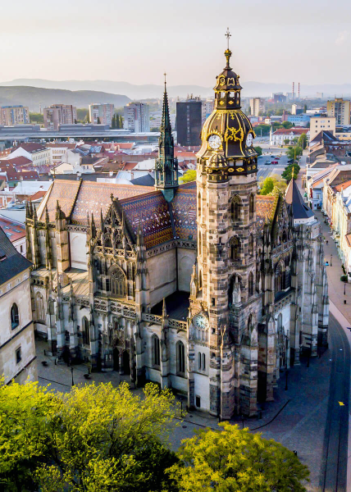
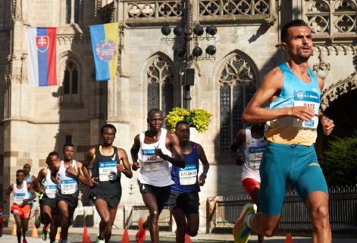

220 000 people, 20 000 students, 3 universities
Notes:
The gradutes do not need to leave our region to make the change of the world. The Košice IT Valley comprises 49 companies from small creative startups to big global bussiness players. The job market thrives after IT specialists, data analysts, medicians, material scientists, teachers.

Slide 3

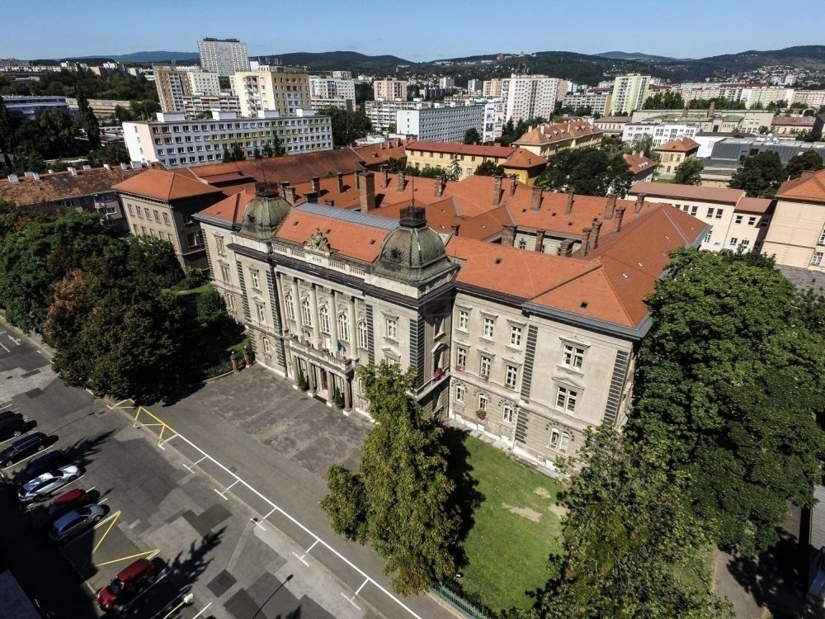
FACULTY OF SCIENCE
WWW.SCIENCE.UPJS.SK
INSTITUTE
OF GEOGRAPHY
WWW.UGE.SCIENCE.UPJS.SK
MICHAL GALLAY
MICHAL.GALLAY@UPJS.SK

Slide 4
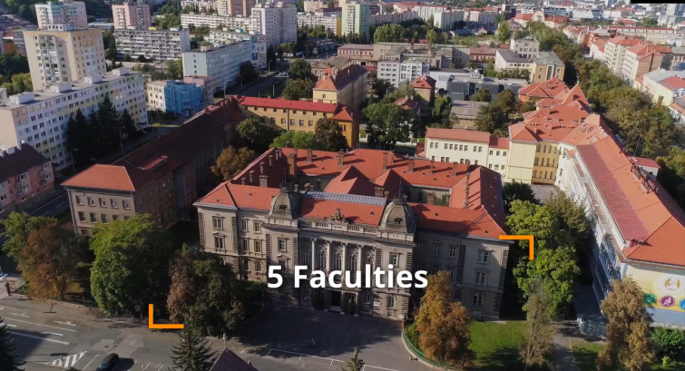

MEDICINE
SCIENCE
ARTS
LAW
PUBLIC ADMINISTRATION

Slide 5


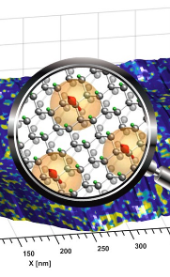
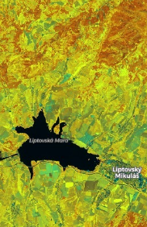
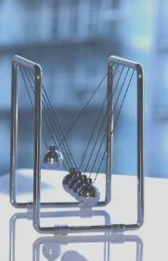



RESEARCH DRIVEN FACULTY MULTIDISCIPLINARY STRUCTURE
INSTITUTE
OF BIOLOGY
AND ECOLOGY
INSTITUTE
OF PHYSICS
INSTITUTE
OF CHEMISTRY
INSTITUTE
OF INFORMATICS
INSTITUTE
OF GEOGRAPHY
INSTITUTE
OF MATHEMATICS
52 acad.staff
55 acad.staff
46 acad.staff
21 acad.staff
16 acad.staff
26 acad.staff

Slide 6
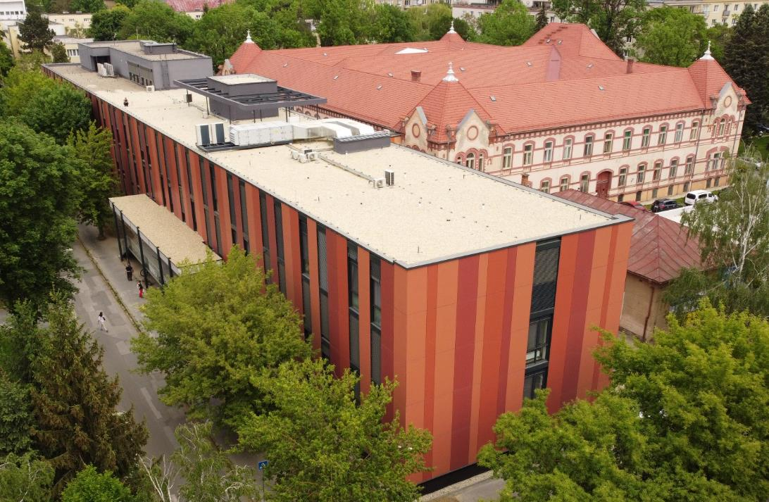
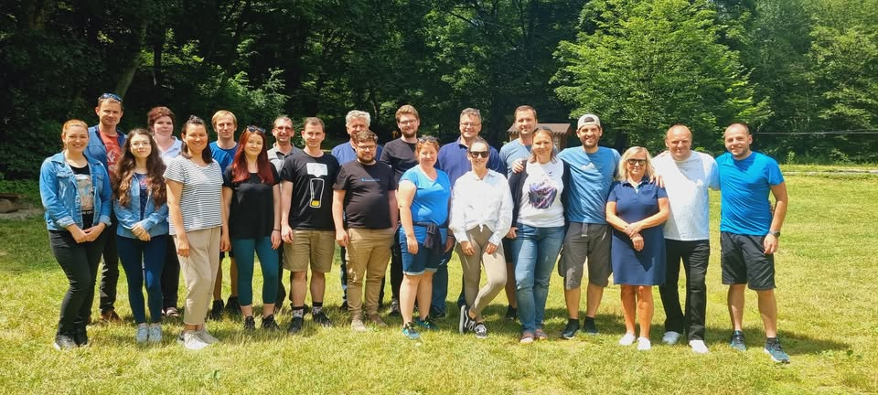
INSTITUTE OF GEOGRAPHY
48.728725° N, 21.248469°E
17 academic staff (1 prof., 5 assoc.prof., 3 res. assist., 7 researchers) + 1 admin. support staff
3 departments
  Department of Geoinformatics
  Department of Physical Geography
  Department of Human Geography
4 laboratories

Slide 7
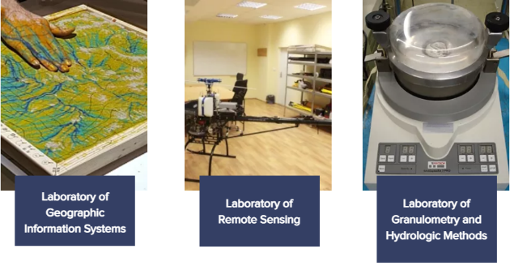

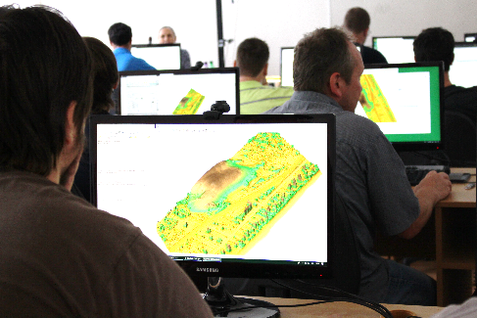
INSTITUTE OF GEOGRAPHY
Research & Education facilities
Geoinformatics & Remote Sensing: UAV lidar, hyperspectral mapping, solar radiation and urban heat modeling (UHI), flood simulation, geomorphometry, cave scanning, GRASS GIS development.
Physical Geography: Karst and Flysch landscapes, fluvial geomorphology, cave mapping, palaeogeography via sediment and mineral analysis.
Human Geography: Migration, population change, post-socialist regional transformation.
Geography Education: Innovative methods with GIS, remote sensing, and 3D printing for schools.

Slide 8
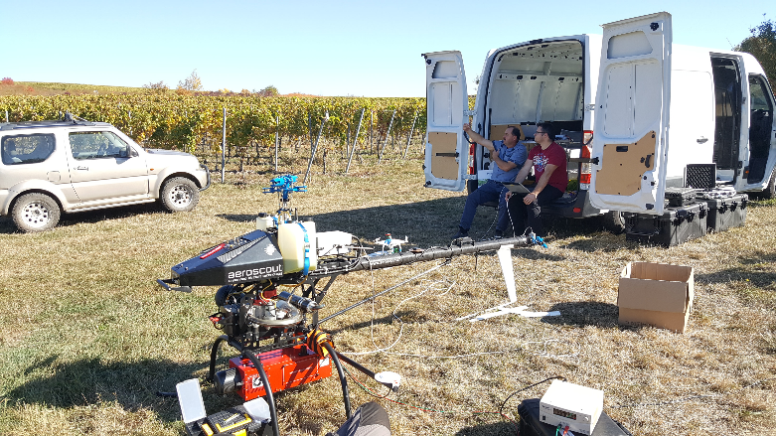
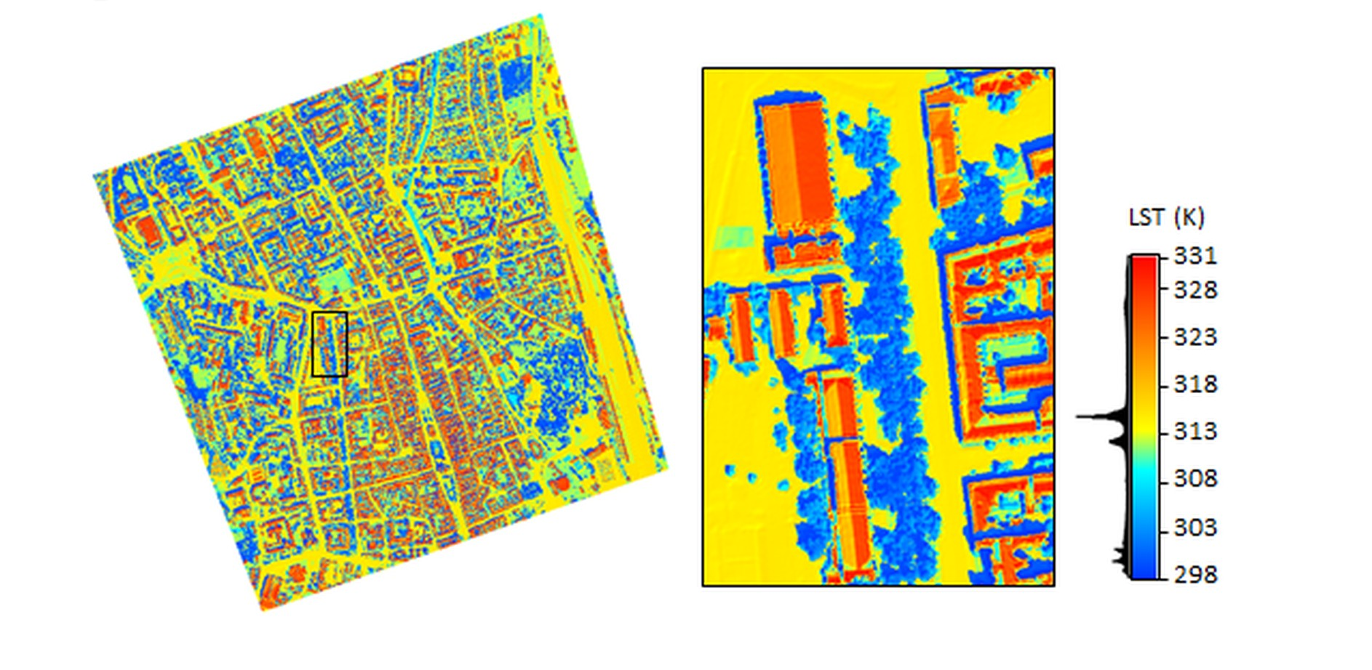
INSTITUTE OF GEOGRAPHY
International research projects
ESA – European Space Agency Projects
URBANA (2023–2024)Development and verification of urban analytics (in collaboration with Geomatics, Italy).
ENEUM (2023–2024)Enhancing Earth observation curriculum with a focus on ESA sensors.
SURGE (2016–2018)Simulating the cooling effect of urban greenery using a new generation of ESA sensors.
INTERREG Projects (Cross-border Cooperation)
GEOSES - Space Emergency Protection System (2019–2022) Monitoring hazardous natural and anthropogenic geoprocesses in the HU-SK-RO-UA region.
TOKAJGIS (2017–2020)Development of a webGIS platform using big geodata for the Tokaj Wine Region to foster cross-border collaboration.
https://www.uge.science.upjs.sk/projekty

Slide 9
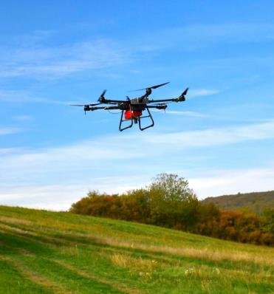
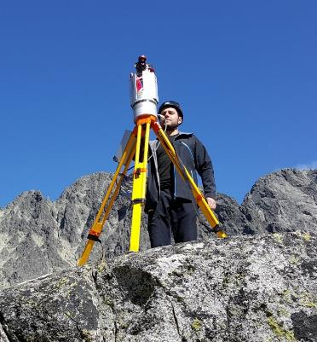
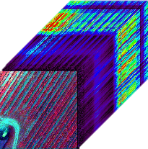
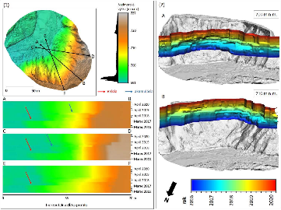
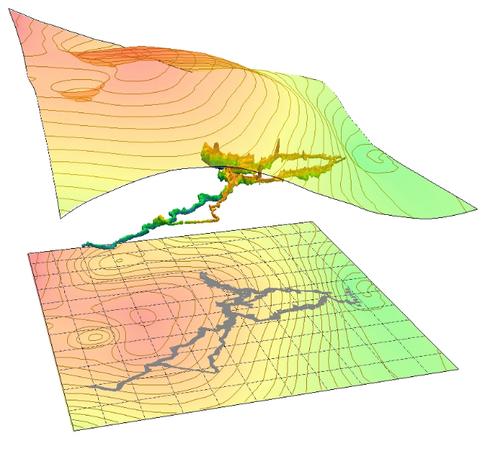
INSTITUTE OF GEOGRAPHY
National research projects
Lidar and Hyperspectral Fusion for Land Cover Classification (2024–2026)
Physical Geomorphometry for Geographic Research (2023–2027) (with Comenius University, Bratislava).
Urban Heat Island Modelling using Geospatial Tools (2023–2025)
Palaeogeographic Interpretation of Detrital Minerals (2023–2025)
Multi-scale assessment of spatial variability of socio-economic stratification of the population (2024-2026)
3D technologies and machine learning methods for environmental monitoring of rivers (2024-2027)
https://www.uge.science.upjs.sk/projekty

Slide 10
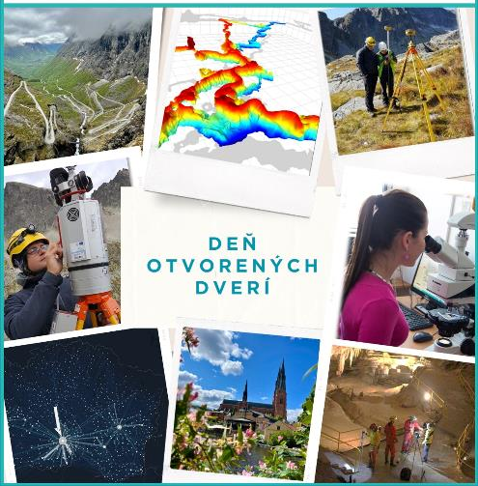
INSTITUTE OF GEOGRAPHY
Education profile
Single degree study
BSc. Geography and Geoinformatics
MSc. Geography and Geoinformatics
PhD. Geoinformatics and Remote Sensing
Joint degree study
BSc., Geography with other Science
(e.g. Mathematics, Computer Science,
Physics, Biology, Chemistry, Slovak,
German, English language, History)
Msc. Geography teaching
https://studijne-programy.upjs.sk/en/faculty/PF

Slide 11
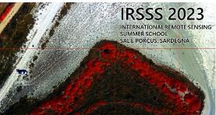
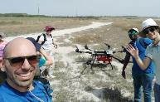
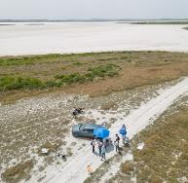
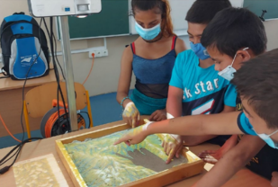
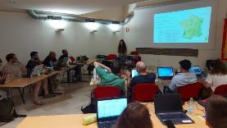
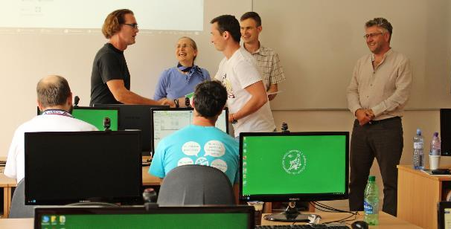
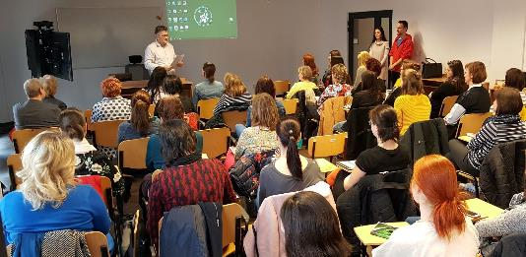
INSTITUTE OF GEOGRAPHY
Public outreach
Summer schools
  Int. Remote Sensing Summer School, Univ. Cagliari (2023, 2024)
  Workshop on Lidar mapping/Sentinel 3 Odra river,
  Univ. Wroclaw (2023)
  Exploring the landscape with dynamic visualization, tangible interaction, and UAV-lidar (2019)
Geography teachers’club
Seminars for potential students / secondary schools
School geography competitions

Slide 12
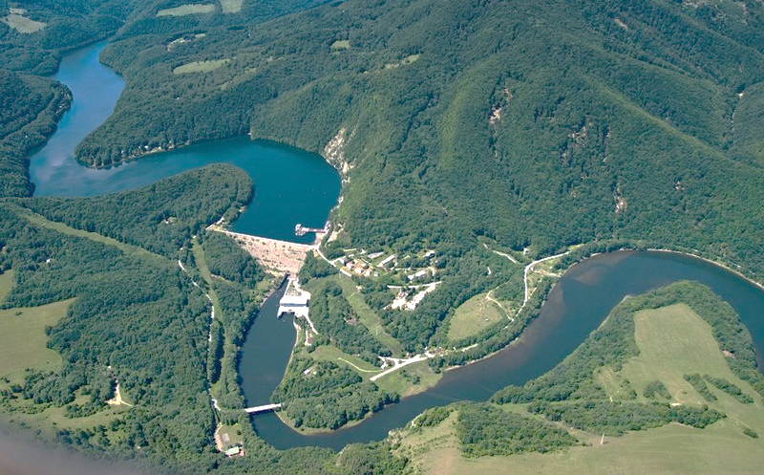
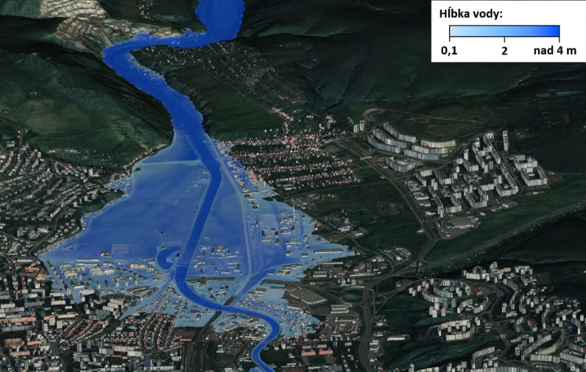
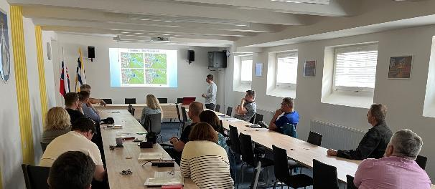
INSTITUTE OF GEOGRAPHY
Ružín water dam
59 mil. m³ water storage capacity
Consultancy projects
Simulating the flooding after water dam breaching for Košice city civil protection
Simulating flash floods for the town of Púchov
Carbon emissions strategy for Košice city
Training in GIS for Košice self-government region, Deutsche Telekom IT Solutions Slovakia
Water depth

Slide 13
Simulating flash floods and designing control measures for urban areas:
Case study of the town of Púchov and Košice

Slide 14

r.sim.water : physical-numerical model of a shallow overland flow
Open source
Key references
Mitas L, Mitasova H. 1998. Multi-scale Green’s function Monte Carlo approach to erosion modelling and its application to land-use optimization. In Summer W, Klaghofer E, Zhang W, editors. Modelling soil erosion, sediment transport and closely related hydrological processes. Proceedings of an International Symposium; Wallingford: IAHSA Publication; p. 81–90.
Hofierka J, Mitasova H, Mitas L. 2002. GRASS and modeling landscape processes using duality between particles and fields. In Ciolli M, Zatelli P, editors. Open-source GIS - GRASS users conference 2002, 11-13 September 2002, Trento. Proceedings of the conference. Trento: University of Trento; p. 1–11.
Hofierka J, Knutová M. 2015. Simulating spatial aspects of a flash flood using the Carlo method and GRASS GIS: a case study of the Malá Svinka Basin (Slovakia). Open Geosciences 7(1):118–125. doi: 10.1515/geo-2015-0013.
Hofierka J, Lacko M, Zubal S. 2017. Parallelization of interpolation, solar radiation and water flow simulation modules in GRASS GIS using OpenMP. Computers & Geosciences 107:20–27. doi: 10.1016/j.cageo.2017.07.007.
Useful for 2D hydrodynamic modelling of floods induced by rainfall
Implements the hydrological component of the SIMWE model.
Solves diffusion wave approximation of the Saint-Venant equations using a Monte Carlo method (path sampling).
Advantages:
  High-resolution, physically based
  Scenario testing in GIS
  Open-source & reproducible
Parallelized using OpenMP for efficient processing of high-resolution data.

Slide 15
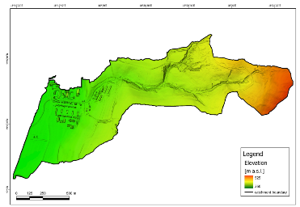
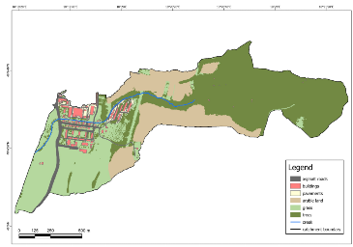
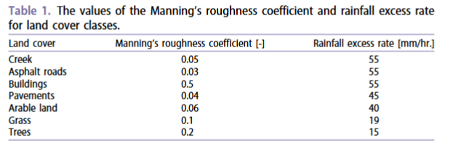
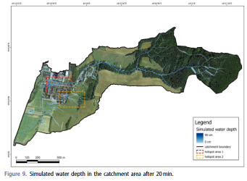
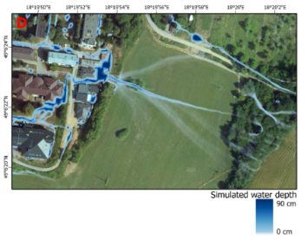
r.sim.water : physical-numerical model of a shallow overland flow
Open source
Key Inputs:
Digital Terrain / Surface Model
+ partial derivatives (dx, dy)
Rainfall excess = rainfall - infiltration (constant or derived from land use/soil)
Manning’s roughness (per land cover via reclassified rasters)
Optional: preferential flow (e.g., along streams or roads, underground pipes) and semi-permeable structures (via flow_control parameter)
Outputs:
time series of water depth and discharge raster layers.
Adopted from: Tokarčík and Hofierka (2024)

Slide 16
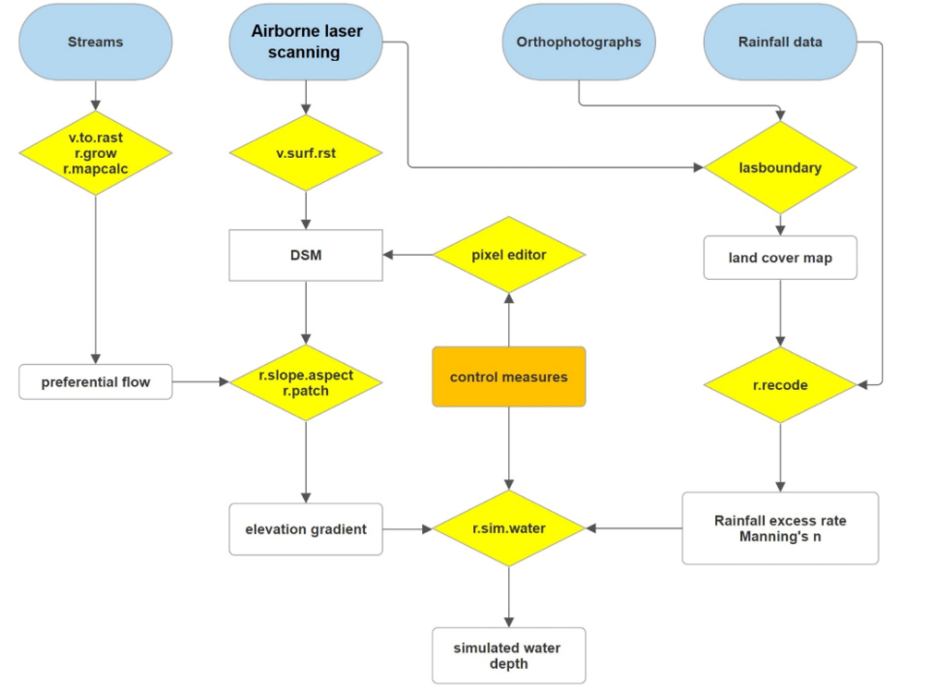
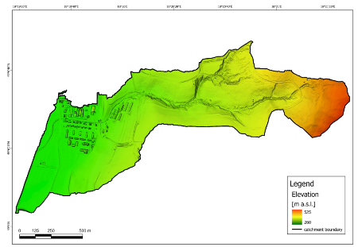
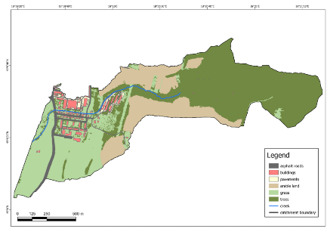
TOKARČÍK, O., HOFIERKA, J. (2024). Designing flash flood control measures for urban areas using the Monte Carlo water flow simulation. Geomatics, Natural Hazards and Risk, 15, 1, 2361806.
Open source
Digital terrain model + buildings
Case study of the town of Púchov, simulation of a real rainfall 55 mm over 60 minutes.
Similar work flow adopted for flood simulations in Košice for the AquaUrban project.

Slide 17
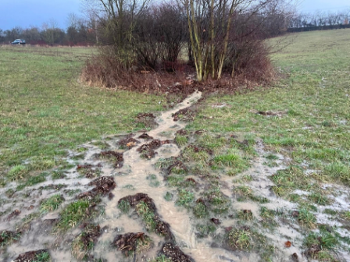
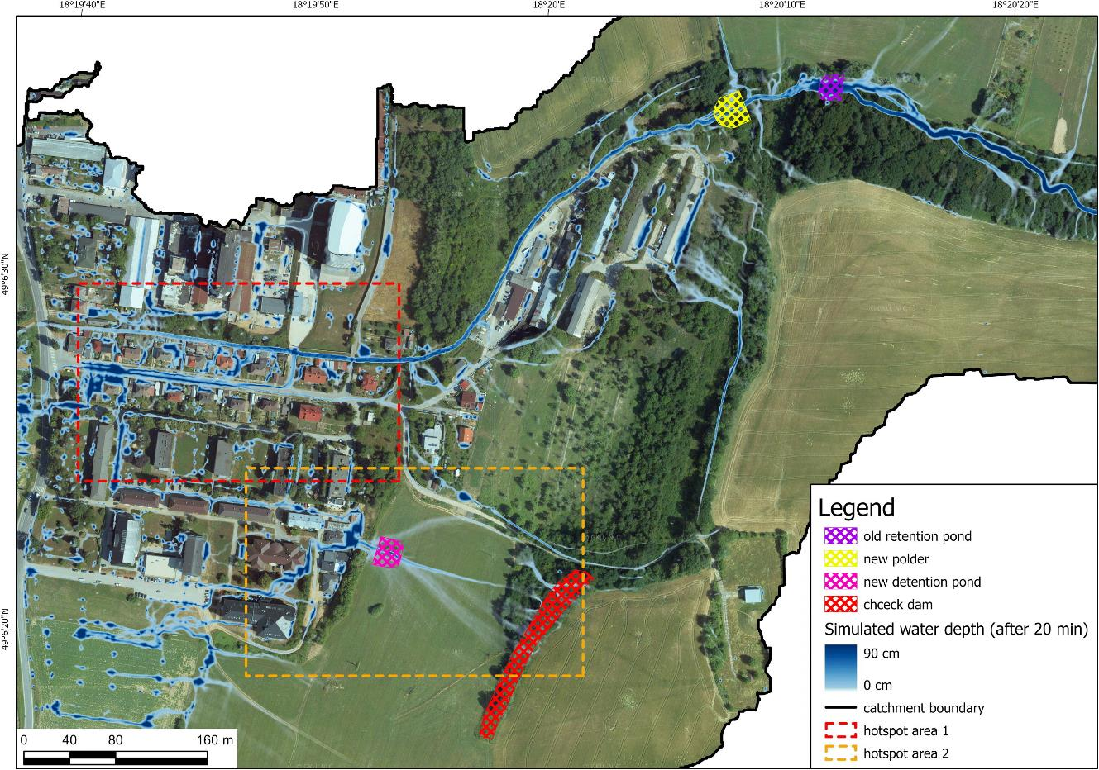
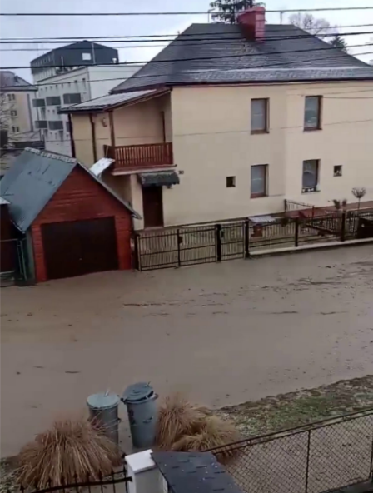
TOKARČÍK, O., HOFIERKA, J. (2024). Designing flash flood control measures for urban areas using the Monte Carlo water flow simulation. Geomatics, Natural Hazards and Risk, 15, 1, 2361806.
Case study of the town of Púchov, simulation of a real rainfall 55 mm over 60 minutes.
Frequent flash floods in the summer.
Water concentrates on a gentle slope.
Flooding nearby streets and houses.
Adopted from: Tokarčík and Hofierka (2024)

Slide 18
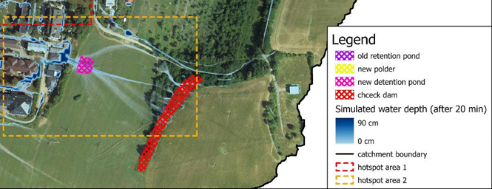

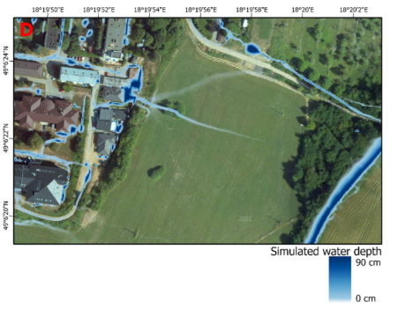
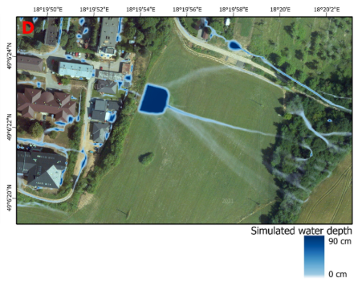

TOKARČÍK, O., HOFIERKA, J. (2024). Designing flash flood control measures for urban areas using the Monte Carlo water flow simulation. Geomatics, Natural Hazards and Risk, 15, 1, 2361806.
Case study of the town of Púchov
Simulating the effect of water flow control measures
No measures taken
Building a check dam
Building a detention pond

Slide 19
AquaUrban: Commercial Assignment from the Košice City Council
Target Areas: Račí potok catchment (∼2 km²), City district Terasa (∼2.5 km²)
Main Objectives:
2D hydrodynamic modeling of flash floods from extreme rainfall
3D visualizations and animations of water flow and flood depths
Scenario simulations (e.g., 30%, 50%, 100% retention pond capacity, 30–100 mm/h rainfall)
Expected Outcomes:
Water retention capacity calculations for revitalized ponds
Impact assessment on buildings, infrastructure, and drainage systems
Maps, time series, animations for 3–4 flood scenarios
Management recommendations to enhance flood resilience and biodiversity
Methods & Data:
DEM from airborne lidar (ÚGKK 2021), GNSS, total station surveys
Surface roughness classification
Sewer network data (from VVS)Surface runoff routing and rainfall-runoff analysis
Project Conditions: Delivery of simulation results + models
Participation in 2 joint workshops with partners from the University of Nyíregyháza
5-year warranty & audit compliance (EU-funded project)

Slide 20
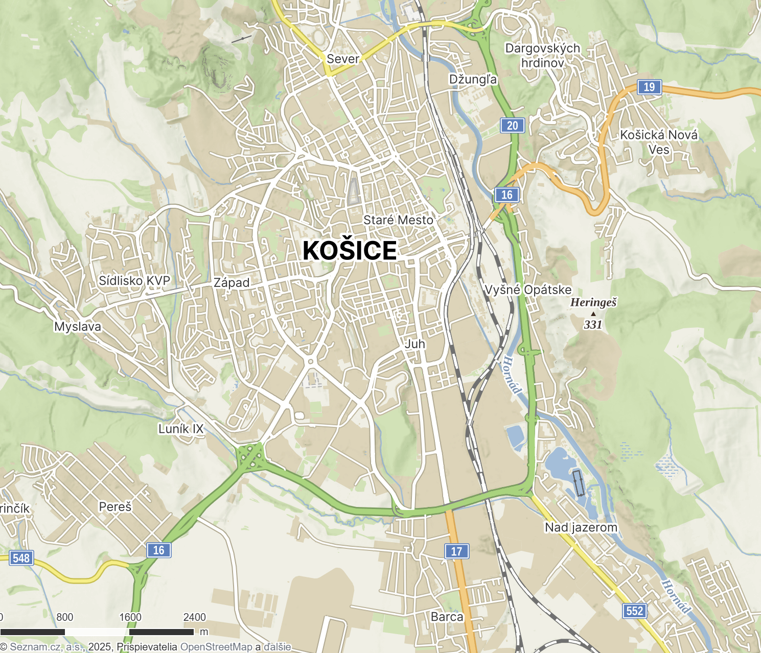
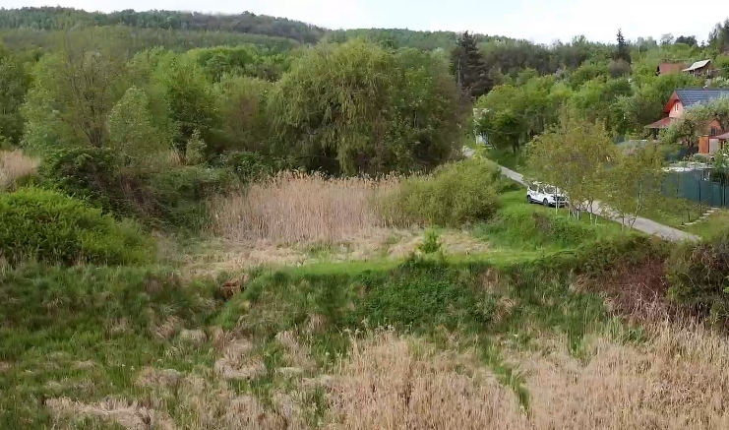
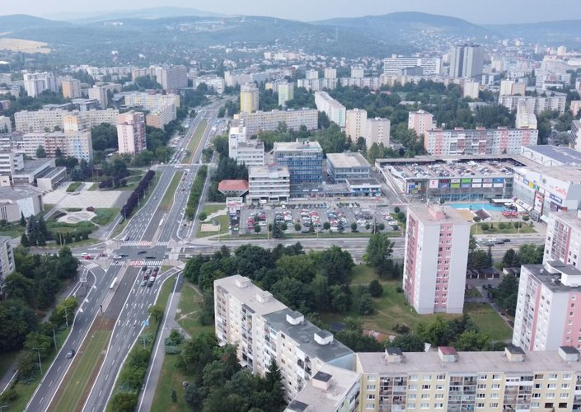
Case study areas in Košice
Račí potok watershed (2 km²)
Urban zone Terasa (2 km²)

Slide 21
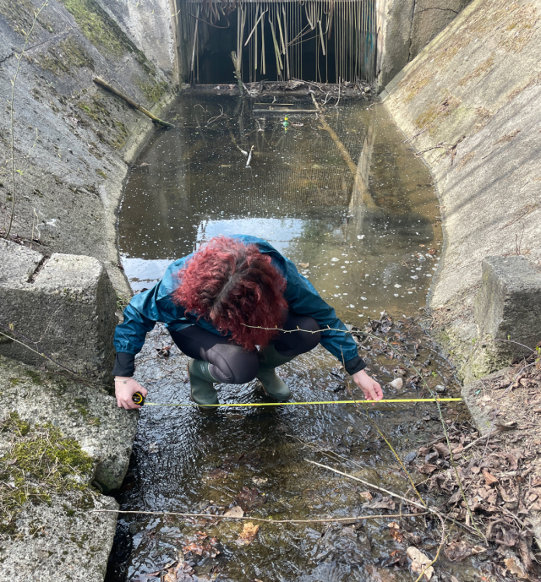
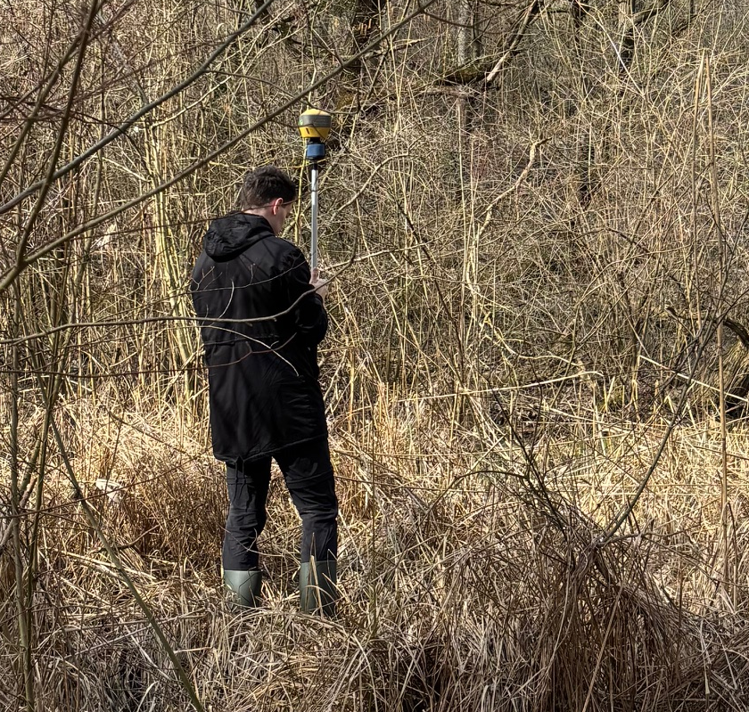
Methods and data
TOKARČÍK, O., HOFIERKA, J. (2024). Designing flash flood control measures for urban areas using the Monte Carlo water flow simulation. Geomatics, Natural Hazards and Risk, 15, 1, 2361806.
Case study of Račí potok watershed
simulation of a real rainfall 30, 50, 100 mm over 60 minutes
for 0%, 50%, 100% capacity of retention ponds,
considering culverts, earth dams
Field survey with students
Update of the terrain model with terrestrial lidar scanning, GNSS surveying
Digital terrain model + buildings

Slide 22



AquaUrban case study area 1 in Košice: Račí potok
Detention pond
earth dam
V cut for the flow
© Igi Petrilla (MEREO) 2022, https://www.youtube.com/watch?v=rb5-aFoNrWI&ab_channel=IgiPetrilla%28MEREO%29
earth dam
V cut for the flow
© Institute of Geography 28.3.2025, UPJŠ in Košice

Slide 23




AquaUrban: Area 1: Račí potok watershed
Digtal surface model – airborne laser scanning ZBGIS © UGKK SR
Manning coef. of roughness
Urban Atlas 2018 © Copernicus
Watershed area: 1.7 km²
600 m
600 m
300 m
0.03 Roads
0.06 Arable land
0.13 Grass land
0.4 Trees and forest
0.5 Build-up area
Vertical cross-section of lidar point cloud along the red line.

Slide 24




V-cuts in the dams are to big , dam does not slow the water flow down.
Simulated rainfal 30 mm in 60 min., no infiltration, soil saturated.
Some culverts are half blocked with sediments.
Water concentrating on the streets / unpaved roads causes problems

Slide 25


Simulated rainfal 30 mm/h after 60 minutes, no infiltration, soil saturated.
No change of terrain, current state, V-cuts open.
Earth dams working, V-cuts filled.
Culvert is too small
Simulated water depth (cm):
100 m
< 1,9
2 - 4,9
5 - 9,9
10 - 24,9
25 - 49,9
50 - 99,9
100 - 199,9
> 200

Slide 26
Case study areas in Košice
2. Urban zone Terasa (2 km²)

Slide 27



Digital terrain model + buildings
Rain drains / curb inlets
Infiltration rate mm/h
Manning roughenss coef.
0 roads, impervious surfaces
0.03 roads
5 Build-up with vegetation
0.06 arable land pôda
10 Industrial areas
0.13 grass areas
Areas with grass
0.4 forest, trees
35 forest, trees
0.5 build up areas
300 m
300 m
300 m
DSM + Vpuste

Slide 28

Rainfall intensity 30 mm in 60 min.
Scenario 2: Drainage system capacity sufficient. Water is drained into the sewage system.
Rainfall intensity 30 mm in 60 min.
Scenario 1: Drainage system capacity exceeded from the start. Water flows on the surface, water is not drained into the sewage system.
Simulated water depth in meters

Slide 29
Relevance of the results for urban planning
What the simulations provide:
Water depth & flow velocity over time
Peak flood timing & duration
Spatial flood extent
Urban Planning Applications
Zoning & Risk Maps: Guide land use; restrict development in high-risk areas
Infrastructure Design: Size drainage, culverts, and retention systems
Emergency Planning: Optimize evacuation routes & early warning systems
Climate Resilience: Test scenarios & plan green/blue infrastructure

Slide 30
Conclusions
We are active in environmental geospatial research.
Real-world impact in Košice through flood simulations.
Potential for cross-border knowledge exchange.
Welcome to Košice !

Slide 31
#AquaUrban Project: Innovative water retention solutions for improved quality of life in cities of Košice and Nyíregyháza
Project workshop, 16 May 2025, University of Nyíregyháza, Hungary
Simulating flash floods in Košice:
The role of geospatial modelling in innovative urban water management
Dr. Michal Gallay
Institute of Geography, Faculty of Science
Pavol Jozef Šafárik University in Košice (UPJŠ)
Köszönöm a figyelmet.
michal.gallay@upjs.sk
+421-55-234-2453

